Slide 1


Slide 2
IMPLEMENTATION OF FIR FILTER USING STRUCTURES

Slide 3
GROUP MEMBERS: * FAISAL EHSAN (E14-65) * CHAUDHARY MUHAMMAD HADEEQ (E14-132) * USMAN SIKANDER MIRZA(E14-137)

Slide 4
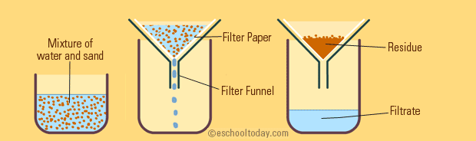
WHAT IS A FILTER ?
* FILTERS IN SIGNAL PROCESSING (DIGITAL FILTERS)

Slide 5
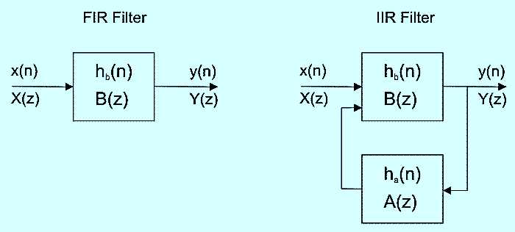
TYPES OF DIGITAL FILTERS
FIR (FINITE IMPULSE RESPONSE)(No Feedback)
IIR (INFINTE IMPULSE RESPONSE)(Feedback)

Slide 6
FIR FLTERS AND STRUCTURE TYPES
FIR FILTERS HAVE ONLY ZEROS (NO POLES).HENCE KNOWN ALSO AS ‘ALL ZERO’ FILTERS.
THE IMPULSE RESPONSE IS OF FINITE LENGTH ‘M’.
FIR FILTERS ARE ALSO KNOWN AS FEEDFORWARD AND NON-RECURSIVE.
DIRECT FORM
CASCADE FORM
LINEAR PHASE FORM

Slide 7
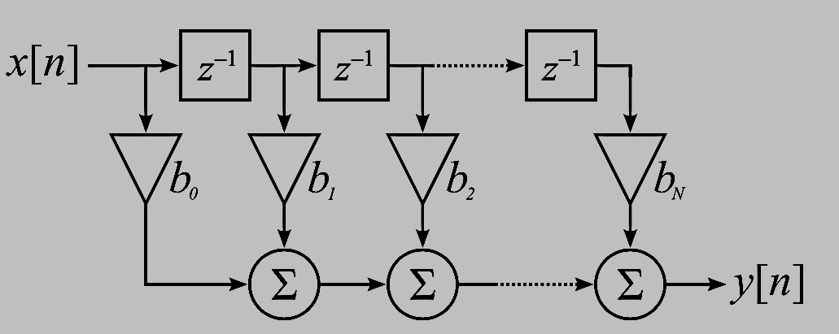
DIRECT FORM

Slide 8


LCCDE FORM FOR IMPLEMTING DIRECT FORM

Slide 9
NOW HOW TO COMPUTE Y(N) IN MATLAB ?
BECAUSE WHEN WE ARE COMPUTING Y[N] IN MATLAB , HOW WILL MATLAB COMPUTE X[N-K].
THAT IS :- X[-1] AND X[-3] .
MATLAB CANNOT COMPUTE VALUES AT NEGATIVE TIME.
SO WHAT TO DO ???

Slide 10
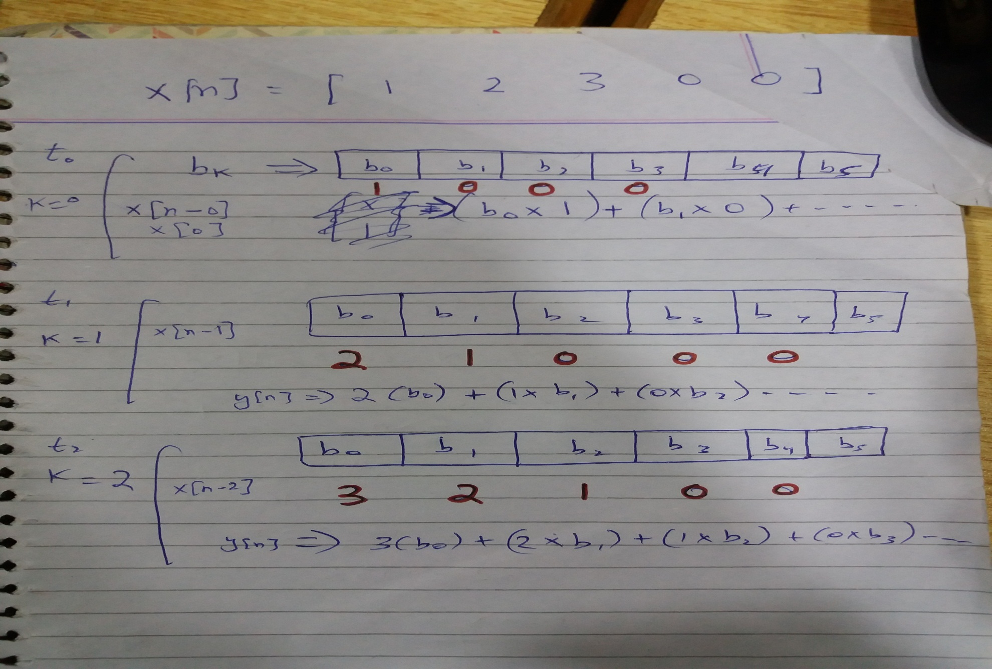
SO,WE DEVELOPED A ALGORITHM TO COMPUTE Y[N]

Slide 11
* WE PICKED THE FIRST INPUT ELEMENT X[0] AND INSERTED IN AN EMPTY ARRAY AT THE 1ST PLACE IN TIME T0. * THEN IN TIME T1 WE GAVE THE ARRAY A RIGHT SHIFT AND INSERTED X[1] IN THE 1ST PLACE OF ARRAY. * THEN IN TIME T2 WE GAVE THE ARRAY ANOTHER RIGHT SHIFT AND INSERTED X[2] IN THE 1ST LOCATION OF ARRAY WHILE X[1] IS IN THE 2ND LOCATION OF THE ARRAY AND X[0] IN THE 3RD LOCATION OF THE ARRAY.

Slide 12
CODING
*COMPUTING H[N](ZEROS).
*IMPLEMENTING RIGHT SHIFT IN CODING.
*CONVOLVING X[N] AND H[N].
*COMPUTING Y[N].

Slide 13
REFERENCES :-
Discrete time signal processing by Oppenheim 2ND EDITION .
Wikipedia

Slide 14
