Slide 1
Deep Learning
Lecture 6
Introduction to Neural Network
Dr. Muhammad Jawad Khan
Robotics and Intelligent Machine Engineering Department,
School of Mechanical and Manufacturing,
National University of Sciences and Technology,
Islamabad, Pakistan.
\

Slide 27

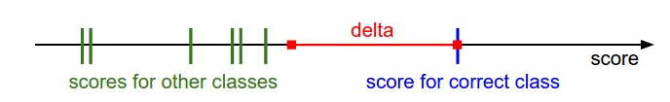

Slide 28
This is a form of regression, that constrains/ regularizes or shrinks the coefficient estimates towards zero. In other words, this technique discourages learning a more complex or flexible model, so as to avoid the risk of overfitting.

Slide 33
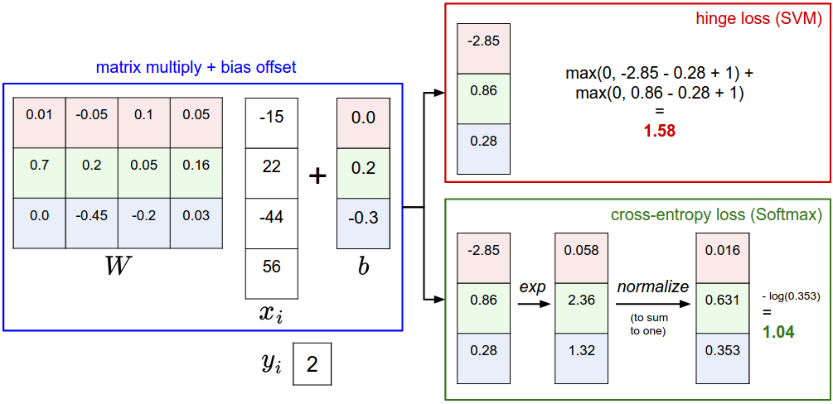

Slide 36
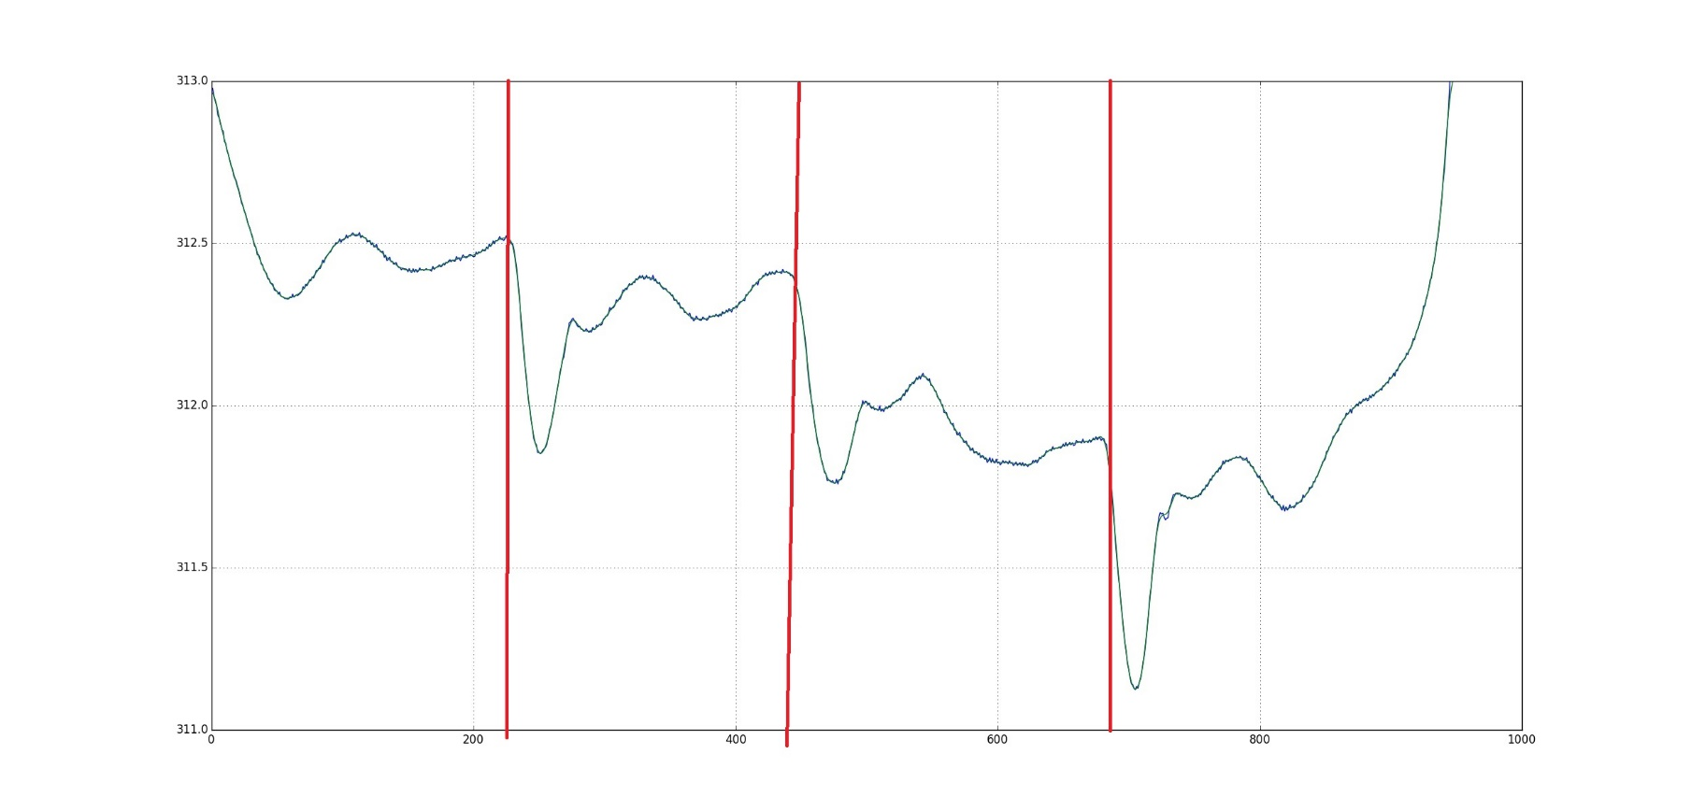

Slide 37
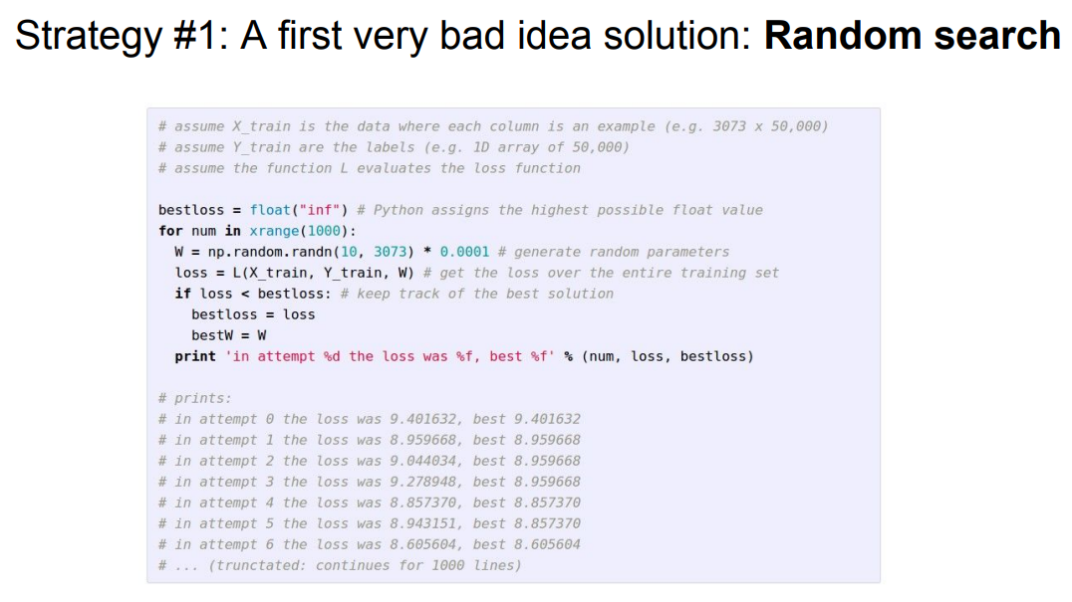

Slide 38
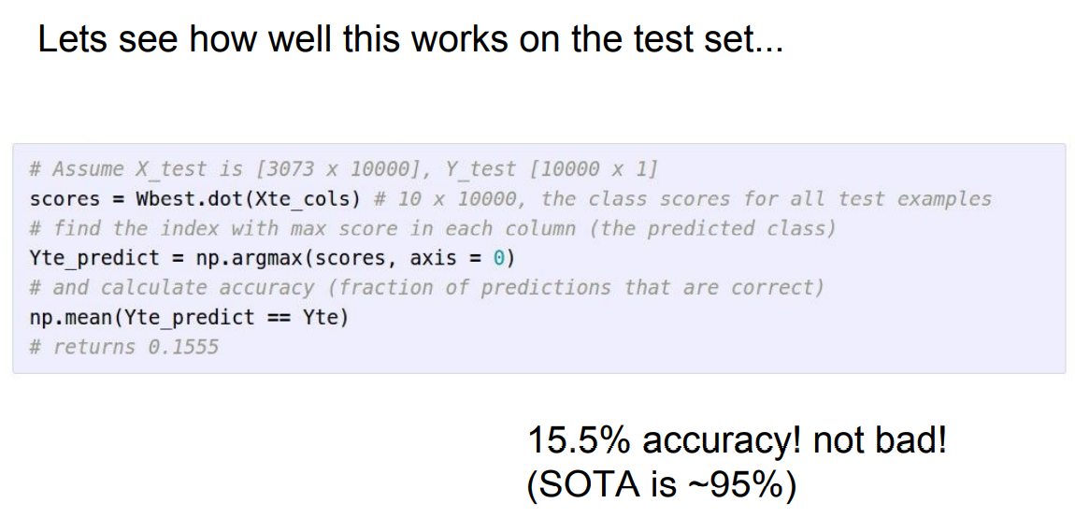

Slide 46
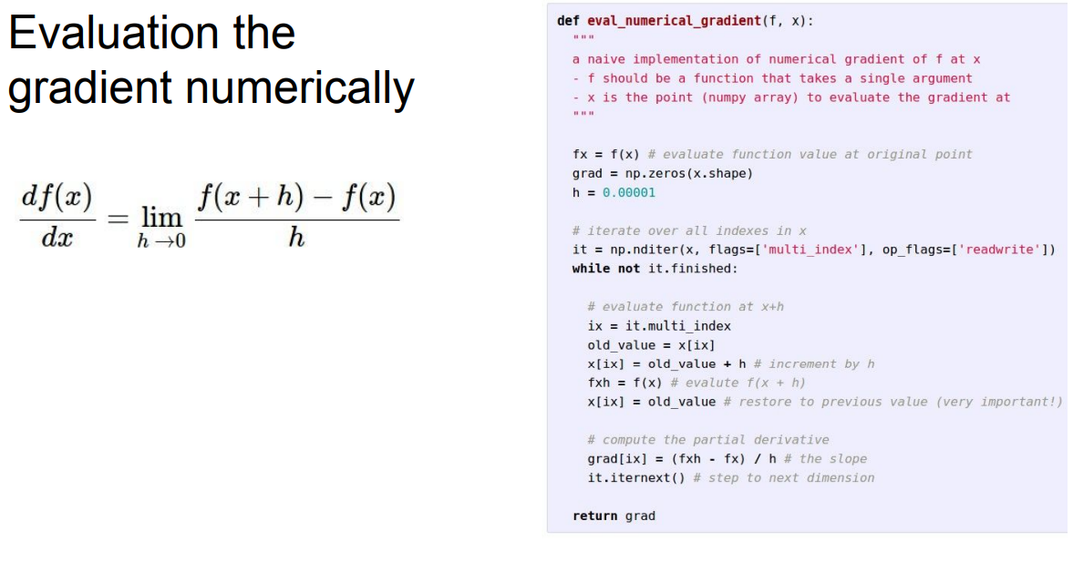

Slide 47
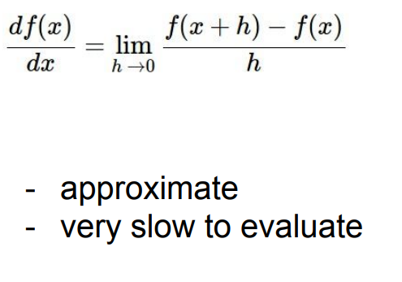

Slide 48
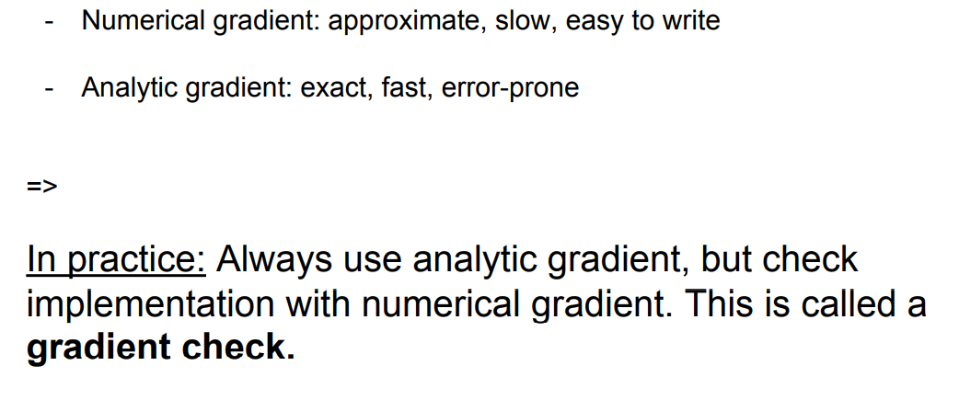

Slide 50
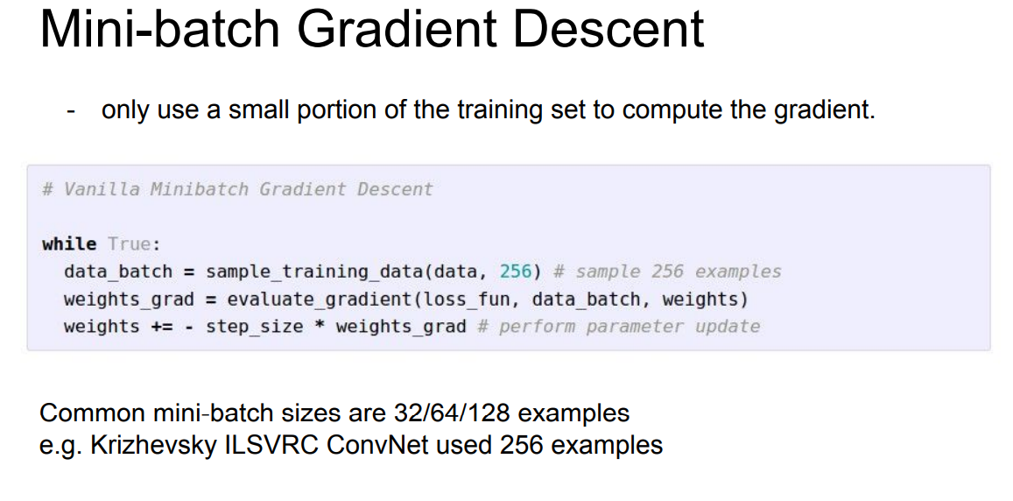

Slide 51
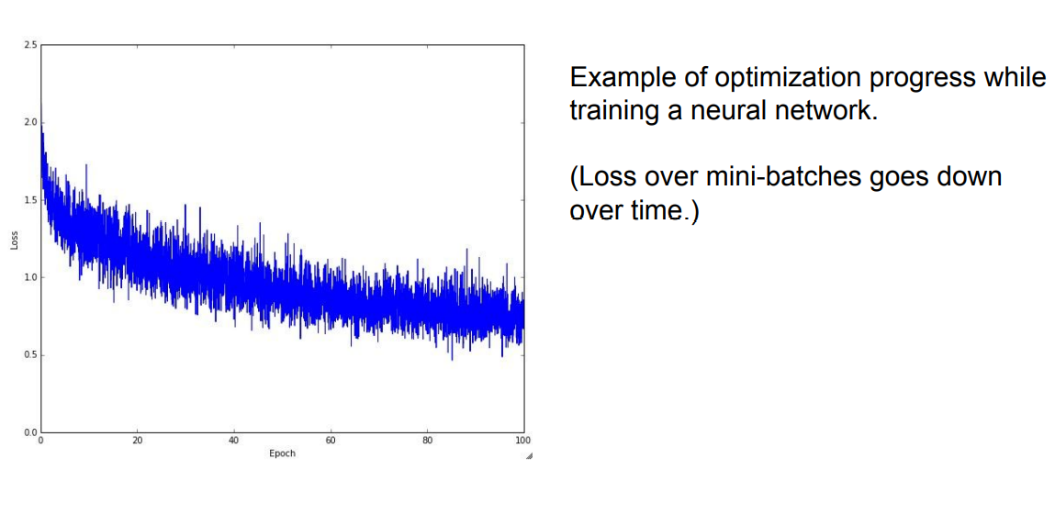

Slide 52
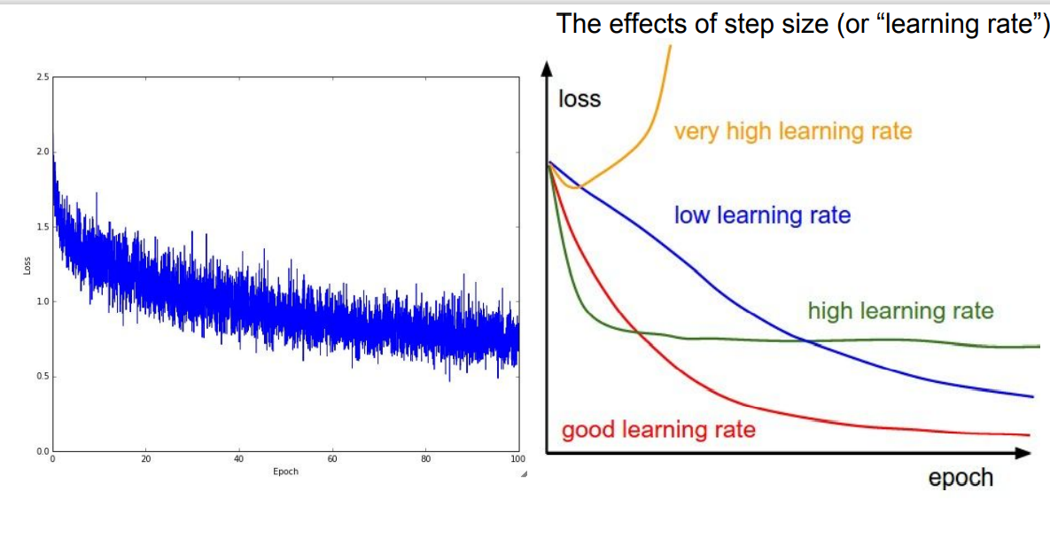

Slide 53
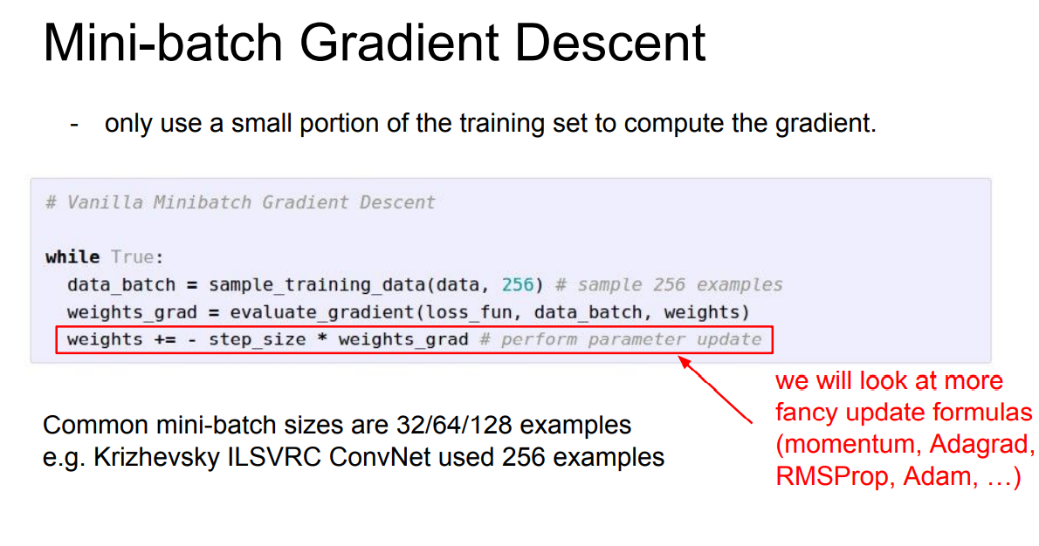

Slide 55
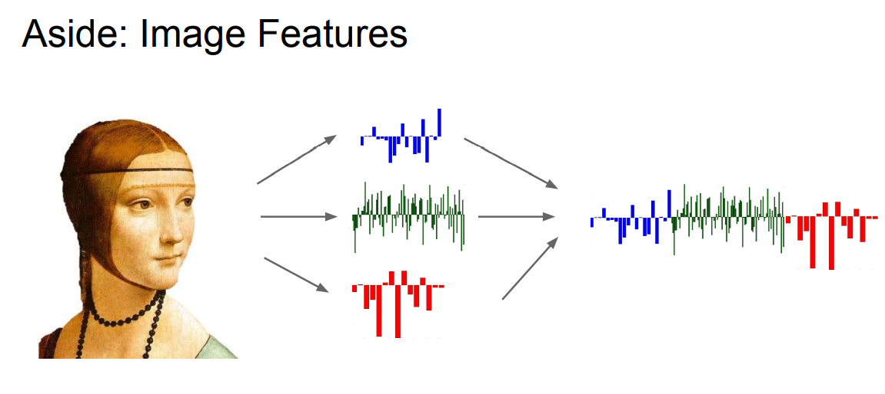

Slide 60




Where we are...
scores function
SVM loss
data loss + regularization
want

Slide 61

Gradient Descent
Numerical gradient: slow :(, approximate :(, easy to write :)
Analytic gradient: fast :), exact :), error-prone :(
In practice: Derive analytic gradient, check your implementation with numerical gradient

Slide 62


Computational Graph
x
*
s (scores)
hinge loss
+
L
W
R

Slide 63
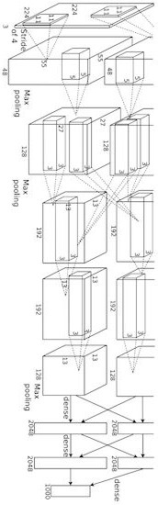
Convolutional Network (AlexNet)
input image weights
loss

Slide 64
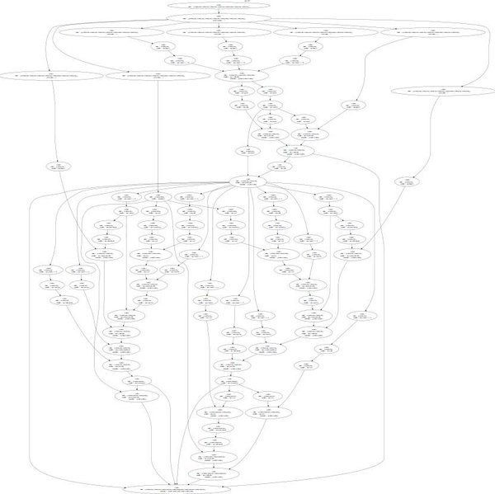
Neural Turing Machine
input tape
loss

Slide 65
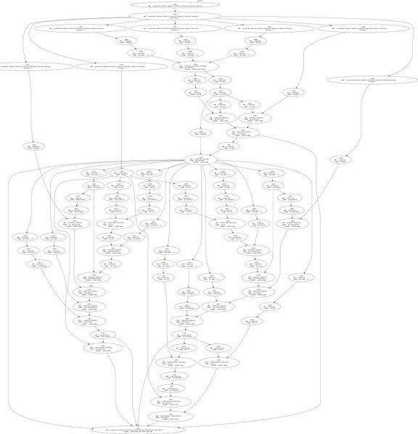
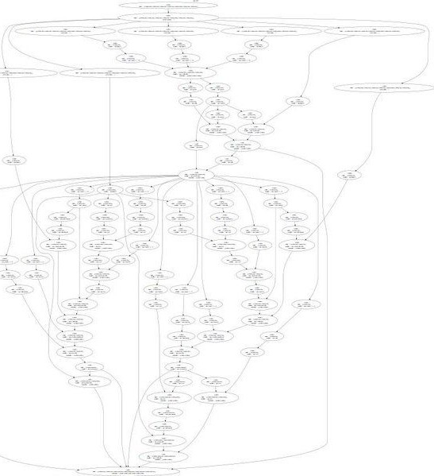
Neural Turing Machine

Slide 66

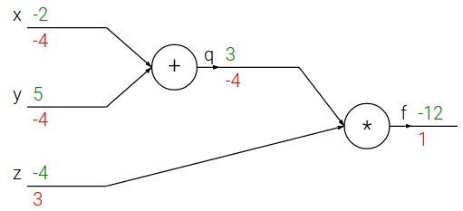
e.g. x = -2, y = 5, z = -4

Slide 67





e.g. x = -2, y = 5, z = -4
Want:

Slide 68

e.g. x = -2, y = 5, z = -4
Want:

Slide 69
e.g. x = -2, y = 5, z = -4
Want:

Slide 70

e.g. x = -2, y = 5, z = -4
Want:

Slide 71
e.g. x = -2, y = 5, z = -4
Want:

Slide 72

e.g. x = -2, y = 5, z = -4
Want:

Slide 73
e.g. x = -2, y = 5, z = -4
Want:

Slide 74

e.g. x = -2, y = 5, z = -4
Want:

Slide 75


e.g. x = -2, y = 5, z = -4
Chain rule:
Want:

Slide 76

e.g. x = -2, y = 5, z = -4
Want:

Slide 77
e.g. x = -2, y = 5, z = -4
Chain rule:
Want:

Slide 78


activations
f

Slide 79


activations
“local gradient”
f

Slide 80

activations
“local gradient”
f
gradients

Slide 81
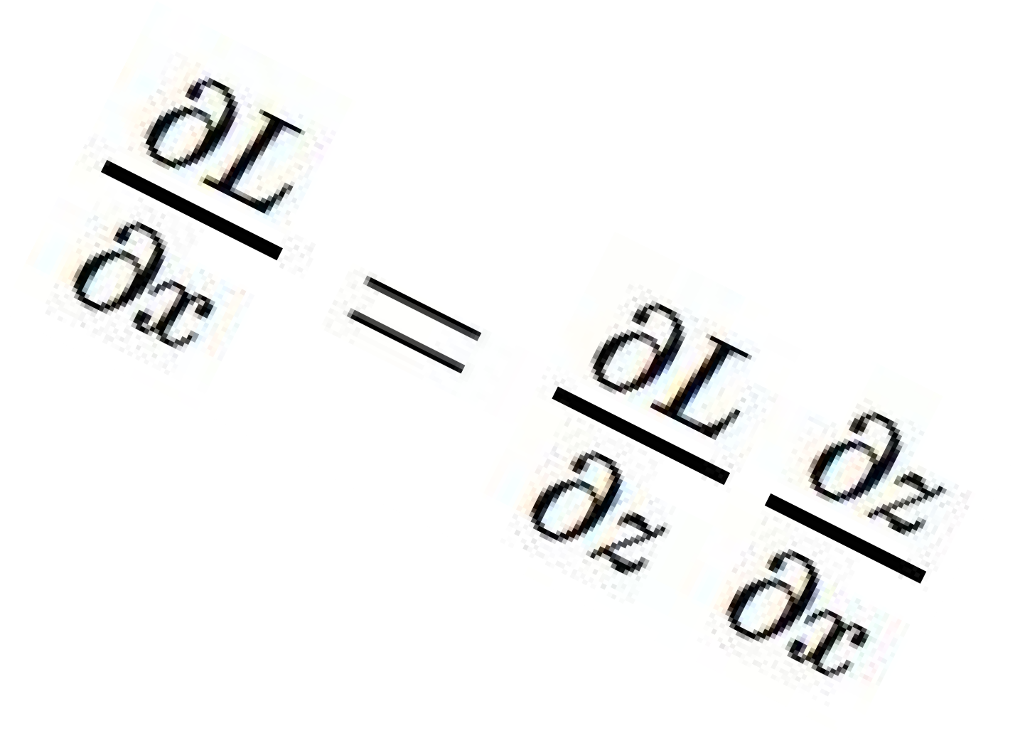
activations
“local gradient”
f
gradients

Slide 82
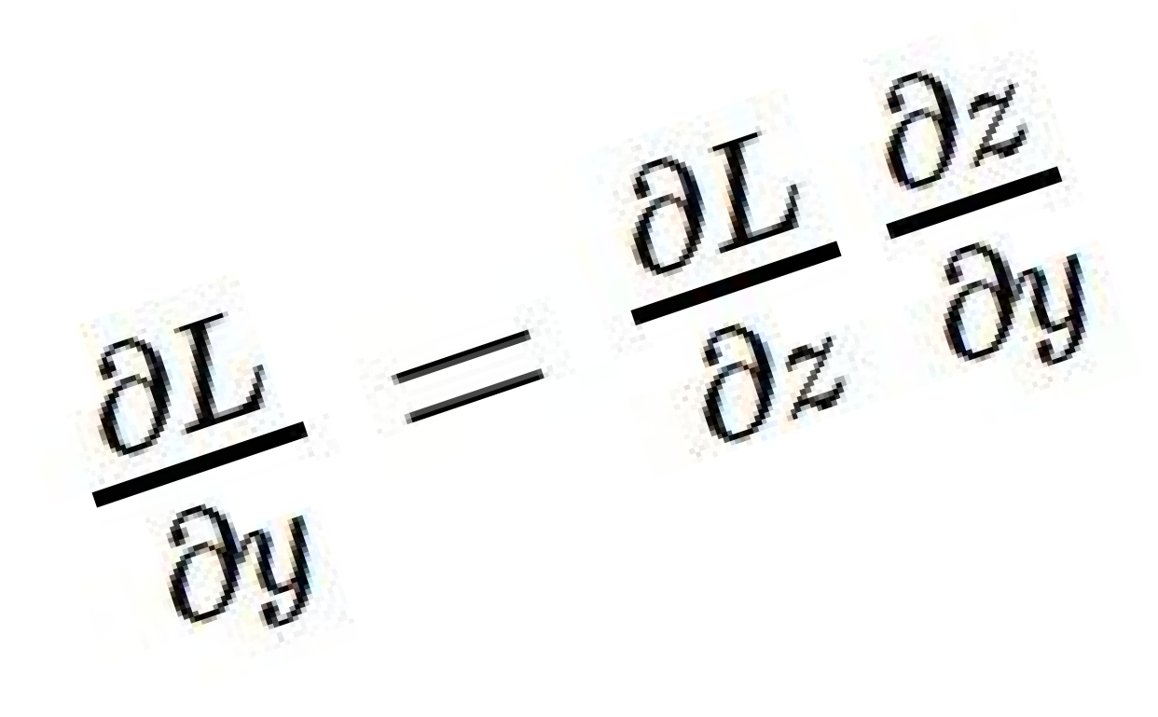
activations
“local gradient”
f
gradients

Slide 83
activations
“local gradient”
f
gradients

Slide 84
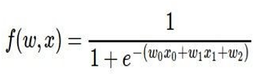
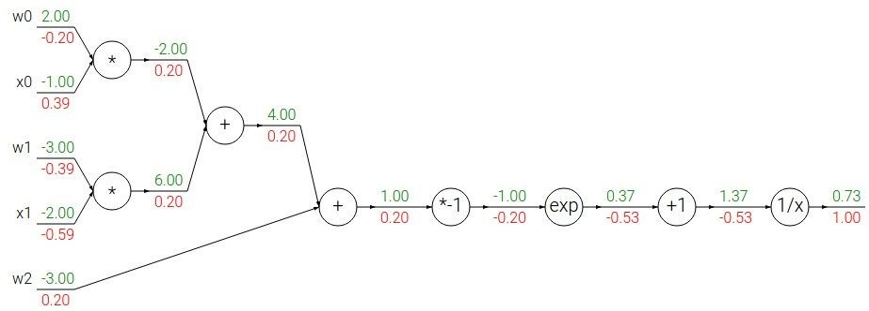
Another example:

Slide 85
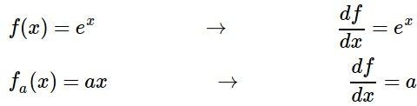
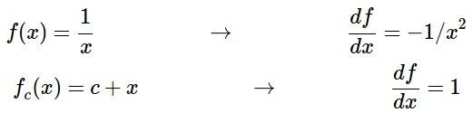
Another example:

Slide 86

Another example:

Slide 87
Another example:

Slide 88

Another example:

Slide 89
Another example:

Slide 90

Another example:

Slide 91
Another example:

Slide 92

Another example:
(-1) * (-0.20) = 0.20

Slide 93
Another example:

Slide 94
Another example:
[local gradient] x [its gradient] [1] x [0.2] = 0.2
[1] x [0.2] = 0.2 (both inputs!)

Slide 95
Another example:

Slide 96
Another example:
[local gradient] x [its gradient] x0: [2] x [0.2] = 0.4
w0: [-1] x [0.2] = -0.2

Slide 97

sigmoid function
sigmoid gate

Slide 98
sigmoid function
sigmoid gate
(0.73) * (1 - 0.73) = 0.2

Slide 99
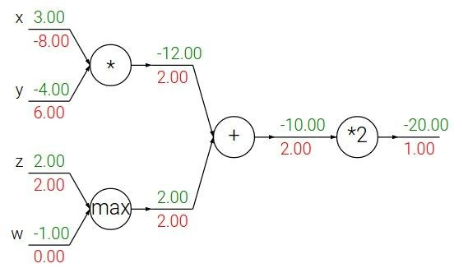
Patterns in backward flow
add gate: gradient distributor
max gate: gradient router
mul gate: gradient… “switcher”?

Slide 100
Gradients add at branches
+

Slide 101
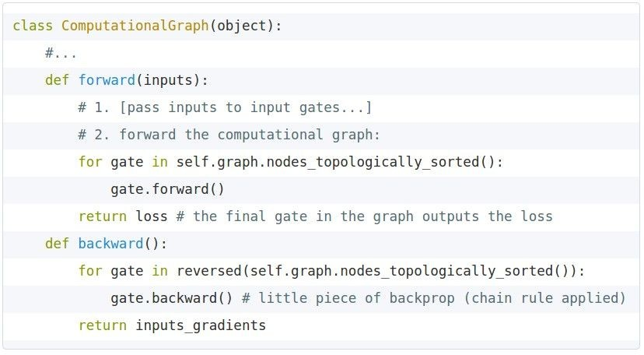
Implementation:
forward/backward API
Graph (or Net) object. (Rough psuedo code)

Slide 102
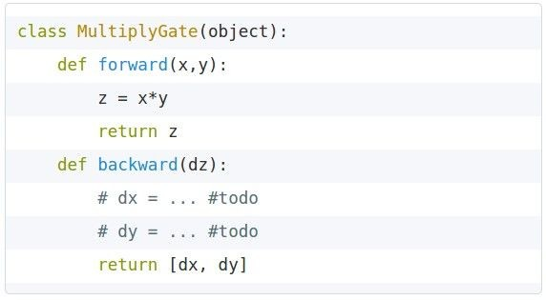


Implementation:
forward/backward API
x
z
*
y
(x,y,z are scalars)

Slide 103
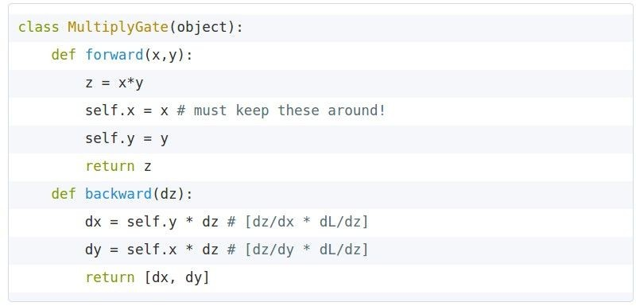
Implementation:
forward/backward API
x
z
*
y
(x,y,z are scalars)

Slide 104

Gradients for vectorized code (x,y,z are now vectors)
This is now the Jacobian matrix (derivative of each element of z w.r.t. each element of x)
“local gradient”
f
gradients

Slide 105
Vectorized operations
f(x) = max(0,x)
(elementwise)
4096-d
input vector
4096-d
output vector

Slide 106

Vectorized operations
f(x) = max(0,x)
(elementwise)
Jacobian matrix
4096-d
input vector
4096-d
output vector
Q: what is the size of the Jacobian matrix?

Slide 107
Vectorized operations
f(x) = max(0,x)
(elementwise)
Jacobian matrix
4096-d
input vector
max(0,x)
(elementwise)
4096-d
output vector
Q: what is the size of the Jacobian matrix? [4096 x 4096!]
Q2: what does it look like?

Slide 108
Vectorized operations
in practice we process an entire minibatch (e.g. 100) of examples at one time:
f(x) = max(0,x)
(elementwise)
100 4096-d
input vectors
max(0,x)
(elementwise)
100 4096-d
output vectors
i.e. Jacobian would technically be a [409,600 x 409,600] matrix :\

Slide 109
Summary so far
neural nets will be very large: no hope of writing down gradient formula by hand for all parameters
backpropagation = recursive application of the chain rule along a computational graph to compute the gradients of all inputs/parameters/intermediates
implementations maintain a graph structure, where the nodes implement the forward() / backward() API.
forward: compute result of an operation and save any intermediates needed for gradient computation in memory
backward: apply the chain rule to compute the gradient of the loss function with respect to the inputs.

Slide 110

Neural Network: without the brain stuff
(Before) Linear score function:

Slide 111

Neural Network: without the brain stuff
(Before) Linear score function:
(Now) 2-layer Neural Network

Slide 112
Neural Network: without the brain stuff
(Before) Linear score function:
(Now) 2-layer Neural Network
x
h
s
W1
W2
3072
100
10

Slide 113

Neural Network: without the brain stuff
(Before) Linear score function:
(Now) 2-layer Neural Network
X
h
W1
W2
s
3072
100
10

Slide 114
Neural Network: without the brain stuff
(Before) Linear score function:
(Now) 2-layer Neural Network or 3-layer Neural Network

Slide 115
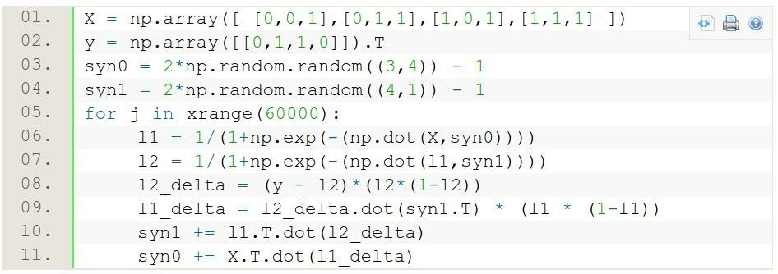
Full implementation of training a 2-layer Neural Network needs ~11 lines:
from @iamtrask, http://iamtrask.github.io/2015/07/12/basic-python-network/

Slide 116
A look at Hidden Layers
What you have studied so far is included as a part of a single perceptron.
What happens when you have multiple perceptrons…
What happens when you have multiple layers of perceptrons…
(hint: perceptrons = neurons)

Slide 117
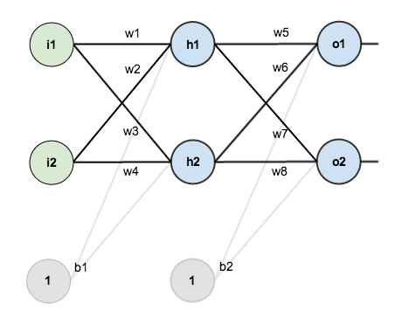
Consider a 2 layer neural network

Slide 118
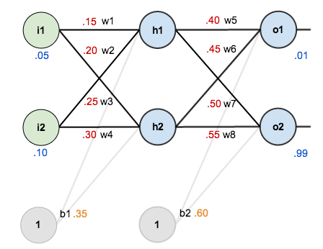
Step 1: Let’s initialize weights and biases for any inputs
Weights and biases have been randomly assigned for now.

Slide 119
Step 2: Propagate through the network to find the outputs (Forward Pass)

Slide 120
Step 2 (continued): How did we calculate the Network Output?
To begin, lets see what the neural network currently predicts given the weights and biases above and inputs of 0.05 and 0.10. To do this we’ll feed those inputs forward though the network.
We figure out the total net input to each hidden layer neuron, squash the total net input using an activation function (here we use the logistic function also known as sigmoid function), then repeat the process with the output layer neurons.

Slide 121
Step 2 (continued): How did we calculate the Network Output?
Here’s how we calculate the total net input for h₁
We then squash it using the logistic function to get the output of h₁:
Similarly we can calculate h₂. (What is it?)

Slide 122
Step 2 (continued): How did we calculate the Network Output?
Continuing onwards. We repeat this process for the output layer neurons, using the output from the hidden layer neurons as inputs. For o₁.
For o₂

Slide 123
Step 3: Loss Calculation.
Recall there are multiple methods for Loss calculation. The total loss is also called total error.
We will be using squared error function or L2 Loss.
We will have to calculate error in both of the network outputs when we are given target outputs.

Slide 124
Step 3: Loss Calculation.
The error for the first output is:
The error for the second output is:
The total error is the sum of both of these individual output errors:

Slide 125
Step 4: The Backwards Pass
We want to calculate the dependence of the Error that we calculated on each and every single weight.
Recall: We want to see how the Error can be minimized by changing the weights.
So we need to find the derivatives of Error with respect to each weight
For a single layer it is relatively straight forward.
For the next layer, however…

Slide 126
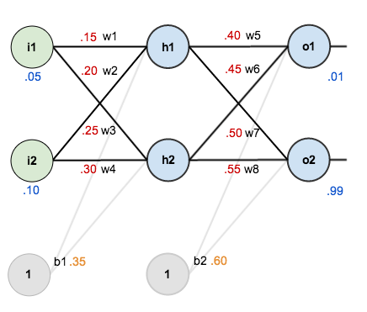
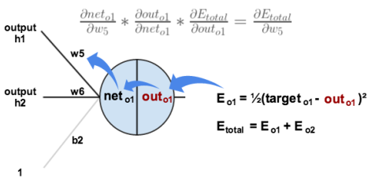
Step 4 (Continued): The Backwards Pass
Error dependence on w5?
Apply the chain rule.

Slide 127
Step 4 (Continued): The Backward Pass
We need to figure out each piece in this equation.
First, how much does the total error change with respect to the output?

Slide 128

Step 4 (Continued): The Backward Pass
Recall: The partial derivative of the logistic function is the output multiplied by 1 minus the output:
Going back even further…

Slide 129
Step 4 (Continued): The Backward Pass
You’ll often see this calculation combined in the form of the delta rule:
To decrease the error, we then subtract this value from the current weight. This is called weight update
We will multiply by some learning rate, etc., which we’ll set to 0.5):

Slide 130
Class Assignment
Calculator time!
Calculate updated weights of w₆, w₇ and w₈

Slide 131
Class Assignment
Calculator time!
Calculate updated weights of w₆, w₇ and w₈

Slide 132
Step 4 (Continued): The Backward Pass through the Hidden Layer
How to update w₁, w₂, w₃ and w₄?
For instance for w₁ what we want is:

Slide 133
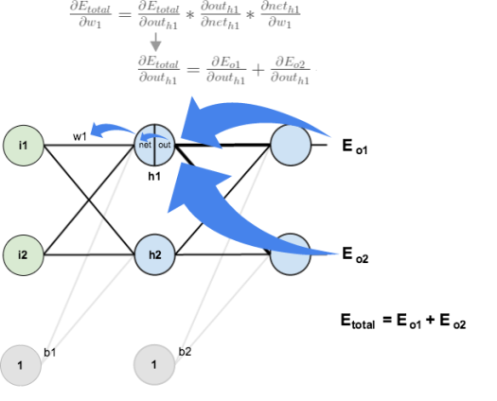
Step 4 (Continued): The Backward Pass through the Hidden Layer
Visually what we want is this:

Slide 134
Step 4 (Continued): The Backward Pass through the Hidden Layer
We’re going to use a similar process as we did for the output layer, but slightly different to account for the fact that the output of each hidden layer neuron is contributing to all the neurons in the subsequent layer.
So:

Slide 135
Step 4 (Continued): The Backward Pass through the Hidden Layer
Continuing:
Plugging them all in:

Slide 136
Step 4 (Continued): The Backward Pass through the Hidden Layer
Similarly:
Therefore:
Moving on, Recall the derivative of sigmoid:
Next:

Slide 137
Step 4 (Continued): The Backward Pass through the Hidden Layer
Putting it all together…(Finally!)
We can update the weight w1 similar to what we did earlier

Slide 138
Hidden weight update
Error with respect to sigmoid (out)
Sigmoid with respect to net
Net with respect to weight w5
Net with respect to weight w7
1st layer update
Error 1 with respect to sigmoid (out)
Sigmoid with respect to net o1
Error 2 with respect to sigmoid (out)
Sigmoid with respect to net o2
Sum
Net wrt sigmoid h1 (out h1)
Out h1 wrt net h1
Net h1 wrt weight w1 (= i1)

Slide 139
Assignment: 2
Calculate the weight updates of w₂, w₃, w₄

Slide 140
Summary
we arrange neurons into fully-connected layers
the abstraction of a layer has the nice property that it allows us to use efficient vectorized code (e.g. matrix multiplies)
neural networks are not really neural
- neural networks: bigger = better (but might have to regularize more strongly)

Slide 142
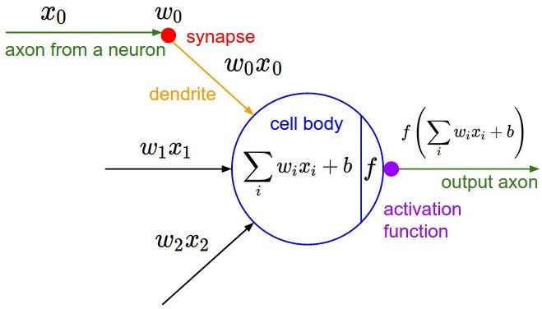

Slide 143
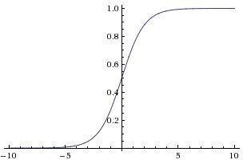

sigmoid activation function

Slide 144
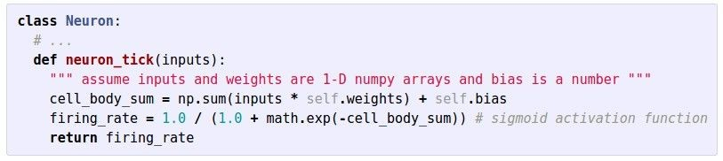

Slide 145
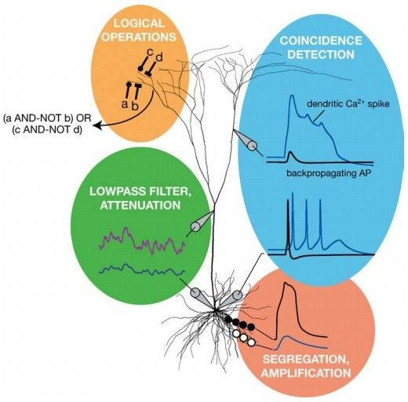
Be very careful with your Brain analogies:
Biological Neurons:
Many different types
Dendrites can perform complex non- linear computations
Synapses are not a single weight but a complex non-linear dynamical system
Rate code may not be adequate
[Dendritic Computation. London and Hausser]

Slide 146
Activation Functions

Slide 147
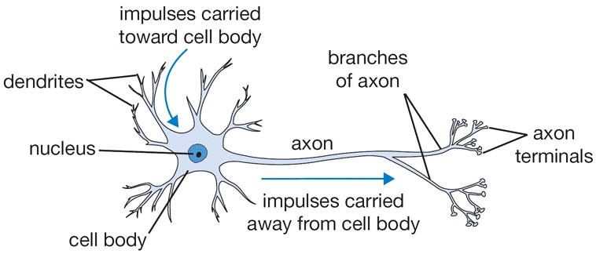
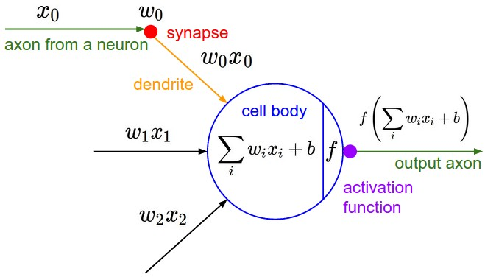
Activation Functions

Slide 148
Activation Functions

Slide 151


Slide 159
Class Assignment

Slide 160
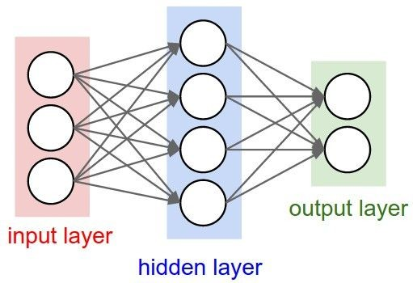
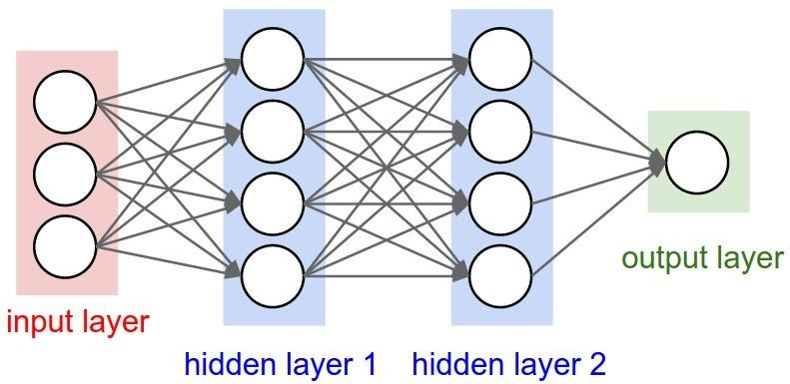
Neural Networks: Architectures
“3-layer Neural Net”, or
“2-hidden-layer Neural Net”
“Fully-connected” layers
“2-layer Neural Net”, or
“1-hidden-layer Neural Net”

Slide 161
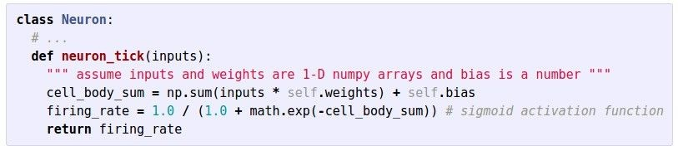
Example Feed-forward computation of a Neural Network
We can efficiently evaluate an entire layer of neurons.

Slide 162
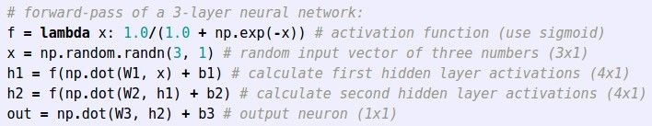
Example Feed-forward computation of a Neural Network

Slide 163
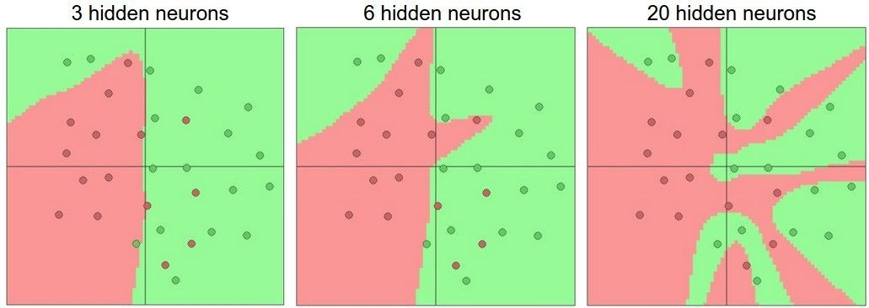
Setting the number of layers and their sizes
more neurons = more capacity

Slide 164
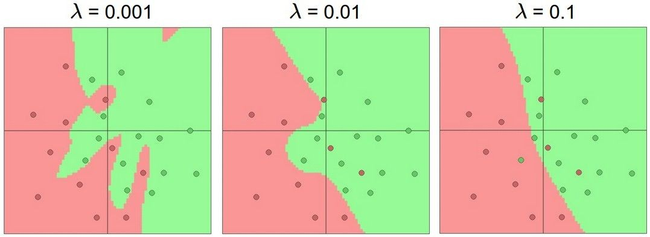
Do not use size of neural network as a regularizer. Use stronger regularization instead:

