Slide 1
Evaluation Metrics Example

Slide 2
Binary Classification
x is input
y is binary output (0/1)
Model is ŷ = h(x)
Two types of models
Models that output a categorical class directly (K-nearest neighbor, Decision tree)
Models that output a real valued score (SVM, Logistic Regression)
Score could be margin (SVM), probability (LR, NN)
Need to pick a threshold
We focus on this type (the other type can be interpreted as an instance)

Slide 3
Score based models
Score = 1
 | Positive example
 | Negative example
Example of Score: Output of logistic regression.
For most metrics: Only ranking matters.
If too many examples: Plot class-wise histogram.
# positive examples
# positive examples + # negatives examples
Prevalence =
Score = 0
Notes:
Dots are examples: Green = positive label, gray = negative label.
Consider score to be probability output of Logistic Regression.
Position of example on scoring line based on model output. For most of the metrics, only the relative rank / ordering of positive/negative matter.
Prevalence decides class imbalance.
If too many examples, plot class-wise histogram instead.
Rank view useful to start error analysis (start with the topmost negative example, or bottom-most positive example).

Slide 4
Threshold -> Classifier -> Point Metrics
Label positive Label negative
Th
0.5
Th=0.5
Predict Negative Predict Positive
Notes:
Only after picking a threshold, we have a classifier.
Once we have a classifier, we can obtain all the Point metrics of that classifier.

Slide 5
Point metrics: Confusion Matrix
Label Positive Label Negative
9
2
Th
0.5
Th=0.5
Predict Negative Predict Positive
Properties:
Total sum is fixed (population).
Column sums are fixed (class-wise population).
Quality of model & threshold decide how columns are split into rows.
We want diagonals to be “heavy”, off diagonals to be “light”.
1
8
Notes:
All point metrics can be derived from the confusion matrix. Confusion matrix captures all the information about a classifier performance, but is not a scalar!
Properties:
Total Sum is Fixed (population).
Column Sums are Fixed (class-wise population).
Quality of model & selected threshold decide how columns are split into rows.
We want diagonals to be “heavy”, off diagonals to be “light”.

Slide 6
Point metrics: True Positives
Label positive Label negative
9
2
Th
0.5
TP
9
Th=0.5
Predict Negative Predict Positive
1
8
Notes:
TP = Green examples correctly identified as green.

Slide 7
Point metrics: True Negatives
Label positive Label negative
9
2
Th
0.5
TP
9
TN
8
Th=0.5
Predict Negative Predict Positive
1
8
Notes:
TN = Gray examples correctly identified as gray. “Trueness” is along the diagonal.

Slide 8
Point metrics: False Positives
Label positive Label negative
9
2
Th
0.5
TP
9
TN
8
FP
2
Th=0.5
Predict Negative Predict Positive
1
8
Notes:
FP = Gray examples falsely identified as green.

Slide 9
Point metrics: False Negatives
Label positive Label negative
9
2
Th
0.5
TP
9
TN
8
FP
2
FN
1
Th=0.5
Predict Negative Predict Positive
1
8
Notes:
FN = Green examples falsely identified as gray.

Slide 10

Point metrics: Accuracy
Label positive Label negative
9
2
Th
0.5
TP
9
TN
8
FP
2
FN
1
Acc
.85
Th=0.5
Predict Negative Predict Positive
Equivalent to 0-1 Loss!
1
8
Notes:
Accuracy = what fraction of all predictions did we get right?
Improving accuracy is equivalent to having a 0-1 Loss function.

Slide 11

Point metrics: Precision
Label positive Label negative
9
2
Th
0.5
TP
9
TN
8
FP
2
FN
1
Acc
.85
Pr
.81
Th=0.5
Predict Negative Predict Positive
1
8
Notes:
Precision = quality of positive predictions.
Also called PPV (Positive Predictive Value).

Slide 12
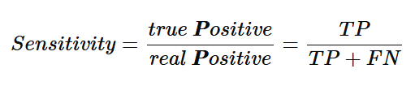
Point metrics: Positive Recall (Sensitivity)
Label positive Label negative
9
2
Th
0.5
TP
9
TN
8
FP
2
FN
1
Acc
.85
Pr
.81
Recall
.9
Th=0.5
Predict Negative Predict Positive
1
8
Notes:
Recall (sensitivity) - What fraction of all greens did we pick out? Terminology from lab tests: how sensitive is the test in detecting disease?
Somewhat related to Precision ( both recall and precision involve TP)
Trivial 100% recall = pull everybody above the threshold.
Trivial 100% precision = push everybody below the threshold except 1 green on top (hopefully no gray above it!).
Striving for good precision with 100% recall = pulling up the lowest green as high as possible in the ranking.
Striving for good recall with 100% precision = pushing down the top most gray as low as possible in the ranking.

Slide 13

Point metrics: Negative Recall (Specificity)
Label positive Label negative
9
2
Th
0.5
TP
9
TN
8
FP
2
FN
1
Acc
.85
Pr
.81
Recall
.9
Spec
0.8
Th=0.5
Predict Negative Predict Positive
1
8
Notes:
Negative Recall (Specificity) - What fraction of all negatives in the population were we able to keep away?
Note: Sensitivity and specificity operate in different sub-universes.

Slide 14
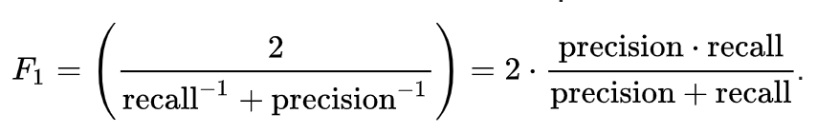
Point metrics: F1-score
Label positive Label negative
9
2
Th
0.5
TP
9
TN
8
FP
2
FN
1
Acc
.85
Pr
.81
Recall
.9
Spec
.8
F1
.857
Th=0.5
Predict Negative Predict Positive
1
8
Notes:
Summarize precision and recall into single score
F1-score: Harmonic mean of PR and REC
G-score: Geometric mean of PR and REC

Slide 15
Point metrics: Changing threshold
Label positive Label negative
7
2
Th
0.6
TP
7
TN
8
FP
2
FN
3
Acc
.75
Pr
.77
Recall
.7
Spec
.8
F1
.733
Th=0.6
Predict Negative Predict Positive
# effective thresholds = # examples + 1
3
8
Notes:
Changing the threshold can result in a new confusion matrix, and new values for some of the metrics.
Many threshold values are redundant (between two consecutively ranked examples). Number of effective thresholds = M + 1 (# of examples + 1)

Slide 16
Threshold Scanning
Threshold | TP | TN | FP | FN | Accuracy | Precision | Recall | Specificity | F1
1.00 | 0 | 10 | 0 | 10 | 0.50 | 1 | 0 | 1 | 0
0.95 | 1 | 10 | 0 | 9 | 0.55 | 1 | 0.1 | 1 | 0.182
0.90 | 2 | 10 | 0 | 8 | 0.60 | 1 | 0.2 | 1 | 0.333
0.85 | 2 | 9 | 1 | 8 | 0.55 | 0.667 | 0.2 | 0.9 | 0.308
0.80 | 3 | 9 | 1 | 7 | 0.60 | 0.750 | 0.3 | 0.9 | 0.429
0.75 | 4 | 9 | 1 | 6 | 0.65 | 0.800 | 0.4 | 0.9 | 0.533
0.70 | 5 | 9 | 1 | 5 | 0.70 | 0.833 | 0.5 | 0.9 | 0.625
0.65 | 5 | 8 | 2 | 5 | 0.65 | 0.714 | 0.5 | 0.8 | 0.588
0.60 | 6 | 8 | 2 | 4 | 0.70 | 0.750 | 0.6 | 0.8 | 0.667
0.55 | 7 | 8 | 2 | 3 | 0.75 | 0.778 | 0.7 | 0.8 | 0.737
0.50 | 8 | 8 | 2 | 2 | 0.80 | 0.800 | 0.8 | 0.8 | 0.800
0.45 | 9 | 8 | 2 | 1 | 0.85 | 0.818 | 0.9 | 0.8 | 0.857
0.40 | 9 | 7 | 3 | 1 | 0.80 | 0.750 | 0.9 | 0.7 | 0.818
0.35 | 9 | 6 | 4 | 1 | 0.75 | 0.692 | 0.9 | 0.6 | 0.783
0.30 | 9 | 5 | 5 | 1 | 0.70 | 0.643 | 0.9 | 0.5 | 0.750
0.25 | 9 | 4 | 6 | 1 | 0.65 | 0.600 | 0.9 | 0.4 | 0.720
0.20 | 9 | 3 | 7 | 1 | 0.60 | 0.562 | 0.9 | 0.3 | 0.692
0.15 | 9 | 2 | 8 | 1 | 0.55 | 0.529 | 0.9 | 0.2 | 0.667
0.10 | 9 | 1 | 9 | 1 | 0.50 | 0.500 | 0.9 | 0.1 | 0.643
0.05 | 10 | 1 | 9 | 0 | 0.55 | 0.526 | 1 | 0.1 | 0.690
0.00 | 10 | 0 | 10 | 0 | 0.50 | 0.500 | 1 | 0 | 0.667
Score = 1
Threshold = 1.00
Threshold = 0.00
Score = 0
Notes:
As we scan through all possible effective thresholds, we explore all the possible values the metrics can take on for the given model.
Each row is specific to the threshold.
Table is specific to the model (different model = different effective thresholds).
Observations: Sensitivity monotonic, Specificity monotonic in opposite direction. Precision somewhat correlated with specificity, and not monotonic. Tradeoff between Sensitivity and Specificity, Precision and Recall.

Slide 17
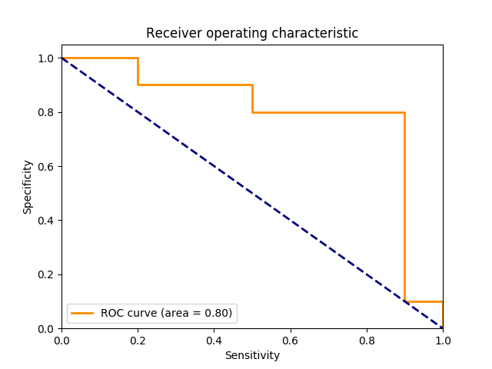
Summary metrics: Rotated ROC (Sen vs. Spec)
Pos examples
Score = 1
Neg examples
Specificity
= True Neg / Neg
AUROC = Area Under ROC
= Prob[Random Pos ranked
higher than random Neg]
Random Guessing
Agnostic to prevalence!
Score = 0
Sensitivity = True Pos / Pos
Notes:
AUC = Area Under Curve. Also called C-Statistic (concordance score). Represents how well the results are ranked. If you pick a positive e.g by random, and negative e.g by random, AUC = probability that positive eg is ranked > negative example. Measure of quality of discrimination.
Some people plot TPR (= Sensitivity) vs FPR (= 1 - Specificity).
Thresholds are points on this curve. Each point represents one set of point metrics.
Diagonal line = random guessing.
Grid view (top left to bottom right, postive = move right, negative = move down)
Agnostic to prevalence.

Slide 18
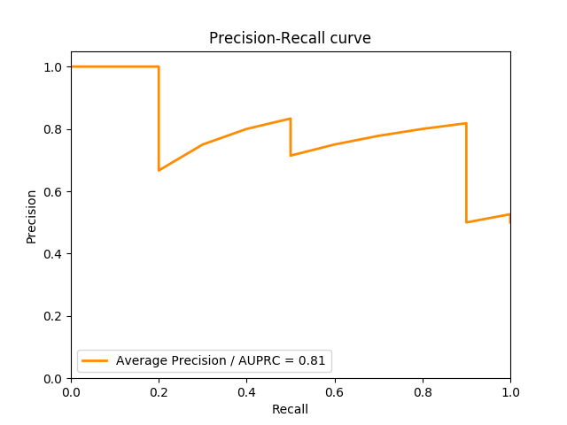
Summary metrics: PRC (Recall vs. Precision)
Pos examples
Score = 1
Neg examples
Precision
= True Pos /
Predicted Pos
AUPRC = Area Under PRC
= Expected precision for
Random threshold
Precision >= prevalence
Score = 0
Recall = Sensitivity = True Pos / Pos
Notes:
Precision Recall curve represents a different tradeoff. Think search engine results ranked.
End of curve at right cannot be lower than prevalence.
Area under PRC = Average Precision. Intuition: By randomly picking the threshold, what’s the expected precision?
While specificity monotonically decreases with increasing recall (the number of correctly classified negative examples goes down), precision can be “jagged”. Getting a bunch of positives in the sequence increases both precision and recall (hence curve climbs up slowly), but getting a bunch of negatives in the sequence drops the precision without increasing recall. Hence, by definition, curve has only slow climbs and vertical drops.

Slide 19
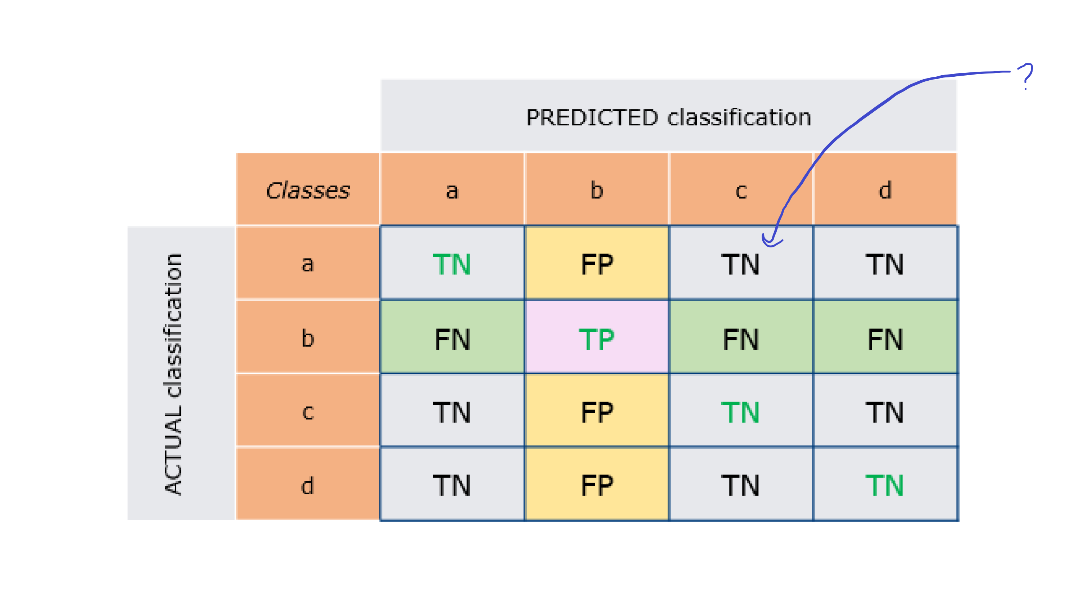
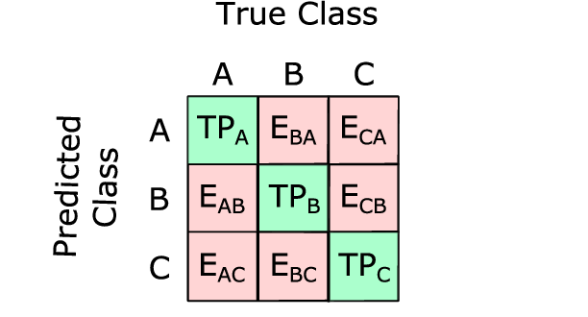
Confusion matrix for more than 2 classes

Slide 20
Thank You!

