Slide 1
Discriminant Analysis

Slide 2

Data Representation vs. Data Classification
PCA finds the most accurate data representation
in a lower dimensional space
Project data in the directions of maximum variance
However the directions of maximum variance may be useless for classification
separable
apply PCA
not separable
to each class
Fisher Linear Discriminant project to a line which preserves direction useful for data classification

Slide 3

Fisher Linear Discriminant
Main idea: find projection to a line s.t. samples from different classes are well separated
Example in 2D
bad line to project to, classes are mixed up
good line to project to, classes are well separated

Slide 4


Fisher Linear Discriminant
Suppose we have 2 classes and d-dimensional samples x₁,…,x_{n} where
n₁ samples come from the first class
n₂ samples come from the second class
consider projection on a line
Let the line direction be given by unit vector v
Scalar v^{t}x_{i} is the distance of projection of x_{i} from the origin
Thus it v^{t}x_{i} is the projection of x_{i} into a one dimensional subspace
x
t
i
v
x_{i}
v

Slide 5
Fisher Linear Discriminant
Thus the projection of sample x_{i} onto a line in direction v is given by v^{t}x_{i}
How to measure separation between projections of different classes?
Let μ~ and μ~ be the means of projections of
1 2
classes 1 and 2
Let μ₁ and μ₂ be the means of classes 1 and 2
▪
μ~ − μ~
1 2
seems like a good measure
1
n₁ n₁
⎞
~
Σ i
_{t} ( 1
Σ i
μ =
t
|
|
= v μ
v x = v
x
t
1
|
n
|
1
^{n}1 x ∈C1
⎝
x ∈C1
⎠
i
1
i
similarly ,
μ~ ₂ = v ^{t} μ ₂

Slide 6

Fisher Linear Discriminant
How good is
μ~ − μ~
1 2
as a measure of separation?
The larger μ~ − μ~
, the better is the expected separation
μ₁
1
2
_{μ}~
1
_{μ}~
μ₂
2
_{μ}_
1
_{μ}_
2
the vertical axes is a better line than the horizontal axes to project to for class separability
_{μ}_
however
− μ_ > μ~ − μ~
2 1 2
1

Slide 7

Fisher Linear Discriminant
The problem with
μ~ − μ~
is that it does not
1 2
consider the variance of the classes
_{μ}~
μ₁
small variance
1
_{μ}~
μ₂
2
_{μ}_
1
_{μ}_
2
large variance

Slide 8

Fisher Linear Discriminant
We need to normalize proportional to variance
μ~ − μ~
1 2
by a factor which is
₌ 1 _{Σ}^{n}
Have samples z₁,…,z_{n} . Sample mean is μ
z
z
n
i
i = 1
Define their scatter as
n
s = Σ (z − μ
)
2
i z
i = 1
Thus scatter is just sample variance multiplied by n
scatter measures the same thing as variance, the spread of data around the mean
scatter is just on different scale than variance
larger scatter:
smaller scatter:

Slide 9
Fisher Linear Discriminant
_{μ}~
− μ~
Fisher Solution: normalize
Let y_{i} = v^{t}x_{i} , i.e. y_{i} ‘s are the projected samples
Scatter for projected samples of class 1 is
by scatter
1 2
~ 2
= Σ (y − μ
~ ₎
s
2
1
i
1
y _{i} ∈Class 1
Scatter for projected samples of class 2 is
~ 2
s = Σ (y − μ
~ ₎
2
2
i
2
y _{i} ∈Class 2

Slide 10
Fisher Linear Discriminant
We need to normalize by both scatter of class 1 and scatter of class 2
Thus Fisher linear discriminant is to project on line in the direction v which maximizes
want projected means are far from each other
~ ₎
J (v ) = ^{(μ~}
− μ
2
1 2
~ 2 ~
2
s
+ s
1
2
want scatter in class 1 is as
want scatter in class 2 is as
small as possible, i.e. samples small as possible, i.e. samples
of class 1 cluster around the
of class 2 cluster around the
projected mean μ~
projected mean μ~
1
2

Slide 11

Fisher Linear Discriminant
~ ₎
J (v ) = ^{(μ~}
− μ
2
1 2
~ 2 ~
2
s
+ s
1 2
If we find v which makes J(v) large, we are guaranteed that the classes are well separated
projected means are far from each other
_{μ}~
_{μ}~
1
2
small s~ implies that
small s~ implies that
projected¹ samples of class 1 are clustered around projected mean
2
projected samples of class 2 are clustered around projected mean

Slide 12
~ ₎
Fisher Linear Discriminant Derivation
J (v ) = ^{(μ~}
− μ
2
1 2
~ 2 ~
2
s
+ s
1 2
All we need to do now is to express J explicitly as a function of v and maximize it
straightforward but need linear algebra and Calculus
Define the separate class scatter matrices S₁ and S₂ for classes 1 and 2. These measure the scatter of original samples x_{i} (before projection)
S = Σ (x
x _{i} ∈Class 1
S = Σ (x
x _{i} ∈Class 2
− μ )(x − μ )
t
1
i
1 i 1
− μ )(x − μ )
t
2
i
2
i
2

Slide 13
Fisher Linear Discriminant Derivation
Now define the within the class scatter matrix
S_{W} = S₁ + S₂
~ 2
= Σ (y − μ
~ ₎
Recall that s
2
1
i
1
y _{i} ∈Class 1
~
μ
= v μ
Using y_{i} = v^{t}x_{i} and
t
1
1
= Σ (v ^{t} x − v μ )
= Σ (v ^{t} (x − μ
=
=
~ 2
t
2
s
1
i
1
y _{i} ∈Class 1
)) ( (
t
v x − μ ))
t
i
1
i
1
y _{i} ∈Class 1
) ) (( ) )
Σ ((x − μ
t
t
v x − μ
t
v
i
1
i
1
y _{i} ∈Class 1
Σ v ^{t} (x − μ )(x − μ )
t
v
t
= v S v
i
1
i
1
1
y _{i} ∈Class 1

Slide 14
Fisher Linear Discriminant Derivation
Similarly s
Therefore s
Define between the class scatter matrix
~ 2
= v ^{t} S v
2
2
~ 2 ~ 2
+ s = v ^{t} S₁v + v ^{t} S₂v = v ^{t} S v
1 2
W
S = (μ − μ )(μ − μ )
t
B 1 2 1 2
S_{B} measures separation between the means of two classes (before projection)
Let’s rewrite the separations of the projected means
(μ~ − μ
~ ₎
= (v ^{t} μ − v μ )
2
2
t
1
2
1 2
= v ^{t} (μ − μ )(μ − μ ) v
t
1
= v ^{t} S_{B}v
2 1 2

Slide 15
Fisher Linear Discriminant Derivation
Thus our objective function can be written:
(μ~ − μ~ )²
v ^{t} S v
J (v )
₌ 1 2 ₌ B
~ 2 ~ 2
s
+ s v ^{t} S v
1 2 W
Minimize J(v) by taking the derivative w.r.t. v and setting it to 0
( d
⎞ ⎞
t
t t
v S v v S v − ^{( d} v ^{t} S
v v S v
|
|
d
| dv
B
⎠
W
| dv
W
B
J (v ) = ⎝
⎝
⎠
dv
(v S )
2
t
v
W
₌ (2S_{B} v )v ^{t} S_{W} v − (2S_{W} v )v ^{t} S_{B}v ₌
(v ^{t} S v )²
0
W

Slide 16
Fisher Linear Discriminant Derivation
Need to solve
v ^{t} S_{W} v (S_{B} v ) − v ^{t} S_{B}v (S_{W} v ) = 0
⇒ v ^{t} S_{W} v (S_{B} v ) ₋ v ^{t} S_{B}v (S_{W} v ) ₌ ₀
v ^{t} S_{W} v v ^{t} S_{W} v
t
v (S v )
v S
⇒ S v −
B W
= 0
B
v ^{t} S_{W} v
= λ
⇒ S_{B}v = λ S_{W} v
generalized eigenvalue problem

Slide 17
Fisher Linear Discriminant Derivation
S_{B}v = λ S_{W} v
If S_{W} has full rank (the inverse exists), can convert this to a standard eigenvalue problem
S ⁻ ¹S v = λ v
W B
But S_{B} x for any vector x, points in the same
direction as μ₁ - μ₂
α
S x = (μ − μ )(μ − μ )
t
x
= (μ − μ )((μ − μ ) )
= α (μ − μ )
B 1 2 1 2
t
x
1 2 1 2
1 2
Thus can solve the eigenvalue problem immediately
(
μ − μ )
v = S
−1
W 1
2
= α [S μ − μ )]
λ
S S [ μ − μ ] = S
[ ( )]
(
− 1
W B W
( )
α μ − μ
− 1
− 1
S
−1
W
1 2
1 2
W 1 2
v
v

Slide 18
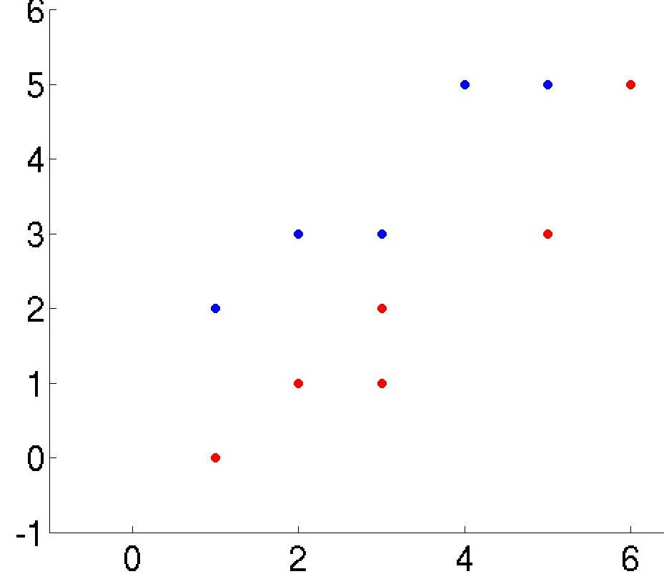
Fisher Linear Discriminant Example
Data
Class 1 has 5 samples c₁=[(1,2),(2,3),(3,3),(4,5),(5,5)]
Class 2 has 6 samples c₂=[(1,0),(2,1),(3,1),(3,2),(5,3),(6,5)]
Arrange data in 2 separate matrices
「1 2
「1 0
c₁ = | |
c₂ = | |
|L|L|L|5 5 |]|]|]
|L|6 5 |]|]
Notice that PCA performs very poorly on this data because the direction of largest variance is not helpful for classification

Slide 19
Fisher Linear Discriminant Example
First compute the mean for each class
μ₁ = mean (c₁ ) = [3 3.6 ] μ ₂ = mean (c₂ ) = [3.3 2 ]
Compute scatter matrices S₁ and S₂ for each class
S₁ = 4 ∗ cov (c₁ ) = ^{「 10}
8.0
S₂ = 5 ∗ cov (c ₂ ) = ^{「17 .3 16}
_{L}|_{L}|_{L}|8.0 7.2 ]|]|]
_{L}|_{L}| 16 16 |]|]
Within the class scatter:
S_{W} = S₁ + S₂
_{= |}「27 .3 24
_{L}| 24 23 .2 |]|]
it has full rank, don’t have to solve for eigenvalues
₎ ₌ 「 0.39
The inverse of S
is S ⁻¹ = inv (S
W W
− 0.41
_{L}|_{L}|_{L}|− 0.41 0.47 |]|]
W
Finally, the optimal line direction v
(μ
_{− μ ) =} 「− 0.79
v = S
−1
W
1 2
L|L|L ^{0.89} |]|]

Slide 20
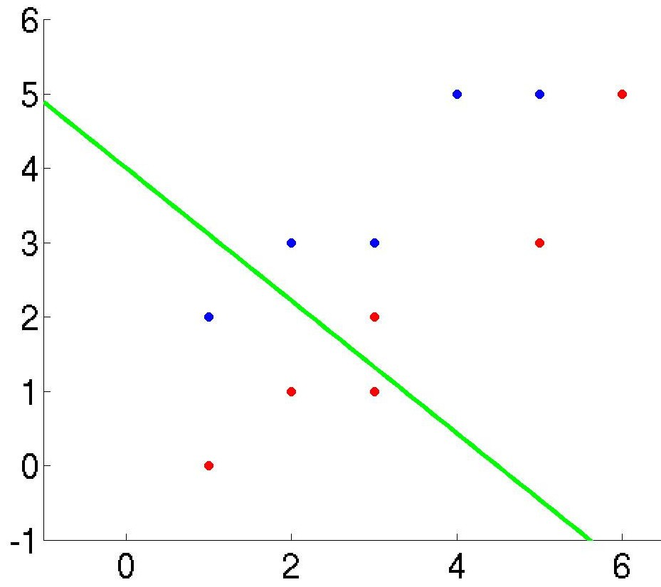
Fisher Linear Discriminant Example
Notice, as long as the line has the right direction, its exact position does not matter
Last step is to compute the actual 1D vector y. Let’s do it separately for each class
Y₁ = v ^{t} c ^{t} = [− 0.65 0.73 ]^{「1 ⋯ 5} = [0.81 ⋯ 0.4 ]
1
|L|2 ⋯ 5 |]|]
Y₂ = v ^{t} c ^{t} = [− 0.65
0.73 ]^{「1 ⋯ 6} = [− 0.65 ⋯ − 0.25 ]
2
|L|0 ⋯ 5 |]|]

Slide 21
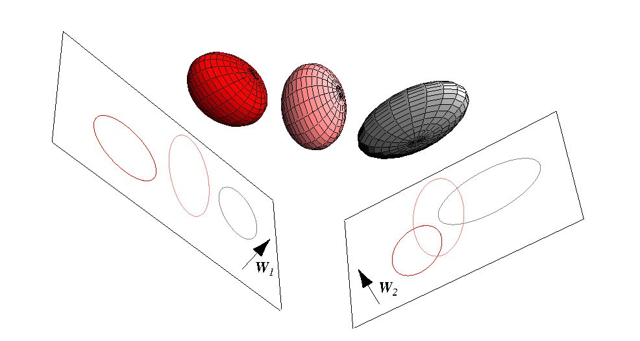
Multiple Discriminant Analysis (MDA)
Can generalize FLD to multiple classes
In case of c classes, can reduce dimensionality to 1, 2, 3,…, c-1 dimensions
Project sample x_{i} to a linear subspace y_{i} = V^{t}x_{i}
V is called projection matrix

Slide 22
Multiple Discriminant Analysis (MDA)
Let
n_{i} by the number of samples of class i
and μ_{i} be the sample mean of class i
μ be the total mean of all samples
μ _{i}
₌ 1
Σ x μ = ¹ Σ x _{i}
n_{i}
n
x ∈ class i x _{i}
_{J (V ) =} det (V ^{t} S_{B}V )
Objective function:
det (V ^{t} S_{W} V )
within the class scatter matrix S_{W} is
c c
S = Σ S = Σ Σ (x − μ )(x − μ )
t
W
i k i
k
i
i =1 i =1 x _{k} ∈class i
between the class scatter matrix S_{B} is
c
S = Σ n (μ − μ )(μ − μ )^{t}
B i i i
i =1
maximum rank is c -1

Slide 23
Multiple Discriminant Analysis (MDA)
_{J (V ) =} det (V ^{t} S_{B}V )
det (V ^{t} S_{W} V )
First solve the generalized eigenvalue problem:
S_{B}v = λ S_{W} v
At most c-1 distinct solution eigenvalues
Let v₁, v₂ ,…, v_{c-1} be the corresponding eigenvectors
The optimal projection matrix V to a subspace of dimension k is given by the eigenvectors corresponding to the largest k eigenvalues
Thus can project to a subspace of dimension at most c-1

Slide 24
FDA and MDA Drawbacks
Reduces dimension only to k = c-1 (unlike PCA)
For complex data, projection to even the best line may result in unseparable projected samples
Will fail:
1. J(v) is always 0: happens if μ₁ = μ₂
PCA performs
PCA also
reasonably well
fails:
here:
2. If J(v) is always large: classes have large overlap when projected to any line (PCA will also fail)

