Slide 1
Intro+Plotting

Slide 2
Machine Learning
Machine Learning is divided into 3 types
Supervised Learning(Data(X) with labels(y))
Classification
Regression
Unsupervised Learning(Only Data(X) and no labels(y))
Clustering
Decomposition
Reinforcement or Semi Supervised(Data(X) and labels(y), Model learns on its own via rewards and punishments(See its explanation in Psychology)

Slide 3
Supervised Learning
Supervised Learning consists of learning the relation/mapping/function between the Data X(Can be images, videos, audio, raw data) and y(The target variable)
This relation or mapping is then used to predict y for any/future values of X that come up
This is the traditional Machine Learning everyone is familiar with or starts with in his/her career.

Slide 4
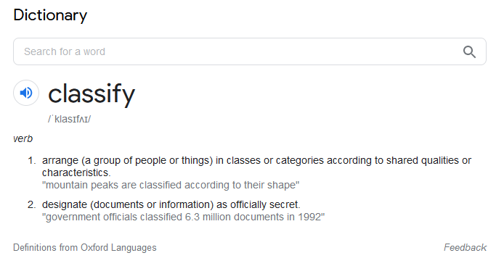
Classification
In supervised learning if the target variable is guaranteed to have discrete values for the data that you have then that problem is called a classification problem. E.g the target variable can be animal(lion, tiger whatever), age bracket(10-20,20-30), Gender(M,F) etc

Slide 5
Regression
However if the target variable has continuous values which can range from infinity to -infinity then that problem is called a regression problem e.g Age, Salary, Experience.
Note that you cannot always say that the target variable is a classification or regression variable just by looking at its name. You have to observe the data e.g Experience can have the values of Junior, Associate, Senior or can have the number of years as experience. So do observe the data before making a conclusion.

Slide 6
IMP Note
Note that you cannot always say that the target variable is a classification or regression variable just by looking at its name. You have to observe the data e.g Experience can have the values of Junior, Associate, Senior or can have the number of years as experience. So do observe the data before making a conclusion.

Slide 7
A small intro to plotting Classification/Regression Probs
Plotting classification and regression problems is different from one another. Its simple with one key difference
You do not plot the target in Classification problems. The class(category) of a respective sample can be shown with a distinct color with a legend telling which class it belongs to
However in case of Regression, you have to plot the target variable in an axis because it is a continuous variable and can be any value

Slide 8
Classification Plotting
As we now know that we do not plot the target variable on any axis, we can say that for
One feature, the plot can be shown via a line
For two features a 2D plot and
For three features a 3D plot
Unfortunately you cannot plot a classification plot for data which have more than 3 features as we cannot visualize 4D or anything of the sort

Slide 9
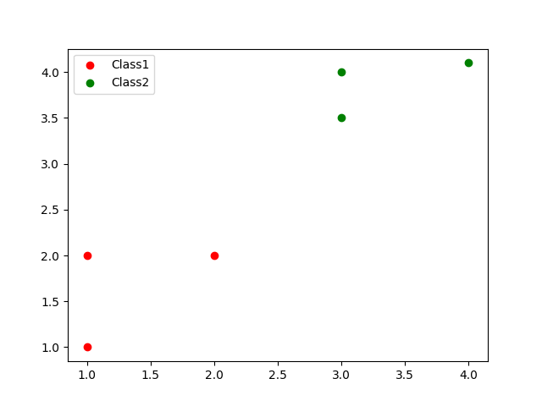
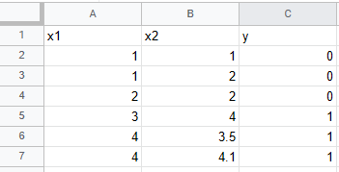
Classification Plotting
Data The Plot

Slide 10
Regression Plotting
For regression we do plot the target variable on an axis so for regression plots
For a single feature, it will be a 2D plot
For 2 features it would be a 3D plot
And that's it. You cannot make any plot for features>2

Slide 11
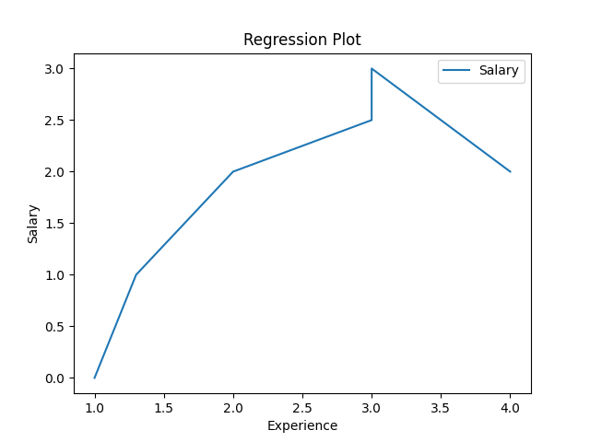
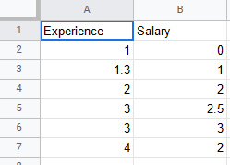
Regression Plotting
Data The Plot

