Slide 1
FYP Ideas

Slide 2
An Intelligent AI based blogging platform

Slide 3
Introduction and background
The idea of this project is to make a blogging platform like wordpress through which users will be able to build their blogs but with the addition of a number of AI utilities/features added in the platform.

Slide 4
Project Key Features
1) Paraphrasing of words using one of the following APIs listed https://rapidapi.com/collection/paraphrasing
2) Grammar check using Grammarly’s API
3) Summary Generation (ML Based LSA: Latent Semantic Analysis)
4) Automatic blog content generation using GANs coupled with LSTMs.

Slide 5
Project Key Features(Contd)
5) Profile & Spamming features
A Machine Learning model will be employed which will be used to check if the user’s profile picture is already present in some other profile or not. This would be essential in keeping a check that only one account can be opened one person. This would be done using one shot learning on CNNs.
A machine learning model per person would be employed to keep a check on spam comments. A machine learning model will be trained based on what the user considers as spam and then it would be saved per the user preferences so that spam comments could not be made on the blog. This can be done by using LSTMs.

Slide 6
Project Key Features(Contd)
6) An SEO tool which would analyze the posts and then assign a score to them. This would be built by training a LSTM model on a variety of blogs so that the model knows what is a good blog and what is not. It also recommends good keywords, headings for the blog.
7) Figure out a domain name related to the blog which would get the website good SEO. In addition to it, also integrate an API which can be used to buy a domain.
8) Add a tool which would post/schedule the blog’s link or related posts on all social media pages of the owner.
9) An editorial calendar will be integrated within the platform so that content creators can schedule their publications

Slide 7
Project Key Features(Contd)
3) How can we verify the accuracy of the generated blog by GAN
We can verify the accuracy of the generated blog using two ways:
Manually. This would require a person with that field’s expertise to review it and tell if its good or not
We can evaluate it programmatically using one of these techniques Nearest Neighbors, Rapid Scene Categorization, Rating and Preference Judgment, Evaluating Mode Drop and Mode Collapse and Investigating and Visualizing the Internals of Networks.

Slide 8
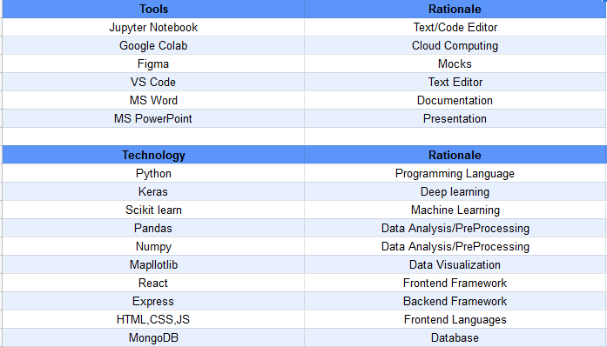
Tools and Technologies

