Slide 1

SpaceX Falcon 9 First-Stage Landing Prediction
IBM Applied Data Science Capstone Project
Presenter: Muhammad Usman Ali

Slide 2
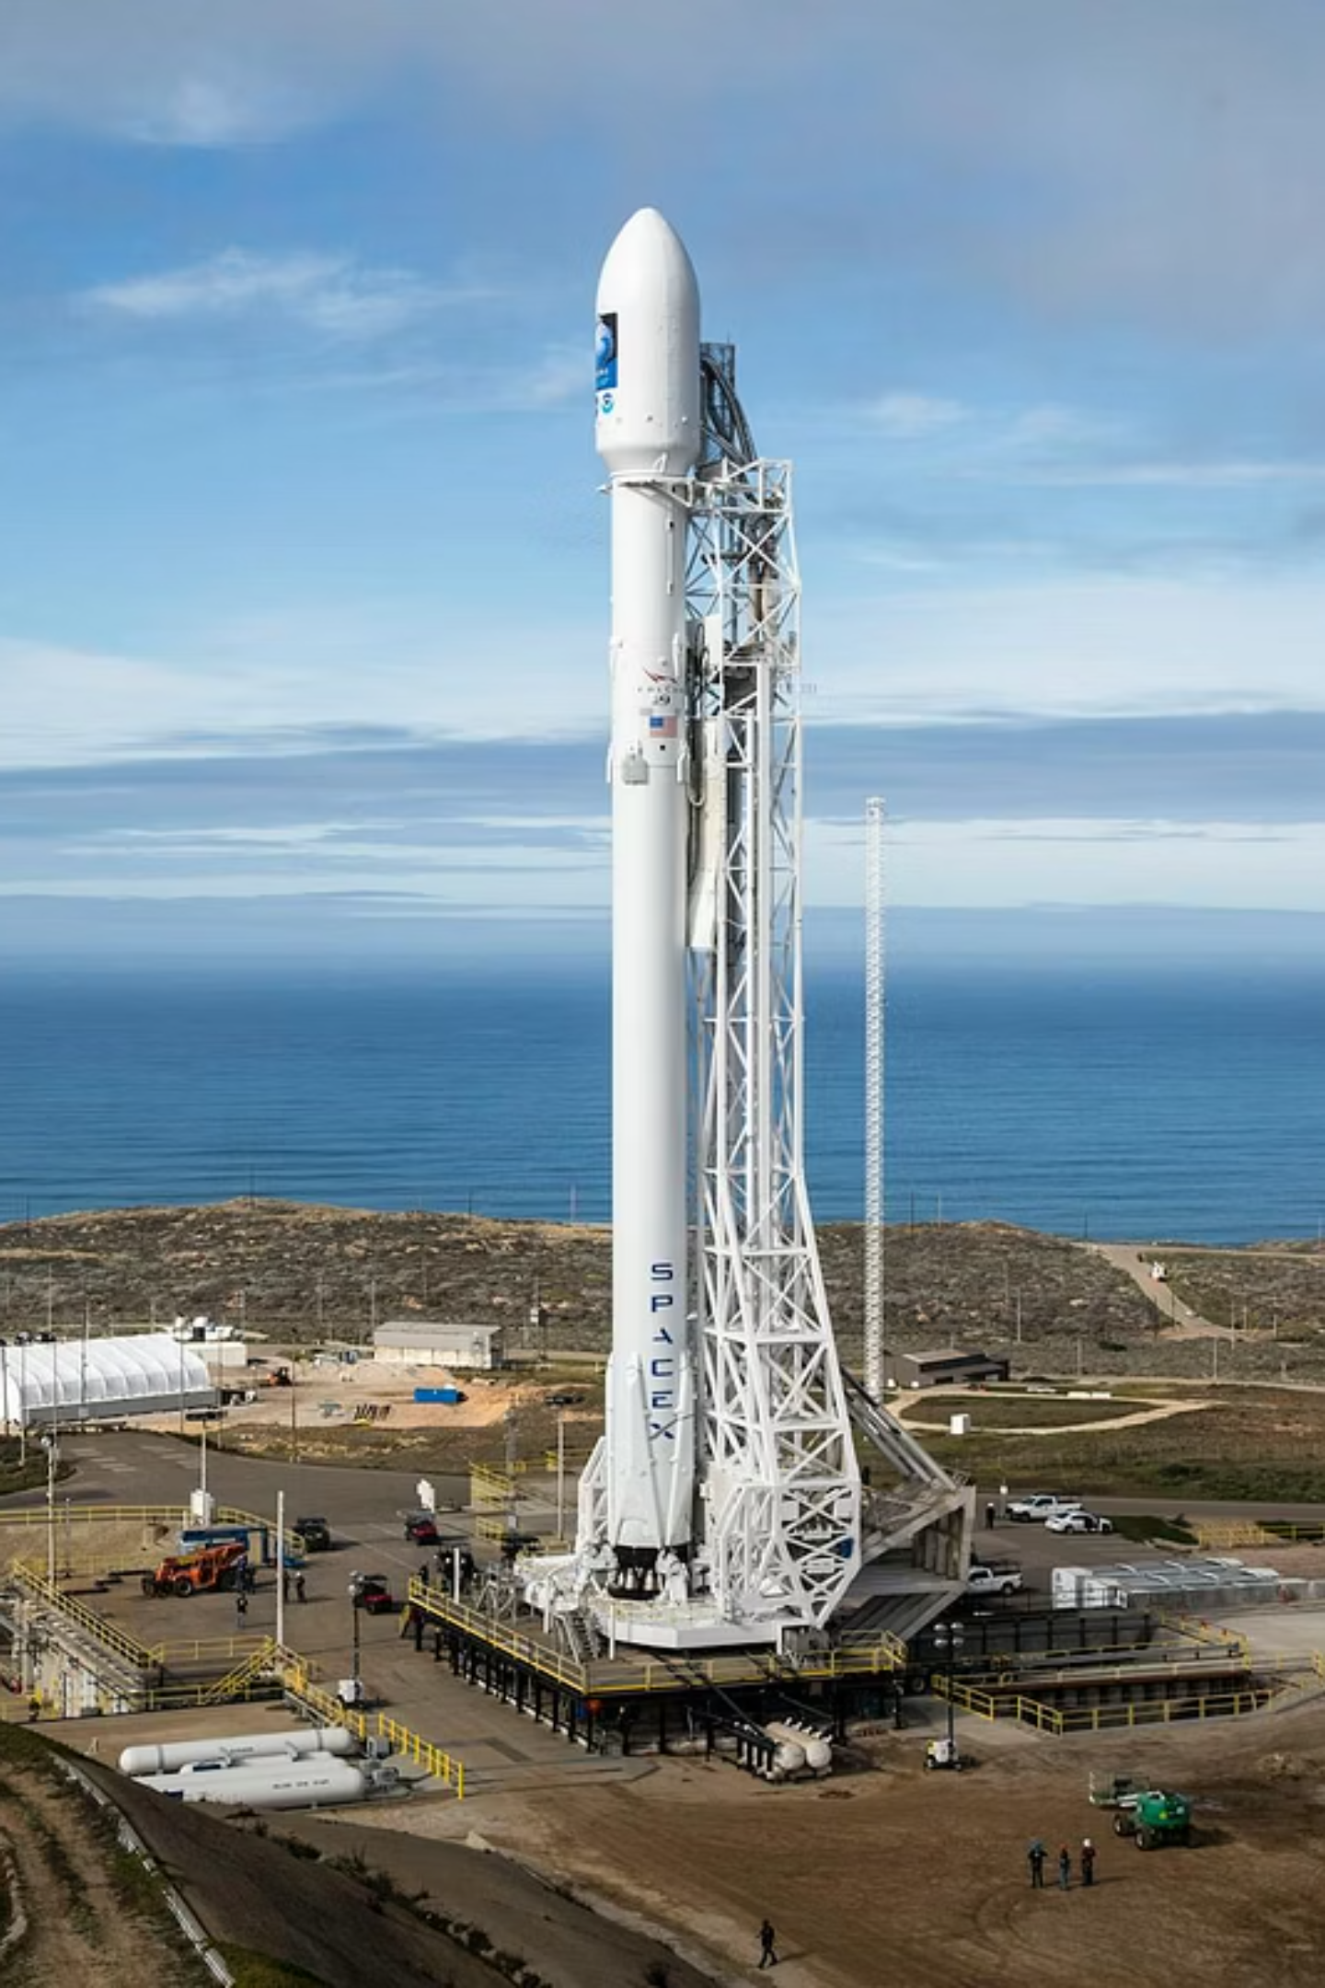

Project Overview
The Problem
Commercial space flight pricing drops dramatically if rocket booster stages are recovered cleanly.
The Goal
Classify successful recovery parameters using historical flight configurations.
Core Elements
REST APIs, web scraping, relational database SQL queries, geospatial maps, and predictive models.

Slide 3

Core Data Pipeline Phases
Data Collection
Spatial & App Deployment
Ingest SpaceX API and scrape Wikipedia
Create Folium layers and Dash panel
Data Wrangling
Clean labels, flatten params, One-Hot encode
Each phase builds on the previous — from raw ingestion through structured transformation to interactive spatial deployment — forming a complete end-to-end analytics pipeline.

Slide 4

Exploratory Data Analysis & Tech
Relational Analytics & SQL
SQL Environment
Formulated explicit relational queries to expose historical operational trend lines.
Data Insights
Isolated payload weight configurations, flight frequencies, and launch site landing distributions.
Repository Folders
All processed graphs are stored under the lowercase data directory.

Slide 5

Engineering Tech Stack
Language Runtime
Python 3 ecosystem.
Data Manipulation
Pandas dataframes and structured NumPy matrices.
Visual Tools
Interactive Folium map overlays and Plotly Dash interfaces.
Model Pipeline
Scikit-Learn libraries and GridSearchCV hyperparameter matrices.

Slide 6
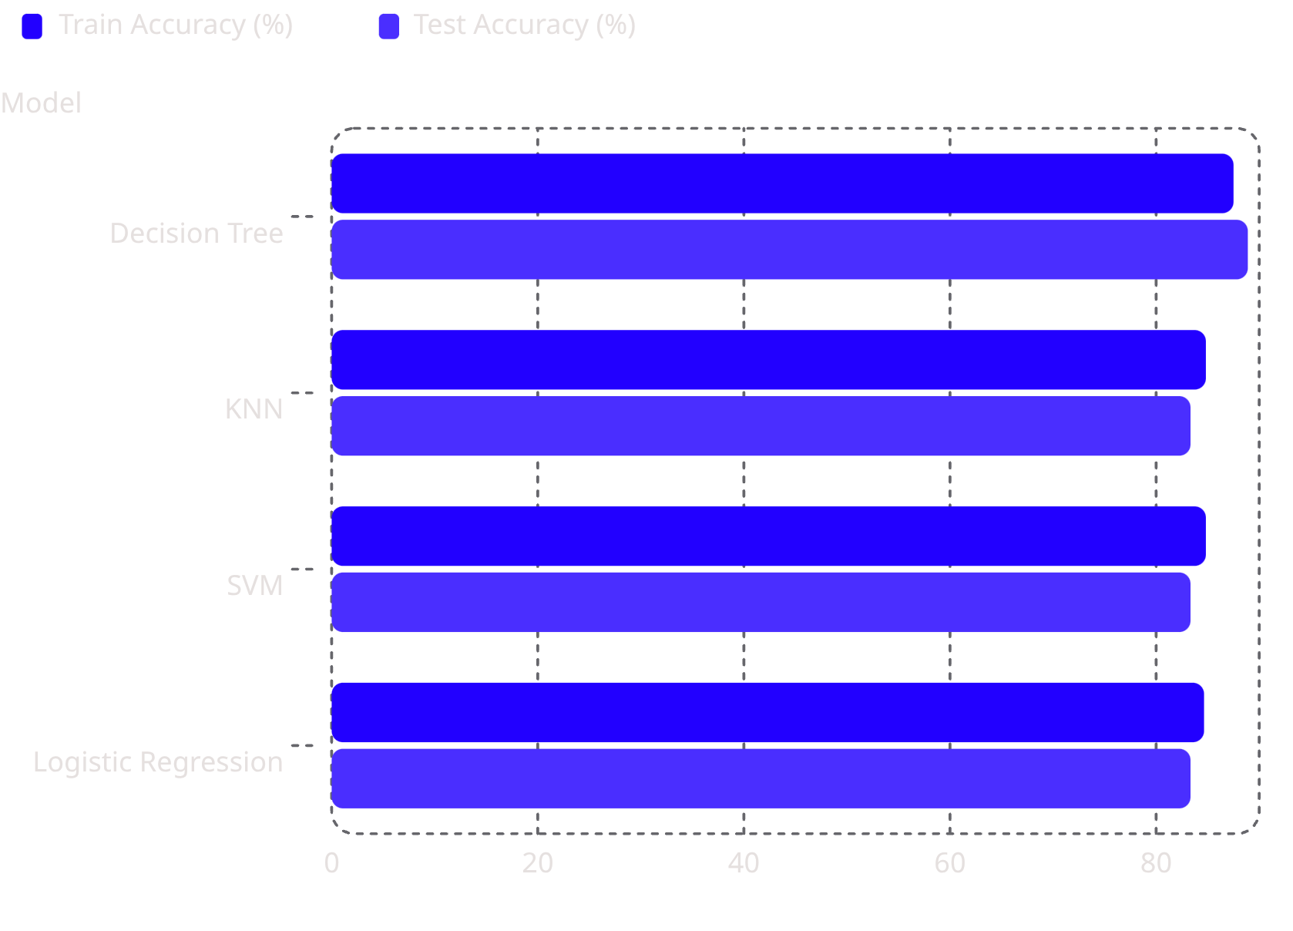
Machine Learning Summary
Model Configurations & Accuracies
Decision Tree
K-Nearest Neighbors
Test: 88.89%
criterion: gini, max_depth: 8, max_features: sqrt, min_samples_leaf: 1, min_samples_split: 5, splitter: random
Test: 83.33%
algorithm: auto, n_neighbors: 10, p: 1
Support Vector Machine
Logistic Regression
Test: 83.33%
C: 0.01, penalty: l2, solver: lbfgs
Test: 83.33%
C: 1.0, gamma: 0.0316, kernel: sigmoid

Slide 7
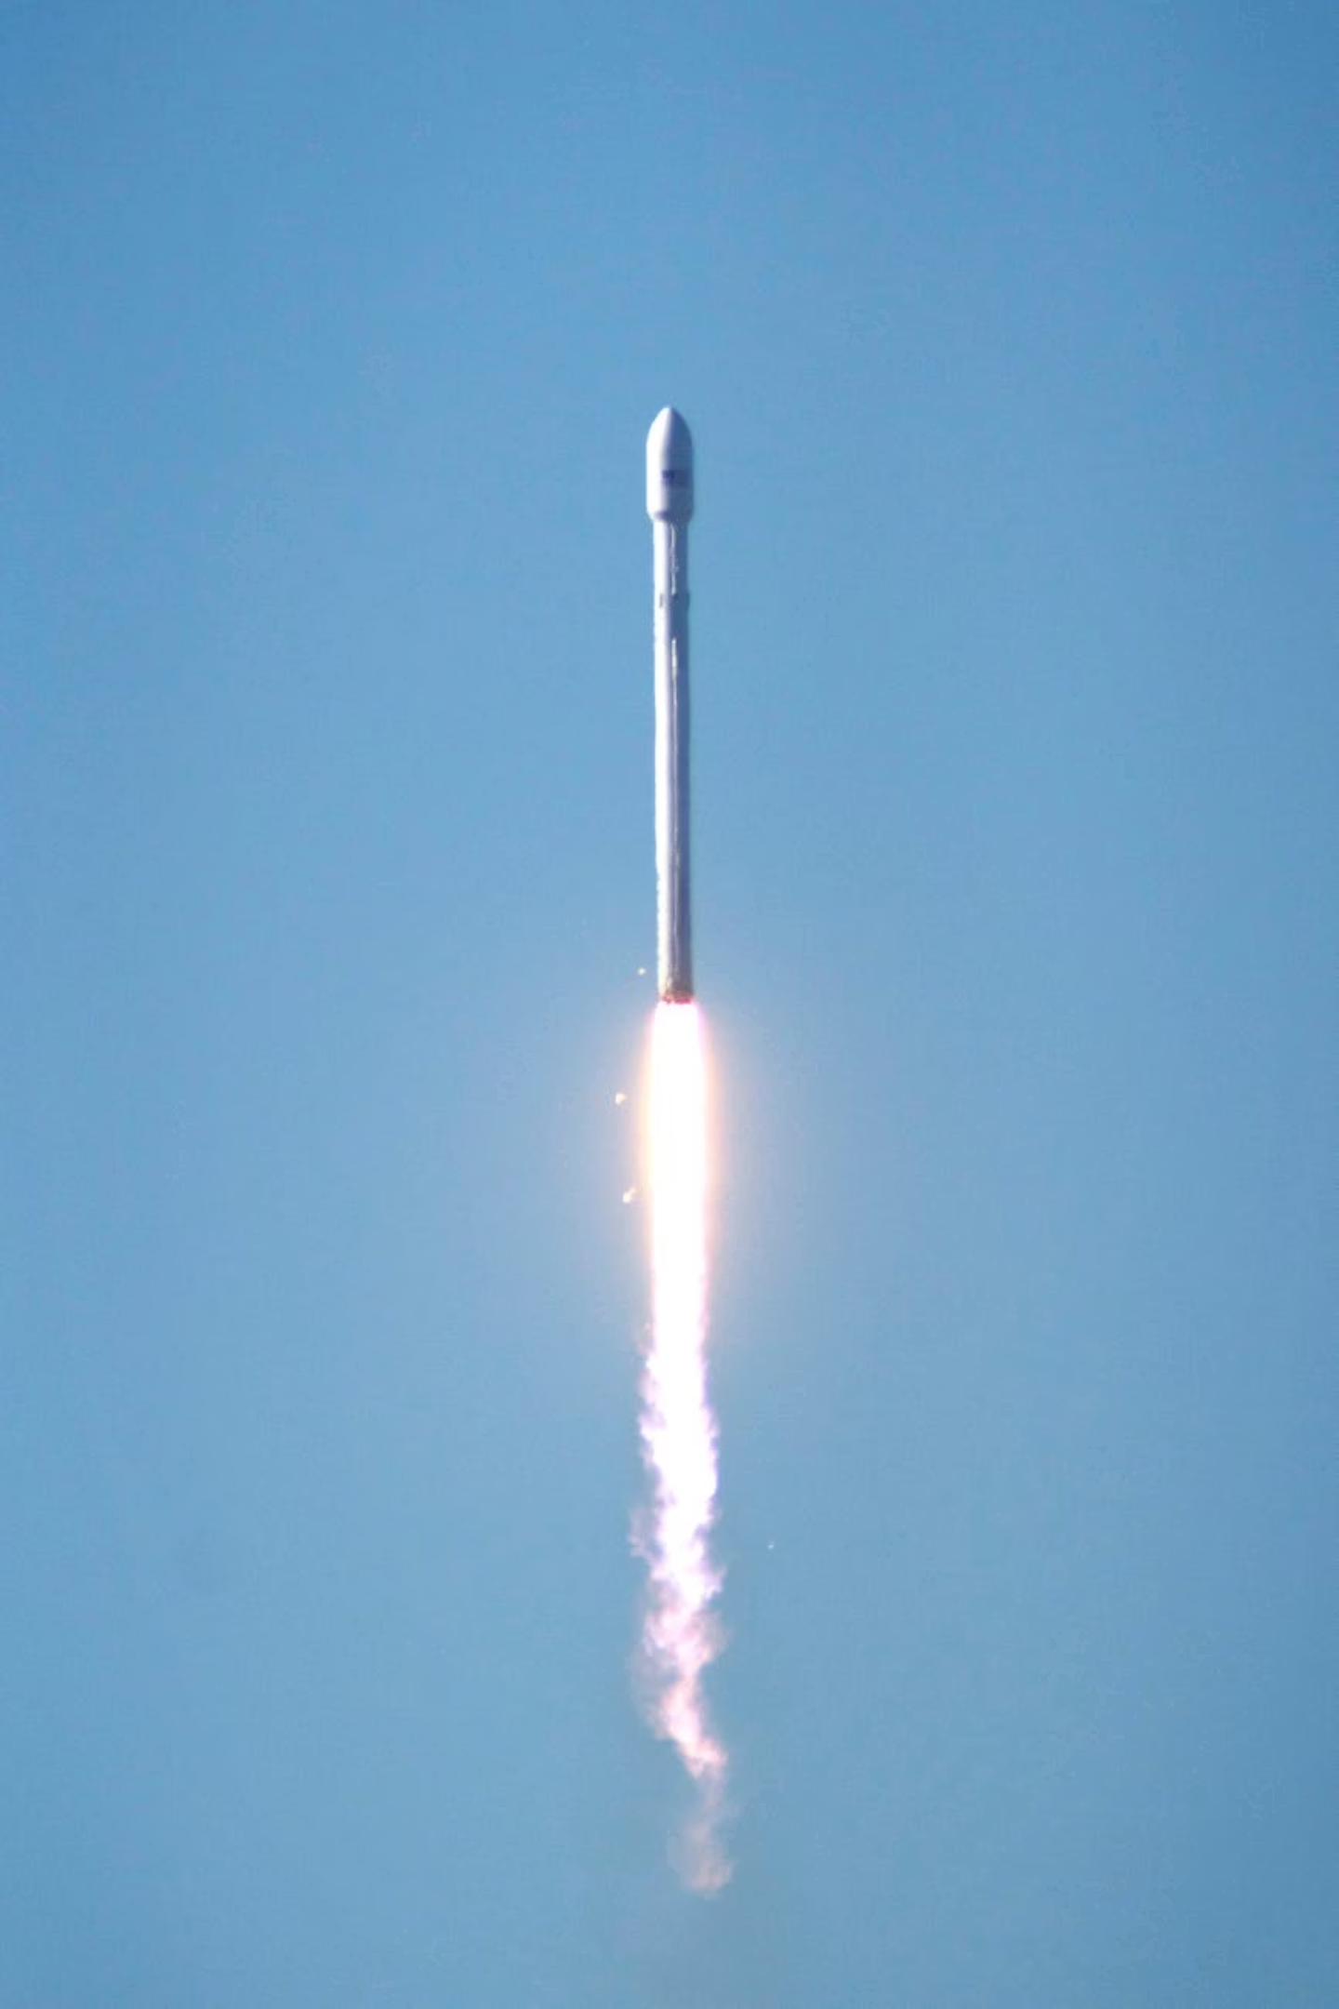

Final Model Selection
88.89%
4
Peak Test Accuracy
Models Evaluated
DecisionTreeClassifier — the highest-performing model across all candidates.
Decision Tree, KNN, SVM, and Logistic Regression compared via GridSearchCV.
5.56%
Accuracy Gap
Improvement over the 83.33% baseline achieved by SVM, KNN, and Logistic Regression.
Strategic Takeaway: While SVM, KNN, and Logistic Regression hit a solid baseline of 83.33%, the tree-structured logic adjusted best to the strict classification boundaries of target payloads and orbit traits — making the DecisionTreeClassifier the optimal choice for this mission-critical prediction task.

