Slide 1
Climate Change Impact
Geospatial Analysis
Global Climate Trends, Projections & Vulnerability Analysis
2000–2050
Usman Ali
SkilledScore Data Visualization Internship
Supervisor: Dr. Zeeshan Usmani

Slide 2
Climate Challenge & Analytical Approach
• Climate impacts vary substantially across countries and over time.
• Analyzed 233 geographic entities across four indicators:
Temperature • Precipitation • CO2 Emissions • Sea-Level Rise
• Historical synthetic analysis: 2000–2025
• Country-level linear projections: 2026–2050
• Integrated climate indicators with global geographic boundaries to reveal spatial and temporal patterns.

Slide 3
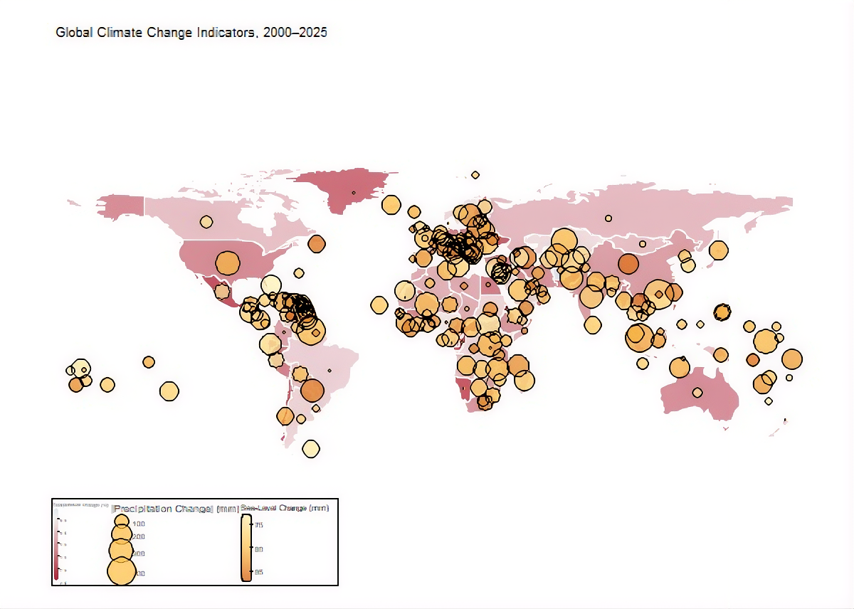
Global Climate Trends | 2000–2025
• Global average temperature increased by
approximately 0.88°C.
• Mean sea-level rise increased by approximately 80 mm.
• Precipitation changed by approximately +40 mm
globally.
• Geographic patterns vary considerably across
individual countries and regions.
• Multi-layer mapping combines temperature change,
precipitation change, and sea-level change for spatial comparison.

Slide 4
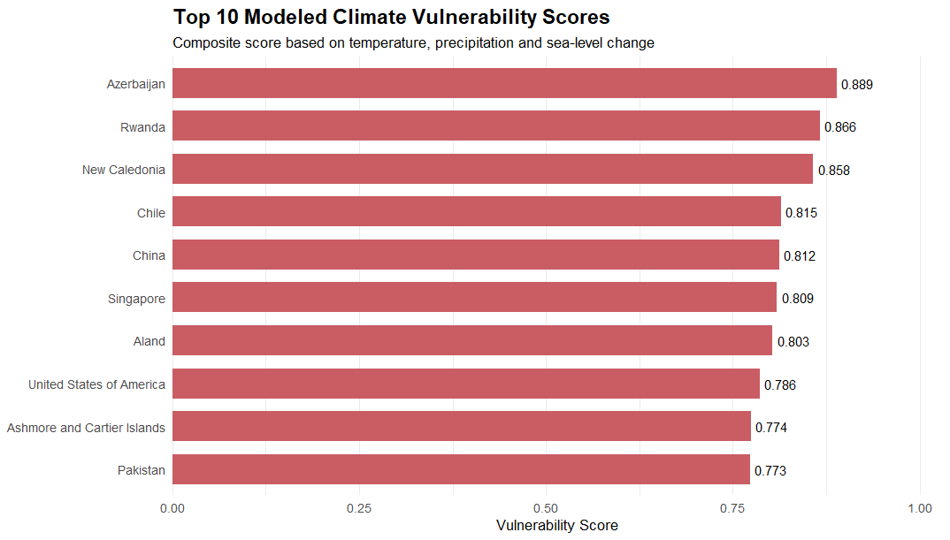
Modeled Climate Vulnerability
• Composite vulnerability combines temperature change,
Absolute precipitation change, and sea-level change.
• Highest modeled vulnerability scores:
Azerbaijan — 0.889
Rwanda — 0.866
New Caledonia — 0.858
• Asia recorded the highest average modeled vulnerability
score among the six analyzed continents.
• Cross-country CO2 relationships with climate-impact indicators were weak in the synthetic dataset.
• Vulnerability scores represent analytical prioritization, not official real-world risk ratings.

Slide 5
Recommendations & Model Limitations
• Prioritize multi-indicator monitoring in areas showing elevated modeled climate pressure.
• Integrate population, infrastructure, socioeconomic exposure, and adaptive capacity in future risk analysis.
• Use authoritative observational climate data before applying the framework to real-world decisions.
• Explore nonlinear and scenario-based forecasting methods for more sophisticated projections.
• Limitation: 2026–2050 projections are linear extensions of synthetic historical trends and are not authoritative climate forecasts.

