Slide 1
Machine Learning Performance Visualization
SkilledScore Data Visualization Internship — Task 5
Usman Ali
Supervisor: Dr. Zeeshan Usmani
Interactive evaluation of five classification models across ten synthetic classification scenarios

Slide 2
Business Problem & Experimental Design
Business Problem
ML model performance can change significantly under class imbalance, label noise, feature complexity,
and class overlap.
Experimental Design
• 10 synthetic binary classification scenarios
• 2,000 observations per task
• 5 classification algorithms
• 75/25 stratified train-test split
• 50 total model–task evaluations
• Metrics: Accuracy, Precision, Recall, F1 Score & ROC-AUC

Slide 3
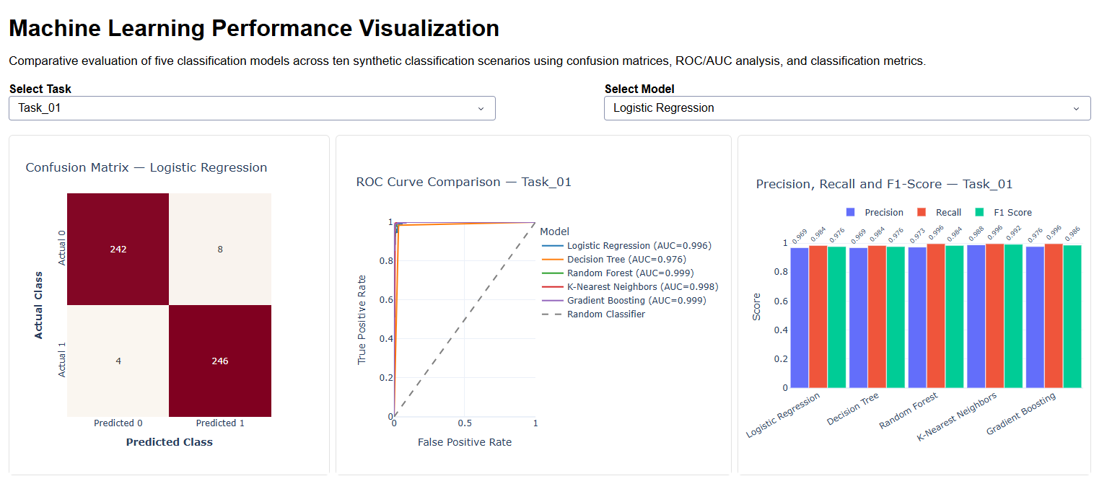
Interactive Performance Dashboard

Slide 4
Key Performance Findings
Random Forest — Strongest Overall Model
• Average F1 Score: 0.922
• Average ROC-AUC: 0.964
• Best-performing model in 6 of 10 tasks
K-Nearest Neighbors — Strongest Alternative
• Average F1 Score: 0.908
• Best-performing model in 4 of 10 tasks
Most Challenging Scenario — Task_10
• Average F1 Score: 0.657
• Average ROC-AUC: 0.803
• Combined class overlap, label noise, imbalance and feature complexity
Takeaway: Ensemble methods provided the strongest overall robustness, while model performance declined substantially under combined synthetic data challenges.

Slide 5
Recommendations & Project Impact
Recommended Next Steps
• Optimize model hyperparameters through systematic tuning
• Apply class weighting or resampling for imbalanced scenarios
• Tune classification thresholds to balance Precision and Recall
• Evaluate feature selection or dimensionality reduction
• Validate performance on real-world datasets before deployment
Project Impact
Built an interactive ML performance evaluation framework covering 50 controlled model–task experiments, translating confusion matrices, ROC/AUC analysis, and classification metrics into decision-ready performance insights.
Python • Scikit-learn • Plotly • Dash

