Slide 1
End-of-Year
Marketing Report
Sinclair Verde Lamp Company
Submited by : Usman Ali

Slide 2
Agenda
1. | The Goal
2. | End-of-Year Overview
3. | Holiday Season Report
4. | Conclusion

Slide 3
The Goal

Slide 4
The Goal
The three primary marketing goals for the Sinclair Verde Lamp Company are:
Create brand awareness
Drive visits to the physical store
Increase online holiday sales by 3%

Slide 5
End-of-Year Overview
This section will give a review of the marketing trends presented in the analytics report.

Slide 6
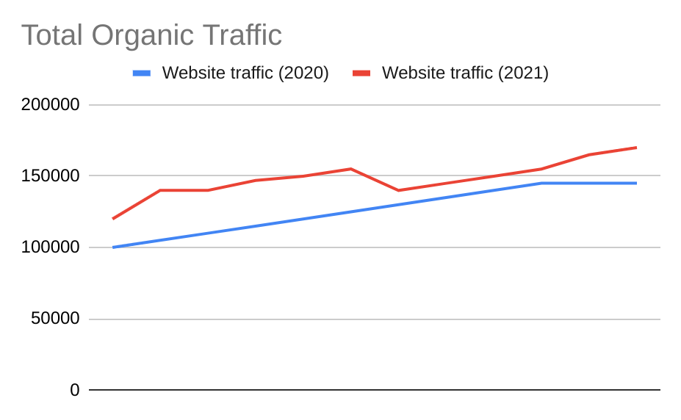
Organic traffic
In 2021, we experienced an overall increase organic traffic to the Sinclair Verde website.
In January, we started with 120,000 organic visits.
We ended December with 170,000 organic visits.
Organic traffic increased by 41.67% from January to December 2021.
Notes:
Chart shows total organic traffic data for 2020 and 2021

Slide 7
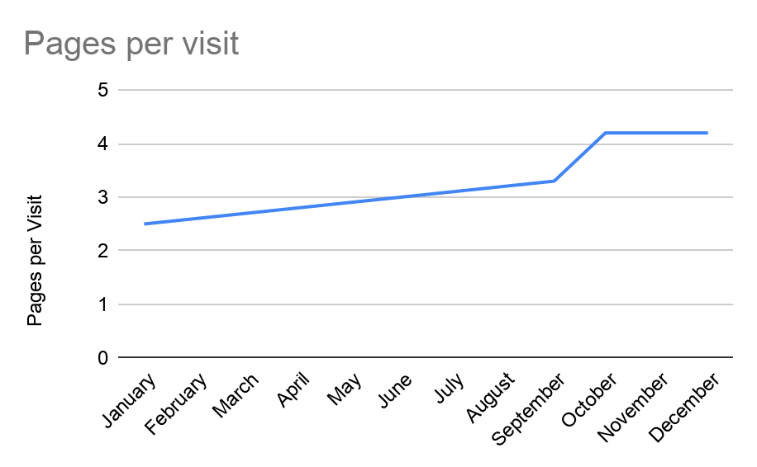
Notes:
Graph displays pages per customer visit rates between January and December

Slide 8
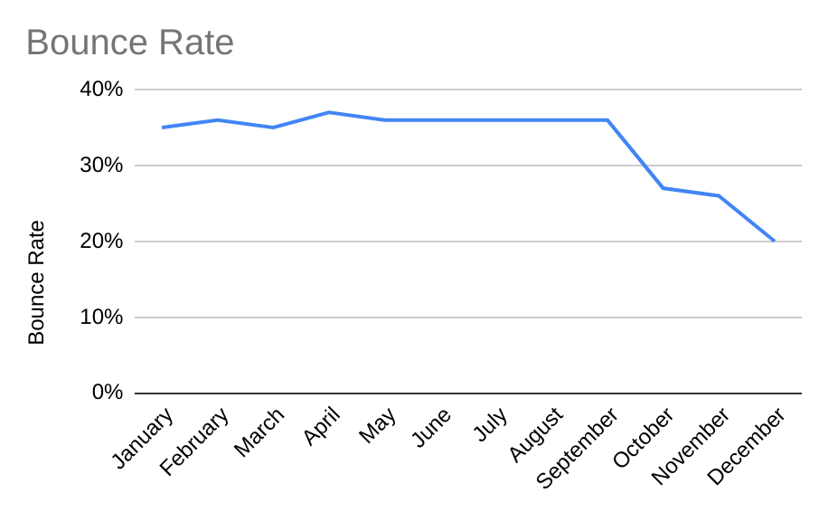
Notes:
Graph shows bounce rate by percentage between January and December

Slide 9
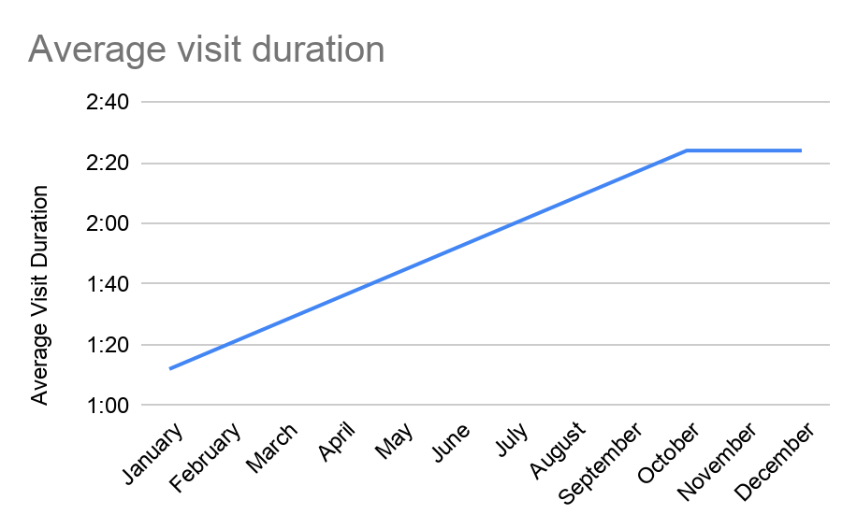
Notes:
Chart shows average visit duration between January and December

Slide 10
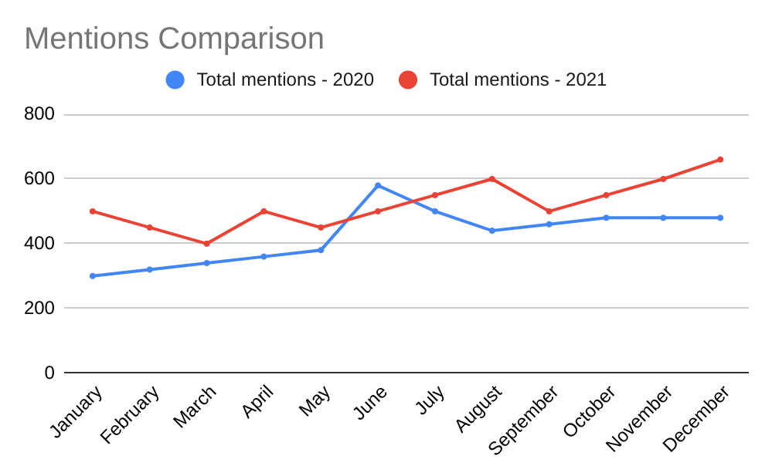
Social media mentions
In January 2021, Sinclair Verde received approximately 500 social media mentions.
By December, mentions had increased to approximately 650, representing a 30% increase.
Notes:
Chart shows social media total mention comparisons between 2020 and 2021

Slide 11
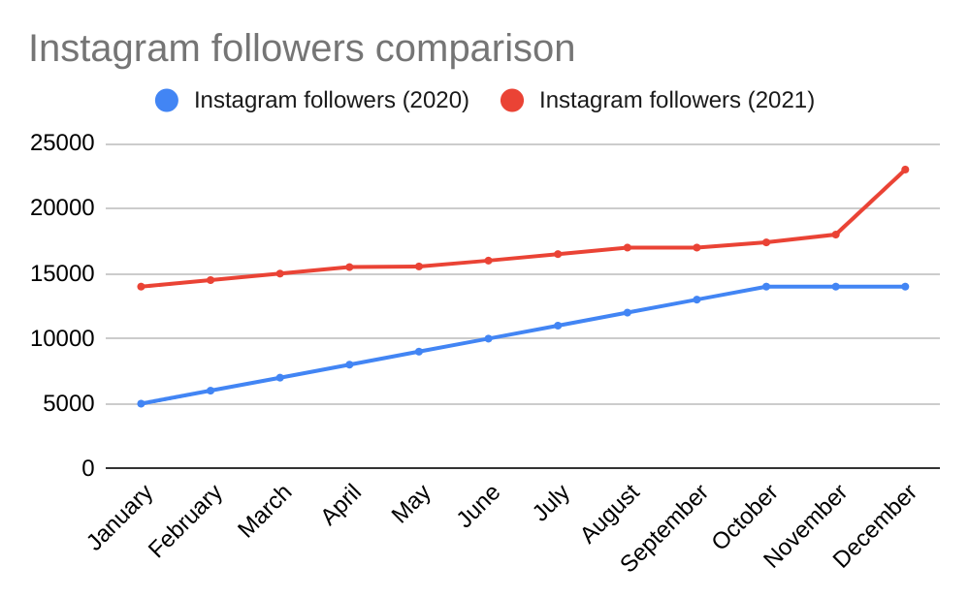
Instagram followers
In 2021, Sinclair Verde's Instagram account gained 9,000 followers, growing from 14,000 in January to 23,000 in December.
This represents a 64.29% increase in followers during 2021.
Notes:
Chart shows total number of Instagram followers for 2020 and 2021

Slide 12
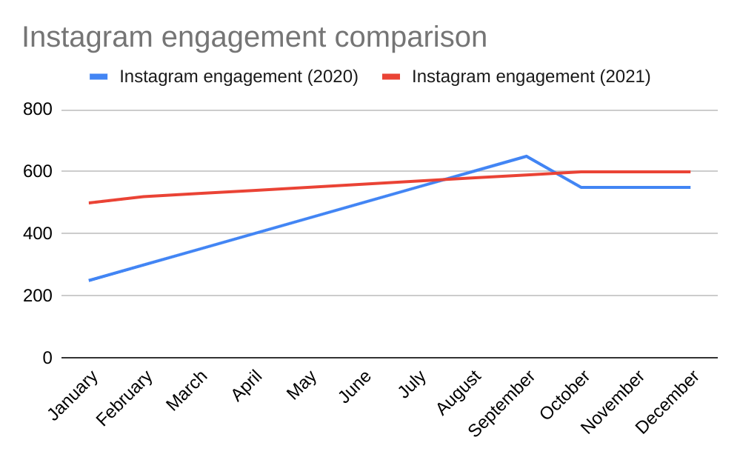
Instagram engagement
In January 2021, Instagram recorded 500 engagements.
By December, engagement increased to 600, representing a 20% increase during 2021.
Compared with December 2020 (550), engagement increased by 50, or 9.09%.
Notes:
Chart shows total number of Instagram engagements for 2020 and 2021

Slide 13
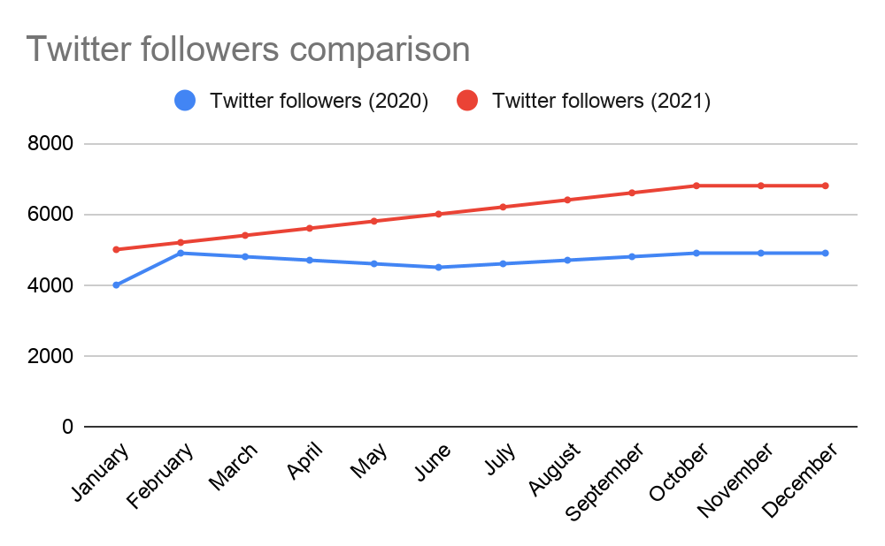
Twitter followers
In January 2021, Sinclair Verde had 5,000 Twitter followers.
By December, the account reached 6,800 followers, gaining 1,800 followers (36%) during 2021.
Compared with December 2020 (4,900), followers increased by 1,900, or 38.78%.
Notes:
Chart shows total number of Twitter followers for 2020 and 2021

Slide 14
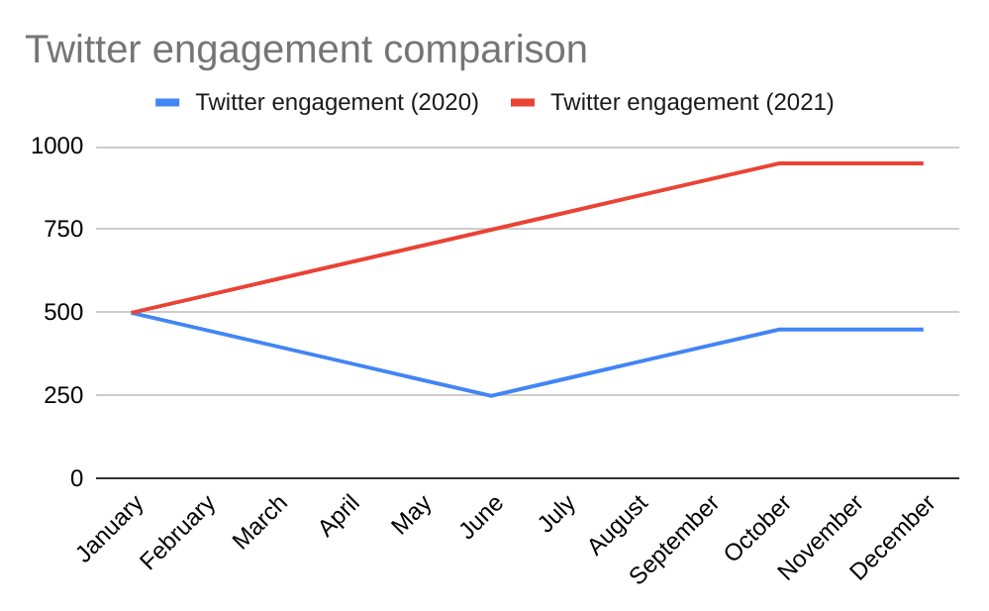
Twitter engagement
In January 2021, Sinclair Verde recorded 500 Twitter engagements.
By December, engagement increased to 950, representing a 90% increase during 2021.
Compared with December 2020 (450), engagement increased by 500, or 111.11%.
Notes:
Chart shows total number of Twitter engagements for 2020 and 2021

Slide 15
Holiday Season Report
This section summarizes the data presented in the analytics report, specifically focusing on the months of November and December.

Slide 16
Organic Performance
 | November (Month 11) | December Month 12 | Net Growth:
2020 Holiday Season | 145,000 | 145,000 | 0%
2021 Holiday Season | 165,000 | 170,000 | +3.03%

Slide 17
Conclusion
In this section, we will summarize the overall success of the campaign and make predictions about the upcoming year.

Slide 18
Conclusion
Sinclair Verde's marketing performance improved throughout 2021, with growth in organic website traffic, social media followers, and engagement. Organic traffic reached 170,000 in December, while Instagram followers increased to 23,000 and Twitter engagement reached 950.
Sinclair Verde is likely to maintain positive digital growth if current trends continue. Good Mercury Marketing recommends prioritizing organic search, engaging social media content, and conversion optimization to sustain growth and improve customer acquisition.This outlook is supported by the 41.67% increase in organic traffic and the strong growth in social media engagement during 2021.

