Slide 1
Economic Inequality Analysis
Comparative Visualization of Income & Wealth
Education • Employment • Regional Inequality
D3.js | Observable
Usman Ali
SkilledScore Data Visualization Internship
Supervisor: Dr. Zeeshan Usmani

Slide 2
Dataset & Analytical Approach
DATASET
• 1,000 synthetic records
• 5 geographic regions
• Education
• Employment
• Income & Wealth
• Income Bracket
DATA PREPARATION
• Income & wealth normalization
• Categorical encoding
• Data validation
• Preprocessing
ANALYTICAL APPROACH
• Distribution analysis
• Sankey flow
• Parallel coordinates
• Regional Gini coefficient
• Interactive filtering

Slide 3
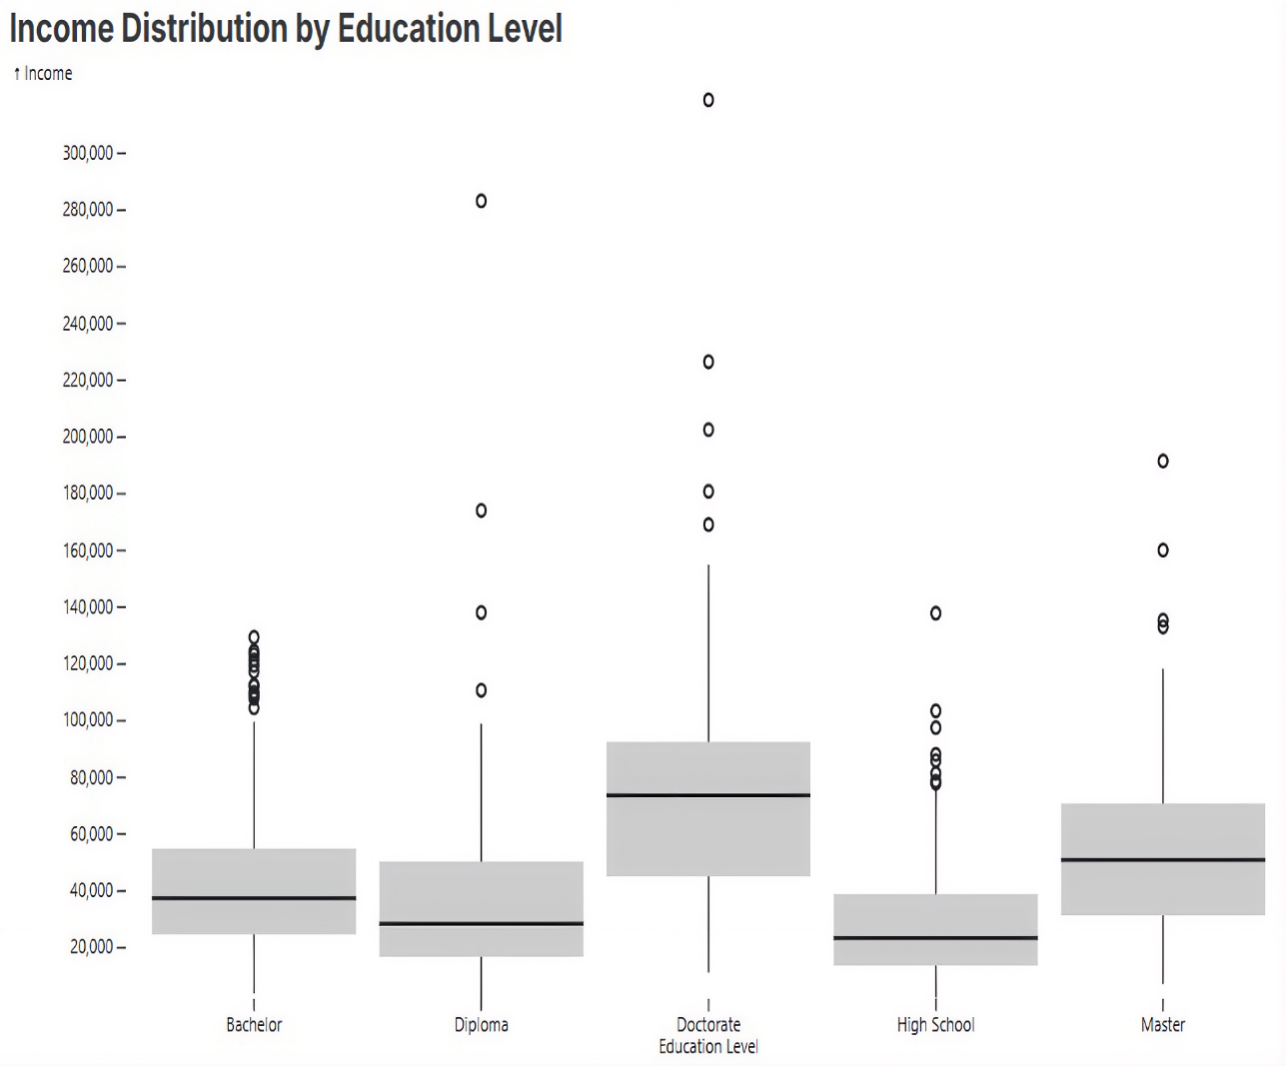
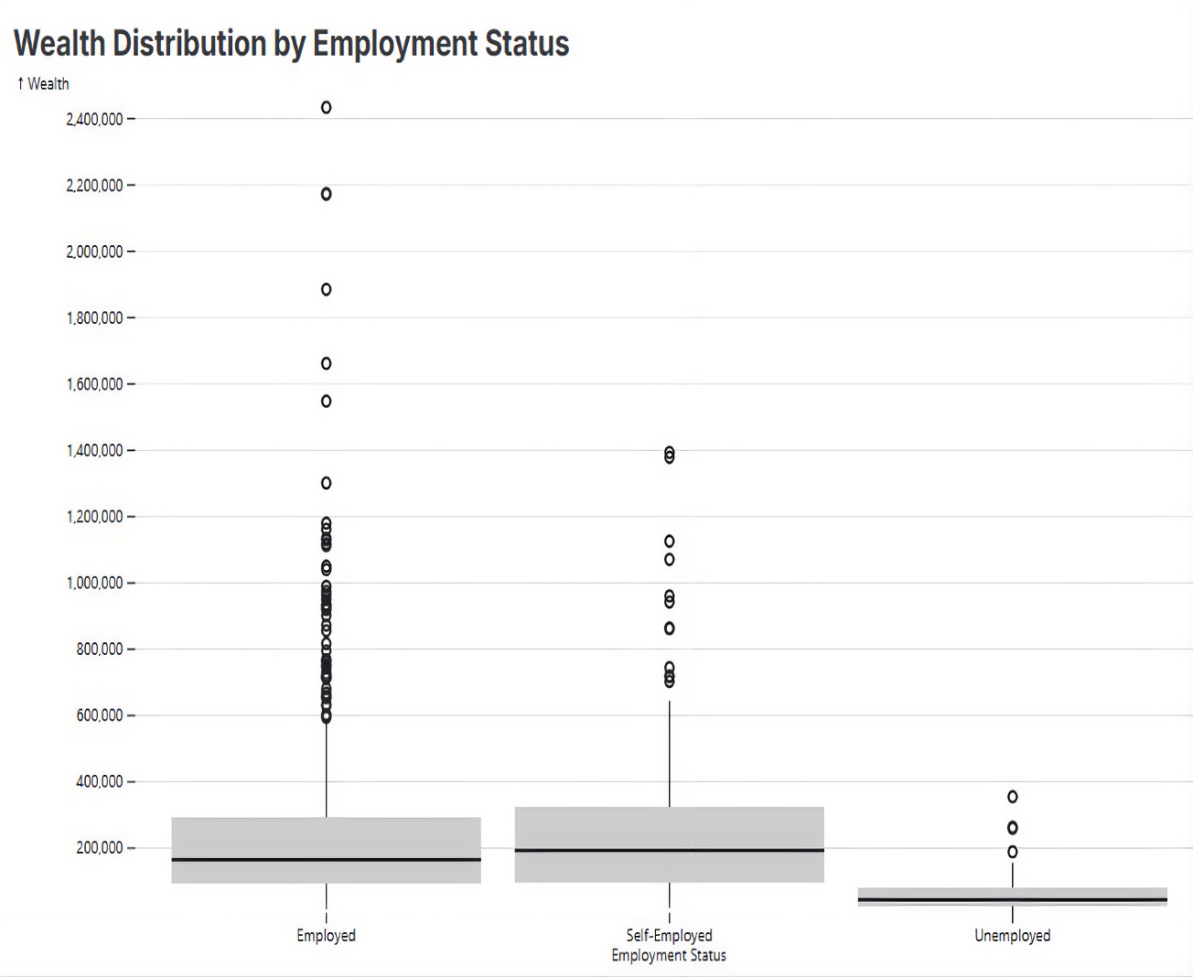
Economic Disparities in Income & Wealth
Key insight: Higher education is associated with higher income, while unemployment is associated with substantially lower wealth. Both distributions contain significant high-value outliers.

Slide 4
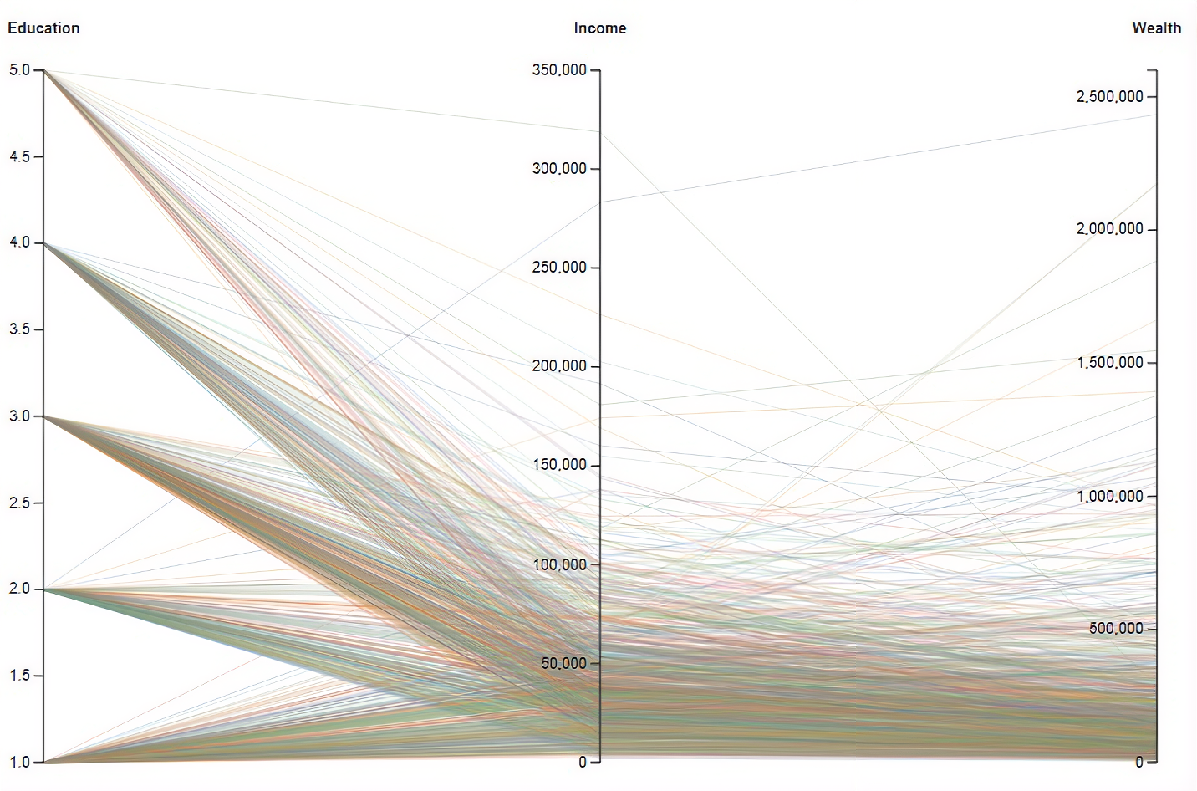
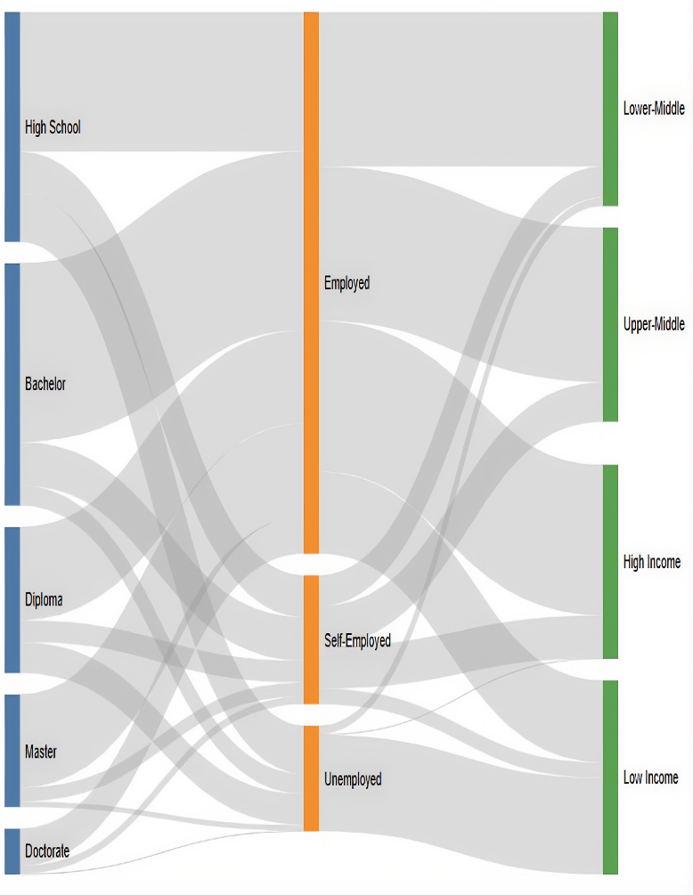
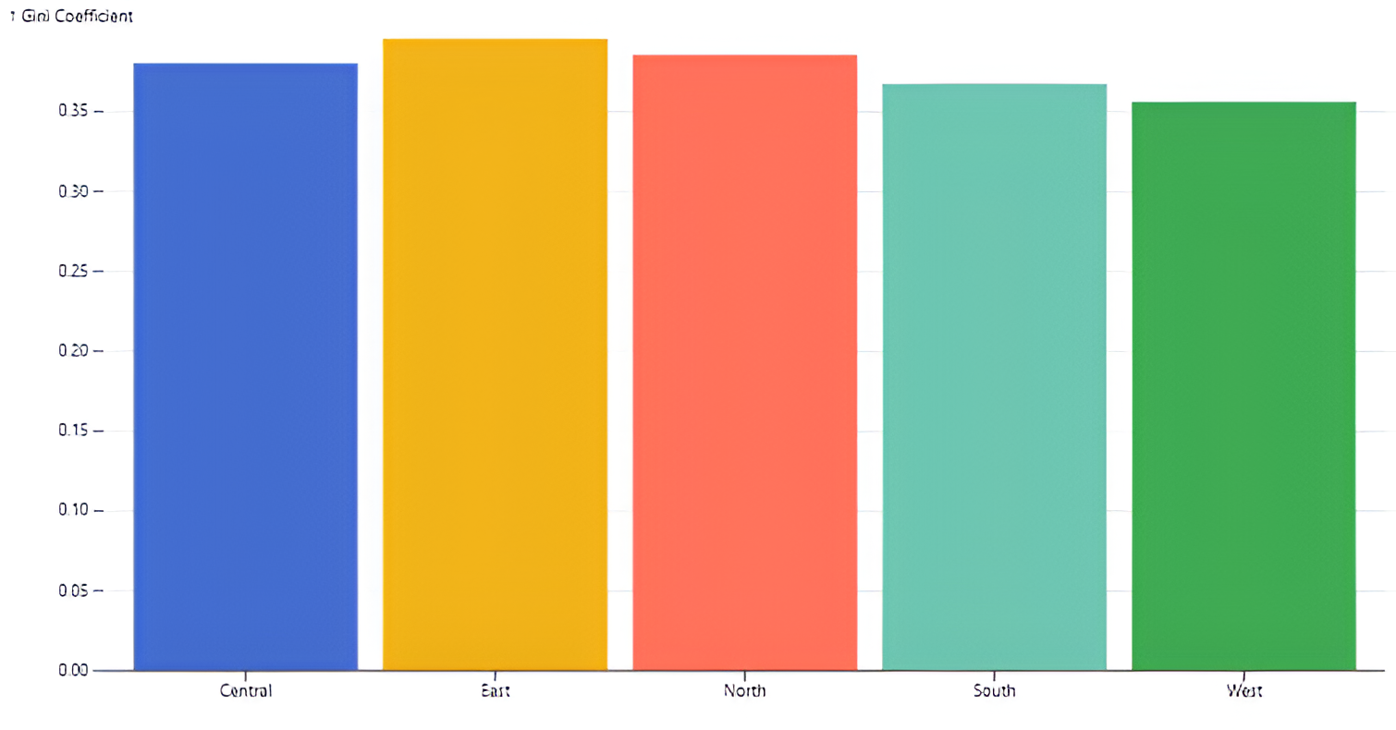
Advanced Comparative Analysis
Key insight: Education and employment pathways lead to distinct income outcomes, while regional Gini coefficients reveal moderate differences in inequality, with East showing the highest inequality in the synthetic dataset.

Slide 5
Key Findings & Recommendations
KEY FINDINGS
• Higher education is associated with higher income and wealth.
• Unemployment is associated with substantially weaker economic outcomes.
• Income and wealth are positively related.
•Regional inequality varies moderately, while education-related income outcomes also differ across regions.
• Wealth contains substantial high-value outliers.
POTENTIAL INTERVENTIONS
• Expand education subsidies and scholarships.
• Strengthen vocational training and job-placement programs.
• Target workforce support toward higher-inequality regions.
• Improve financial literacy and wealth-building opportunities.
Conclusion: Education, employment, and regional factors are associated with meaningful differences in economic outcomes. Combining Sankey flows, parallel coordinates, Gini coefficients, and interactive analysis provides multiple perspectives on these disparities.
Note: Results are based on synthetic data and should not be interpreted as real-world population estimates.

