Slide 1
Social Media Sentiment Network Analysis
SkilledScore — Data Visualization Internship
Supervisor: Dr. Zeeshan Usmani
Intern: Usman Ali

Slide 2
Dataset & Methodology
Synthetic Dataset
• 5,000 users
• 20,000 interactions: posts, retweets, and replies
• Features: User ID, Post ID, Timestamp, Sentiment Score, Interaction Type, and Hashtags
Methodology
• VADER sentiment analysis with scores ranging from -1 to +1
• Duplicate removal and low-activity user filtering
• Directed interaction network constructed using NetworkX
• Degree centrality used to measure user influence
• Louvain algorithm used for community detection
• Force-directed layout used for network visualization

Slide 3
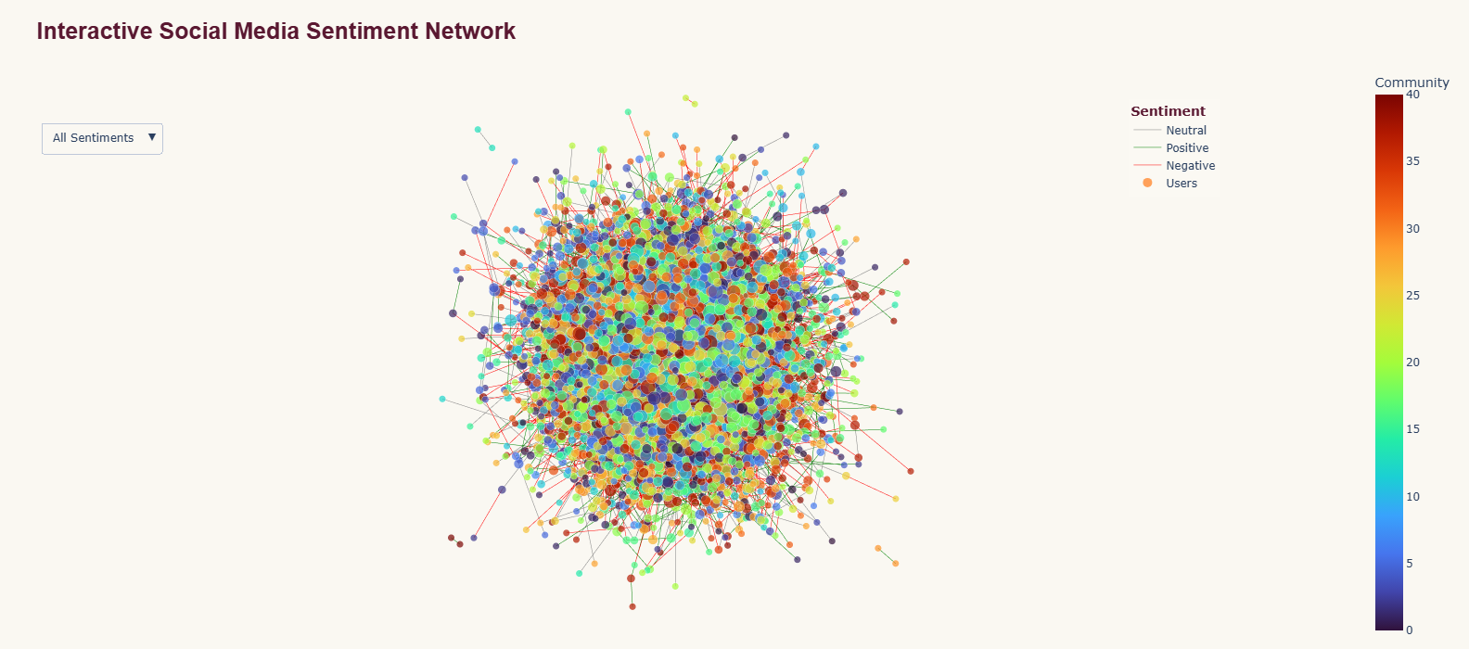
Interactive Social Media Sentiment Network

Slide 4
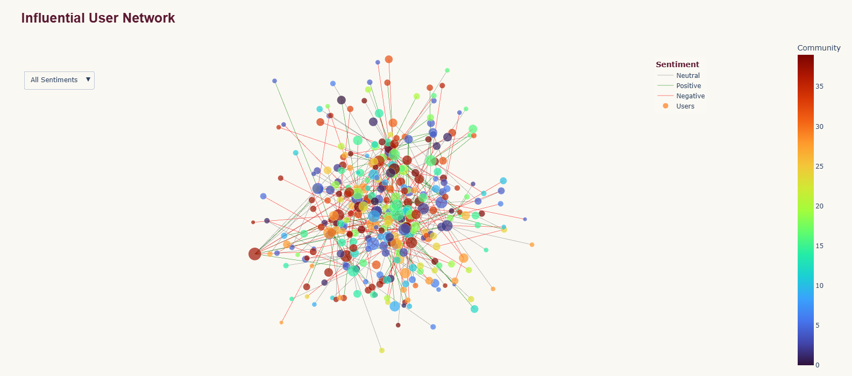
Influential Users & Sentiment Insights

Slide 5
Key Findings & Moderation Implications
Key Findings
• Sentiment distribution: 37.12% neutral, 33.48% negative, and 29.40% positive.
• Degree centrality identified influential users with differing sentiment patterns.
• Louvain analysis identified 41 communities in the final reproducible run.
• Dominant hashtag concentration reached only 13.86% among meaningful communities.
• Larger communities showed mixed sentiment and limited evidence of strong hashtag-driven echo chambers.
Moderation Implications
• Prioritize high-influence users and interaction-level patterns for monitoring.
• Use sentiment as a screening signal rather than treating negative sentiment as a policy violation.
• Community and hashtag membership should provide context rather than determine moderation decisions.
Note: All results are based on synthetic data.

