Slide 1
Saudi Aramco MS&AMD (Medical Services & Affiliation Management Department ) and BUPA Arabia Automated Communication System

Slide 2
User Roles
Aramco Users:
MSMD User (New)
Aramco personnel Account (New)
Bupa Users:
PreAuth (New)
Medical Team
Admin
MCU Team
CREATEREF
AramcoAcountKey
AmendRef

Slide 3
Appeal Workflow
New Appeal
MSMD section + assignments
Bupa Arabia Section
MRO workflow (Part 1 & Part 2)
MRO generation by MSMD
Badge History
Appeal Response History
Discussion list module
Notification

Slide 4
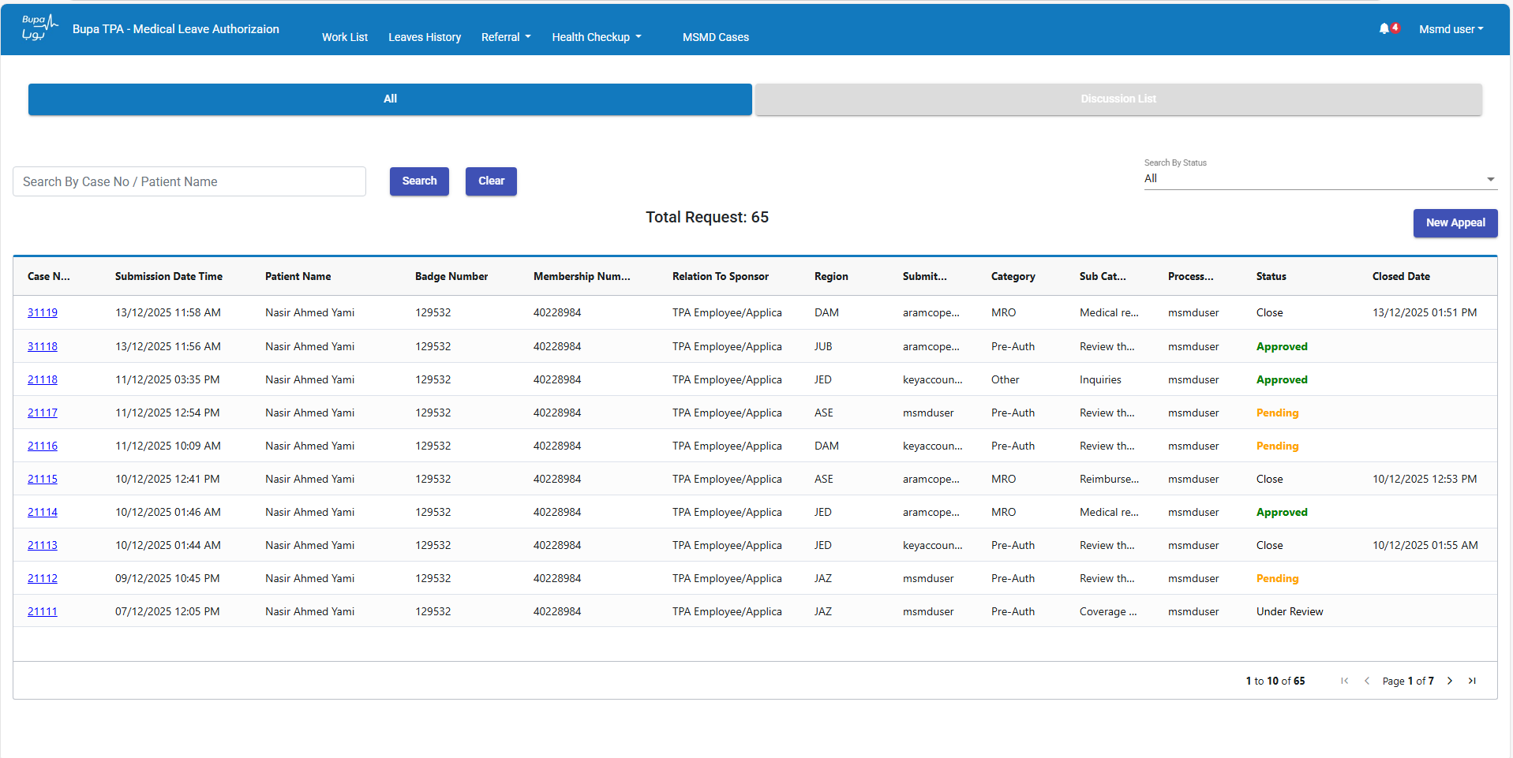
Landing Page
MSMD

Slide 5
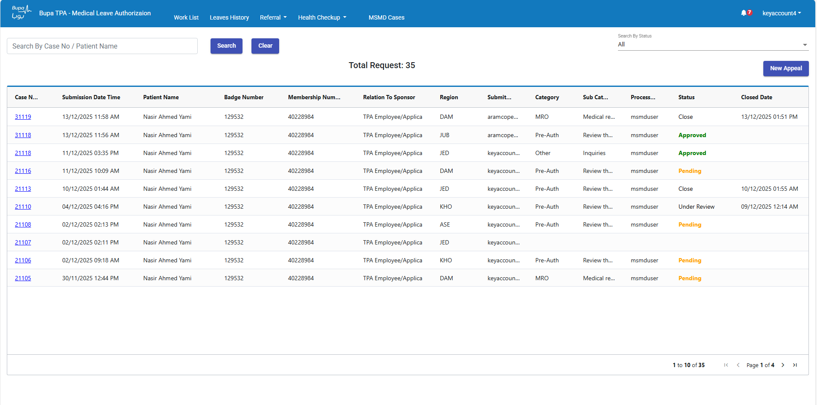
Landing Page
OTHER USER

Slide 6
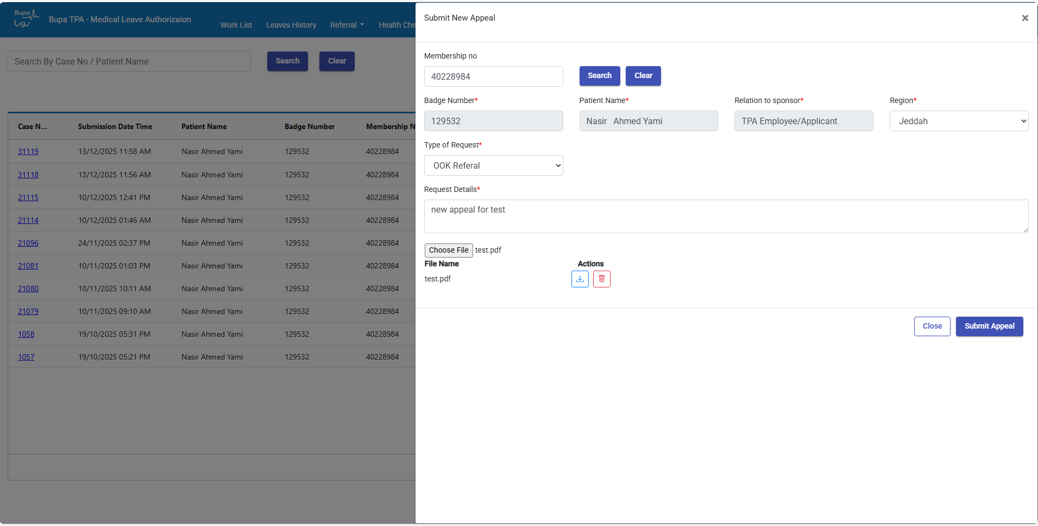
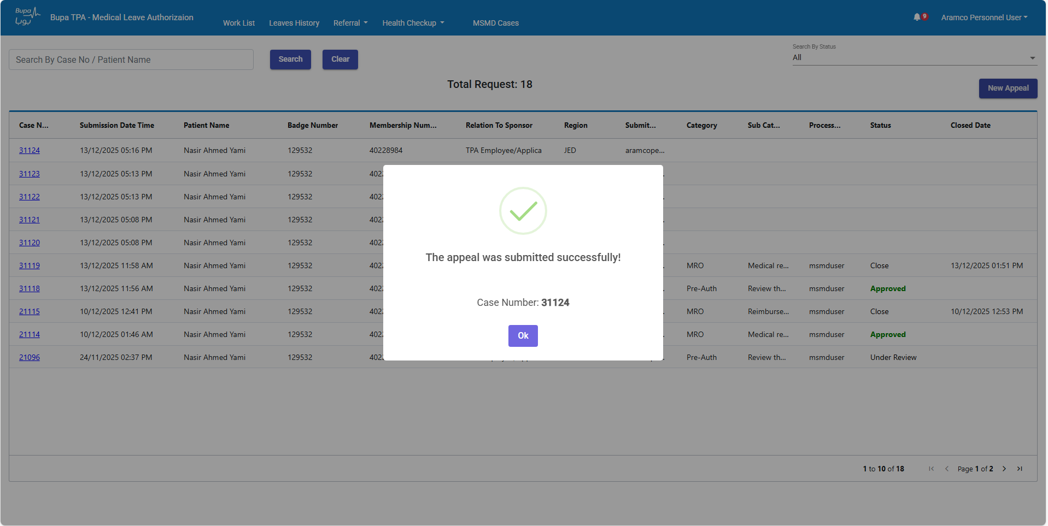
Flow 1 – Step 1: Appeal Created
Created by Bupa Key Account or Aramco Personal Key Account

Slide 7
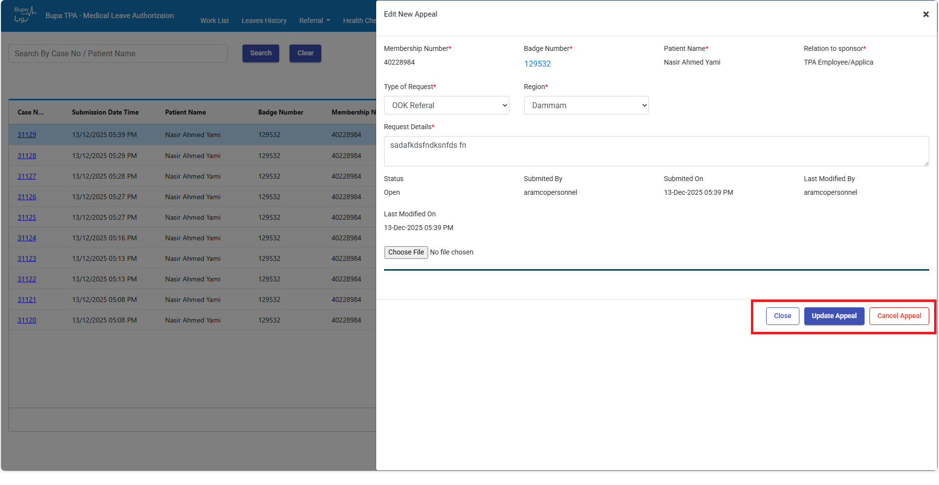
Flow 1 – Step 2: Appeal Edit/Cancel

Slide 8
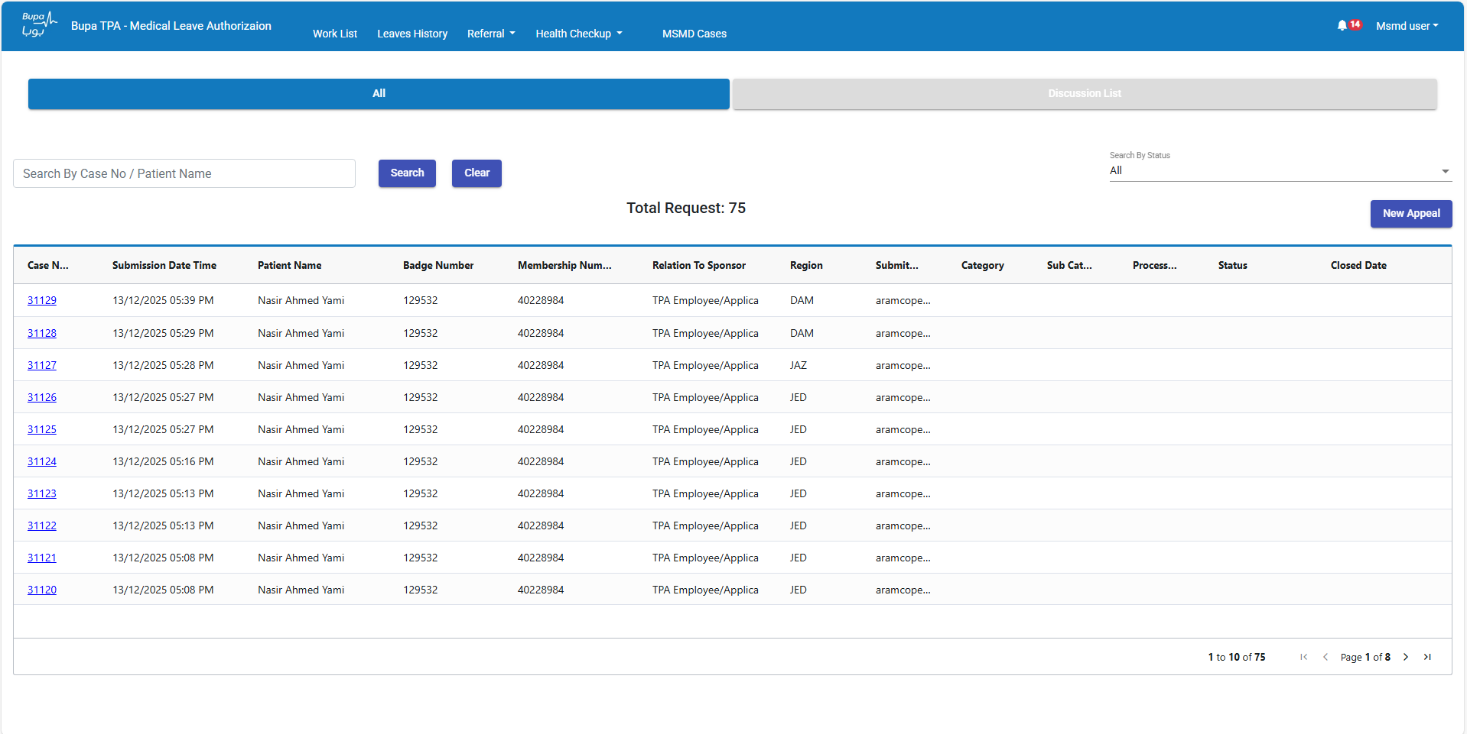
Flow 1 – Step 3: MSMD Login View
MSMD can see created appeals

Slide 9
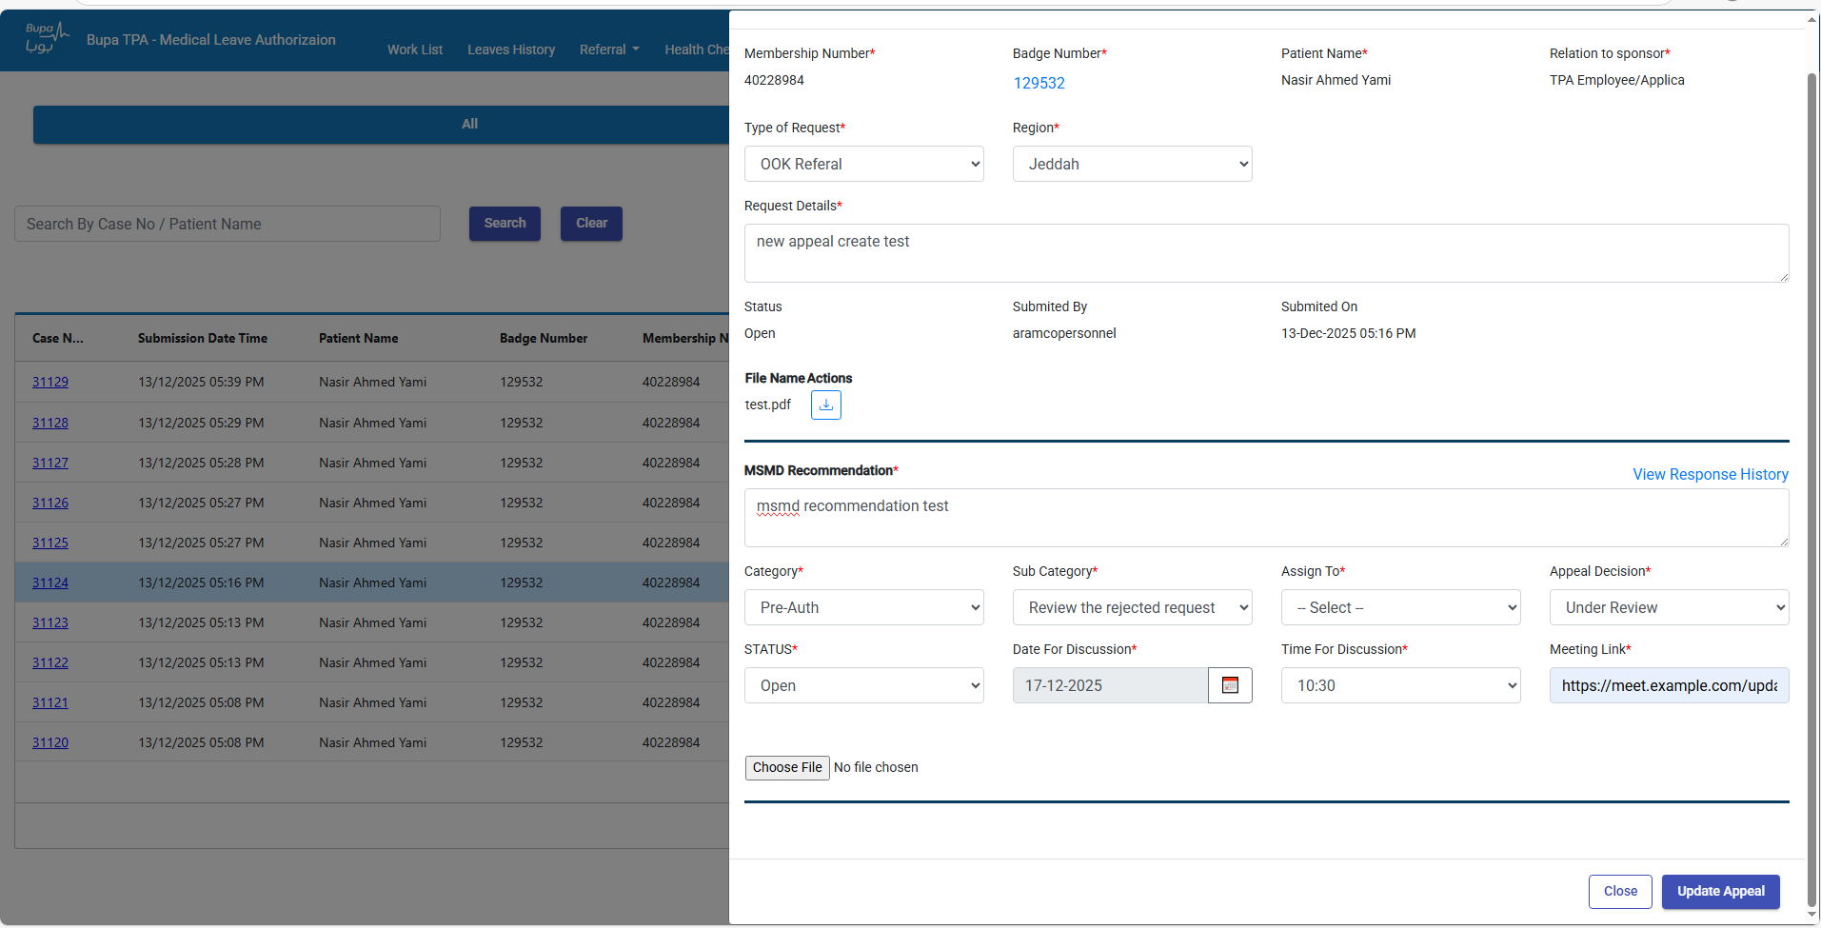
Flow 1 – Step 4: MSMD Edit Mode
Appeal opens in edit modal with MSMD section
MSMD assigns case to Bupa team

Slide 10
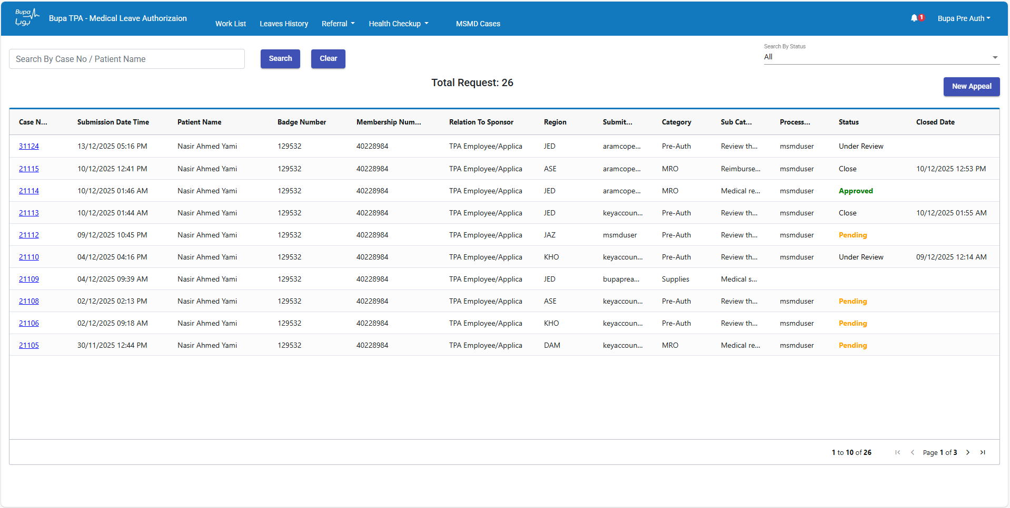
Flow 1 – Step 5: Bupa Team View
Assigned case appears to Bupa users

Slide 11
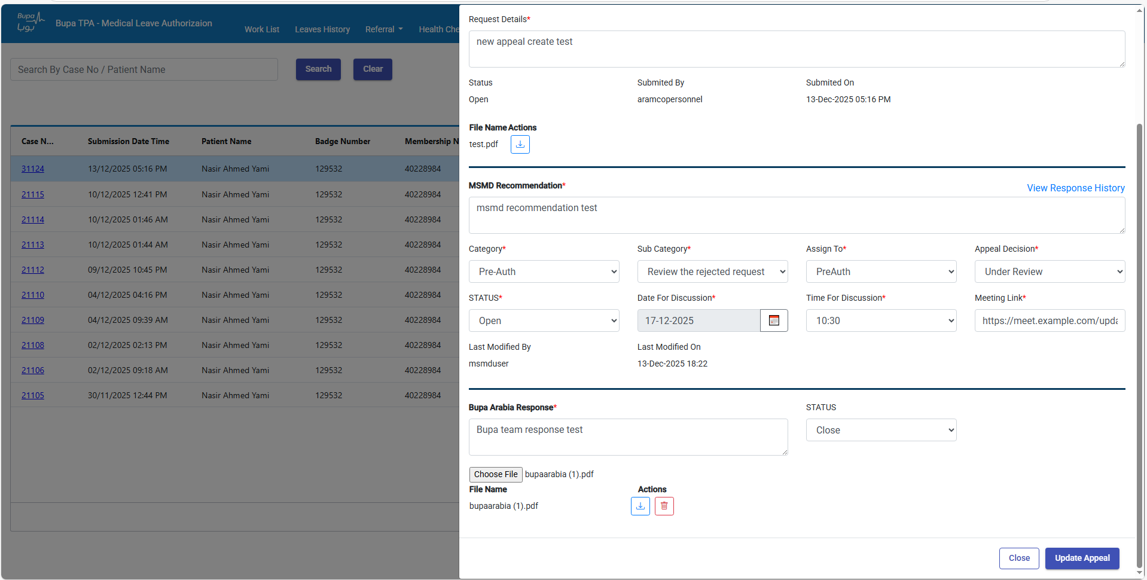
Flow 1 – Step 6: Bupa Response
Bupa Team submits response

Slide 12
Flow 2 – MRO Form
MRO Process: MRO Category → Part 1 by MSMD→ Assign to Bupa Team → Part 2 by Bupa Team→ Final MRO Generation By MSMD

Slide 13
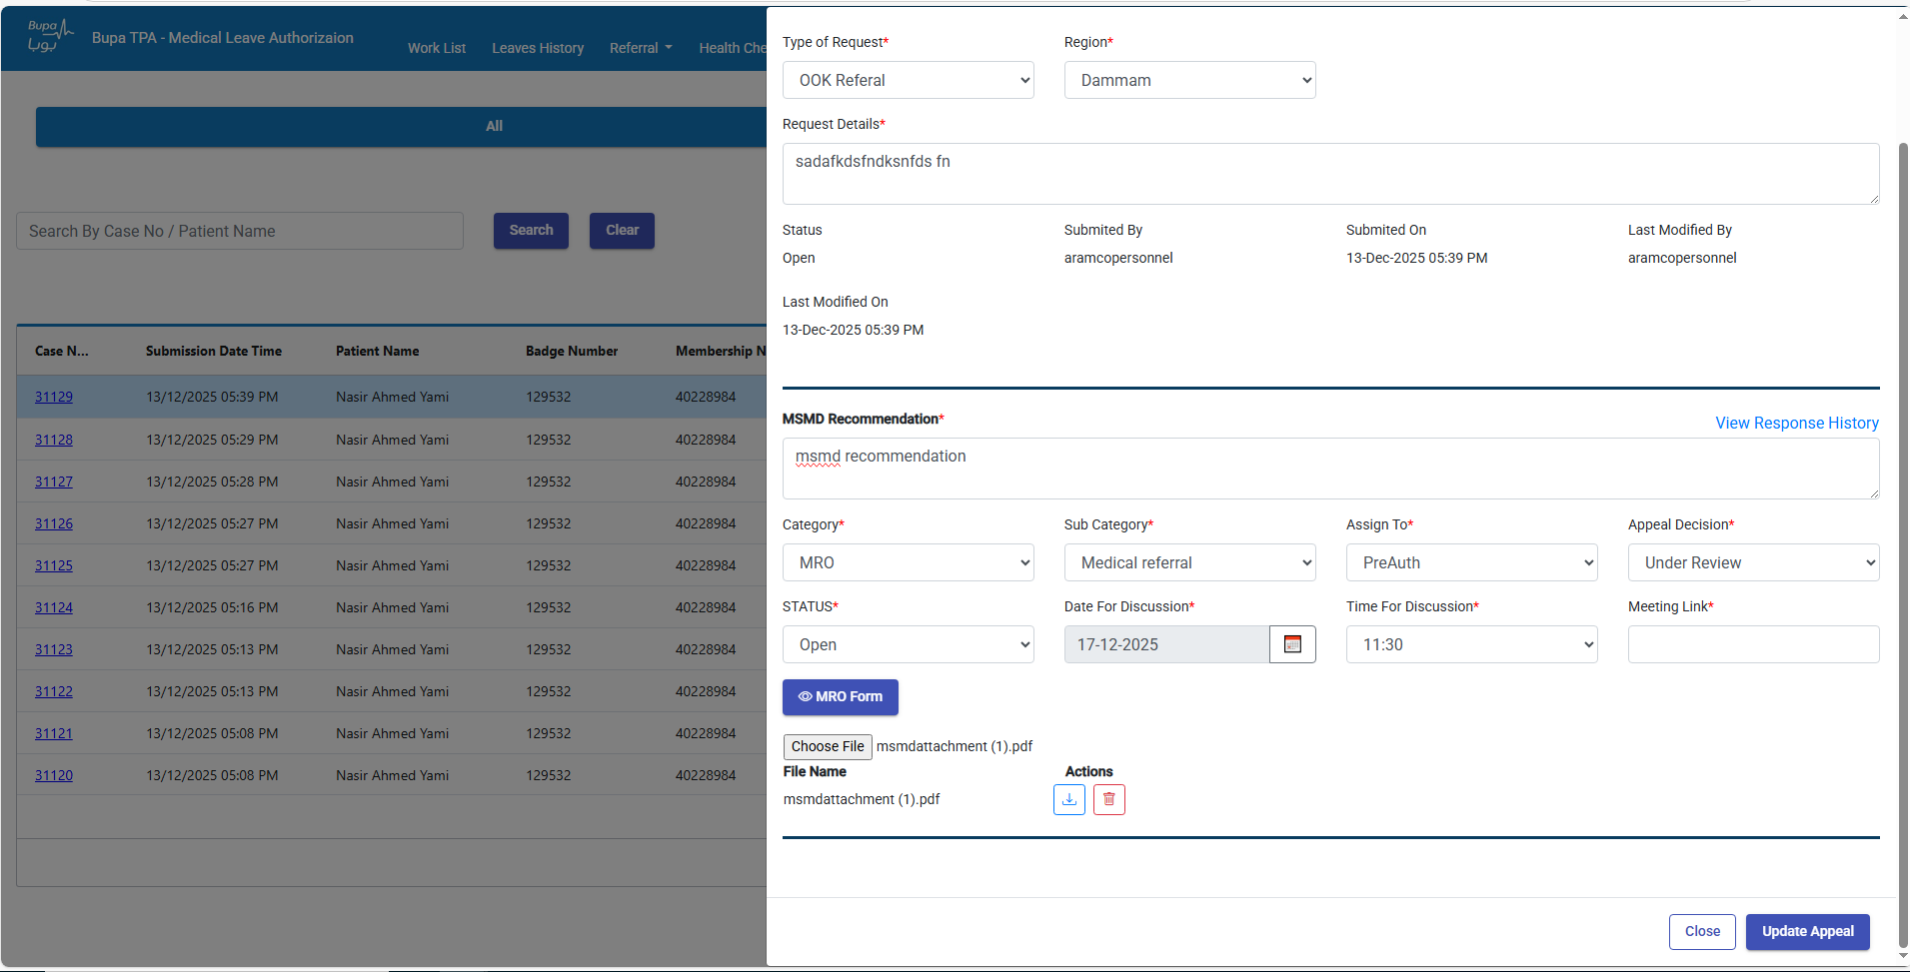
Flow 2 – Step 1: Select MRO Category
MRO button appears when MRO category selected

Slide 14
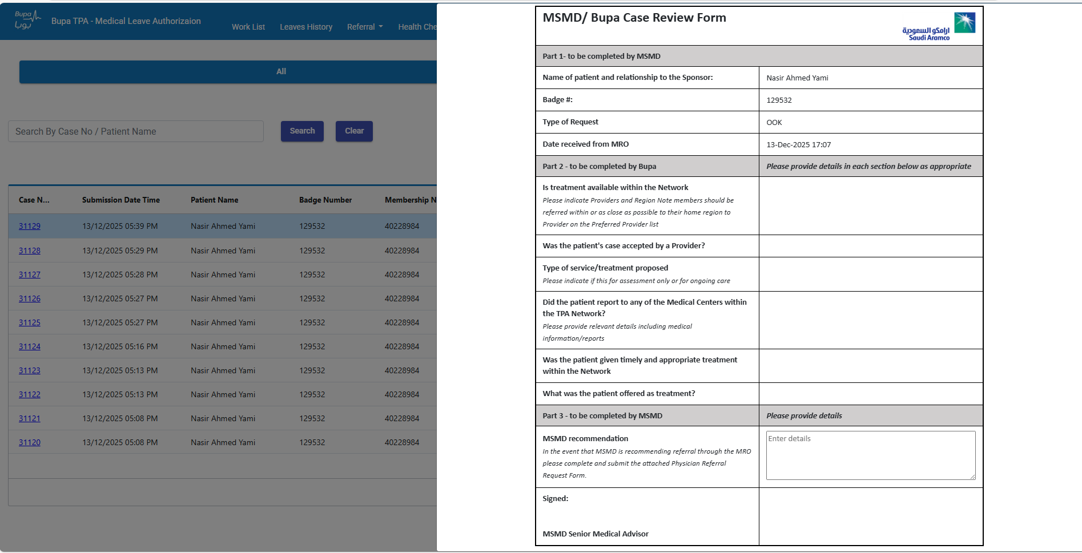
Flow 2 – Step 2: MRO Form Part 1
Form prefilled based on appeal
MSMD Assigns to Bupa

Slide 15
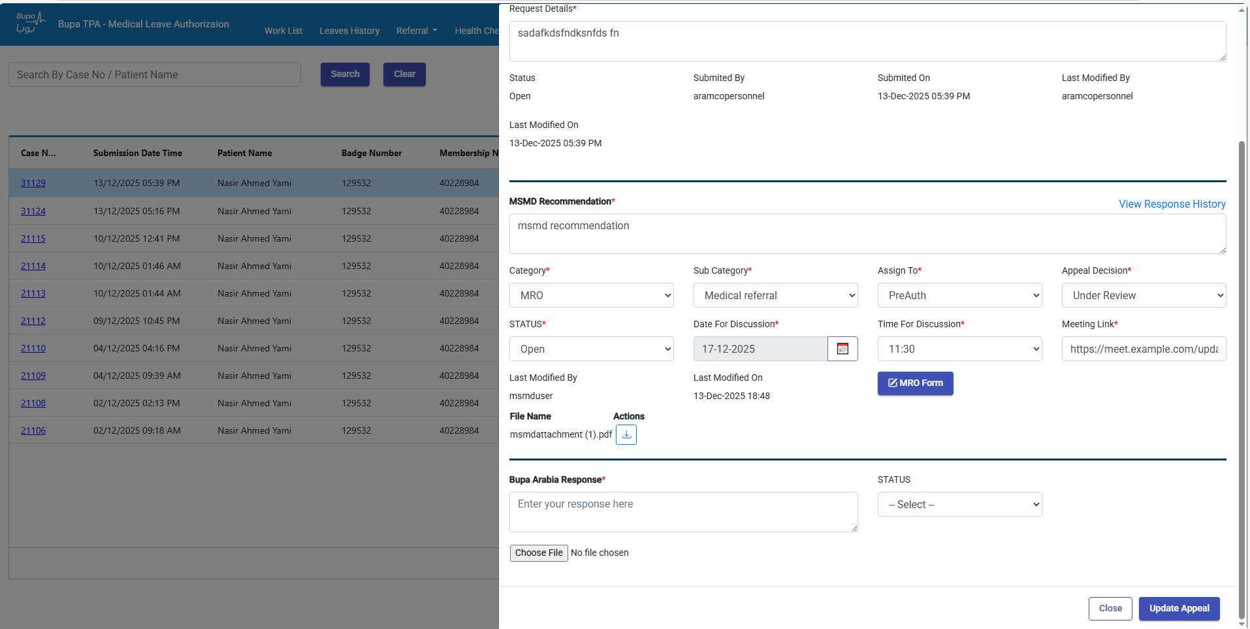
Flow 2 – Step 3: Bupa Team Opens MRO Case
MRO button visible to Bupa

Slide 16
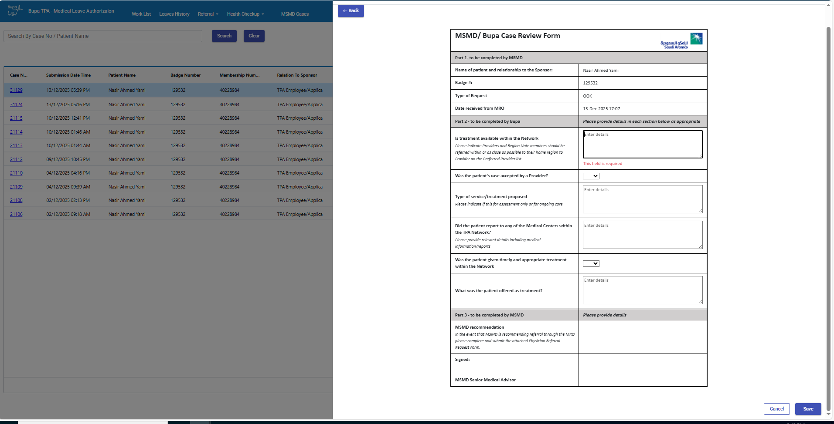
Flow 2 – Step 4: Bupa Team Updates Part 2
Bupa Team completes Part 2 section

Slide 17
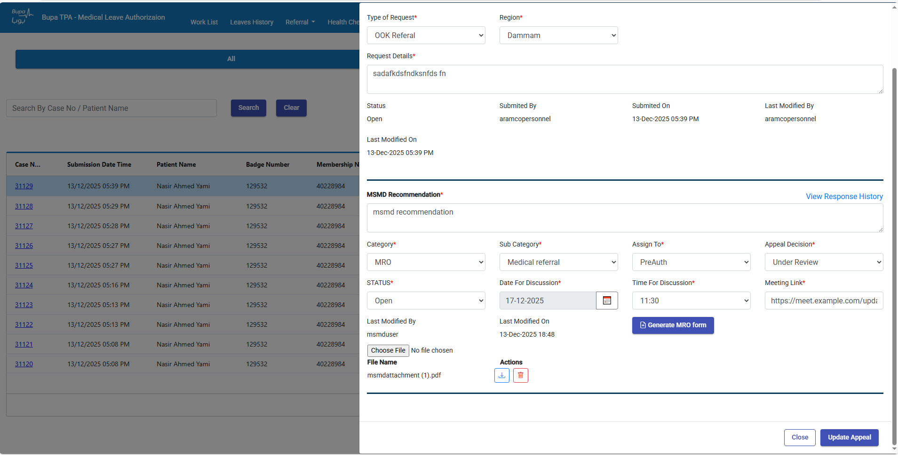
Flow 2 – Step 5: MSMD Generates MRO Form Button
MSMD can see generate MRO Form button

Slide 18
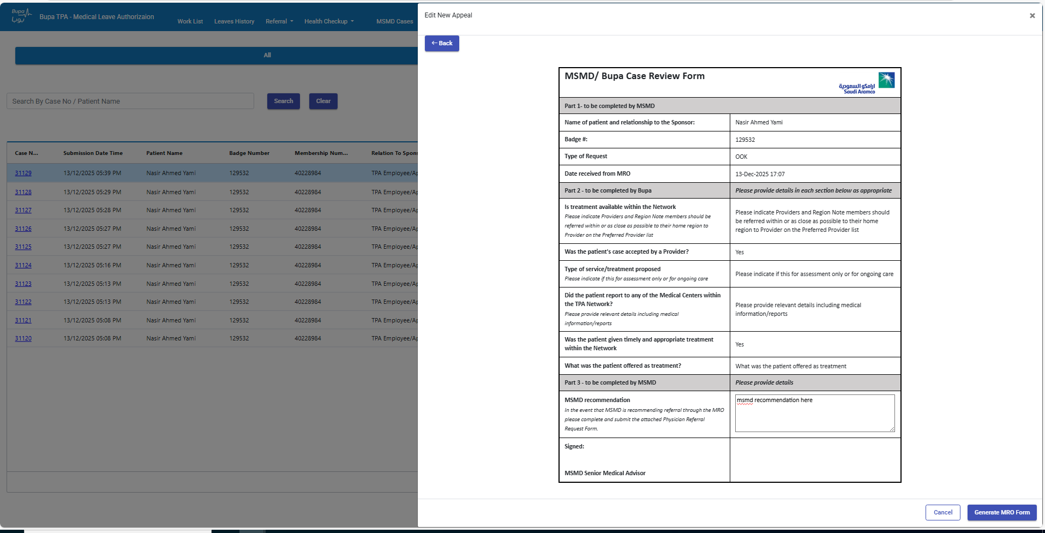
Flow 2 – Step 6: MSMD Generates MRO
MSMD enters recommendation & generates PDF

Slide 19
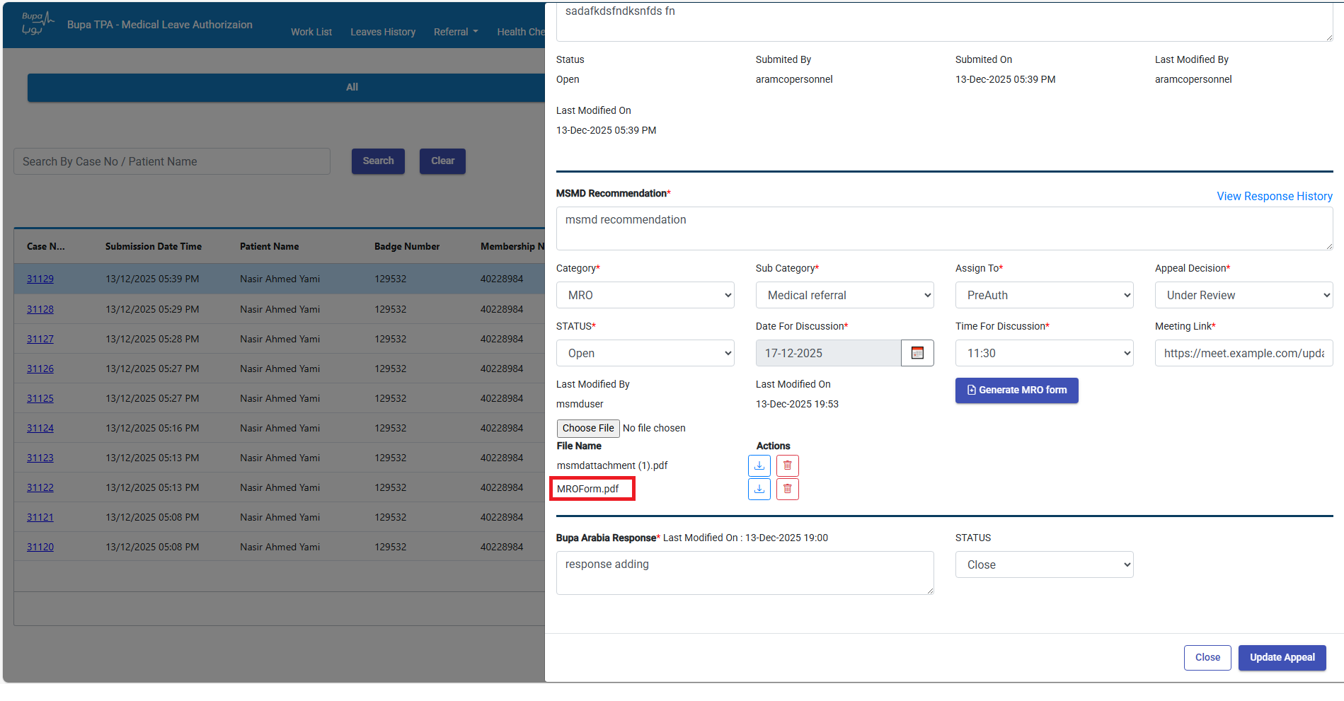
Flow 2 – Step 7: Attachment Generated
Final MRO form is attached automatically

Slide 20
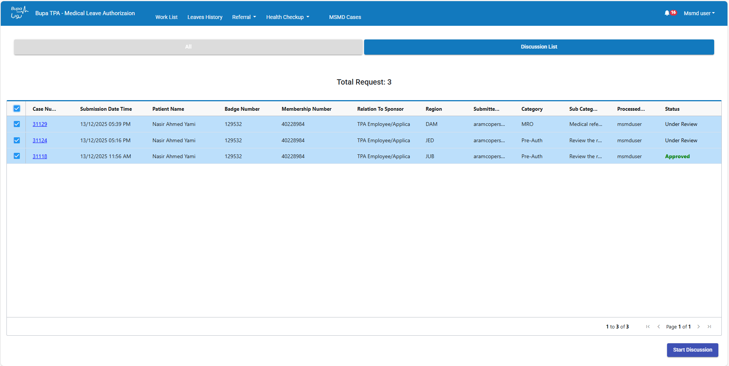
Discussion Module – Step 1
MSMD sets discussion date on assigned cases
Cases appear under Discussion List on matching date
MSMD selects multiple cases for bulk discussion

Slide 21
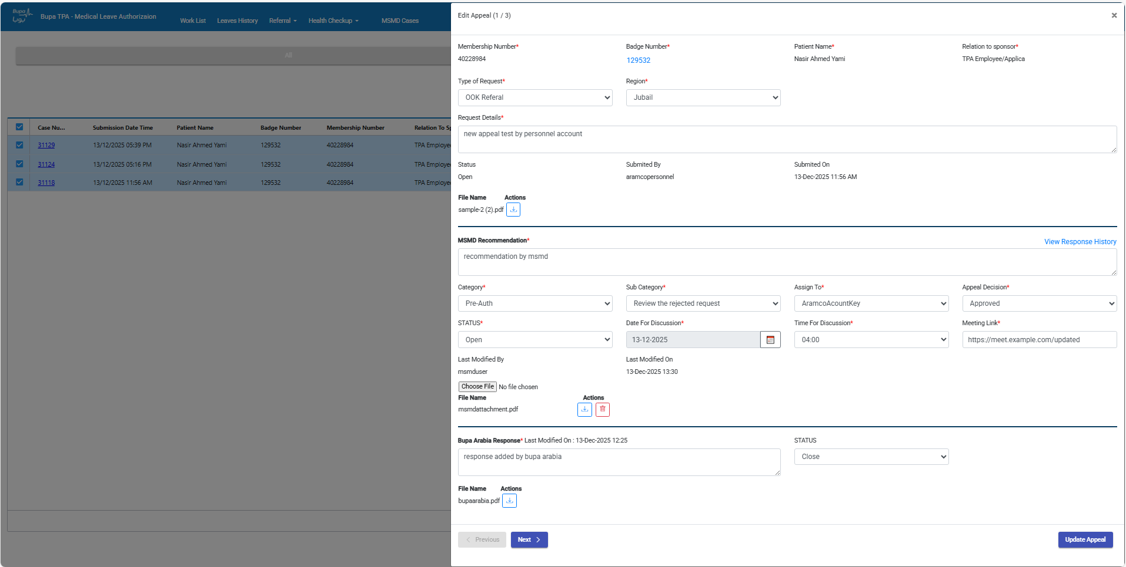
Discussion Module – Step 2
Pop-up with Next/Previous navigation

Slide 22
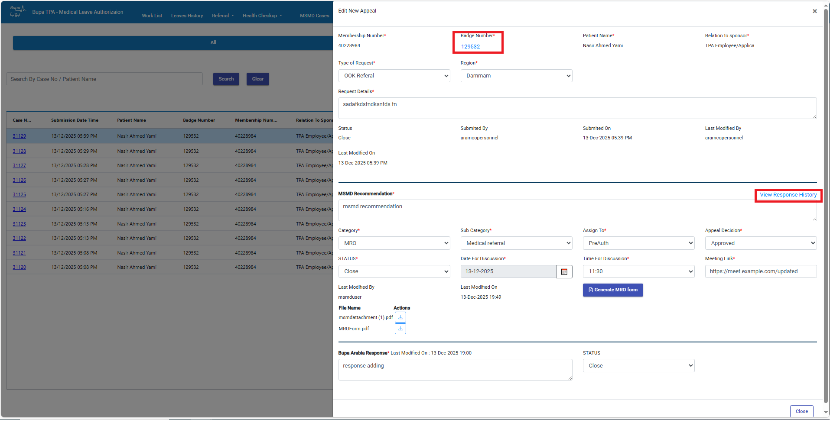
Badge History/Appeal Response History
User can see Badge Number History & Appeal Response History

Slide 23
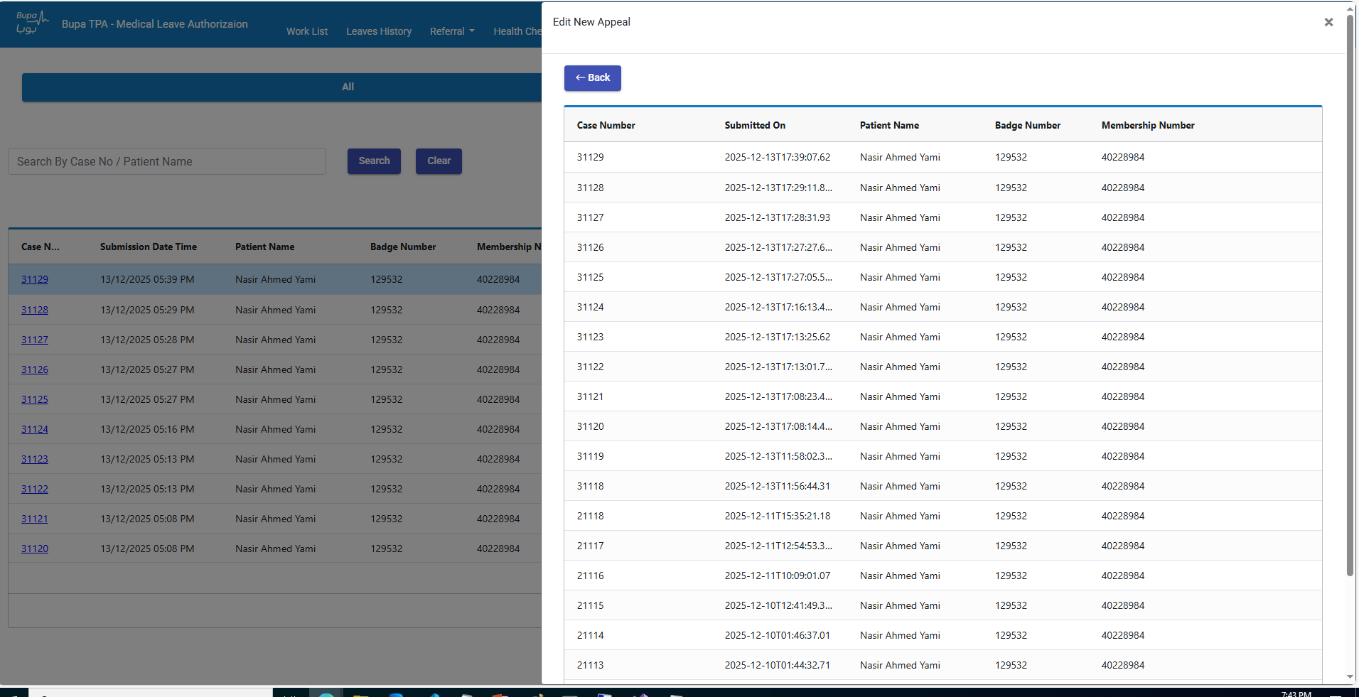
Badge History
User can see Badge Number History

Slide 24
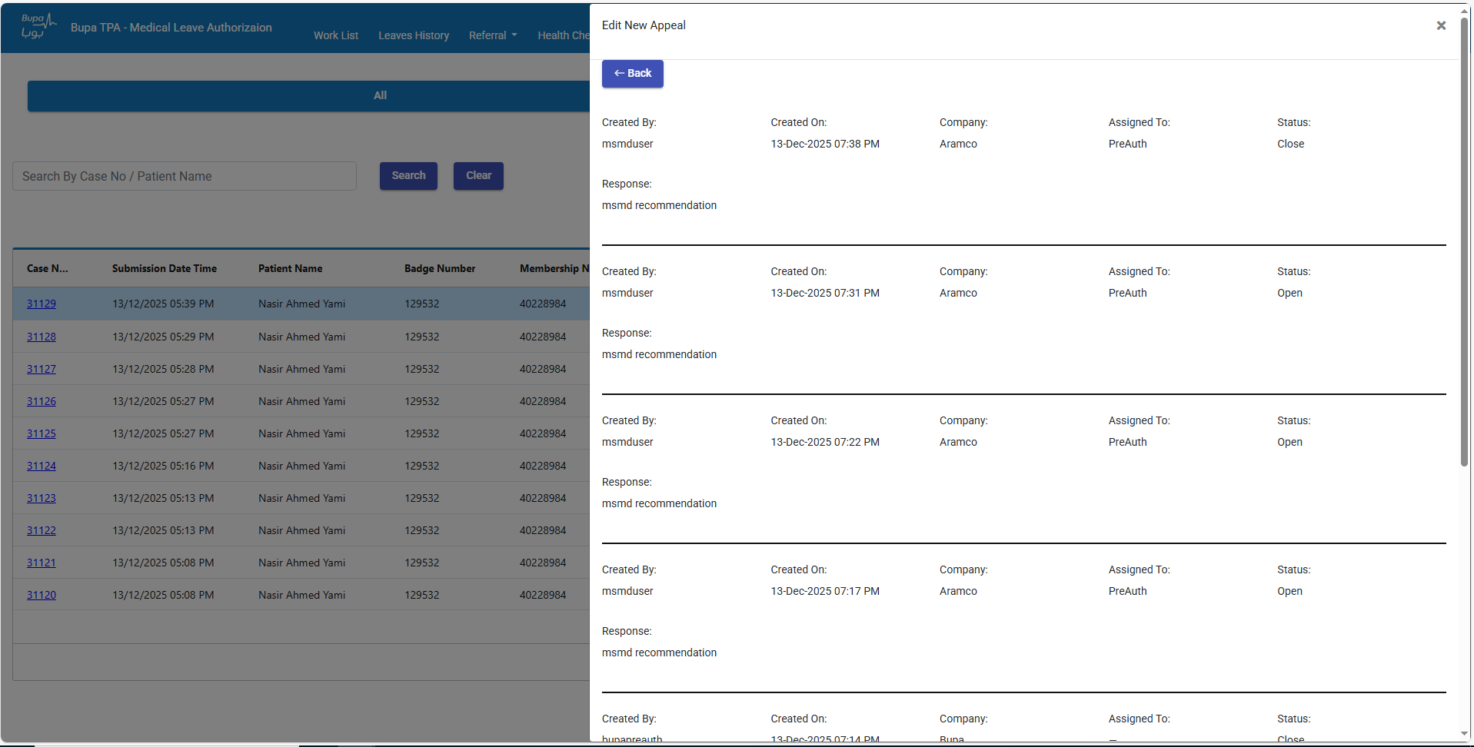
Appeal Response History
User can see appeal Response History for each case

Slide 25
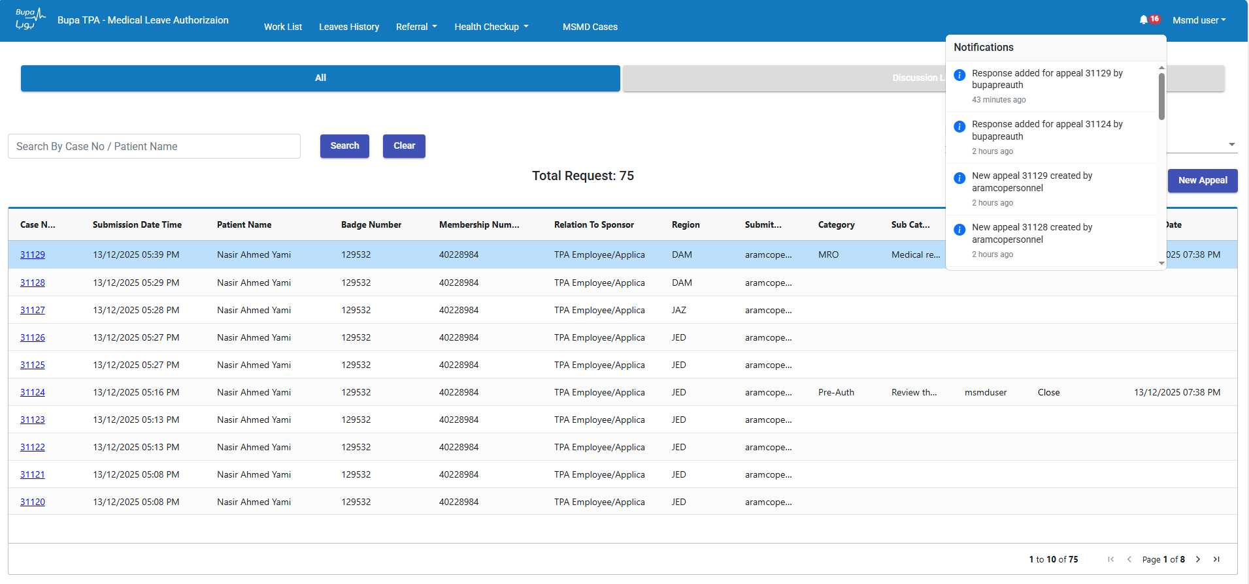
Notification Icon

Slide 26
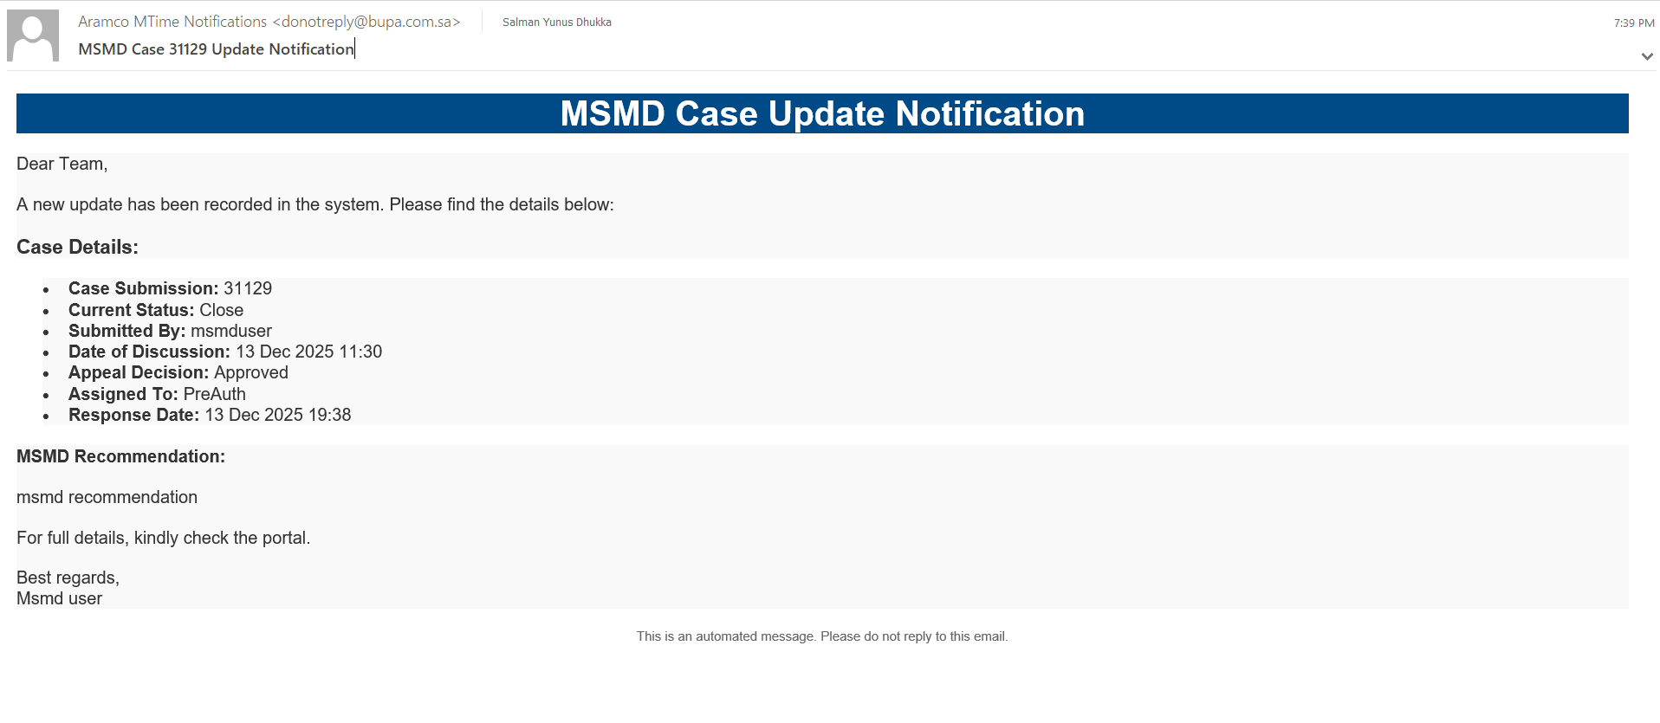
Email Notification

Slide 27
Thank You

