Slide 1

Title: 4 bit Password Security System

Slide 2
Table of contents:
S. no. | Contents | Page
1. | Introduction to security systems | 1
2. | Hardware implementation > Hardware/Software required > Circuit schematics > Implementation of Password set and input > Implementation of Password validation > Implementation of feedback | 4
3. | Software simulation > Hardware/Software required > Circuit schematics > Implementation of Password set and input > Implementation of Password validation > Implementation of encryption/decryption > Implementation of feedback | 10

Slide 3
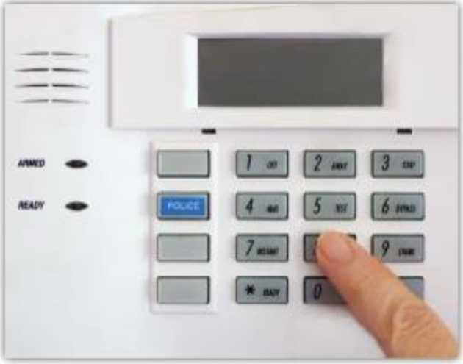
Introduction to Security Systems
> Security and protection devices are used in homes, schools, offices, stores, warehouses, and hospitals to guard persons and property against fire, break-ins, and other hazards.
> Warning mechanisms also protect automobiles and trucks from theft.
> Since the 1960s, due to great increase in domestic crime, airplane hijackings, and international terrorism far more sophisticated security devices have been made.

Slide 4
Hardware Implementation
Hardware used:
S. no. | Contents | Qty
1. | PC | 1
2. | Breadboards | 2
3. | 4001 Quad NOR Gate | 1
4. | 4070 Quad XOR Gate | 1
5. | Eight Position DIP switches | 2
6. | 10 Kilo-ohm resistor | 10
7. | 470 ohm resistor | 2
8. | Pushbutton switches | 1
9. | 9V battery | 1
10. | Light emitting diodes | 2
11. | 1N914 switching diodes | 4
11. | Connecting wires | ---

Slide 5
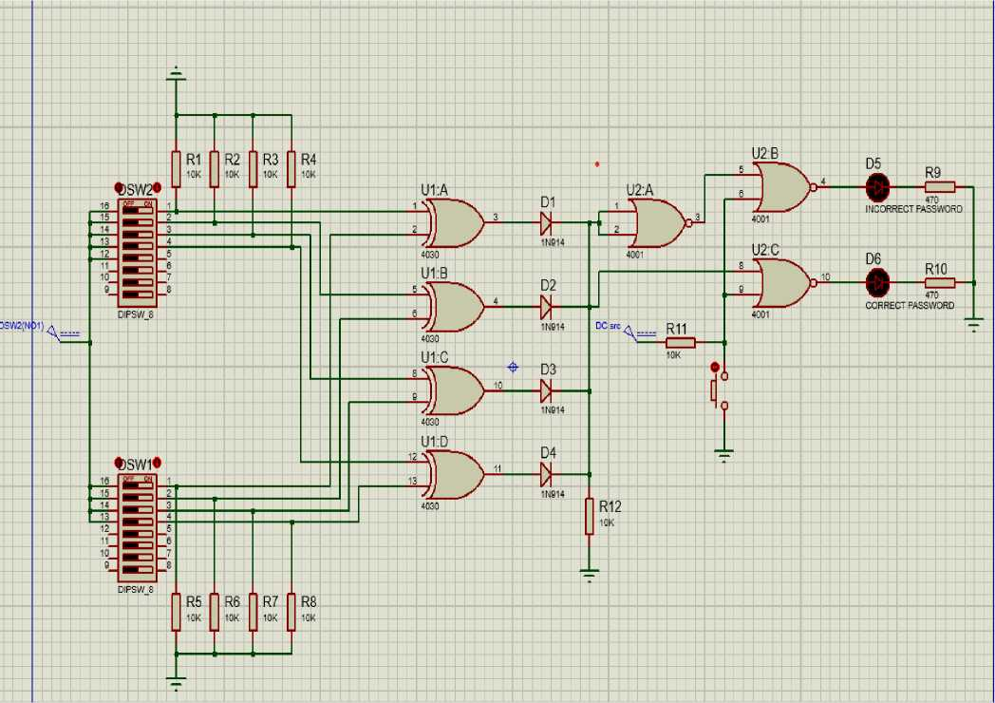
Circuit schematics

Slide 6
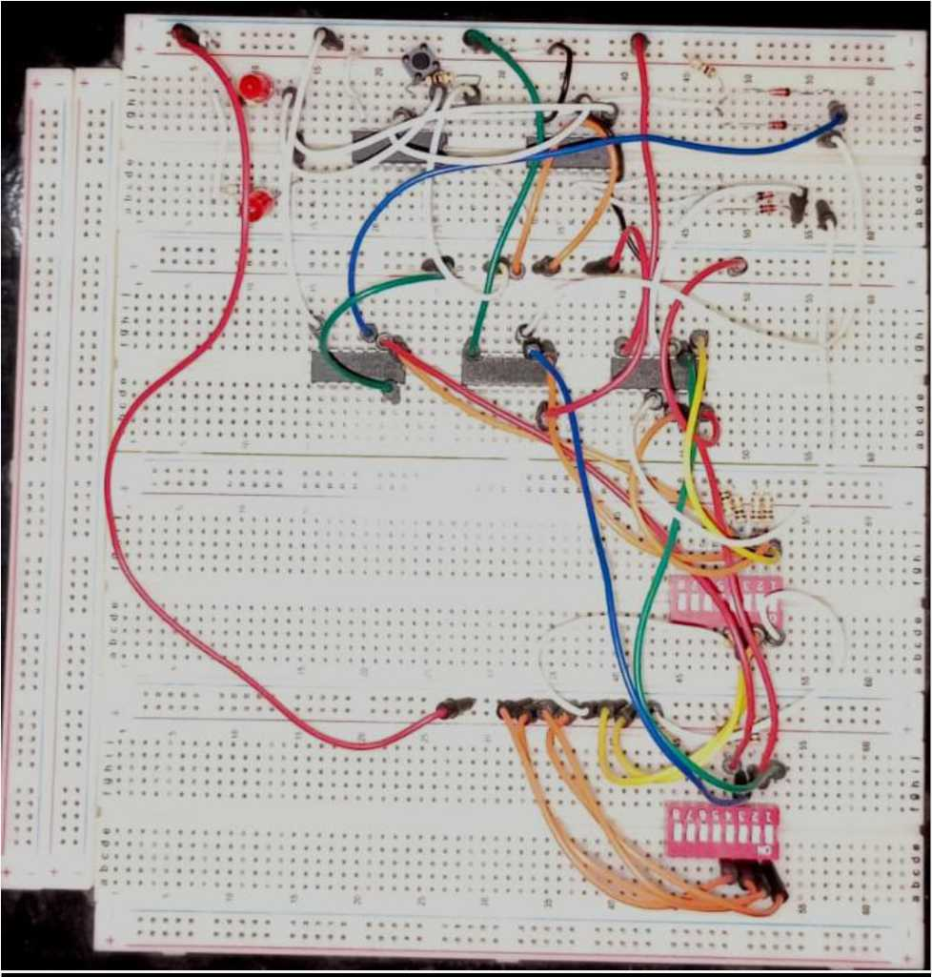

Slide 7
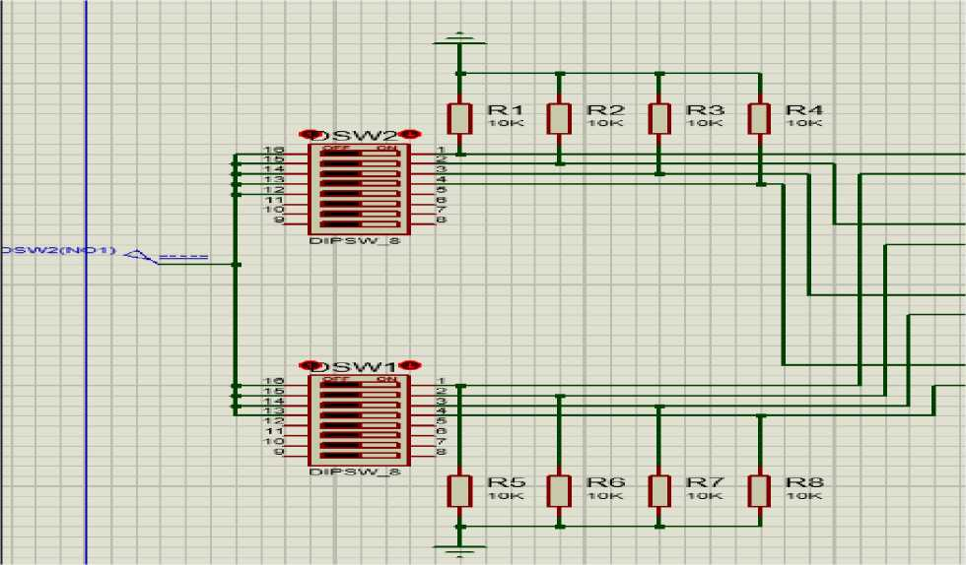
Implementation of password set and input:
> There are two switches in the input section. The first switch sets the password and is the "hidden part” of the circuit. The locked configuration of the DIP switch stores the password pattern. The second switch takes input from the user. It is the "visible part” of the circuit.

Slide 8
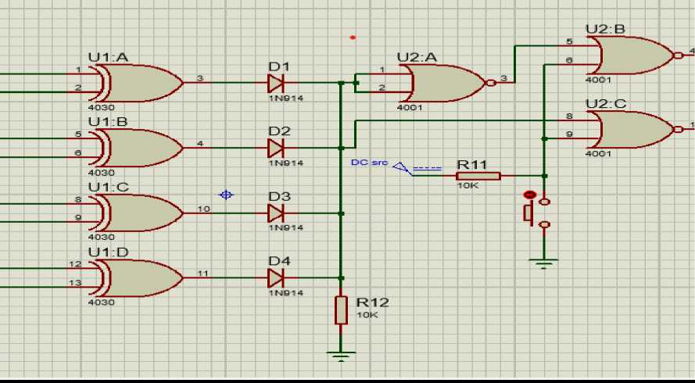
Implementation of password validation:
Password validation is carried out by an assembly of XOR and NOR gates.
When user input is equivalent to the set password, it is validated. Validation is triggered by a push button which saves battery life and ultimately the cost.

Slide 9
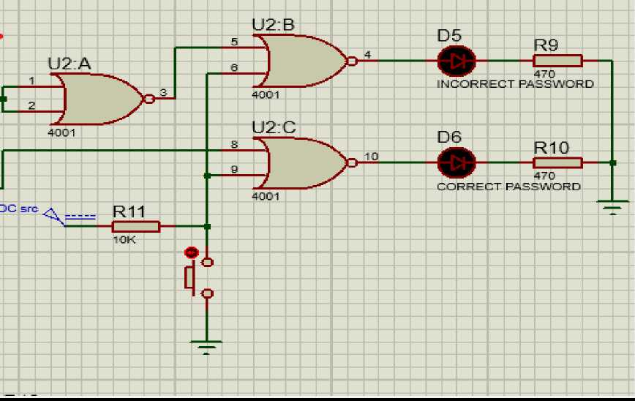
Implementation of feedback:
> When the pushbutton is triggered, password is validated, and the user receives feedback by virtue of 2 LEDS. If the password is correct, the first one turns on, and when the password is incorrect, the second one turns on.

Slide 10
Software Implementation
Components:
S. no. | Contents | Qty
1. | PC | 1
2. | 10K resistors | 64
3. | 4030 Quad XOR Gates | 32
4. | 7 SEGMENT Displays | 12
5. | Four Position DIP switches | 8
6. | 4511 SEVEN SEGMENT Decoder | 12
7. | Switches | 3
8. | 7485 4-bit Magnitude Comparator | 4
9. | Quad input AND Gate | 1
10. | Light emitting diodes | 12
11. | 4042 D-Latch | 4

Slide 11
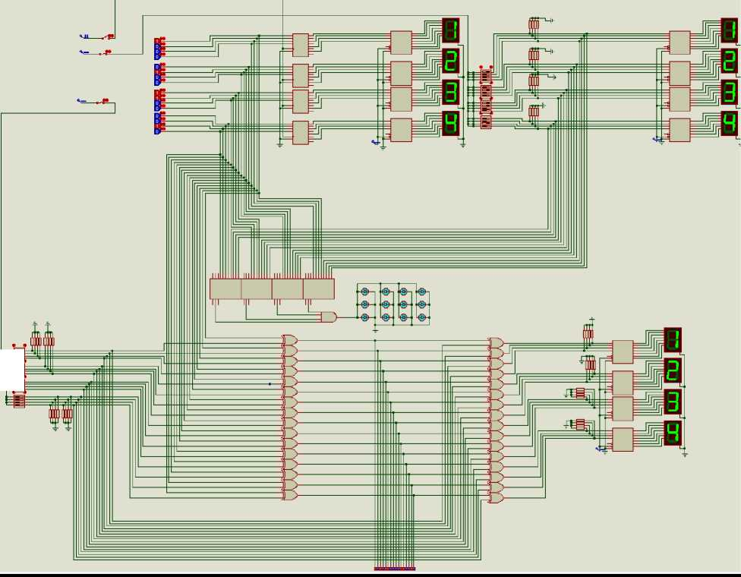
Circuit schematics:
in mm mil

Slide 12
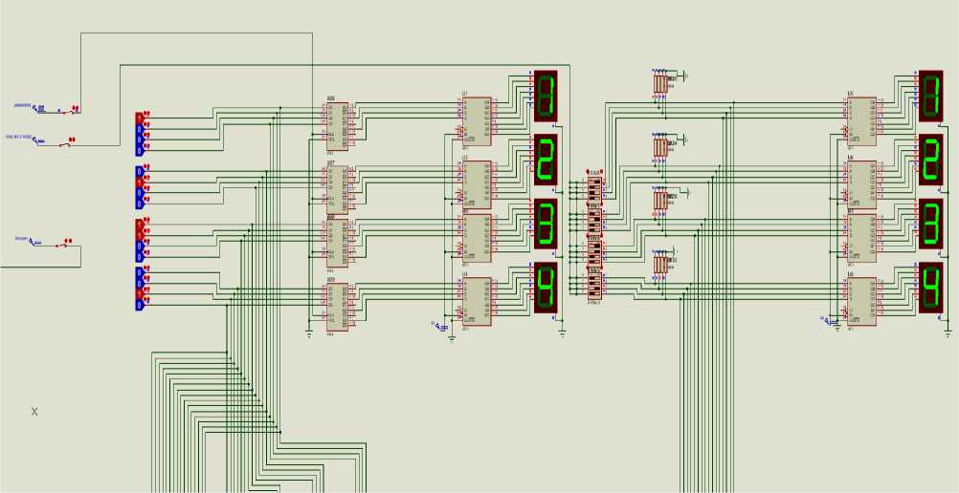
Implementation of Password set and input:
^ The control unit of the system consists of three switches:
O Pass store switch: When triggered, allows the user to store the password by using DIP switches. This is the "hidden part” of the circuit.
O Pass input switch: When triggered, allows the user to give input to the security system by using DIP switches. This is the "visible part” of the circuit.

Slide 13
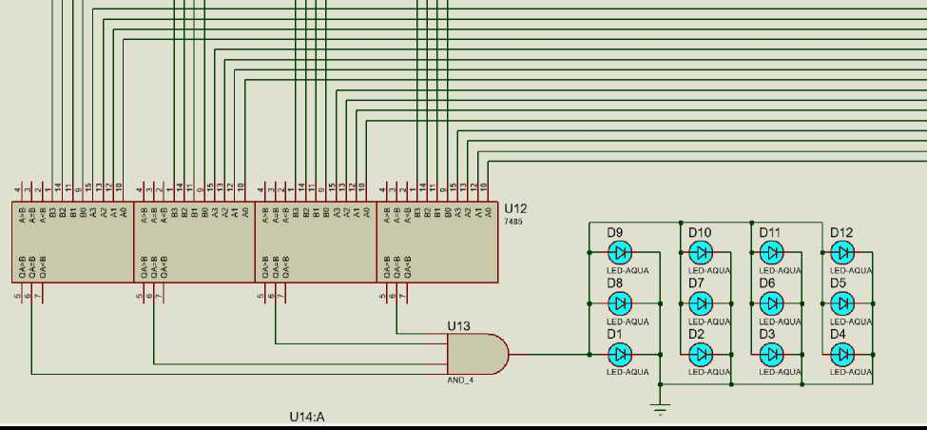
Implementation of Password validation:
^ The validation part of the system has four 4-bit comparators comparing the total 32 bits of the password and the input.
^ If all the digits are equal, the compared results go through an AND Gate and the LEDs turn on indicating that a valid input was entered.

Slide 14
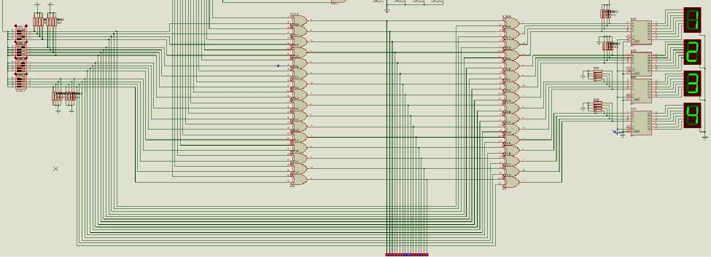
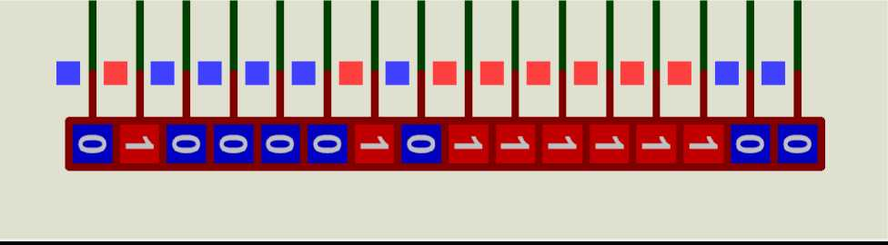
Implementation of encryption/decryption:
^ The encryptor circuit bitwise adds the SET Password with the secret key. The secret key here is the last 4 digits of my registration ID: 0836. Bitwise XOR operation is used for encryption.
^ The decryptor circuit decodes the encrypted binary string.

Slide 15
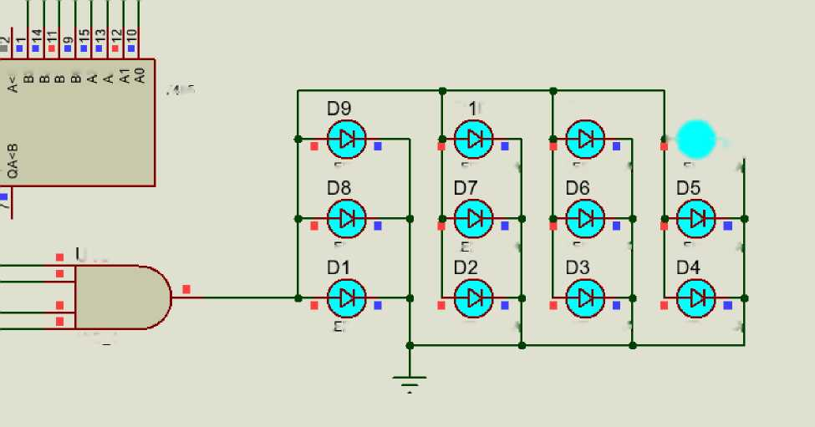
Implementation of feedback:
i CD C¹! (M ^ O CO fN
U12
^ - J :=:
DO
□ 11
D12
*@-*1
L=D-AGUA
L^D-AQUA
L=D-AGUA
L=D-AGUA
J13
L=D-AGUA
L-D-AQUA
L=D-AGUA
L=D-AGUA
AND 4
L-D-ACUA
LED-AQUA LED-AQUA
LED-AGUA
^ LED-AQUA diodes indicate if Set Password and User Input match.

Slide 16
Conclusion and References:
> In conclusion, the security system uses storage and comparison elements to secure sensitive information or resources.
> In building this project, almost all the concepts learnt throughout the course were utilized.
> The hardware implementation is simplified due to cost constraints.
References:
Digital Logic Design by Morris M. Mano https://kids.britannica.com/students/article/security-system/276969#
Laurin Rinder/Shutterstock.com

