Slide 1
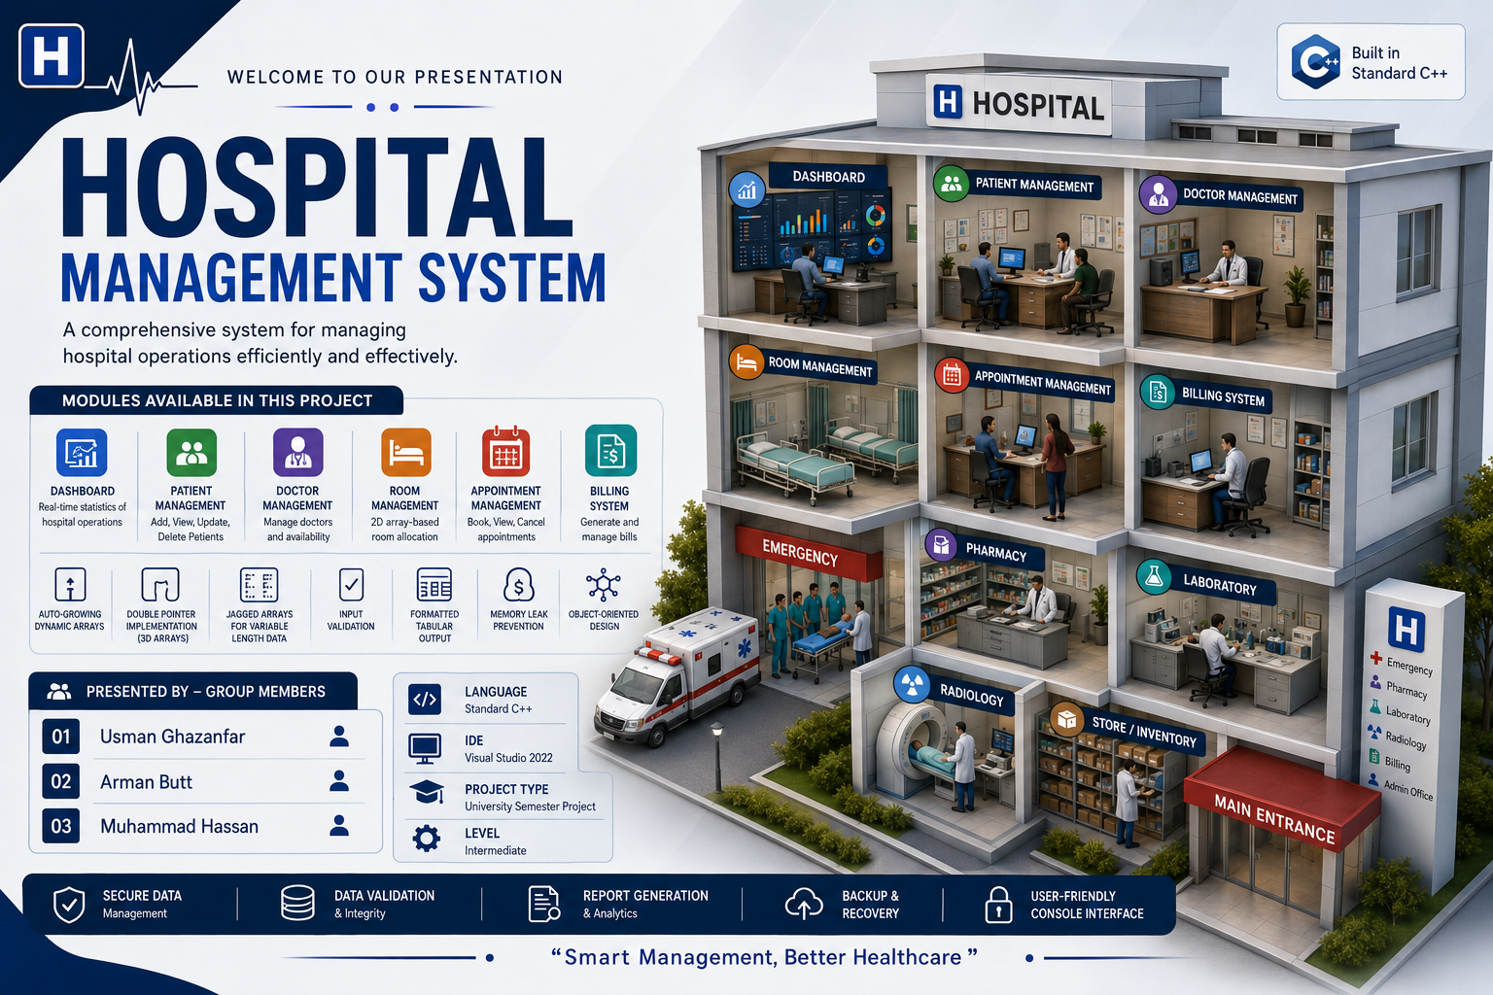

Slide 2



PROJECT OVERVIEW
What Is It, and Why Build It?
A console-based C++ application that digitizes core hospital operations patients, doctors, rooms, appointments, and billing replacing scattered paper registers with one unified, menu-driven system.
Why This Project
Target Users
End Goal
Hands-on mastery of core C++: memory management, OOP, arrays & pointers applied to a real, relatable domain.
Hospital receptionists, administrators, doctors and billing staff who need fast, reliable day-to-day record handling.
A working, menu-driven prototype proving the team can design and integrate a multi-module system from scratch.
Hospital Management System | PF • UCP
3
Notes:
Explain that this is a console-based application (no GUI) intentionally, since the goal was to practice core C++ fundamentals deeply. Emphasize it targets hospital front-desk and admin staff who currently rely on manual, paper-based processes.

Slide 3




THE PROBLEM
Why Hospitals Still Struggle Manually
Manual Record Keeping
Doctor Management
Room Management
Billing Errors
Paper-based patient files are slow to search, easy to lose, and prone to duplication or damage.
No centralized view of doctor availability, specialization, or workload across departments.
Manual tracking of room/bed occupancy leads to double-booking and delayed patient admission.
Hand-calculated bills are time-consuming and prone to human error, delaying discharge and payment.
Hospital Management System | PF • UCP
4
Notes:
Frame this as the motivation for the whole project. Give one real-world consequence for each: lost paper files, no visibility into which doctor is free, double-booked rooms, and billing mistakes that delay a patient's discharge. This sets up the solution on the next slides.

Slide 4




SYSTEM ARCHITECTURE
A Modular, Manager-Based Design
Hospital (Main Controller)
PatientManager
DoctorManager
RoomManager
AppointmentManager
BillingManager
Design principle: Each manager class owns a single responsibility and its own data; the Hospital class composes them and routes menu actions a clean separation of concerns that made parallel development across the team possible.
Hospital Management System | PF • UCP
5
Notes:
Walk through the diagram top-down: the Hospital class is the main controller that owns and coordinates five specialized manager classes, each responsible for one domain — patients, doctors, rooms, appointments, and billing. Emphasize that this separation of concerns is what let three people work on the codebase simultaneously without constant merge conflicts.

Slide 5










UNDER THE HOOD
C++ Concepts Implemented
Functions
Arrays
C-Strings
Pointers
Dynamic Memory
2D Arrays
Double Pointers
Jagged Arrays
Structures
Classes
OOP Principles
Hospital Management System | PF • UCP
7
Notes:
Briefly list the C++ concepts on display: functions for modular logic, arrays and C-strings for storing raw patient/doctor data, pointers and dynamic memory (new/delete) for growable dynamic arrays, 2D and jagged arrays for schedules, double pointers for arrays-of-pointers structures, and structures, classes, and OOP for the overall design. Jagged arrays specifically were used for irregular data like variable-length appointment slots per doctor.

Slide 6






MODULE DETAILS
Six Modules, One Integrated System
Dashboard
Patient Management
Doctor Management
Central menu hub showing live counts of patients, doctors, rooms, and pending bills.
Add, search, update, and discharge patient records with input-validated fields.
Maintain doctor profiles, specializations, and daily availability.
Room Management
Appointment Management
Billing System
Track room types, occupancy status, and assign/release beds in real time.
Book, reschedule, and cancel appointments while checking doctor availability.
Auto-calculates charges from room, consultation, and treatment costs.
Hospital Management System | PF • UCP
8
Notes:
Go module by module at a brisk pace — one sentence each. Note that the Dashboard aggregates live data from the other five managers, which is why the Hospital class needs a reference to each manager instance.

Slide 7
DEMONSTRATION
Main Menu & a Sample Workflow
Sample Workflow
main_menu.cpp — output
==========================================
HOSPITAL MANAGEMENT SYSTEM - DASHBOARD
==========================================
1. Patient Management
2. Doctor Management
3. Room Management
4. Appointment Management
5. Billing System
6. View Dashboard Summary
7. Exit
------------------------------------------
Enter your choice:
1
Register a new patient with validated name, age & contact
2
Assign an available room based on live occupancy
3
Book an appointment with an available doctor
4
Generate the final bill automatically from all charges
Hospital Management System | PF • UCP
9
Notes:
This is the cue to switch to the live terminal and actually run the compiled program if presenting live — otherwise, walk through this simulated menu output. Narrate the sample workflow: registering a patient, assigning a room, booking an appointment with an available doctor, and finally generating the bill — showing how the modules interact end-to-end.

Slide 8


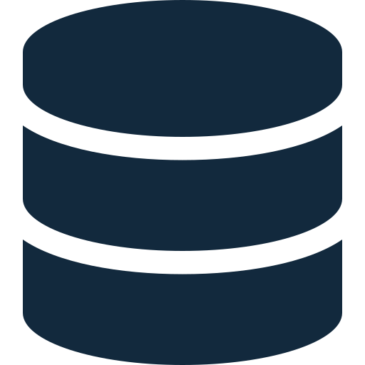


WHAT'S NEXT
Future Enhancements
Data Persistence
Graphical User Interface
Database Integration
Advanced Features
Security
Save/load records to files or a database so data survives restarts.
Replace the console menu with a modern GUI (Qt / desktop or web front-end).
Move from in-memory arrays to SQL/NoSQL storage for scalability.
Analytics dashboards, notifications, and reporting tools.
Role-based login, encrypted records, and audit trails for sensitive data.
Hospital Management System | PF • UCP
11
Notes:
Frame these as a natural next-version roadmap. Data persistence is the most immediately valuable (currently everything resets on program exit), followed by a GUI and real database backing for a production-ready version.

Slide 9


Any Questions ?
Usman Ghazanfar • Arman Butt • Muhammad Hassan
Notes:
Thank the audience and open the floor for questions. Have all three team members ready to field questions on their respective modules — Usman on architecture/integration, Arman on backend data structures, and Hassan on appointments/billing/UI.

