Slide 1
Item-Level Price
Co-Movement Network
Dataset
64
items
17
cities
3
Using CPI Data from Pakistan Bureau of Statistics
Apr 2023 – Mar 2026
fiscal years
31,212
records
Fatima Tehreem | Roll No: 25i-0565
Rameen Azhar | Roll No: 25i-0586
Usman Khan | Roll No: 25i-0592

Slide 2
OVERVIEW
What this project does
Graph theory applied to real PBS consumer price data
01
02
03
Real PBS Data
Graph Theory
Network Analysis
31,212 price records
64 items · 17 cities
Apr 2023 – Mar 2026
Items = nodes
Cosine sim → edges
Weighted by city count
Degree · Closeness
Betweenness centrality
Temporal comparison

Slide 3
METHODOLOGY
Pipeline: 5 steps from raw price data to network insights
1
2
3
4
5
Load & Clean
Price Vectors
Cosine Sim.
Build Graphs
Analyse
31,212 rows
336 missing filled
11 monthly deltas
per item × city
2,016 pairs
× 17 cities
Edge if N(i,j) ≥ K
τ=0.6, K=3
Centrality, temporal
sensitivity analysis
Cosine similarity formula (Project Section 4)
sim(i, j, city, year) = v(i) · v(j) / ( ||v(i)|| × ||v(j)|| )
Edge added if |{ cities : sim ≥ τ }| ≥ K Default parameters: τ = 0.6, K = 3

Slide 4
GRAPH RESULTS
Three yearly graphs
τ = 0.6, K = 3, 64 nodes (items) in all graphs
Year 1
2023-24
Year 2
2024-25
Year 3
2025-26
Edges
232
Edges
87
Edges
105
Density
0.1151
Density
0.0432
Density
0.0521
Components
14
Components
22
Components
20
Avg degree
7.25
Avg degree
2.72
Avg degree
3.28
Isolated nodes
12
Isolated nodes
20
Isolated nodes
19
Peak inflation period
Sharp contraction –62%
Partial recovery +21%

Slide 5
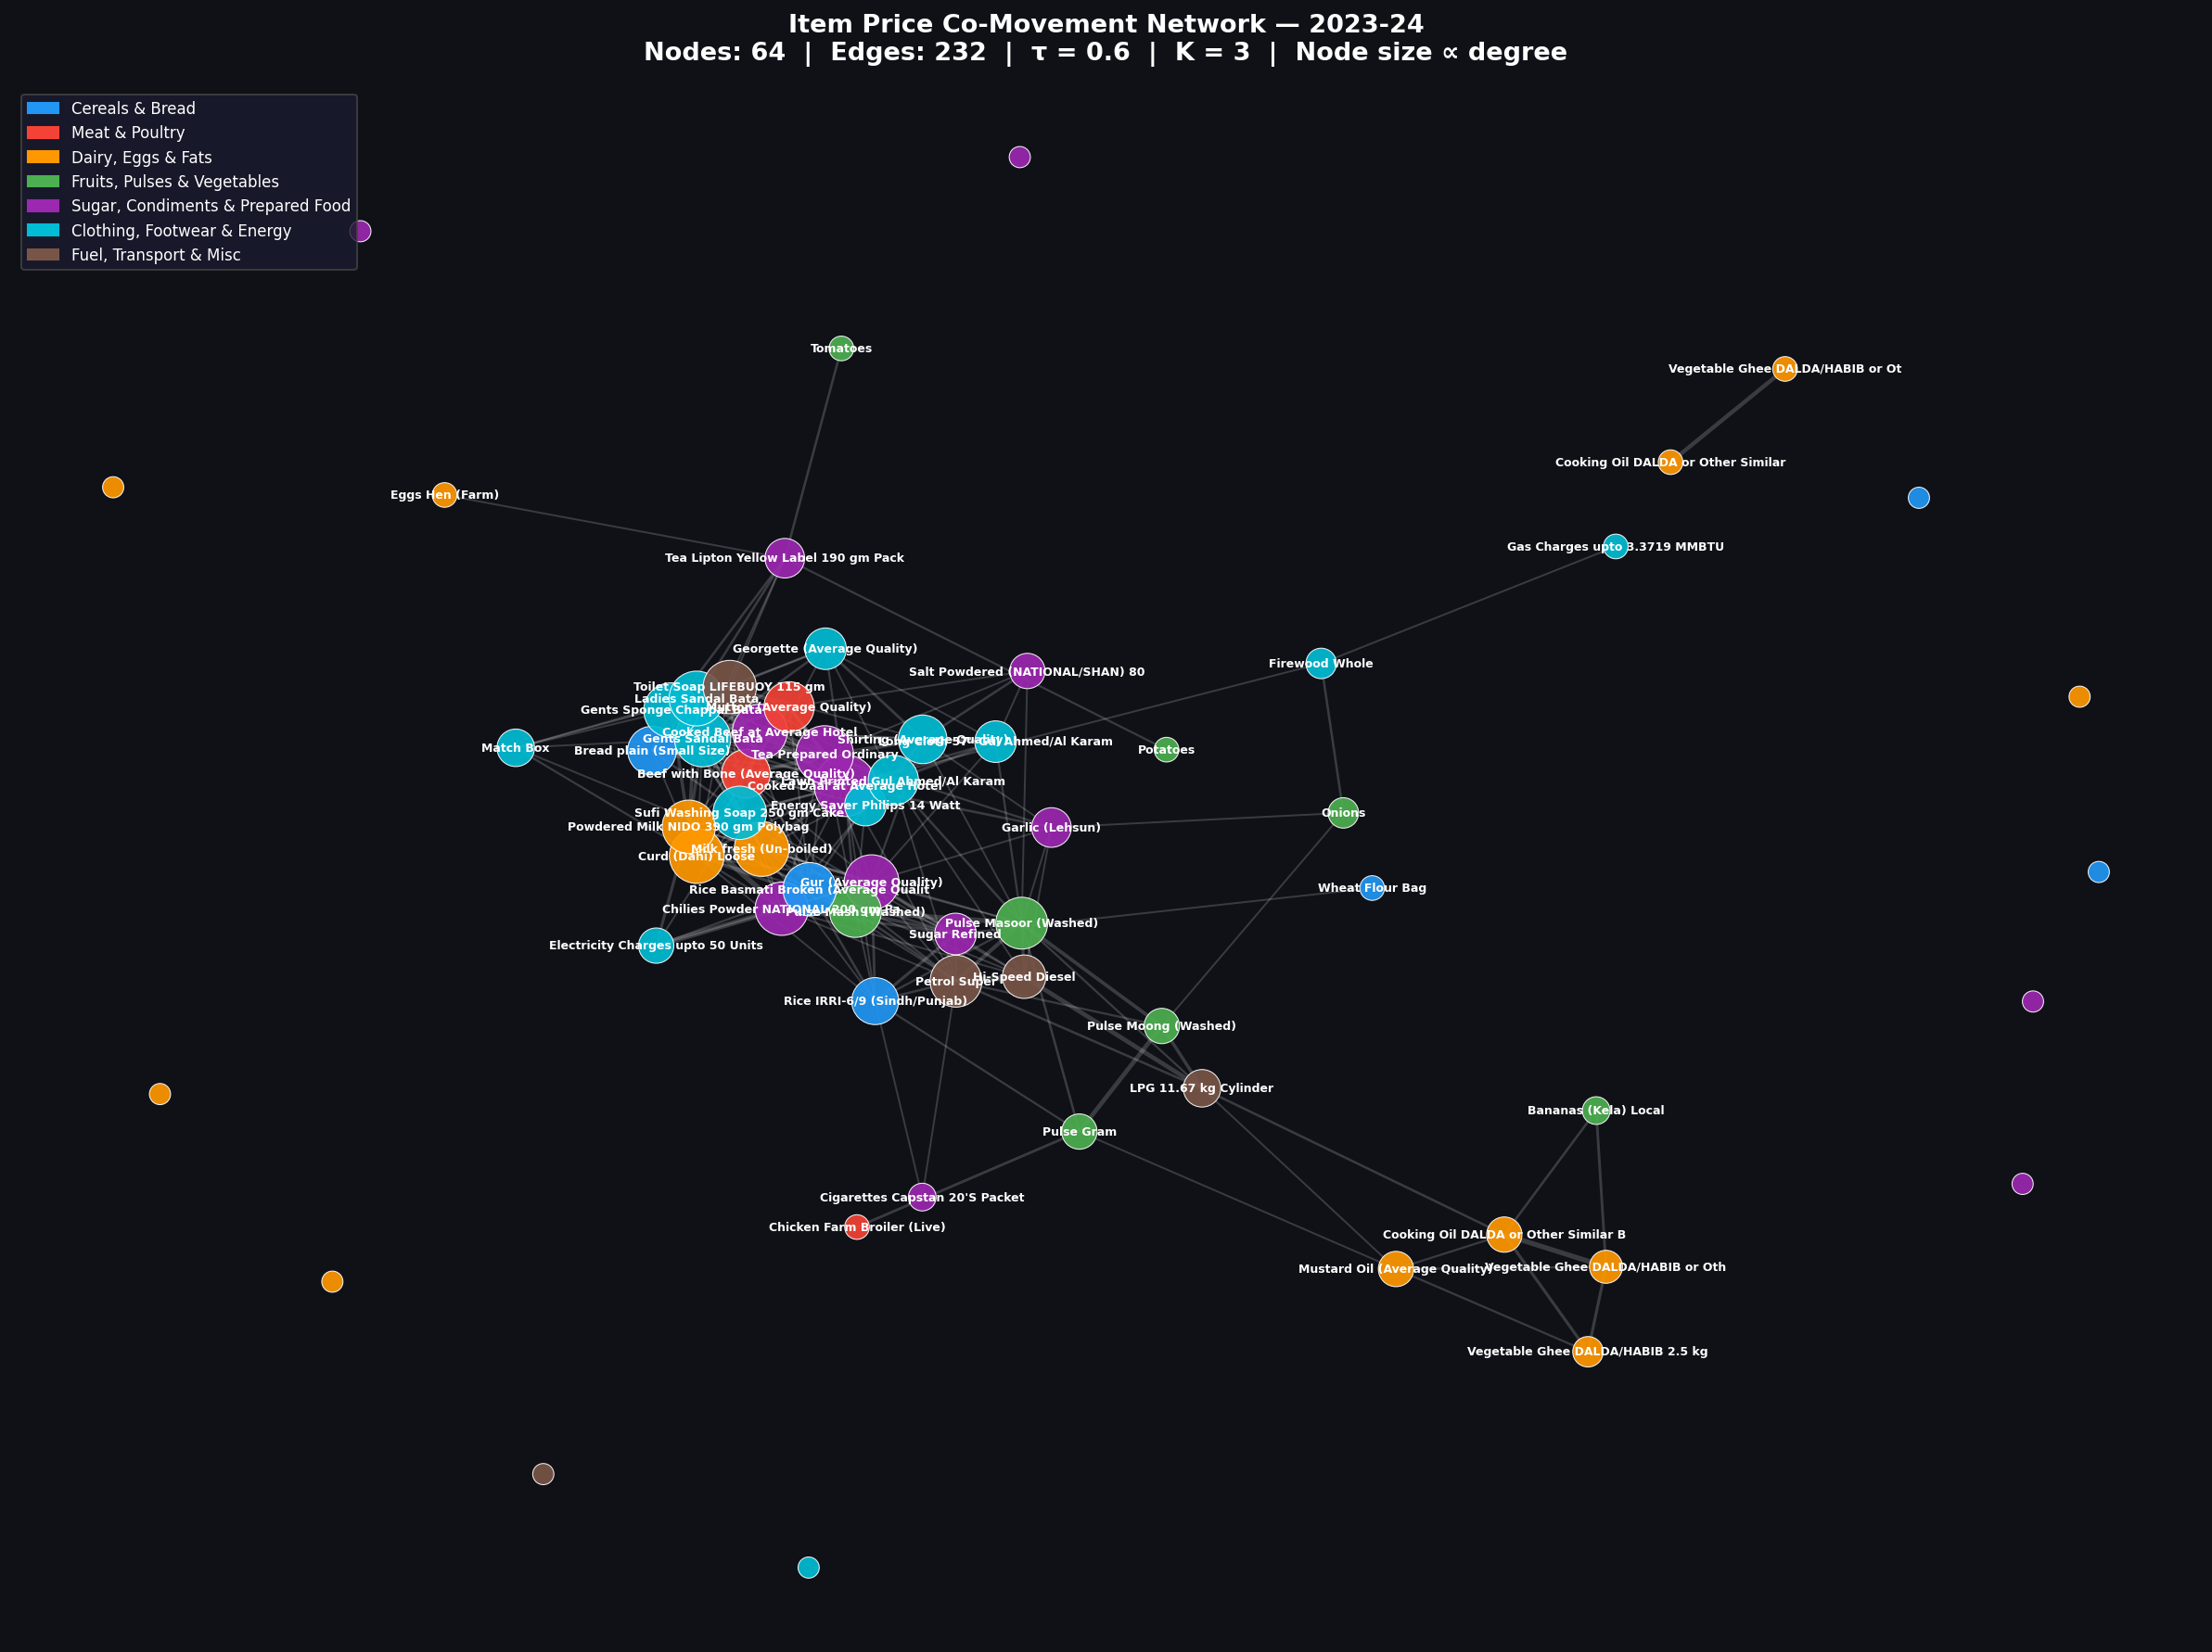
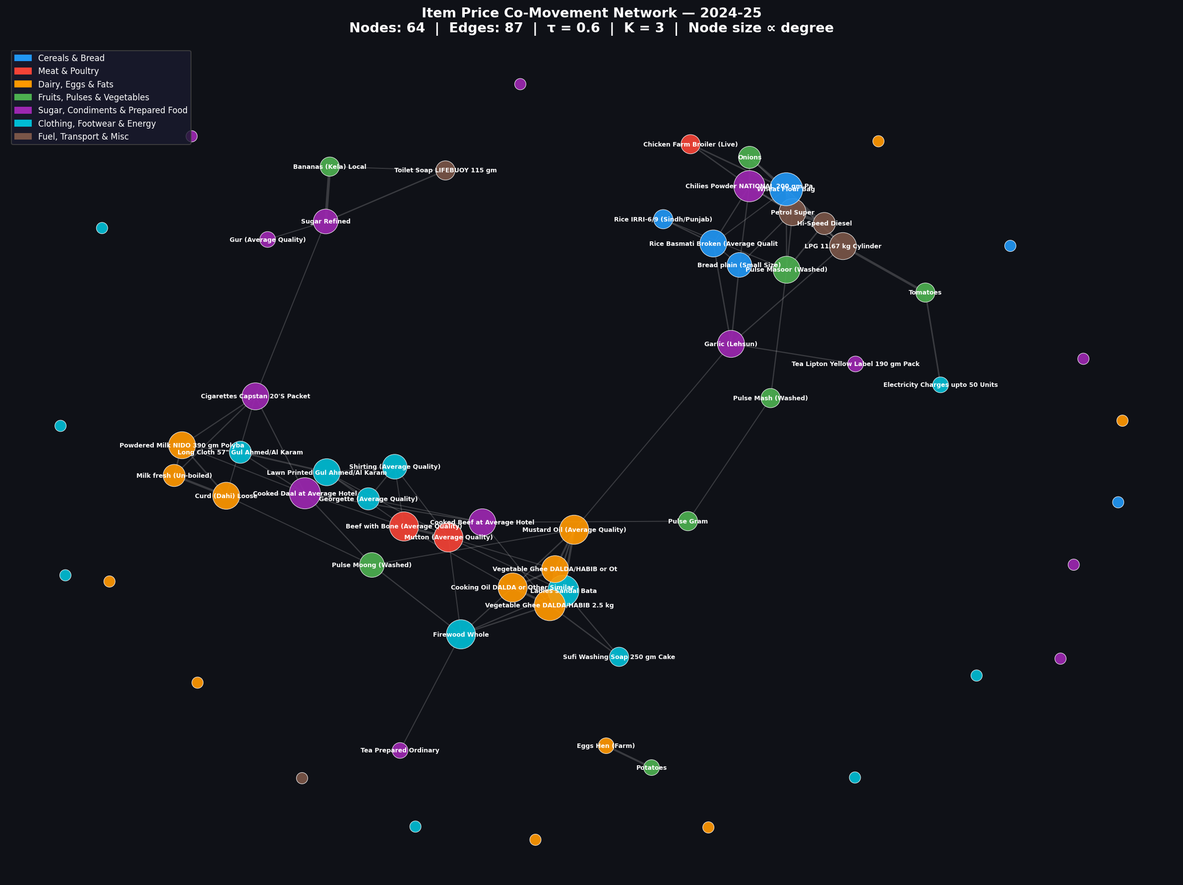
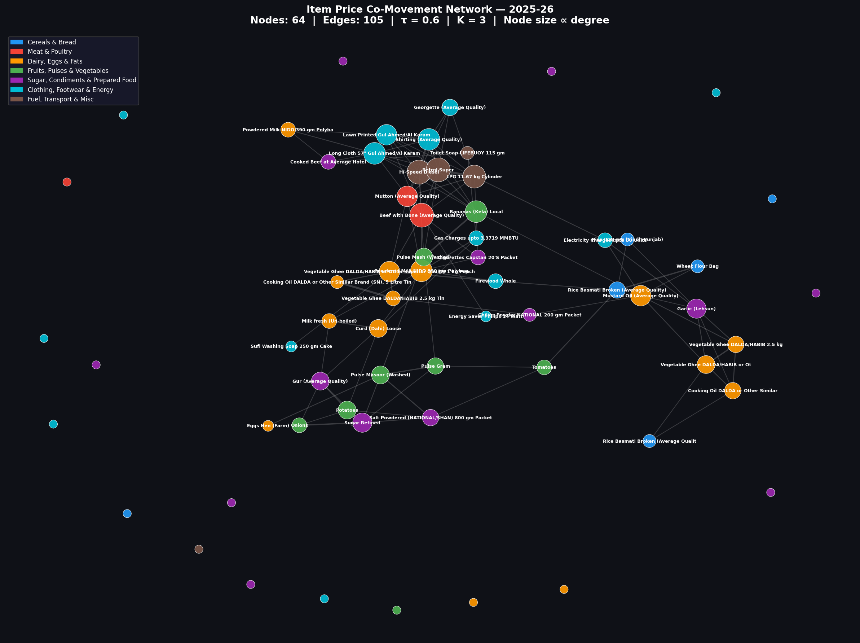
NETWORK GRAPHS
Item Co-Movement Networks — All Three Years
Node colour = category | Node size = degree centrality | Edge thickness = agreeing cities
Year 1 (2023-24)
232 edges
Year 2 (2024-25)
87 edges
Year 3 (2025-26)
105 edges

Slide 6
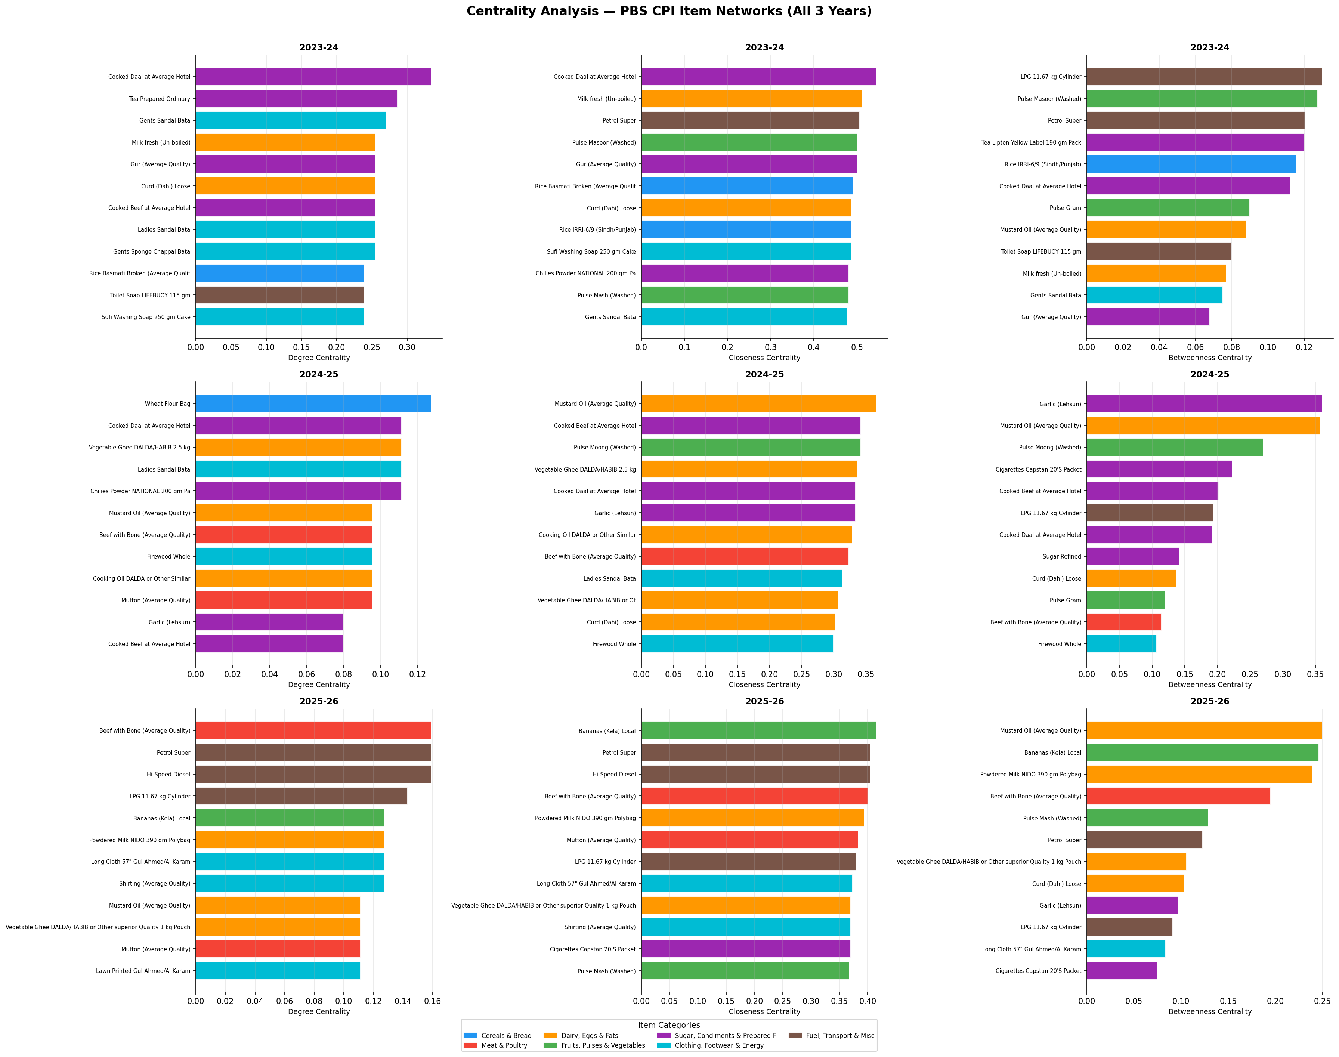
CENTRALITY
Top-12 items by all three centrality measures
Degree = connections count · Closeness = network reach · Betweenness = bridge role between clusters

Slide 7
CENTRALITY
Key central items and economic interpretation
1
Year 1 2023-24 — Cooked Daal (deg = 0.333)
21 direct connections. Street food price aggregates pressures from cereals, oils, meat and energy — became the broadest price-signal during peak inflation.
2
Year 2 2024-25 — Mustard Oil (betw = 0.357) & Garlic (betw = 0.360)
Two bridge items. As the network fragmented, these items were the only connections between otherwise isolated clusters of food and fuel prices.
3
Year 3 2025-26 — Bananas (betw = 0.246) & Beef (deg = 0.159)
Fresh produce and protein both became hubs. Bananas bridged agricultural and non-agricultural clusters — unusual, suggesting supply-chain disruption.
Stability: Petrol Super, Cooked Daal, Mustard Oil, Beef with Bone, Curd (Dahi) — all appeared in top-10 in at least 2 of 3 years

Slide 8
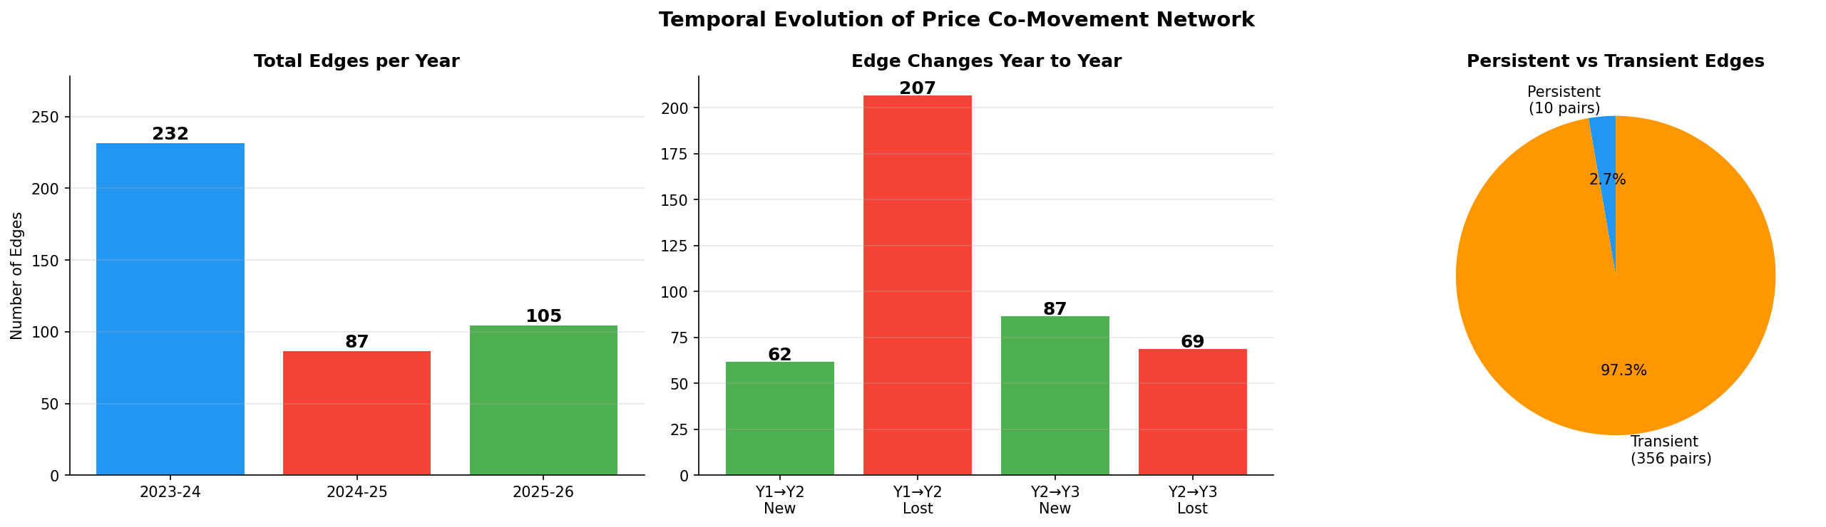
TEMPORAL ANALYSIS
Edge evolution across 3 years
-207 edges lost
Year 1 → Year 2
10 persistent pairs
2.7% of all edges
+87 new edges
Year 2 → Year 3

Slide 9
TEMPORAL ANALYSIS
10 permanently co-moving pairs
Present in all 3 years — structurally linked by supply chain
Petrol Super
↔
Hi-Speed Diesel
Beef with Bone
↔
Mutton
Fuel
Meat substitutes
Sugar Refined
↔
Gur (Average Quality)
Mustard Oil
↔
Vegetable Ghee 2.5 kg
Sugar substitutes
Cooking fats
Milk fresh
↔
Curd (Dahi) Loose
Lawn Printed
↔
Shirting
Dairy chain
Clothing fabrics
Pulse Masoor
↔
Pulse Mash
Lawn Printed
↔
Long Cloth 57"
Pulse substitutes
Clothing brand
Cooking Oil DALDA
↔
Vegetable Ghee
Georgette
↔
Shirting
Edible oils
Fabric substitutes

Slide 10
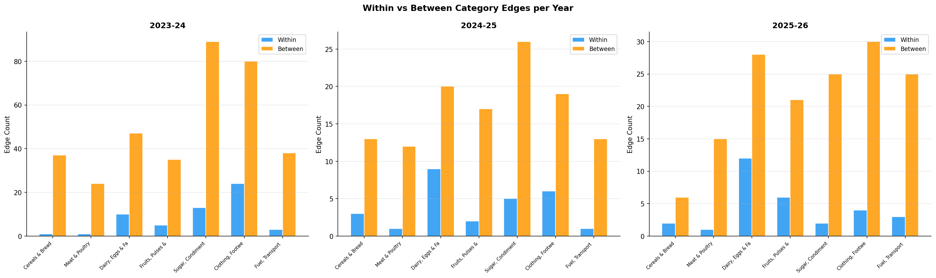
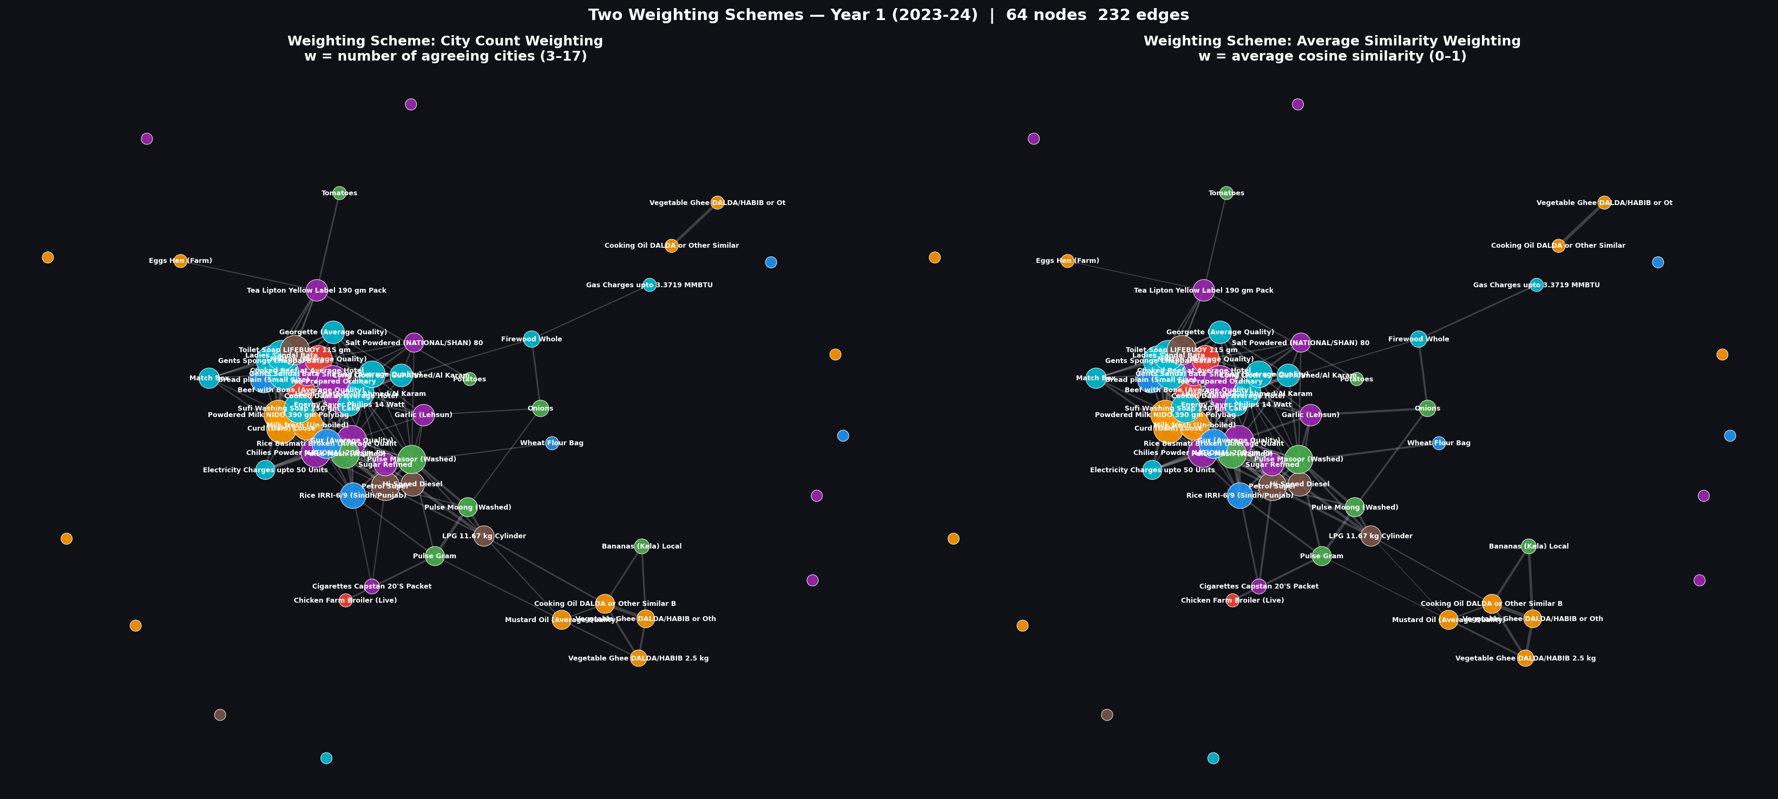
CATEGORY ANALYSIS
69–75% of edges cross category boundaries
Category chart
Two weighting schemes side by side (Year 1)
Year 1: 75%
cross-category
Year 2: 69%
cross-category
Year 3: 71%
cross-category
Price shocks in Pakistan systematically cross category boundaries — fuel affects food, food affects clothing, clothing affects health

Slide 11
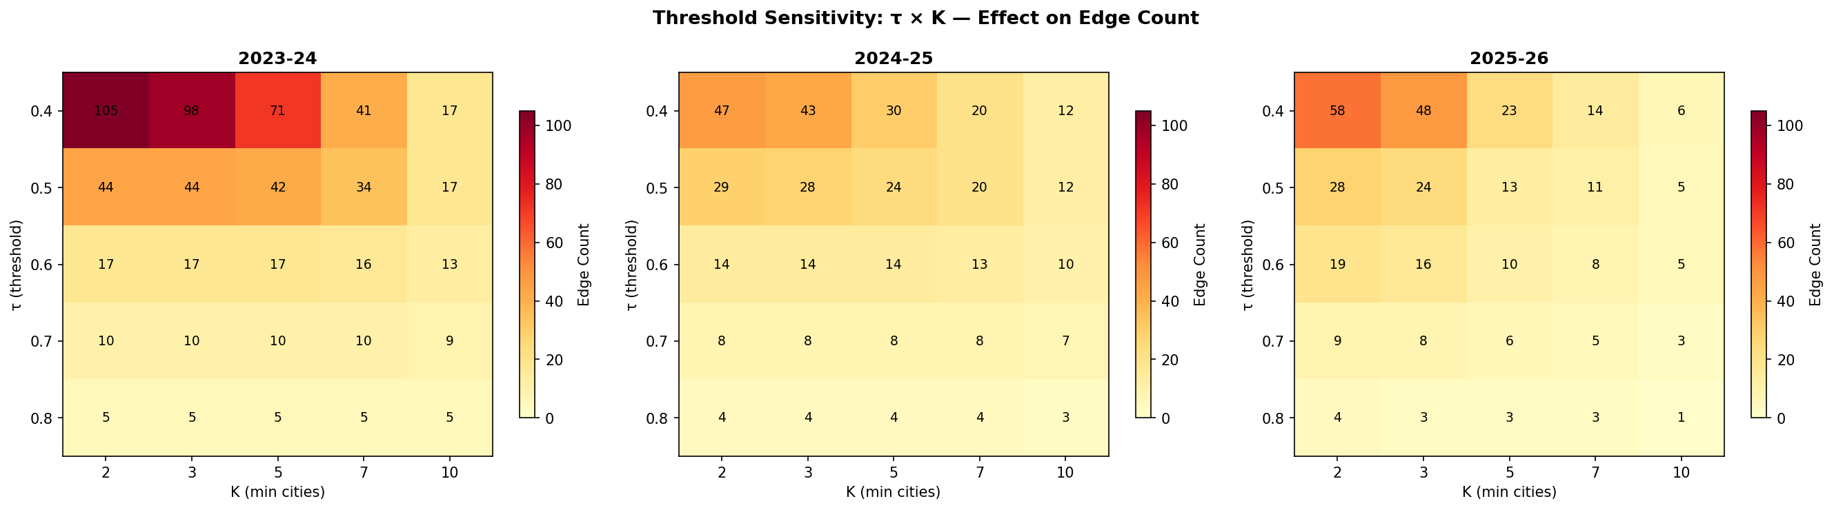
SENSITIVITY ANALYSIS
Effect of varying τ and K on graph structure
τ drives density: raising from 0.4→0.5 cuts Year 1 edges from 105 to 44 — the biggest single drop
K has little effect at τ ≥ 0.6 because very few pairs achieve high similarity in any city at all
Both weighting schemes produce identical topology — only edge thickness and betweenness rankings differ

Slide 12
CONCLUSIONS
5 key findings
1
Inflation synchronises markets
Year 1 had 232 edges — 2.67x more than Year 2. Generalised inflation forces unrelated items to move together.
2
10 permanently linked commodity pairs
Petrol/Diesel, Sugar/Gur, Milk/Curd, Pulses, Oils, Meat — co-move in all 3 years regardless of economic conditions.
3
75% of edges cross category boundaries
Price shocks are systemic in Pakistan — fuel costs ripple into food, clothing, and health simultaneously.
4
Betweenness reveals economic bridges
Mustard Oil (Year 2) and Bananas (Year 3) were structural bridges — disrupting them would fragment the network.
5
τ is the dominant parameter
Similarity threshold τ controls network density far more than K. At τ ≥ 0.6, K becomes redundant.

Slide 13
Thank You
Data Source: pbs.gov.pk/price-statistics/
Tools used: Python · pandas · NumPy · NetworkX · Matplotlib
232
87
105
10
31,212
64 · 17
edges per year
persistent pairs
records
items · cities
Discrete Mathematics | April 2026 | PBS CPI Data 2023–2026

