Slide 1
DEEP LEARNING COURSE
FALL 2024
Usman Khan, PhD

Slide 2
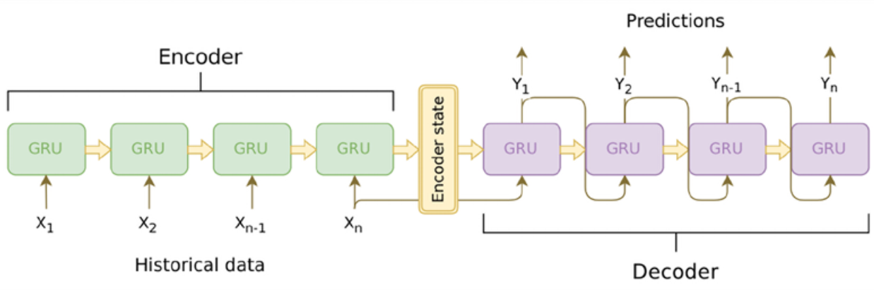
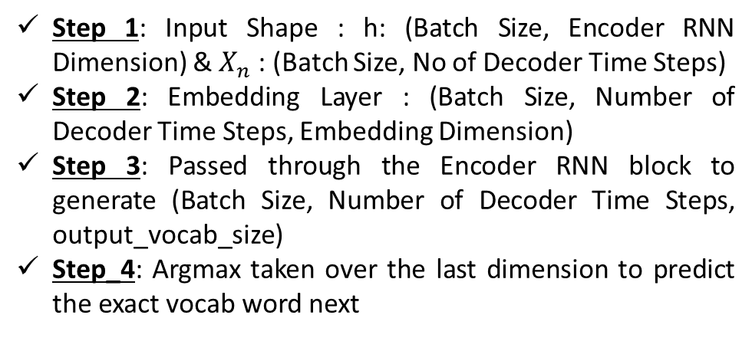
SEQ TO SEQ MODEL
Step 1: Input Shape : h: (Batch Size, Encoder RNN Dimension) & $X_{n}$ : (Batch Size, No of Decoder Time Steps)
Step 2: Embedding Layer : (Batch Size, Number of Decoder Time Steps, Embedding Dimension)
Step 3: Passed through the Encoder RNN block to generate (Batch Size, Number of Decoder Time Steps, output_vocab_size)
Step_4: Argmax taken over the last dimension to predict the exact vocab word next
Step 1: Input Shape : (Batch Size, Number of Encoder Time Steps)
Step 2: Embedding Layer : (Batch Size, Number of Encoder Time Steps, Embedding Dimension)
Step 3: Passed through the Encoder RNN block to generate (Batch Size, Encoder RNN Dimension)

Slide 3
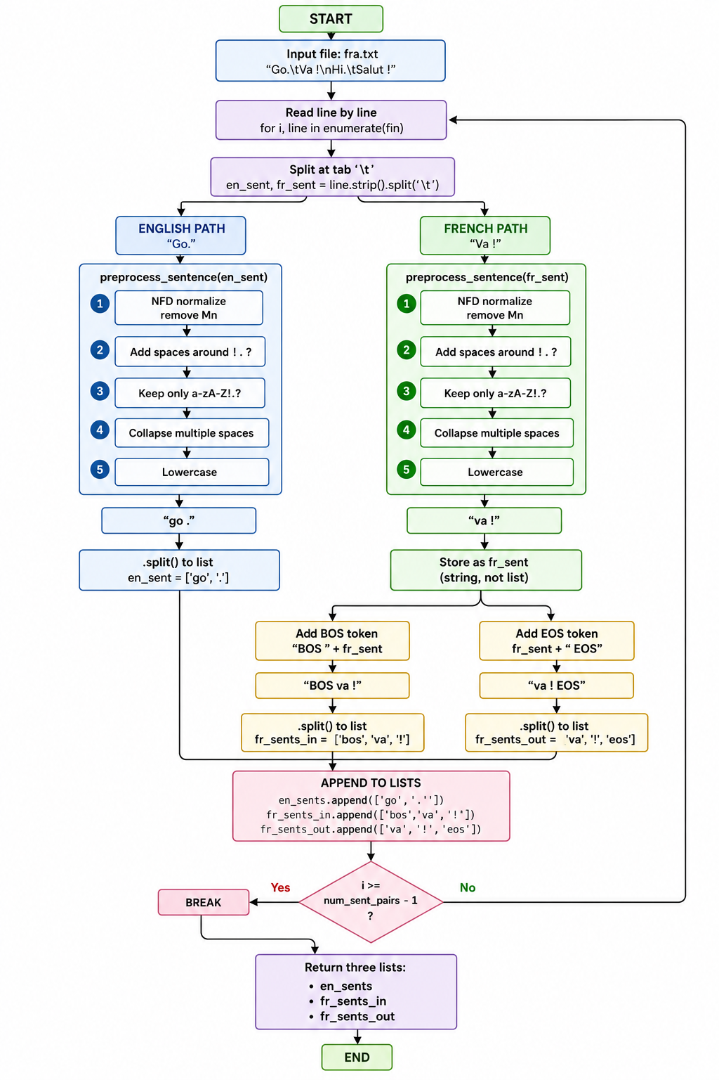
SEQ TO SEQ MODEL

Slide 4
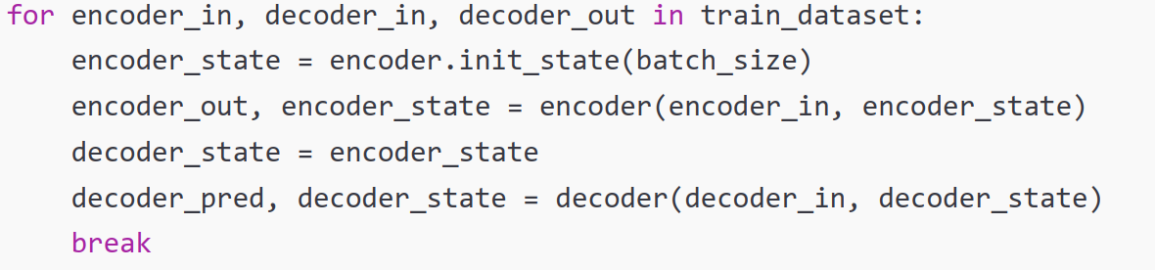
SEQ TO SEQ MODEL
data_en
data_fr_in
data_fr_out
Notes:
def download_and_read():
en_sents, fr_sents_in, fr_sents_out = [], [], [] local_file = os.path.join("datasets", "fra.txt")
with open(local_file, "r") as fin: for i, line in enumerate(fin):
en_sent, fr_sent = line.strip().split('\t')
en_sent = [w for w in preprocess_sentence(en_sent).split()] fr_sent = preprocess_sentence(fr_sent)
fr_sent_in = [w for w in ("BOS " + fr_sent).split()] fr_sent_out = [w for w in (fr_sent + " EOS").split()] en_sents.append(en_sent) fr_sents_in.append(fr_sent_in) fr_sents_out.append(fr_sent_out)
if i >= num_sent_pairs - 1: break
return en_sents, fr_sents_in, fr_sents_out

Slide 5
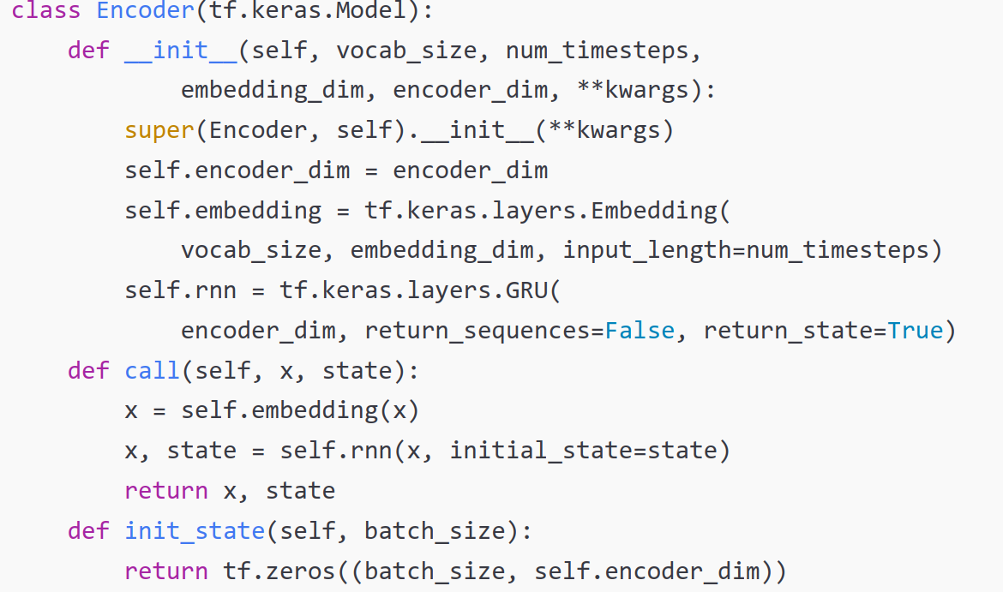
SEQ TO SEQ MODEL

Slide 6
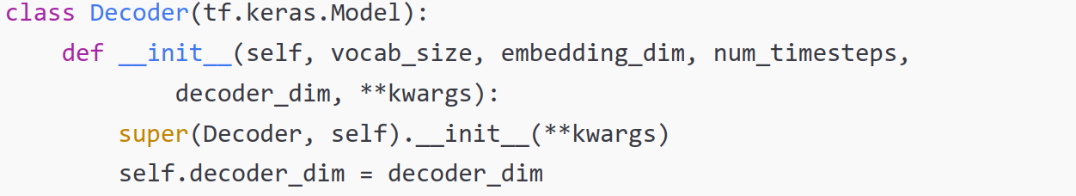
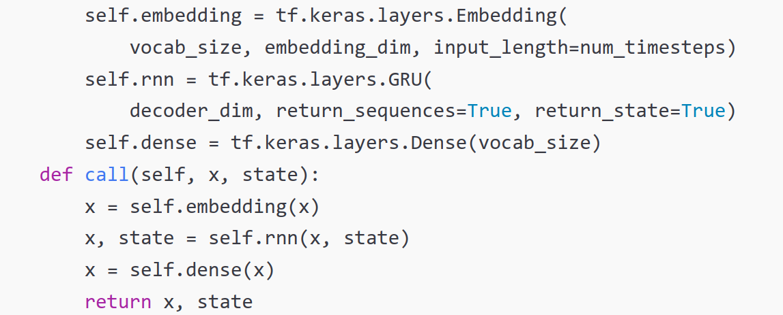
SEQ TO SEQ MODEL

Slide 7
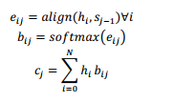
ATTENTION MECHANISM
We saw how the context or thought vector from the last time step of the encoder is fed into the decoder as the initial hidden state.
As the context flows through the time steps on the decoder, the signal gets combined with the decoder output and progressively gets weaker and weaker. The result is that the context does not have much effect on the later time steps in the decoder.
The result is that the context does not have much effect on the later time steps in the decoder
The attention mechanism provides access to all encoder hidden states at every time step on the decoder. The decoder learns which part of the encoder states to pay more attention to
The use of attention is not limited to seq2seq networks. For example, attention is a key component in the “Embed, Encode, Attend, Predict” formula for creating state-of-the-art deep learning models for NLP
Consider an encoder-decoder architecture where the input and output time steps are denoted by indices i and j respectively, and the hidden states on the encoder and decoder at these respective time steps are denoted by hi and sj. Inputs to the encoder are denoted by xi, and outputs from the decoder are denoted by yj.
Notes:
This preprocess_sentence function performs several text cleaning steps:
Remove diacritics (accents, tildes, etc.) unicodedata.normalize("NFD", sent) decomposes characters (e.g., "é" → "e" + "´"). Then unicodedata.category(c) != "Mn" keeps only characters that are not combining marks (like accents).
Add spaces around punctuation re.sub(r"([!.?])", r" \1", sent) inserts a space before !, ., ? (but keeps the punctuation).
Keep only letters, !, ., ? re.sub(r"[^a-zA-Z!.?]+", r" ", sent) replaces any character that is not a letter or ! . ? with a space.
Collapse multiple spaces re.sub(r"\s+", " ", sent) replaces any whitespace sequence with a single space.
Lowercase sent.lower()

Slide 8

ATTENTION MECHANISM
Essentially, the attention mechanism provides a way to score tokens in the target against all tokens in the source and modify the input signal to the decoder accordingly. Consider an encoder-decoder architecture where the input and output time steps are denoted by indices i and j respectively, and the hidden states on the encoder and decoder at these respective time steps are denoted by h_i and s_j. Inputs to the encoder are denoted by xi, and outputs from the decoder are denoted by y_j.
In an encoder-decoder network without attention, the value of decoder state s_j is given by the hidden state s_j-1 and output y_j-1 at the previous time step. The attention mechanism adds a third signal c_j, known as the attention context. With attention, therefore, the decoder’s hidden state sj is a function of y_j-1, s_j-1, and c_j, which is shown as follows:
Notes:
This preprocess_sentence function performs several text cleaning steps:
Remove diacritics (accents, tildes, etc.) unicodedata.normalize("NFD", sent) decomposes characters (e.g., "é" → "e" + "´"). Then unicodedata.category(c) != "Mn" keeps only characters that are not combining marks (like accents).
Add spaces around punctuation re.sub(r"([!.?])", r" \1", sent) inserts a space before !, ., ? (but keeps the punctuation).
Keep only letters, !, ., ? re.sub(r"[^a-zA-Z!.?]+", r" ", sent) replaces any character that is not a letter or ! . ? with a space.
Collapse multiple spaces re.sub(r"\s+", " ", sent) replaces any whitespace sequence with a single space.
Lowercase sent.lower()

Slide 9
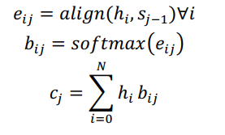
ATTENTION MECHANISM
The attention context signal c_j is computed as follows. For every decoder step j, we compute the alignment between the decoder state s_j-1 and every encoder state h_i. This gives us a set of N similarity values e_ij for each decoder state j, which we then convert into a probability distribution by computing their corresponding softmax values bij.
Finally, the attention context c_j is computed as the weighted sum of the encoder states h_i and their corresponding softmax weights b_ij over all N encoder time steps. The set of equations shown encapsulates this transformation for each decoder step j:
Notes:
This preprocess_sentence function performs several text cleaning steps:
Remove diacritics (accents, tildes, etc.) unicodedata.normalize("NFD", sent) decomposes characters (e.g., "é" → "e" + "´"). Then unicodedata.category(c) != "Mn" keeps only characters that are not combining marks (like accents).
Add spaces around punctuation re.sub(r"([!.?])", r" \1", sent) inserts a space before !, ., ? (but keeps the punctuation).
Keep only letters, !, ., ? re.sub(r"[^a-zA-Z!.?]+", r" ", sent) replaces any character that is not a letter or ! . ? with a space.
Collapse multiple spaces re.sub(r"\s+", " ", sent) replaces any whitespace sequence with a single space.
Lowercase sent.lower()

Slide 10



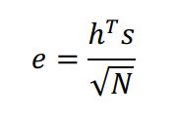
ATTENTION MECHANISM
Multiple attention mechanisms have been proposed based on how the alignment is done. We will describe a few next. For notational convenience, we will indicate the state vector hi on the encoder side with h, and the state vector sj-1 on the decoder side with s:
Content Based Attention
Additive or Bahdanau attention
Multiplicative or Luong’s attention
Scaled Dotproduct Attention
Notes:
This preprocess_sentence function performs several text cleaning steps:
Remove diacritics (accents, tildes, etc.) unicodedata.normalize("NFD", sent) decomposes characters (e.g., "é" → "e" + "´"). Then unicodedata.category(c) != "Mn" keeps only characters that are not combining marks (like accents).
Add spaces around punctuation re.sub(r"([!.?])", r" \1", sent) inserts a space before !, ., ? (but keeps the punctuation).
Keep only letters, !, ., ? re.sub(r"[^a-zA-Z!.?]+", r" ", sent) replaces any character that is not a letter or ! . ? with a space.
Collapse multiple spaces re.sub(r"\s+", " ", sent) replaces any whitespace sequence with a single space.
Lowercase sent.lower()

Slide 11
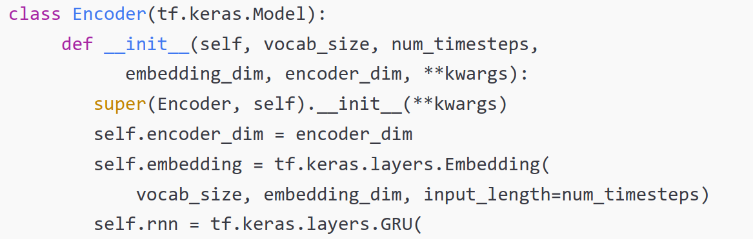
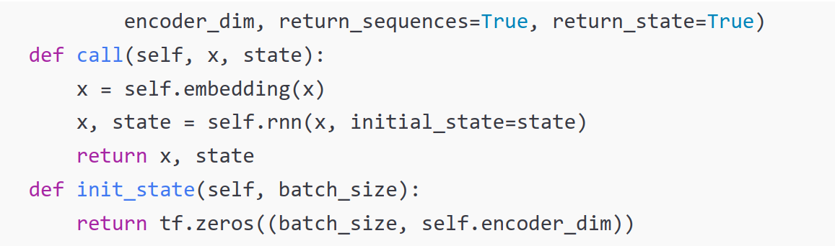
ATTENTION MECHANISM
Notes:
This preprocess_sentence function performs several text cleaning steps:
Remove diacritics (accents, tildes, etc.) unicodedata.normalize("NFD", sent) decomposes characters (e.g., "é" → "e" + "´"). Then unicodedata.category(c) != "Mn" keeps only characters that are not combining marks (like accents).
Add spaces around punctuation re.sub(r"([!.?])", r" \1", sent) inserts a space before !, ., ? (but keeps the punctuation).
Keep only letters, !, ., ? re.sub(r"[^a-zA-Z!.?]+", r" ", sent) replaces any character that is not a letter or ! . ? with a space.
Collapse multiple spaces re.sub(r"\s+", " ", sent) replaces any whitespace sequence with a single space.
Lowercase sent.lower()

Slide 12
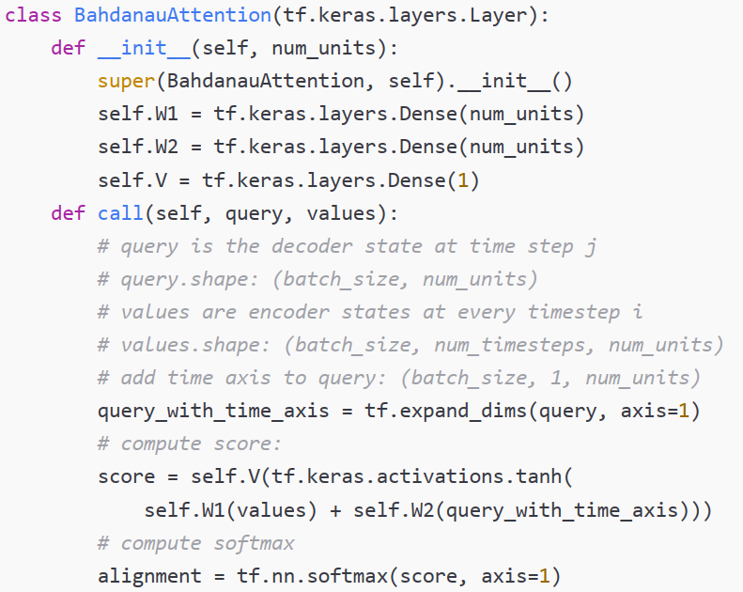
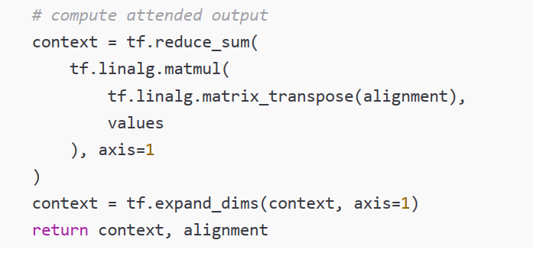

ATTENTION MECHANISM
Note: Here the Query is the hidden state information from the Encoder, & Values is the Decoder Input which is French sentence beginning with BOS tag and finishing just one token behind the current token
Notes:
This preprocess_sentence function performs several text cleaning steps:
Remove diacritics (accents, tildes, etc.) unicodedata.normalize("NFD", sent) decomposes characters (e.g., "é" → "e" + "´"). Then unicodedata.category(c) != "Mn" keeps only characters that are not combining marks (like accents).
Add spaces around punctuation re.sub(r"([!.?])", r" \1", sent) inserts a space before !, ., ? (but keeps the punctuation).
Keep only letters, !, ., ? re.sub(r"[^a-zA-Z!.?]+", r" ", sent) replaces any character that is not a letter or ! . ? with a space.
Collapse multiple spaces re.sub(r"\s+", " ", sent) replaces any whitespace sequence with a single space.
Lowercase sent.lower()

Slide 13
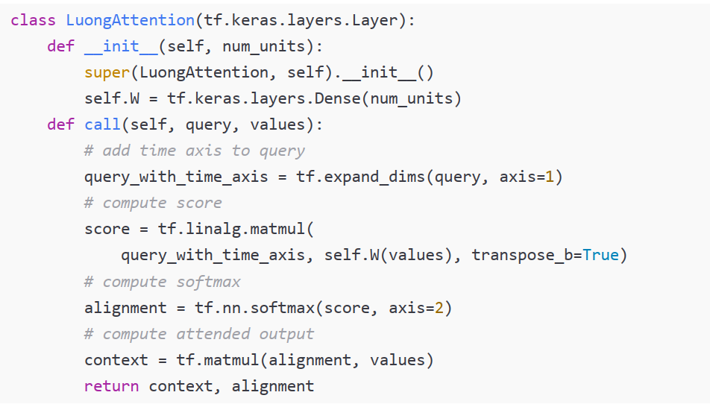
ATTENTION MECHANISM
Note: Here the Query is the hidden state information from the Encoder, & Values is the Decoder Input which is French sentence beginning with BOS tag and finishing just one token behind the current token
Notes:
This preprocess_sentence function performs several text cleaning steps:
Remove diacritics (accents, tildes, etc.) unicodedata.normalize("NFD", sent) decomposes characters (e.g., "é" → "e" + "´"). Then unicodedata.category(c) != "Mn" keeps only characters that are not combining marks (like accents).
Add spaces around punctuation re.sub(r"([!.?])", r" \1", sent) inserts a space before !, ., ? (but keeps the punctuation).
Keep only letters, !, ., ? re.sub(r"[^a-zA-Z!.?]+", r" ", sent) replaces any character that is not a letter or ! . ? with a space.
Collapse multiple spaces re.sub(r"\s+", " ", sent) replaces any whitespace sequence with a single space.
Lowercase sent.lower()

Slide 14
TRANSFORMERS
The original transformer architecture is a variant of the encoder-decoder architecture, where the recurrent layers are replaced with (self-)attention layers
The transformer was initially proposed by Google in the seminal paper titled Attention Is All You Need by Ashish Vaswani, Noam Shazeer, Niki Parmar, Jakob Uszkoreit, Llion Jones, Aidan N. Gomez, Lukasz Kaiser, and Illia Polosukhin, 2017, https://arxiv.org/abs/1706.03762
Prior to that, attention had been used together with Long-Short-Term Memory (LSTM) and other RNN (Recurrent Neural Network). Attention was introduced in 2014 in Neural Machine Translation by Jointly Learning to Align and Translate by Bahdanau et al., https://arxiv.org/abs/1409.0473, and applied to neural machine translation in 2015 in Effective Approaches to Attention-based Neural Machine Translation by Luong et al., https://arxiv. org/abs/1508.04025
In 2017, the first transformer demonstrated that you could remove LSTMs from Neural Machine Translation (NMT) models and use the so-called (self-)attention blocks (hence the paper title Attention Is All You Need).

Slide 15
TRANSFORMERS
The innovation introduced with the transformer in 2017 is based on four main key ideas:
Positional encoding
Attention
Self-attention
Multi-head (self-)attention
RNNs keep the word order by processing words sequentially. The advantage of this approach is simplicity, but one of the disadvantages is that this makes parallelization hard (training on multiple hardware accelerators). If we want to effectively leverage highly parallel architectures, such as GPUs and TPUs, we’d need an alternative way to represent ordering.
The transformer uses a simple alternative order representation called positional encoding, which associates each word with a number representing its position in the text The key intuition is that enriching transformers with a position allows the model to learn the importance of the position of each token (a word in the text/sentence)

Slide 16
TRANSFORMER
To understand how a Multi-Head Attention layer works, we must first understand the Scaled Dot-Product Attention layer, which it is based on
Let’s suppose the encoder analyzed the input sentence “They played chess,” and it managed to understand that the word “They” is the subject and the word “played” is the verb, so it encoded this information in the representations of these words.
Now suppose the decoder has already translated the subject, and it thinks that it should translate the verb next. For this, it needs to fetch the verb from the input sentence. This is analog to a dictionary lookup: it’s as if the encoder created a dictionary {“subject”: “They”, “verb”: “played”, …} and the decoder wanted to look up the value that corresponds to the key “verb
However, the model does not have discrete tokens to represent the keys (like “subject” or “verb”); it has vectorized representations of these concepts (which it learned during training), so the key it will use for the query (lookup – look for the verb) will not perfectly match any key in the dictionary.
The solution is to compute a similarity measure between the query and each key in the dictionary, and then use the softmax function to convert these similarity scores to weights that add up to 1
If the key that represents the verb is by far the most similar to the query, then that key’s weight will be close to 1. Then the model can compute a weighted sum of the corresponding values, so if the weight of the “verb” key is close to 1,

Slide 17

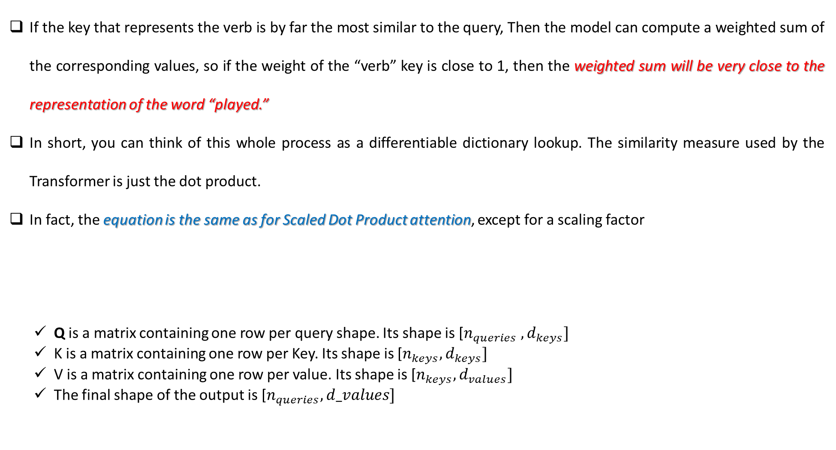
TRANSFORMER
If the key that represents the verb is by far the most similar to the query, Then the model can compute a weighted sum of the corresponding values, so if the weight of the “verb” key is close to 1, then the weighted sum will be very close to the representation of the word “played.”
In short, you can think of this whole process as a differentiable dictionary lookup. The similarity measure used by the Transformer is just the dot product.
In fact, the equation is the same as for Scaled Dot Product attention, except for a scaling factor
Q is a matrix containing one row per query shape. Its shape is [$n_{queries} , d_{keys}]$
K is a matrix containing one row per Key. Its shape is [$n_{keys}, d_{keys}]$
V is a matrix containing one row per value. Its shape is [$n_{keys},d_{values}]$
The final shape of the output is [$n_{queries}, d_values]$

Slide 18
TRANSFORMER
The scaling factor scales down the similarity score to avoid saturating the soft max function which would lead to tiny gradients
It is possible to mask out some key/value pairs by adding a very large negative value to the corresponding similarity scores, just before computing the softmax. This is useful in the Masked Multi-Head Attention layer.
In the encoder, this equation is applied to every input sentence in the batch, with Q, K, and V all equal to the list of words in the input sentence
So each word in the sentence will be compared to every word in the same sentence, including itself
Similarly, in the decoder’s masked attention layer, the equation will be applied to every target sentence in the batch, with Q, K, and V all equal to the list of words in the target sentence, but this time using a mask to prevent any word from comparing itself to words located after it

Slide 19
TRANSFORMER
Each input token sequence (for example, of a sentence) embedding that passes into the transformer (encoder and/or decoder) produces attention weights that are simultaneously calculated between every sequence element (such as a word).
The output results in embeddings produced for every token containing the token itself together with every other relevant token weighted by its relative attention weight.
The attention layer transforms the input vectors into query, key, and value matrices, which are then split into attention heads:
The query word can be interpreted as the word for which we are calculating the attention function.
The key and value words are the words to which we are paying attention.
The dot-product (explained further below) tells us the similarity between words. If the vectors for two words are more aligned, the attention score will be higher. The transformer will learn the weights in such a way that if two words in a sentence are relevant to each other, then their word vectors will be aligned.

Slide 20
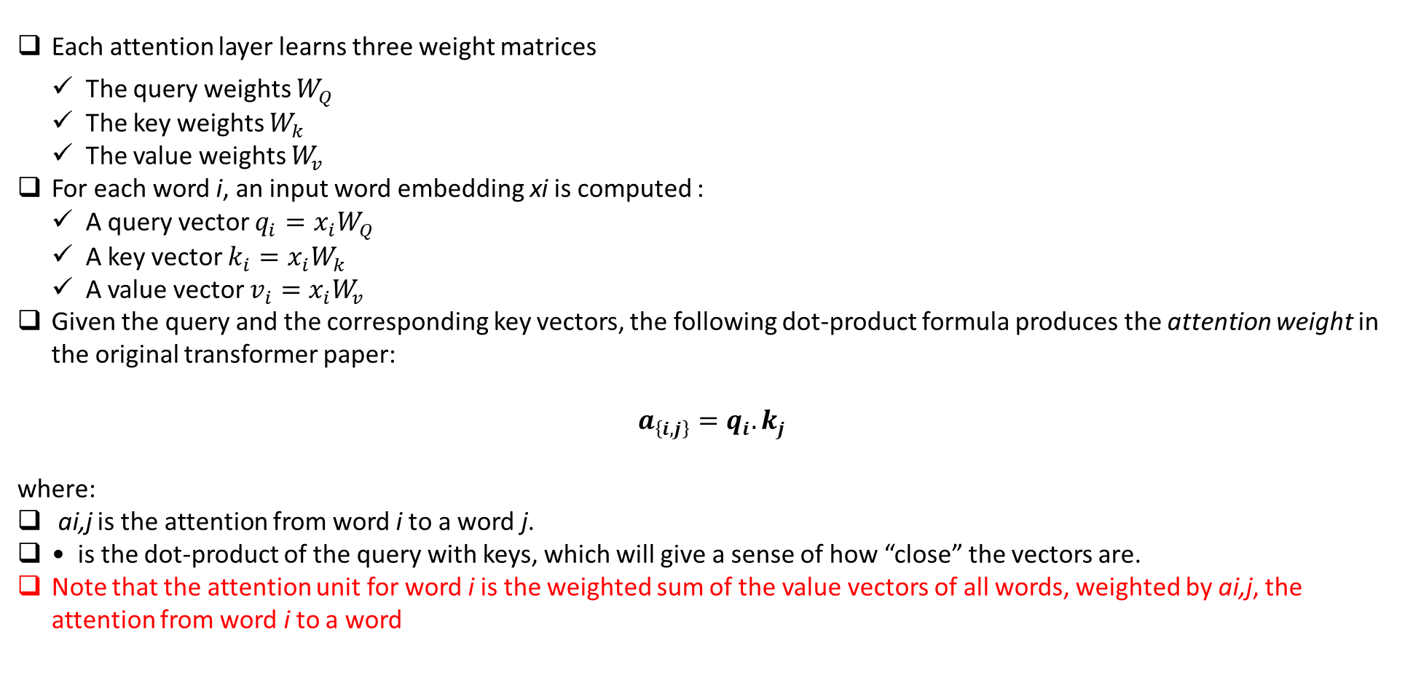
TRANSFORMER
Each attention layer learns three weight matrices
The query weights $W_{Q}$
The key weights $W_{k}$
The value weights $W_{v}$
For each word i, an input word embedding xi is computed :
A query vector $q_{i}=x_{i}W_{Q}$
A key vector $k_{i}=x_{i}W_{k}$
A value vector $v_{i}=x_{i}W_{v}$
Given the query and the corresponding key vectors, the following dot-product formula produces the attention weight in the original transformer paper:
$a_{\left\{i,j\right\}}=q_{i}. k_{j}$
where:
ai,j is the attention from word i to a word j.
• is the dot-product of the query with keys, which will give a sense of how “close” the vectors are.
Note that the attention unit for word i is the weighted sum of the value vectors of all words, weighted by ai,j, the attention from word i to a word

Slide 21

TRANSFORMER
Now, to stabilize gradients during the training, the attention weights are divided by the square root of the dimension of the key vectors
Then, the results are passed through a softmax function to normalize the weight. Note that the attention function from a word i to a word j is not the same as the attention from word j to a word i.

Slide 22
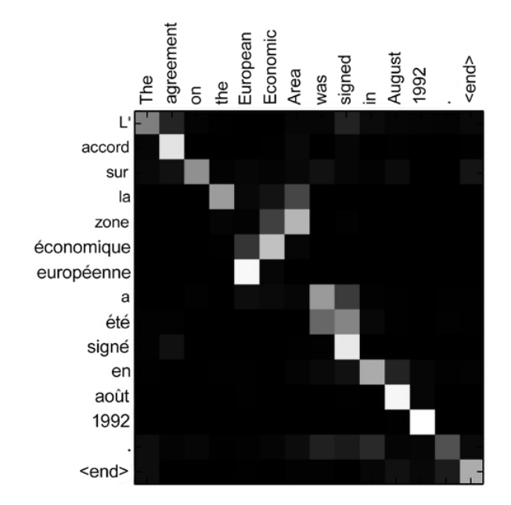
EXAMPLE OF ATTENTION MECHANISM
Using the attention mechanism, the neural network can learn a heatmap of each source English word in relation to each target French word. Note that relationships are not only on the diagonal but might spread across the whole matrix. For instance, when the model outputs the French word “européenne,” it will pay a lot of attention to the input words “European” and “Economic.”
The 2014 attention paper by Bahdanou et al. demonstrated that the model (which used an RNN encoder-decoder framework with attention) can learn to align and attend to the input elements without supervision, and, as Figure shows, translate the input English sentences into French. And, of course, the larger the training set is, the greater the number of correlations that the attention-based model can learn

Slide 23
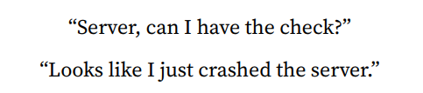
SELF ATTENTION
The third key idea popularized by the original transformer paper is the use of attention within the same sentence in the source language—self-attention. With this mechanism, neural networks can be trained to learn the relationships among all words (or other elements) in each input sequence (such as a sentence) irrespective of their positions
Clearly, the word “server” has a very different meaning in either sentence and self-attention can understand each word considering the context of the surrounding words. Just to reiterate, the attention mechanism can access all previous words and weigh them according to a learned measure of relevancy. Self-attention provides relevant information about tokens located far away in the source sentence.

Slide 24
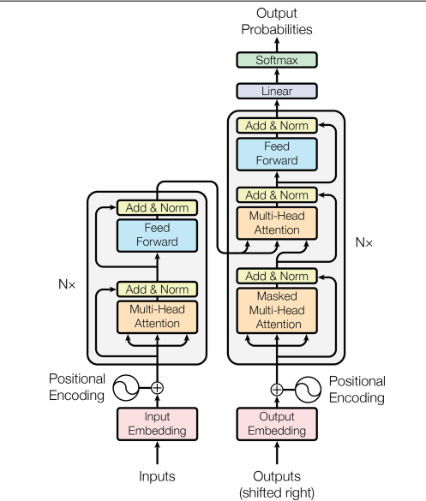
TRANSFORMER

Slide 25
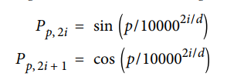
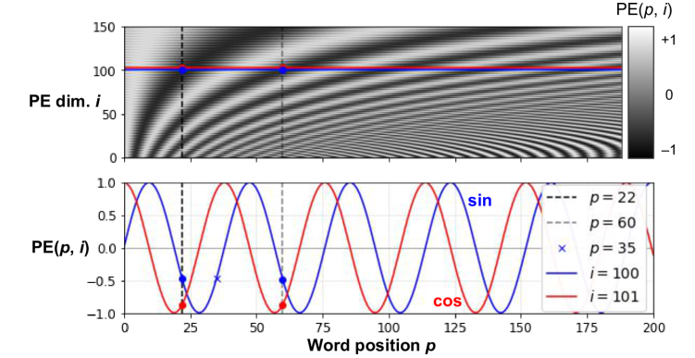
TRANSFORMER
Positional Encoding
A positional embedding is a dense vector that encodes the position of a word within a sentence: the i_th positional embedding is simply added to the word embedding of the i_th word in the sentence.

Slide 26
TRANSFORMER
After the positional embeddings are added to the word embeddings, the rest of the model has access to the absolute position of each word in the sentence because there is a unique positional embedding for each position (e.g., the positional embedding for the word located at the 22nd position in a sentence is represented by the vertical dashed line at the bottom left of Figure, and you can see that it is unique to that position). Moreover, the choice of oscillating functions (sine and cosine) makes it possible for the model to learn relative positions as well.
For example, words located 38 words apart (e.g., at positions p = 22 and p = 60) always have the same positional embedding values in the embedding dimensions i = 100 and i = 101, as you can see in Figure.

Slide 27
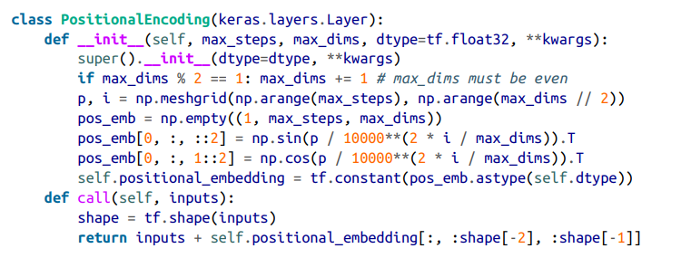
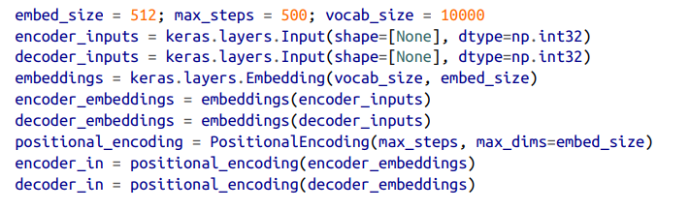
TRANSFORMER
After creating the positional encoding class we can create the positional encoding layer for the Transformer

Slide 28
TRANSFORMER
In the upper attention layer of the decoder, the keys K and values V are simply the list of word encodings produced by the encoder, and the queries Q are the list of word encodings produced by the decoder.
The keras.layers.Attention layer implements Scaled Dot-Product Attention, efficiently applying the equation to multiple sentences in a batch. Its inputs are just like Q, K, and V, except with an extra batch dimension (first dimension)
In TensorFlow, if A and B are tensors with more than two dimensions—say, of shape [2, 3, 4, 5] and [2, 3, 5, 6] respectively—then tf.matmul(A, B) will treat these tensors as 2 × 3 arrays where each cell contains a matrix, and it will multiply the corresponding matri‐ ces: the matrix at the ith row and jth column in A will be multiplied by the matrix at the ith row and jth column in B. Since the product of a 4 × 5 matrix with a 5 × 6 matrix is a 4 × 6 matrix, tf.matmul(A, B) will return an array of shape [2, 3, 4, 6].

Slide 29
POSITIONAL ENCODING CLASS
import numpy as np
import tensorflow as tf
class positional_encoding:
def __init__(self, max_seq_len, d_model):
self.max_seq_len = max_seq_len
self.d_model = d_model
self.pos_encoding = self.get_positional_encoding()
def get_positional_encoding(self):
pos = np.arange(self.max_seq_len)[:, np.newaxis]
i = np.arange(self.d_model)[np.newaxis, :]
angle_rates = 1 / np.power(10000, (2 * (i//2)) / np.float32(self.d_model))
angle_rads = pos * angle_rates
angle_rads[:, 0::2] = np.sin(angle_rads[:, 0::2])
angle_rads[:, 1::2] = np.cos(angle_rads[:, 1::2])
pos_encoding = angle_rads[np.newaxis, ...]
return tf.cast(pos_encoding, dtype=tf.float32)

Slide 30
POSITIONAL ENCODING CLASS
import tensorflow as tf
class padding_mask:
def __init__(self, seq):
self.seq = seq
def create_padding_mask(self):
"""Creates a padding mask for attention mechanisms"""
seq = self.seq
# Create mask where 1 indicates padding position
mask = tf.cast(tf.math.equal(seq, 0), tf.float32)
# Add dimensions: (batch_size, 1, 1, seq_len)
# This allows broadcasting across attention heads
return mask[:, tf.newaxis, tf.newaxis, :] # Shape: (batch_size, 1, 1, seq_len)
def create_look_ahead_mask(self):
"""Creates a look-ahead mask for decoder self-attention"""
size = tf.shape(self.seq)[1]
# Create a lower triangular matrix of 1s and subtract from 1
# This gives a mask that prevents attending to future positions
mask = 1 - tf.linalg.band_part(tf.ones((size, size)), -1, 0)
return mask # Shape: (seq_len, seq_len)

Slide 31
SCALED DOT PRODUCT ATTENTION
import tensorflow as tf
def scaled_dot_product_attention(q, k, v, mask=None):
"""Calculate scaled dot product attention"""
matmul_qk = tf.matmul(q, k, transpose_b=True)
# Scale matmul_qk
dk = tf.cast(tf.shape(k)[-1], tf.float32)
scaled_attention_logits = matmul_qk / tf.math.sqrt(dk)
# Add the mask to the scaled tensor
if mask is not None:
scaled_attention_logits += (mask * -1e9)
# Softmax is normalized on the last axis (seq_len_k)
attention_weights = tf.nn.softmax(scaled_attention_logits, axis=-1)
output = tf.matmul(attention_weights, v)
return output, attention_weights

Slide 32
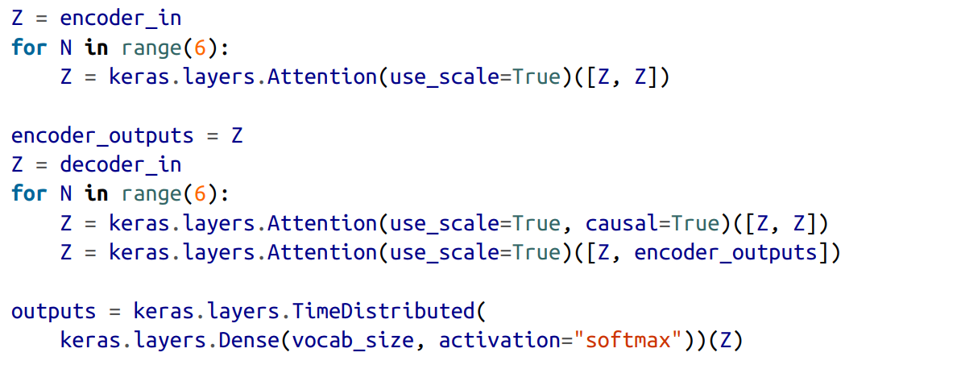
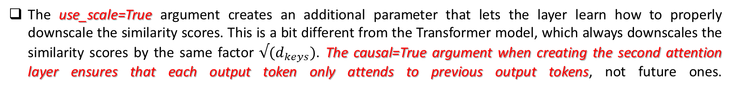
SCALED DOT PRODUCT ATTENTION
The use_scale=True argument creates an additional parameter that lets the layer learn how to properly downscale the similarity scores. This is a bit different from the Transformer model, which always downscales the similarity scores by the same factor $√(d_{keys})$. The causal=True argument when creating the second attention layer ensures that each output token only attends to previous output tokens, not future ones.

Slide 33
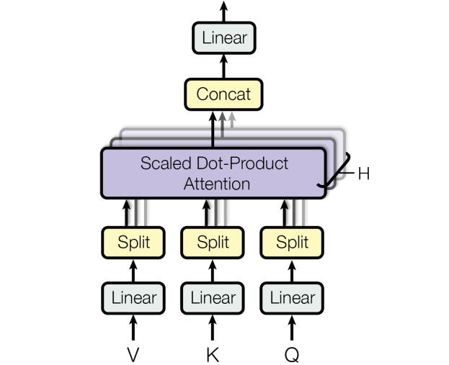
MULTIPLE HEAD ATTENTION
Multi-Head Attention allows the Transformer to:
Focus on multiple relationships simultaneously
Learn different contextual meanings
Capture long-range dependencies
Instead of using one attention mechanism, the Transformer uses multiple attention heads.
Each head will learn some thing new about the input sentence
It is just a bunch of Scaled Dot-Product Attention layers, each preceded by a linear transformation of the values, keys, and queries (i.e., a timedistributed Dense layer with no activation function). All the outputs are simply concatenated, and they go through a final linear transformation (again, timedistributed).

Slide 34
MULTIPLE HEAD ATTENTION
Consider the word “played” in the sentence “They played chess”. The encoder was smart enough to encode the fact that it is a verb. But the word representation also includes its position in the text, thanks to the positional encodings, and it probably includes many other features that are useful for its translation, such as the fact that it is in the past tense. In short, the word representation encodes many different characteristics of the word.
If we just used a single Scaled Dot-Product Attention layer, we would only be able to query all of these characteristics in one shot.
This is why the Multi-Head Attention layer applies multiple different linear transformations of the values, keys, and queries: this allows the model to apply many different projections of the word representation into different subspaces, each focusing on a subset of the word’s characteristics. Perhaps one of the linear layers will project the word representation into a subspace where all that remains is the information that the word is a verb, another linear layer will extract just the fact that it is past tense, and so on. Then the Scaled Dot-Product Attention layers implement the lookup phase, and finally we concatenate all the results and project them back to the original space.

Slide 35
MULTIPLE HEAD ATTENTION
import tensorflow as tf
from scaled_dot_product_attention import scaled_dot_product_attention
class MultiHeadAttention(tf.keras.layers.Layer):
def __init__(self, d_model, num_heads):
super(MultiHeadAttention, self).__init__()
self.num_heads = num_heads
self.d_model = d_model
assert d_model % self.num_heads == 0
self.depth = d_model // self.num_heads
self.wq = tf.keras.layers.Dense(d_model)
self.wk = tf.keras.layers.Dense(d_model)
self.wv = tf.keras.layers.Dense(d_model)
self.dense = tf.keras.layers.Dense(d_model)
def split_heads(self, x, batch_size):
x = tf.reshape(x, (batch_size, -1, self.num_heads, self.depth))
return tf.transpose(x, perm=[0, 2, 1, 3])

Slide 36
MULTIPLE HEAD ATTENTION
def call(self, v, k, q, mask=None): # Changed order to q,k,v but kept interface
batch_size = tf.shape(q)[0]
q = self.wq(q)
k = self.wk(k)
v = self.wv(v)
q = self.split_heads(q, batch_size)
k = self.split_heads(k, batch_size)
v = self.split_heads(v, batch_size)
# FIXED: scaled_dot_product_attention returns (output, attention_weights)
scaled_attention, attention_weights = scaled_dot_product_attention(q, k, v, mask)
scaled_attention = tf.transpose(scaled_attention, perm=[0, 2, 1, 3])
concat_attention = tf.reshape(scaled_attention, (batch_size, -1, self.d_model))
output = self.dense(concat_attention)
return output, attention_weights

Slide 37
POINT WISE FEED FORWARD NETWORK
import tensorflow as tf
class point_wise_feed_forward_network(tf.keras.layers.Layer):
def __init__(self, d_model, dff):
super(point_wise_feed_forward_network, self).__init__()
self.dense1 = tf.keras.layers.Dense(dff, activation='relu')
self.dense2 = tf.keras.layers.Dense(d_model)
def call(self, x):
x = self.dense1(x)
x = self.dense2(x)
return x

Slide 38
POINT WISE FEED FORWARD NETWORK
import tensorflow as tf
from MultiHeadAttention import MultiHeadAttention
from point_wise_feed_forward_network import point_wise_feed_forward_network
class EncoderLayer(tf.keras.layers.Layer):
def __init__(self, d_model, num_heads, dff, rate=0.1):
super(EncoderLayer, self).__init__()
self.mha = MultiHeadAttention(d_model, num_heads)
self.ffn = point_wise_feed_forward_network(d_model, dff)
self.layernorm1 = tf.keras.layers.LayerNormalization(epsilon=1e-6)
self.layernorm2 = tf.keras.layers.LayerNormalization(epsilon=1e-6)
self.dropout1 = tf.keras.layers.Dropout(rate)
self.dropout2 = tf.keras.layers.Dropout(rate)
def call(self, x, training, mask=None):
# Self-attention
attn_output, _ = self.mha(x, x, x, mask = mask) # (batch_size, input_seq_len, d_model)
attn_output = self.dropout1(attn_output, training=training)
out1 = self.layernorm1(x + attn_output)
# Feed forward
ffn_output = self.ffn(out1)
ffn_output = self.dropout2(ffn_output, training=training)
out2 = self.layernorm2(out1 + ffn_output)
return out2

Slide 39
POINT WISE FEED FORWARD NETWORK
import tensorflow as tf
from MultiHeadAttention import MultiHeadAttention
from point_wise_feed_forward_network import point_wise_feed_forward_network
class DecoderLayer(tf.keras.layers.Layer): # FIXED: tf.keras.layers.Layer not tf.keras.Layer
def __init__(self, d_model, num_heads, dff, rate=0.1):
super(DecoderLayer, self).__init__()
self.mha1 = MultiHeadAttention(d_model, num_heads)
self.mha2 = MultiHeadAttention(d_model, num_heads)
self.ffn = point_wise_feed_forward_network(d_model, dff)
self.layernorm1 = tf.keras.layers.LayerNormalization(epsilon=1e-6)
self.layernorm2 = tf.keras.layers.LayerNormalization(epsilon=1e-6)
self.layernorm3 = tf.keras.layers.LayerNormalization(epsilon=1e-6)
self.dropout1 = tf.keras.layers.Dropout(rate)
self.dropout2 = tf.keras.layers.Dropout(rate)
self.dropout3 = tf.keras.layers.Dropout(rate)

Slide 40
POINT WISE FEED FORWARD NETWORK
def call(self, x, enc_output, training, look_ahead_mask=None, padding_mask=None):
# Masked self-attention
attn1, attn_weights_block1 = self.mha1(x, x, x, mask = look_ahead_mask)
attn1 = self.dropout1(attn1, training=training)
out1 = self.layernorm1(x + attn1)
# Cross-attention with encoder output
attn2, attn_weights_block2 = self.mha2(enc_output, enc_output, out1, padding_mask)
attn2 = self.dropout2(attn2, training=training)
out2 = self.layernorm2(out1 + attn2)
# Feed forward
ffn_output = self.ffn(out2)
ffn_output = self.dropout3(ffn_output, training=training)
out3 = self.layernorm3(out2 + ffn_output)
return out3, attn_weights_block1, attn_weights_block2

