Slide 1
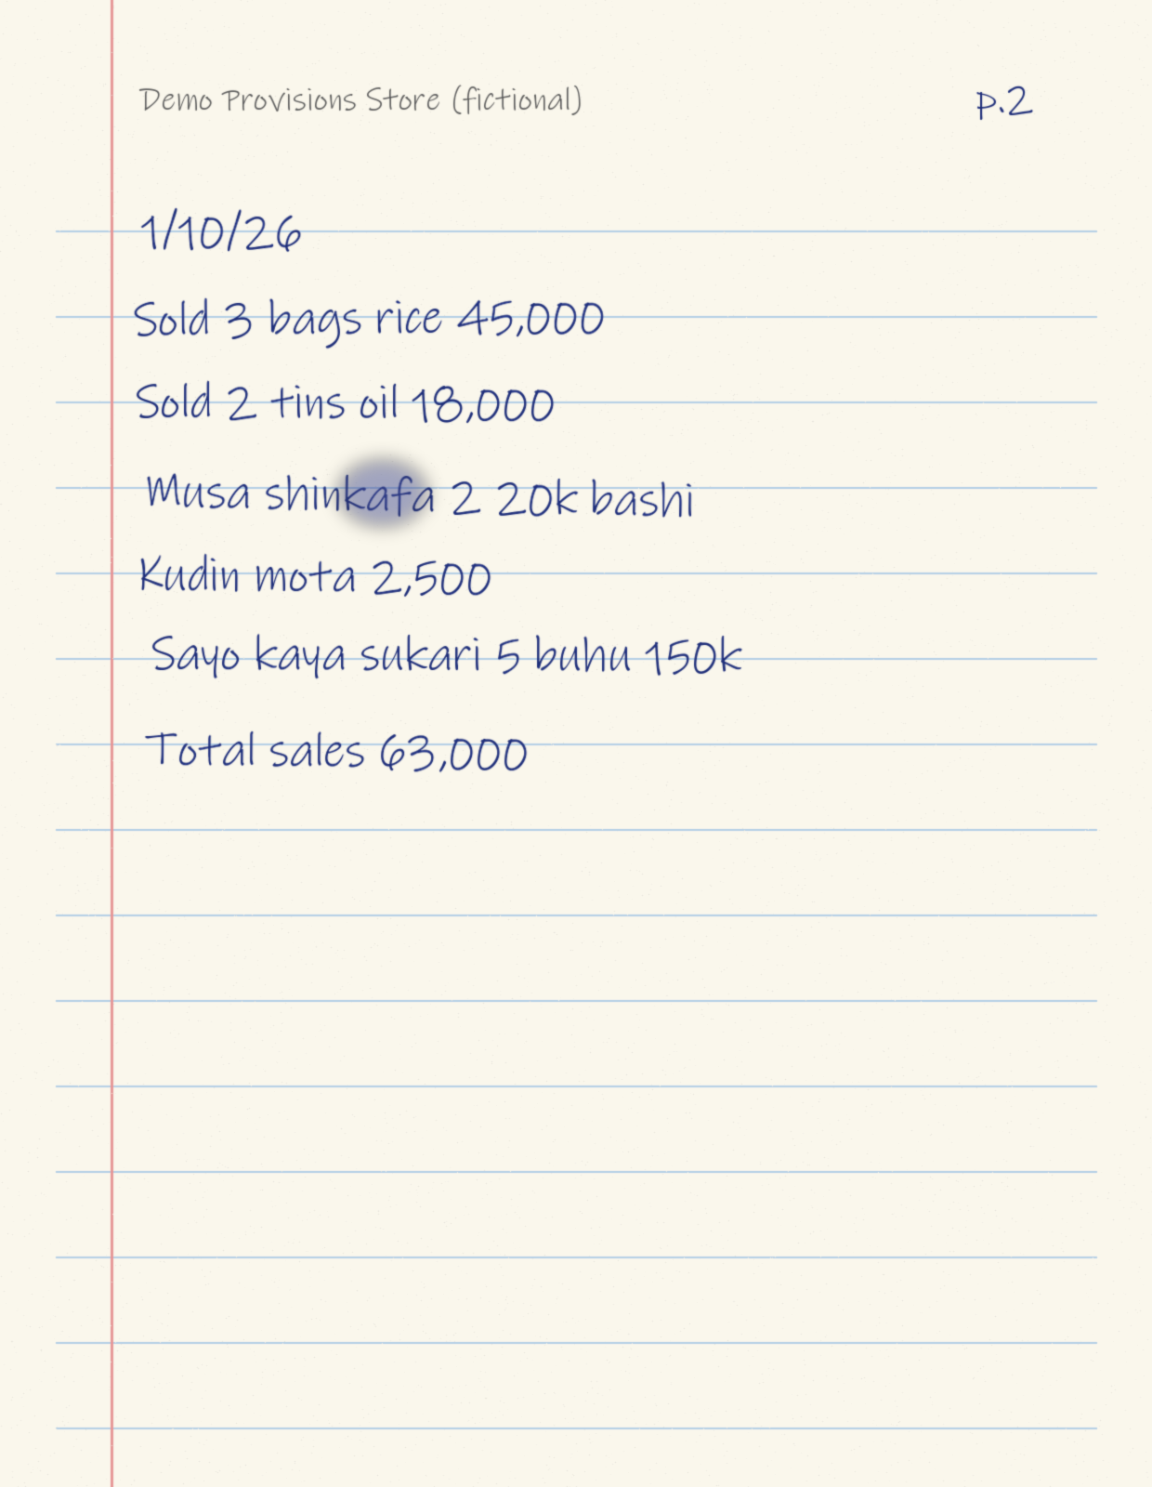
Huawei ICT Competition · Innovation Competition
NotebookOS
Your business already has a database. It's just handwritten.
[Team name] · [University / college]
[Student 1], [Student 2], [Student 3] · Instructor: [Instructor name]
Notes:
Introduce the team. NotebookOS turns a trader's handwritten notebook into structured, trustworthy business records, with every number traceable to the line it came from. All data in this presentation is fictional.

Slide 2
The notebook works, but it can't be counted
1
Can't be totalled
A real-style notebook entry
Daily sales and expenses live on paper; nobody adds them up reliably.
“Musa shinkafa 2? 20k bashi”
2
Can't see who owes
Musa took rice on credit (bashi) worth ₦20,000. The quantity is smudged.
Credit given to customers is scattered across pages and days.
3
Can't be shown to a lender
There is no trustworthy summary of the business to share.
And AI that silently “fills in” unclear values makes numbers nobody can trust.
Notes:
Many small traders keep their whole business in a notebook: sales, credit (bashi), repayments, expenses. It is trusted, but it is not computable. Simple OCR is not enough either: text is not business data, and an AI that guesses unclear values creates untrustworthy numbers.

Slide 3
AI reads. Code checks. The trader decides.
1
2
3
AI reads
Code checks
The trader decides
OCR or speech reads the page; a language model turns mixed Hausa and English into structured records. Unclear → null, never a guess.
Deterministic validation: is every amount and name really in the source text? Do the page totals match? All metrics are exact arithmetic in code.
Uncertain fields are highlighted. Only records the trader confirms become official business data.
Every number has provenance: page · row · pixel box · AI confidence · trader's correction · confirmation
Notes:
Our core principle: AI-powered business memory with traceable evidence. AI does the reading, code does the checking and arithmetic, the trader makes the decision, and every number keeps its evidence.

Slide 4
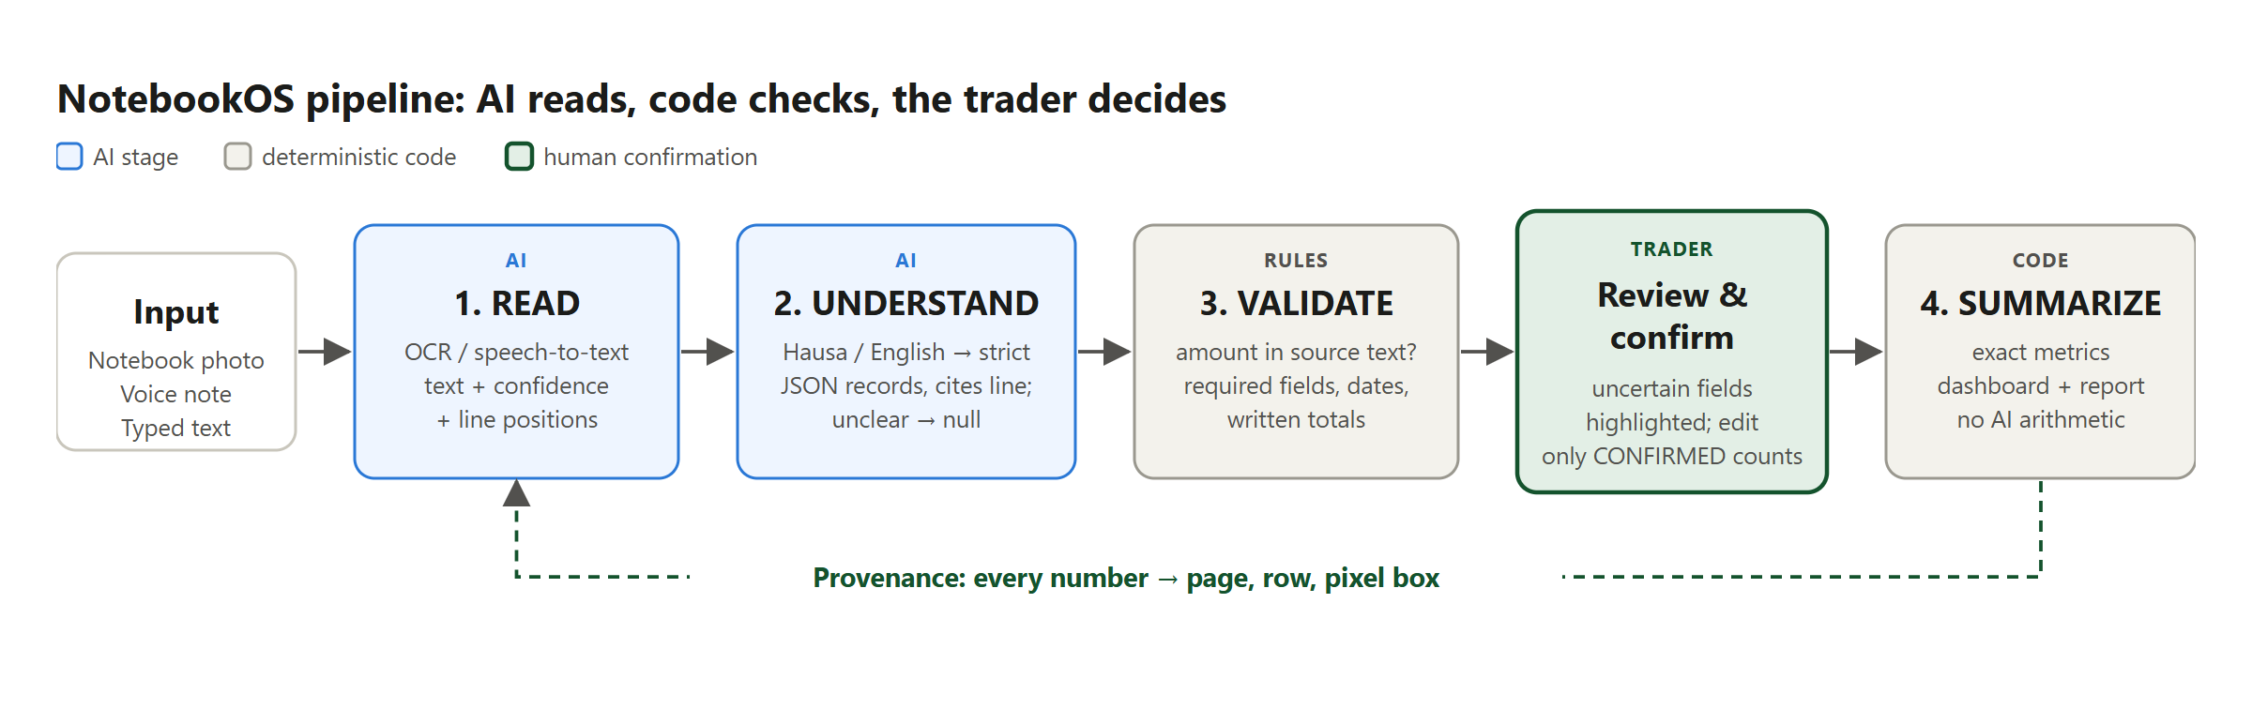
Four-stage pipeline with a human checkpoint
READ
OCR / speech → lines with confidence and position
UNDERSTAND
strict JSON records that must cite their source line
VALIDATE
amount-in-source, required fields, written totals
SUMMARIZE
exact metrics from CONFIRMED records only
Notes:
Walk the pipeline left to right. Emphasise the trader checkpoint between validation and summarising, and the provenance loop: every number on the dashboard links back to the page, row and pixel box it came from.

Slide 5
Huawei technologies in NotebookOS
Huawei technology | Role | Status
ModelArts | Hosted language model for UNDERSTAND (notebook lines → records) | Integration in progress
Huawei Cloud OCR | Handwriting recognition for READ (photos, with line positions) | Implemented; live test pending
SIS | Speech-to-text for voice notes | Implemented; live test pending
ECS | Hosts the web app and API (Docker) | Scripts ready; deployment pending
RDS for MySQL | System of record: records, provenance, reports | Verified on MySQL 8.4; RDS pending
DCS / OBS | Sessions / private photo storage | Supported (optional)
Status is stated honestly.
[Update this table as each integration is completed before submission.]
Other stack: React + TypeScript (web), Python FastAPI (API), SQLAlchemy + Alembic, pytest. Provider interfaces keep AI swappable, with offline fallbacks.
Notes:
State which Huawei technologies are used and how, exactly as their status is on the day. ModelArts is required by the competition: confirm it is integrated before the final presentation and update this table.

Slide 6
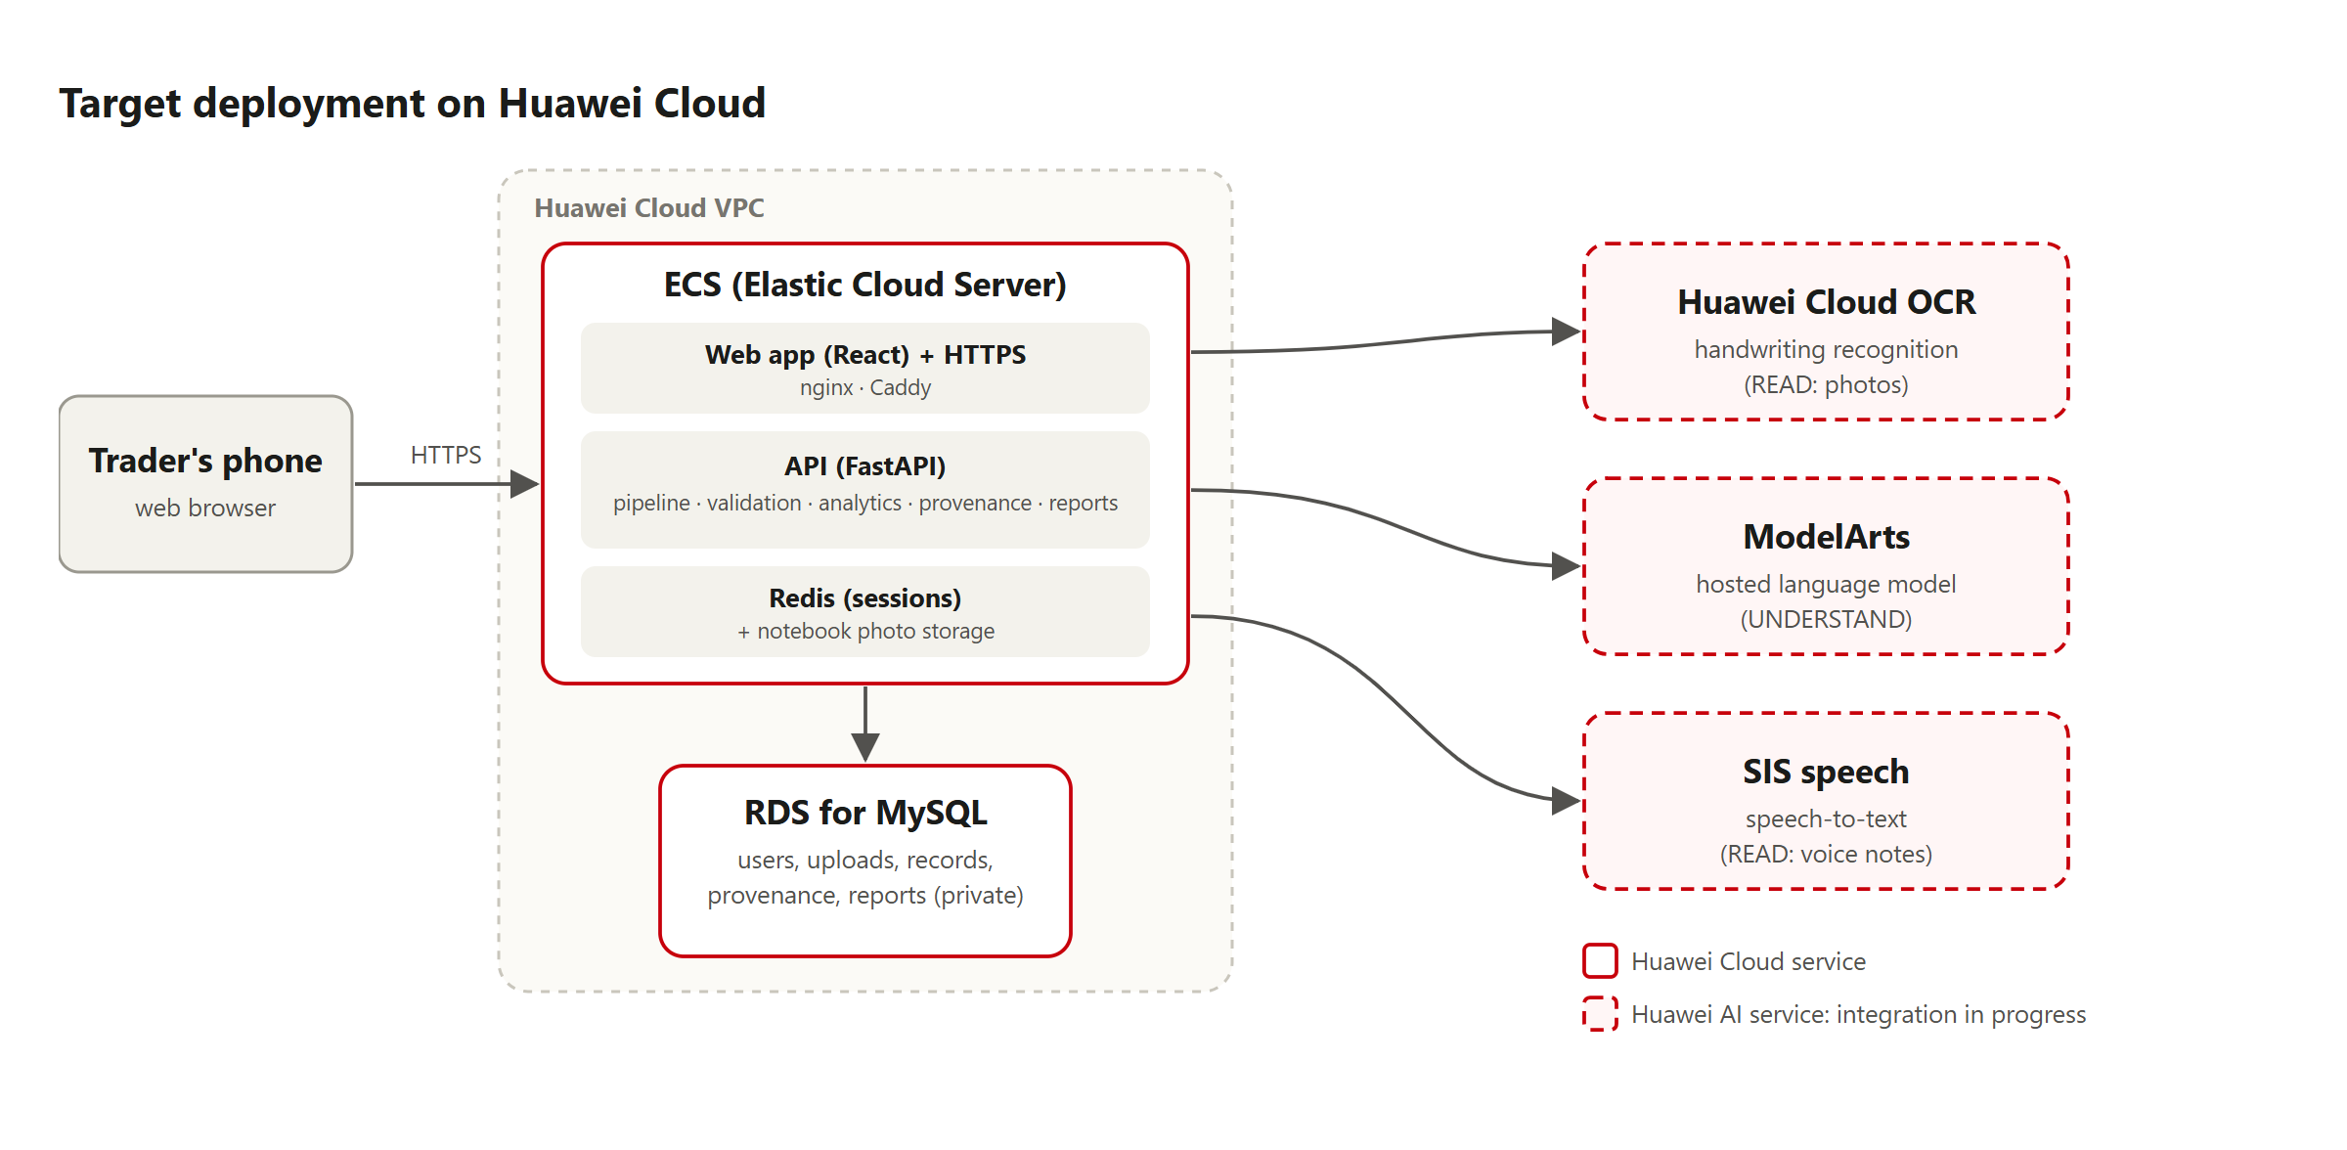
Deployment on Huawei Cloud
The web app and API run on ECS inside a VPC.
Business data lives in RDS for MySQL, which has no public access.
AI runs on Huawei Cloud OCR, ModelArts and SIS.
Interim live demo: Vercel + Render.
Notes:
Target architecture. Be clear about what is deployed today: the live demo currently runs on Vercel and Render while the Huawei Cloud deployment is completed.

Slide 7
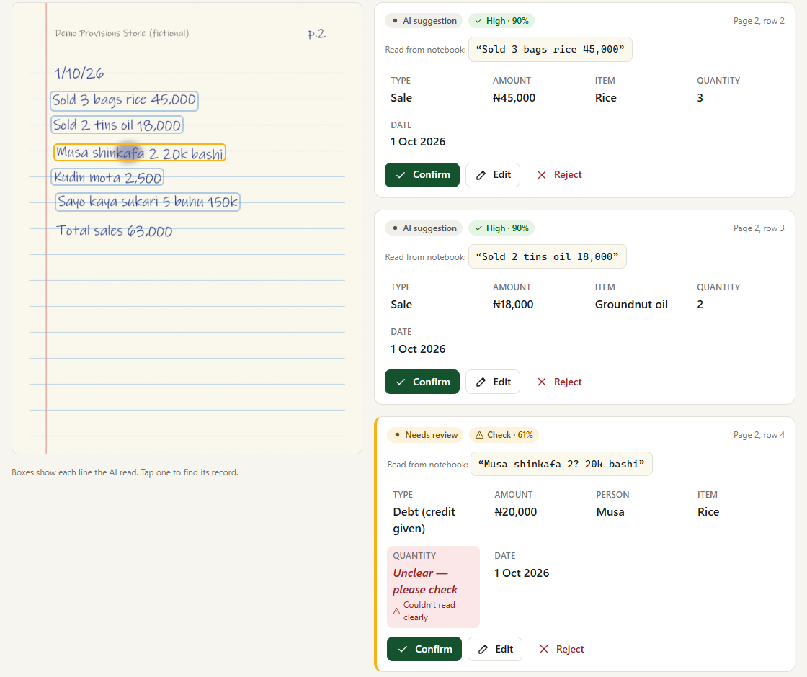
Review: the AI shows its work, the trader confirms
1
Every line boxed on the photo
The trader sees exactly what the AI read.
2
Smudged line flagged at 61%
Musa's record needs review; confident rows don't.
3
Unclear quantity is not guessed
It is marked unclear for the trader to fill in.
4
Written total cross-checked
The page total (₦63,000) matches the sales found.
Notes:
Demo moment: the smudged Musa line is flagged at 61%, and the quantity is left unclear instead of invented. The trader edits it to 2 and confirms.

Slide 8
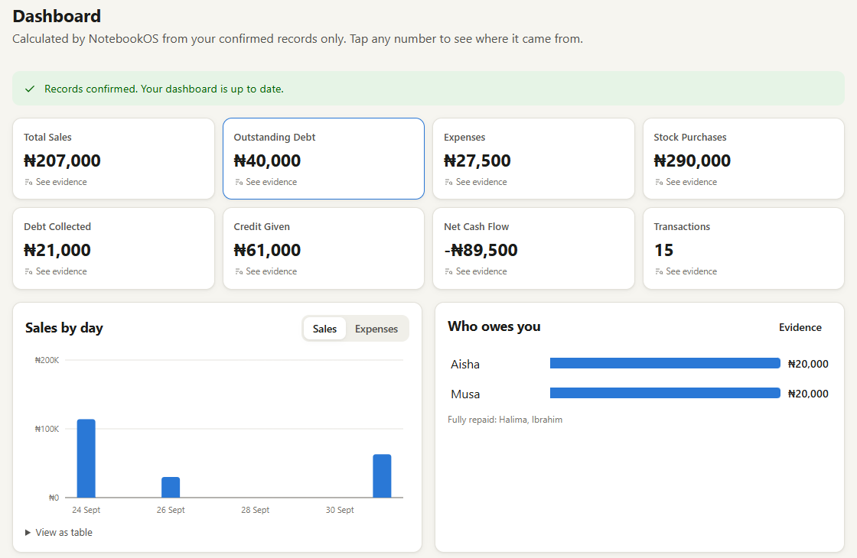
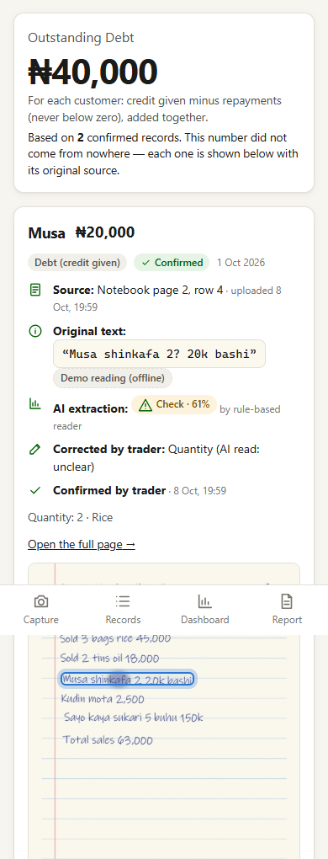
“This number did not come from nowhere”
Tap Outstanding Debt ₦40,000 to see every contributing record:
Notebook page 2, row 4
Original text
AI confidence 61%
Trader's correction
Confirmation time
Line highlighted on the photo
Metrics count CONFIRMED records only, and are calculated in code.
Notes:
The signature feature: provenance. Every dashboard number opens its evidence, down to the highlighted line on the original notebook photo.

Slide 9
Built to be trusted
1
No invention
2
AI never does arithmetic
Unclear values become null; records that can't cite a source line are discarded; AI amounts are checked against the text.
Exact decimal maths in code. An AI-written summary is rejected if it adds any number.
3
Works when AI is down
4
Privacy by default
Provider fallbacks and manual entry, so the trader is never blocked.
Explicit consent before sharing. Reports use a revocable read-only link and never show customer names or photos. Not a credit score.
Notes:
These principles answer a judge's question about trust: AI helps, but never decides and never invents figures.

Slide 10
Effect and value
86
4
1 tap
automated backend tests pass, including a full upload-to-report test
AI and code stages, with a human checkpoint before any number counts
from any dashboard number to the original notebook line
Social value
Scales beyond one city
Traders keep the notebook they trust. They see who owes them, and they get an honest, traceable summary to show a lender or supplier.
Currency, language vocabulary, date format and thresholds are configuration; a new language is a data file. Next: lenders and cooperatives as partners.
Accuracy on real notebooks has not been measured yet; there are no users or pilots. All demo data is fictional.
Notes:
Only claim what is true: tests, the working live demo and the design properties. Do not quote user numbers, market sizes or impact statistics; none have been measured.

Slide 11
Next steps
1
Complete the ModelArts + Huawei Cloud OCR integration
2
Deploy on Huawei Cloud ECS with RDS for MySQL
3
Evaluate on real, consented, anonymised notebook pages
“NotebookOS doesn't ask informal businesses to stop using the notebook they already trust. It makes that notebook computable.”
Live demo: notebook-os-xi.vercel.app · Code: github.com/usmanmasud/NOTEBOOK-OS
Notes:
Close with the quote. Offer the live demo link and the open-source repository.

