Slide 1
Object Oriented Programming
Exceptions and Exception Handling

Slide 2
Exceptions
An exception is an event that occurs during the execution of a program that disrupts the normal flow of instructions
  Eg- Accessing an Out of Bounds Array Element
Java uses exceptions to provide error-handling capabilities
When the system encounters an Error, an Exception Object is created
It contains the details of the Exception

Slide 3
Exceptions
The exception is then handed over to the Runtime System to be handled
This is called Throwing an Exception
The thrown Exception is propagated up the Call Stack
It has to be Caught and Handled so that we can take measures to recover from the error

Slide 4
Exceptions
An Exception has to be caught, or thrown so that it could be caught at a later time
Exception Types
  Runtime Exceptions
  Checked Exceptions
Exceptions can be created by the programmer

Slide 5
Runtime Exceptions
Usually occur within the Java Runtime System
Eg.-
  Arithmetic Expressions (division by zero)
  Null Pointer Exceptions
  Indexing Exceptions
The compiler does not require you to catch these exceptions, but they can be caught if necessary

Slide 6
Checked Exceptions
Not Runtime Exceptions
The compiler checks if these are caught
Compilation errors occur if they are not caught
Eg.-
  IOExceptions

Slide 7
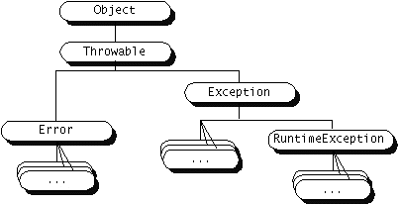
Throwing an Exception
When an Error is caught, an Exception has to be thrown inside that method (throw clause)
Then that method throws the Exception to the outside (throws clause in the method definition)
Any Object derived
from the Throwable
Class can be thrown

Slide 8
Throwing an Exception
Eg.-
  public void myMethod() throws MyException {
for (int i=1; i<10; i++) {
if (i == 5) {
throw new myException();
}
}
}

Slide 9
Catching an Exception
Consists of Three Blocks, try, catch & finally
try {
statementCausingTheException;
} catch (TheException e) {
exceptionHandlingCode;
} finally {
cleanUpCode;
}
The finally block is reached even if no Exception occurs

Slide 10
Catching an Exception
Eg.-
public void someMethod() {
String someString = “xyz”;
int someInt;
try {
someInt = Integer.parseInt(someString);
} catch (NumberFormatException nfe) {
System.err.println(" NumberFormatException: " + nfe.getMessage());
}
}

Slide 11
Defining an Exception
New types of Exceptions can be defined by sub-classing the Exception class or any of its subclasses.
public class MyException extends Exception {
public MyException() {
super("My Exception");
}
}

Slide 12
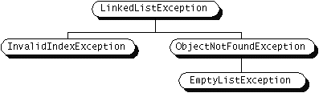
Defining an Exception
Normally done when the required type of exception is not provided by Java
Possible to implement a hierarchy of exceptions

Slide 13
Advantages of Exceptions
Separating Error Handling Code from Regular Code
  Eg.-
try {
statementThatThrowsException1;
statementThatThrowsException2;
} catch (Exception1) {
doSomething;
} catch (Exception2) {
doSomething;
}
The order is important. If you give a parent class first & a child class later, the second catch will not be reached

Slide 14
Advantages of Exceptions
Propagation Errors up the Call Stack
  Eg.-
method1 {
call method2;
}
method2 throws someException {
call method3;
}
method3 throws someException {
someCode;
}
Should be caught here

Slide 15
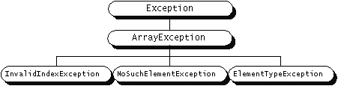
Advantages of Exceptions
Grouping Error Types and Error Differentiation

Slide 16
Questions

