Slide 1
RMI Callbacks
Advanced RMI Programming
© 2010. Usman Saleem - http://usmans.info

Slide 2
RMI Callbacks
A client would need to poll server for any updated changes as server side
Some applications require that for any change on the server side, they should actively communicate back to the client.
  Monitoring, Games, Auction, Voting/Polling, Message/Bulletin Boards etc.
RMI Callbacks can be implemented where registered clients can get notifications from server (callbacks) when needed.

Slide 3
RMI Callback Requirements
A remote method for client registrations for callback
An additional remote interface specifying methods for accepting callbacks
The client must export itself with UnicastRemoteObject and implements the remote interface
The client register itself for callbacks by calling remote registration method
The server invokes client's remote method upon occurrence of some important event.

Slide 4
RMI Callback Example
We will continue building on previous example of CrickInfo
This time the client will register itself with server
The server will inform client whenever there is a change in situation, for example, if a player is out.

Slide 5
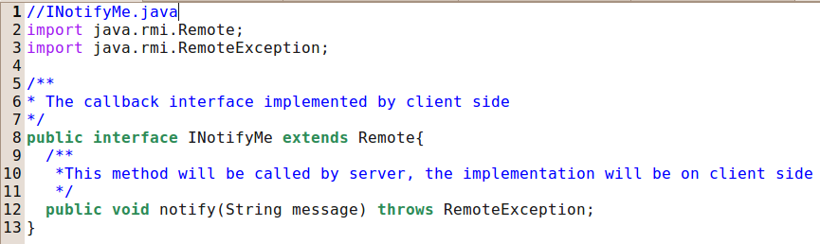
INotifyMe – The callback interface

Slide 6
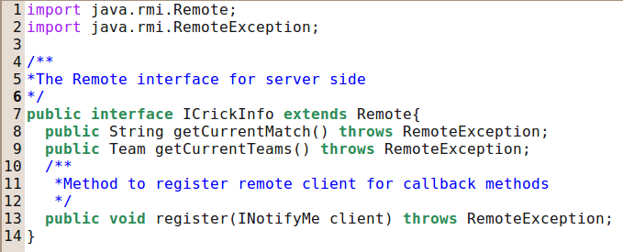
ICrickInfo – The server remote interface

Slide 7
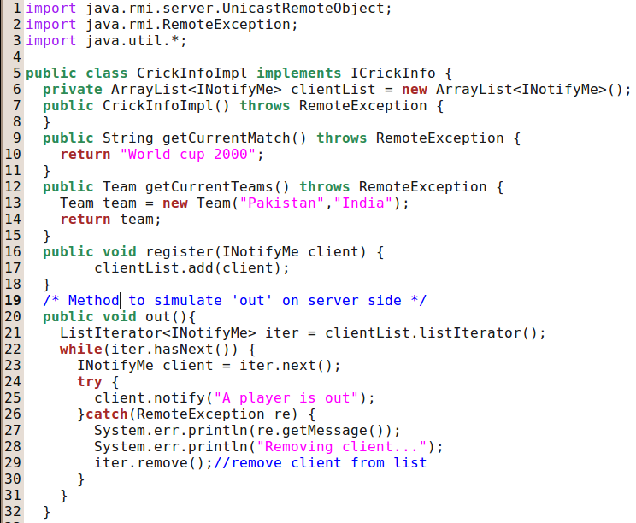
CrickInfoImpl – The server implementation

Slide 8
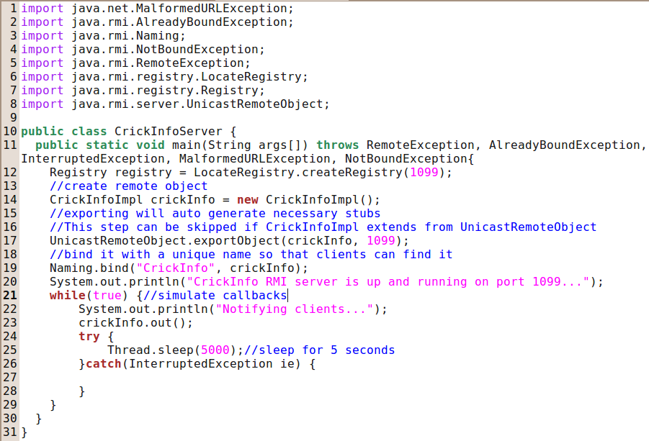
CrickInfoServer – The server launcher

Slide 9
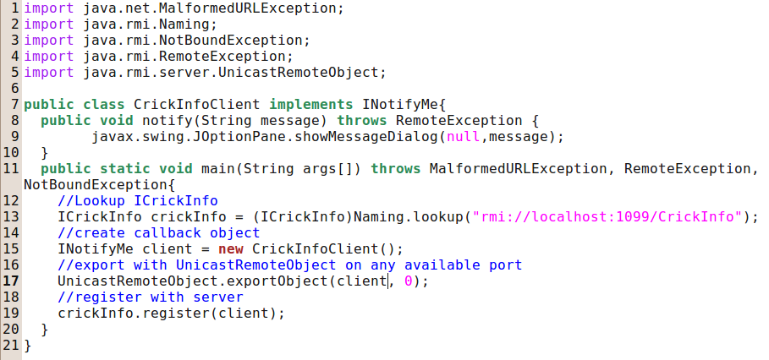
CrickInfoClient – The client launcher and callback provider

Slide 10
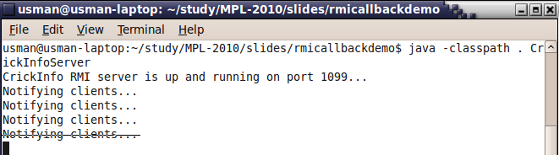
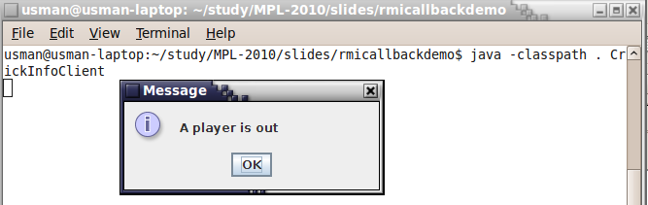
Results
Server side
Client Side

Slide 11
Questions?

