Slide 1
A Short Java RMI Tutorial
Usman Saleem
http://usmans.info

Slide 2
Agenda
Introducing RMI
The RMI classes and interfaces
The General RMI Architecture
Demo – build up 4 required classes
Demo – compiling and running the Weather Server

Slide 3
Introducing RMI
An RMI application is often composed of two separate programs, a server and a client. The server creates remotes objects and makes references to those objects accessible. Then it waits for clients to invoke methods on the objects. The client gets remote references to remote objects in the server and invokes methods on those remote objects.
Users use object as though it were a regular, local object
  Network connections happen automatically behind the scenes
  Java ‘serialization’ lets you pass complex data structures over the network without writing code to parse and reconstruct them

Slide 4
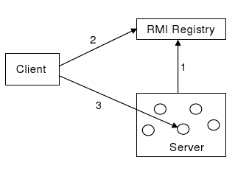
Introducing RMI (cont.)
A distributed object application has to handle the following properties:
  Locate remote objects
  Communicate with remote objects
  Load class bytecodes for objects that are passed as parameters or return values

Slide 5
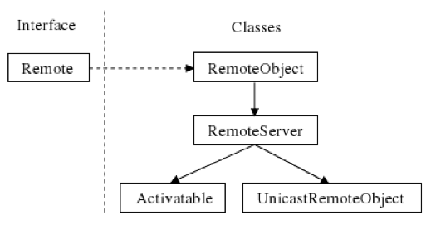
Interfaces and Classes in the java.rmi package

Slide 6
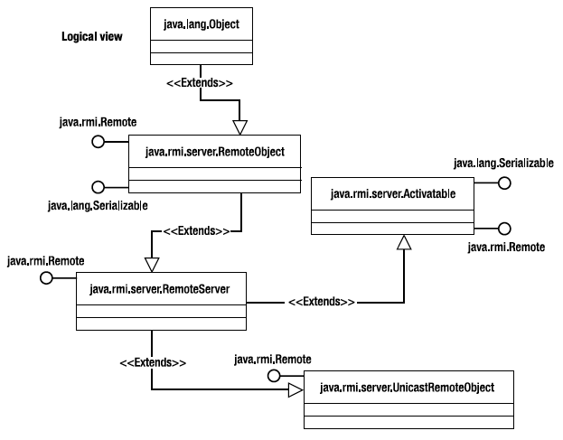
The RMI classes and interfaces

Slide 7
The General RMI Architecture

Slide 8
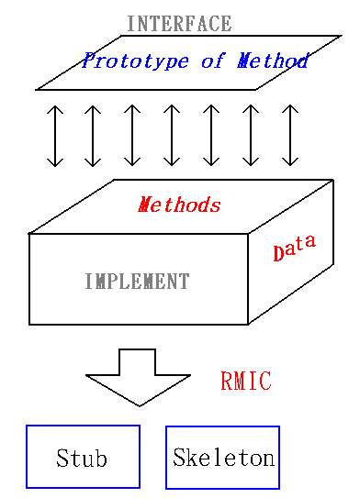
Remote object interface implemenation

Slide 9
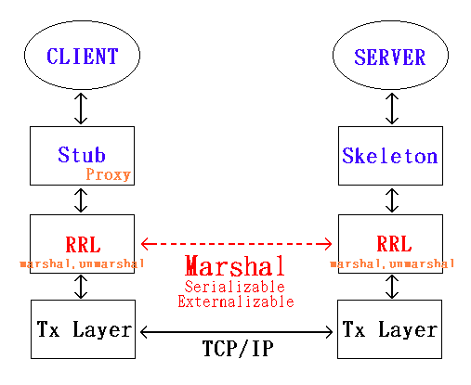
RMI Architecture
*RRL: Remote Reference Layer

Slide 10
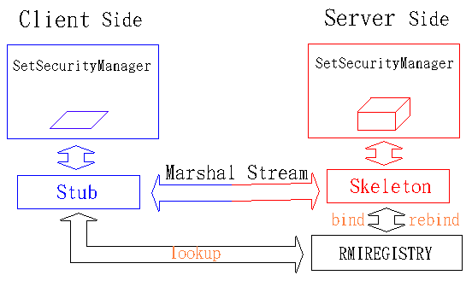
Runtime Architecture

Slide 11
Stub and Skeleton
Stub Operation
Skeleton Operation
Initiates a connection with remote JVM containing the remote object
Marshals (writes and transmits) parameters to remote JVM
Wait for the result of method invocation
Unmarshals (reads) the return value or exception returned
Return the value to the caller
Unmarshals (reads) the parameters for the remote method
Invokes the method on the actual remote method implementation
Marshals (write and transmit) the result (return value or exception) to the caller.

Slide 12
Stub and Skeleton (Cont.)
In Java 2 SDK, Standard Edition, v1.2 an additional stub protocol was introduced that eliminates the need for skeletons in Java 2 platform-only environment.
Instead, generic code is used to carry out the duties performed by the skeletons in JDK 1.1

Slide 13
Demo – build up 4 required classes

Slide 14
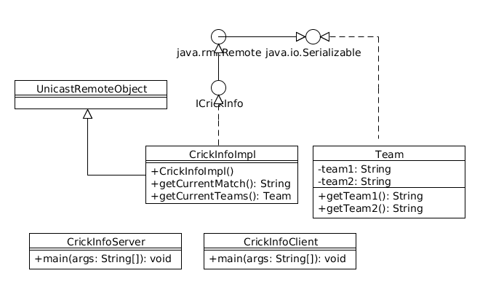




Class Diagram – four required classes
1
2
3
4

Slide 15
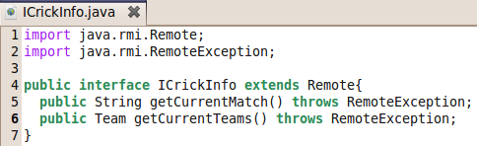
The interface for remote object
The remote interface must satisfy the following conditions:
It must extend the interface Remote.
Each remote method declaration in the remote interface must throw RemoteException

Slide 16
The remote object implementation
The class must extend UnicastRemoteObject and implement the remote object interface
The constructor should throw RemoteException

Slide 17
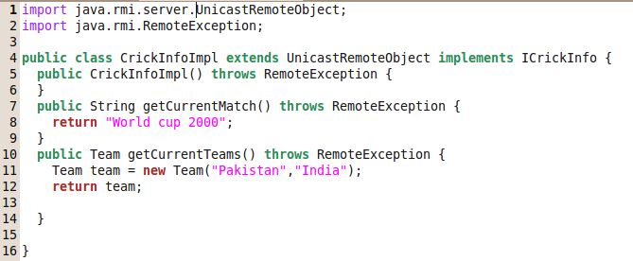
The remote object implementation

Slide 18
The RMI Server
Start RMI Registry through code (It can also run from command line)
Create instance of remote object
Export remote object if it does not extends from UnicastRemoteObject
Bind remote object using Naming.bind(throw AlreadyBoundException if a previous binding exists) or Naming.rebind (replace any previous bindings)

Slide 19
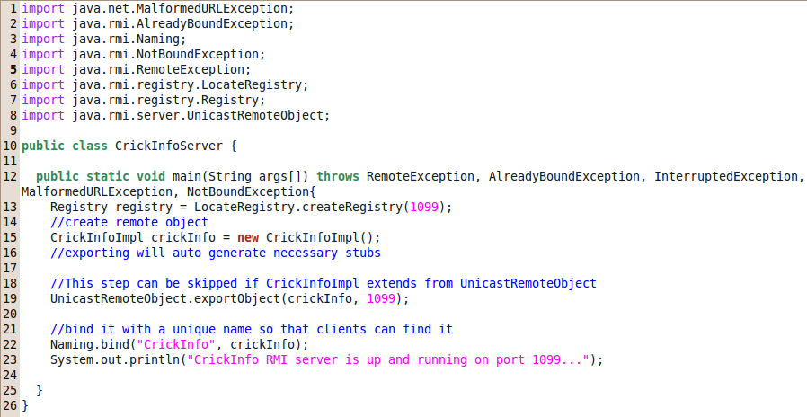
The RMI Server

Slide 20
The RMI Client
Lookup the object from the host using Naming.lookup, cast it to any appropriate type, then use it like a local object

Slide 21
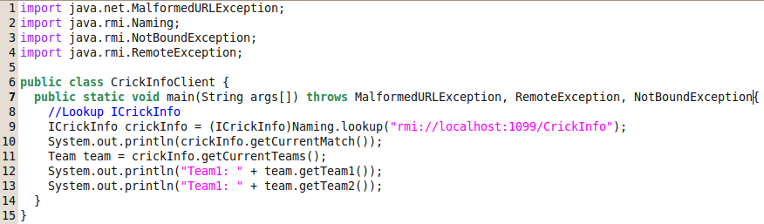
The RMI Client

Slide 22
Demo – compiling and running the CrickInfo Server

Slide 23
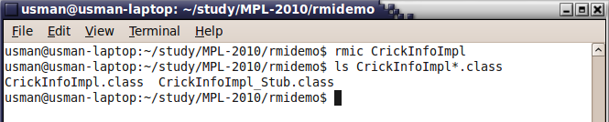
Compiling CrickInfo Server
1. Call rmic to create stubs of remote object (skeletons are optional in JDK 1.2 and above)

Slide 24
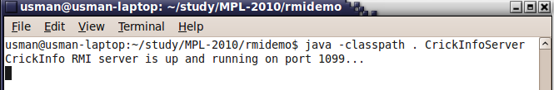
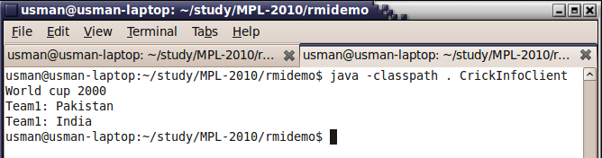
Compiling and running the CrickInfo Server and Client
3. startup the server
4. start the client

