Slide 1
Advanced JDBC
© Usman Saleem
usman.saleem@gmail.com

Slide 2
Topics
Prepared Statements
Transactions
Stored Procedures

Slide 3
Prepared Statements
PreparedStatement are used when similar query needs to be executed many times
PreparedStatement is given a SQL statement at the time it is created (unlike Statement)
The SQL statement gets precompiled by RDBMS in PreparedStatement.
SQL statements that take parameters are usually used by PreparedStatement

Slide 4
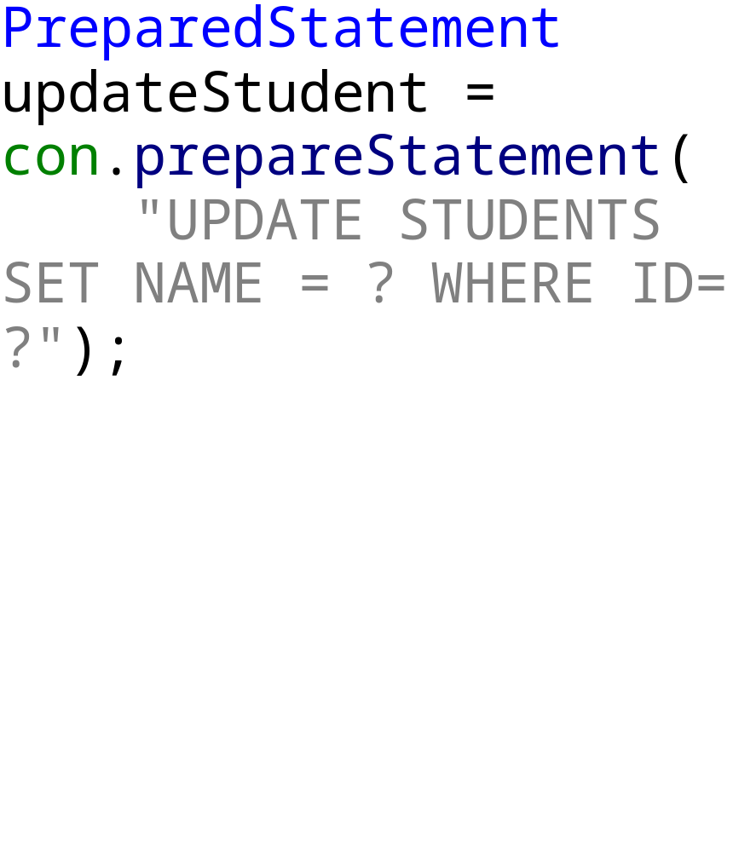
Creating PreparedStatement
Just like Statement objects, PreparedStatement is also created on Connection object
The SQL query normally sent to RDBMS and gets precompiled

Slide 5
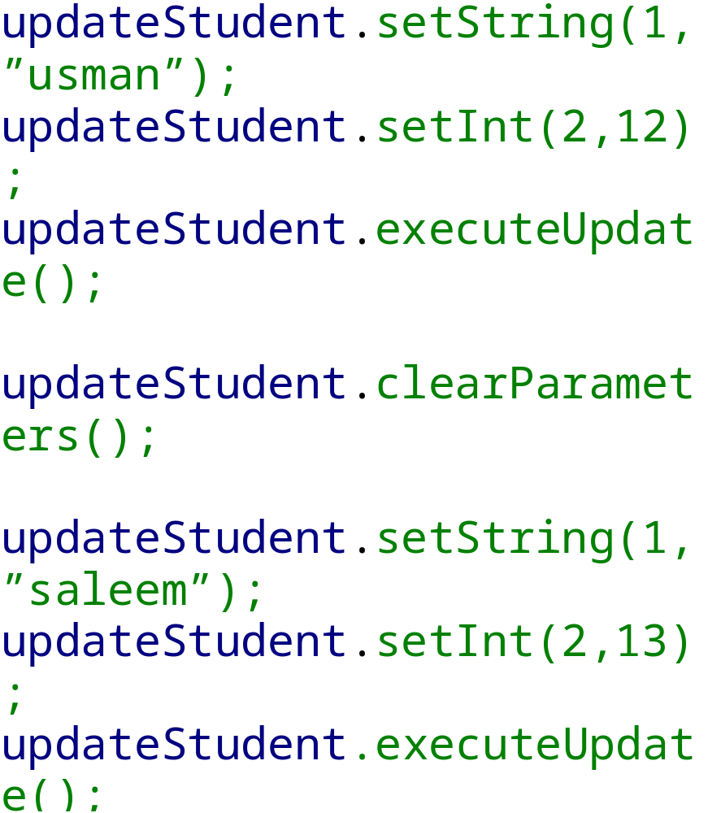
Setting parameters
For each placeholder, a setXXX method on PreparedStatement is called.
For each primitive type there is a corresponding setXXX method
SetInt, setString etc.
The values are set in PreparedStatement until it is reset to another value or clearParameters method is called

Slide 6
Using Transactions
Scenarios where one SQL statement should take efffect until another SQL statement completes
A transaction is a set of one or more statements that are executed together as a unit, so either all of the statements are executed, or none of the statements is executed.
AutoCommit mode is enabled on a new Connection, this means each individual statement will be in a transaction and will be committed right after it is executed
To allow two or more statements to be part of a transaction, AutoCommit needs to be disabled.
con.setAutoCommit(false)

Slide 7
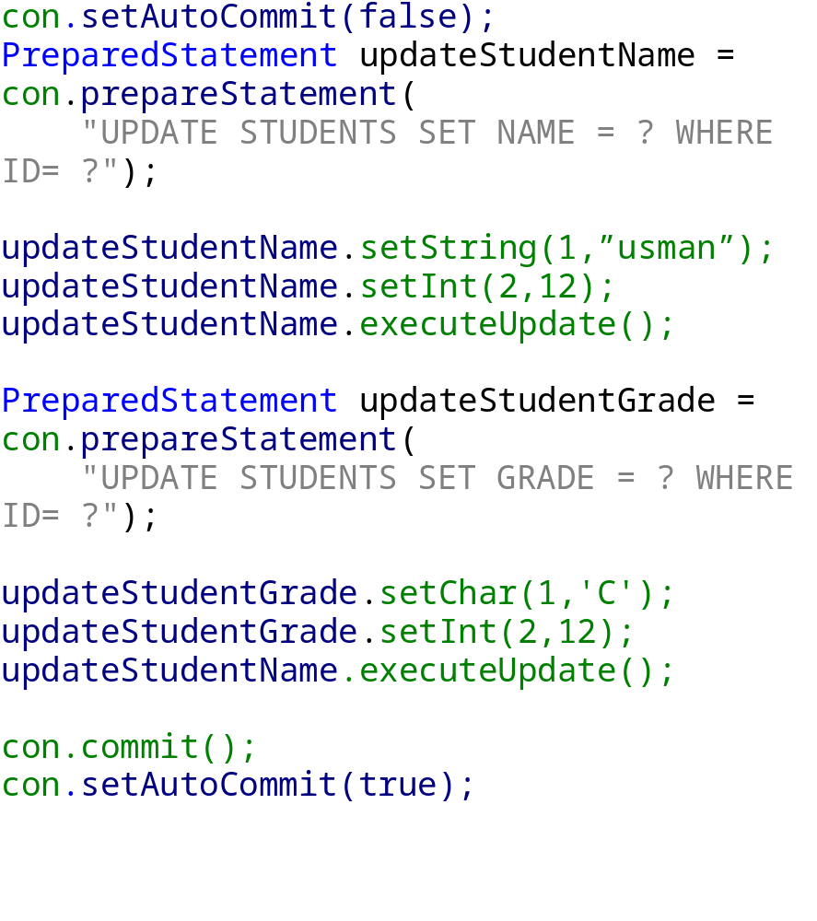
Cont.
A transaction is committed using commit() method
All the SQL statements executed before a commit() will be part of current transaction and will be executed as a unit.
A con.rollback will rollback all executed statements. It is generally call in catch block

Slide 8
Transaction Isolation Levels
Conflicts can arise when various clients use SQL statements to write and read data simultaneously
To avoid conflicts, RDBMS provide lock mechanisms.
Locks are mechanisms for blocking access to data that is being accessed by a transaction
Once a lock is set, it remains in force until a transaction is committed or rollback
For example, a DBMS could lock a row of a table until updates to it have been committed. The effect of this lock would be to prevent a user from getting a dirty read, that is, reading a value before it is made permanent.

Slide 9
JDBC Transactions Isolation Level
Use con.setTransactionIsolation(level)
TRANSACTION_READ_UNCOMMITTED
  Allows dirty reads, non-repeatable reads, and phantom reads to occur.
TRANSACTION_READ_COMMITTED
  Ensures only committed data can be read.
TRANSACTION_REPEATABLE_READ
  Is close to being "serializable," however, "phantom" reads are possible.
TRANSACTION_SERIALIZABLE
  Dirty reads, non-repeatable reads, and phantom reads are prevented. Serializable.

Slide 10
JDBC Transactions Isolation Level
TRANSACTION_NONE
  Transaction not supported by RDBMS. Can be determine by con.getTransactionIsolation.
A "phantom" read occurs when one transaction reads all rows that satisfy a WHERE condition, and a second transaction inserts a row that satisfies that WHERE condition, the first transaction then rereads for the same condition, retrieving the additional "phantom" row in the second read.

Slide 11
CallableStatements
Many RDBMS allows to create stored procedures
Stored procedures group together many SQL statements as a logical unit and perform a specific task.
Stored procedures can be compiled and executed with different parameters and results, and they may have any combination of input, output, and input/output parameters.
The syntax of creating a stored procedure is varied and depends on RDBMS

Slide 12
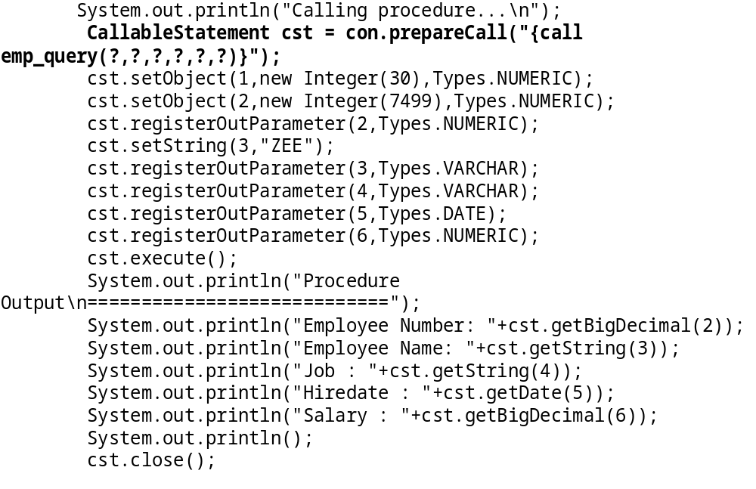
Example

