Slide 1

Basic Object Oriented Programming in Java
© 2009-2011 Usman Saleem
usman@usmans.info

Slide 2
Agenda
Similarities and differences between Java and C++
Object-oriented nomenclature and conventions
Instance variables (fields)
Methods (member functions)
Constructors

Slide 3
Object Oriented Programming in Java
Similarities with C++
  User-defined classes can be used like built-in types.
  Basic syntax
Differences from C++
  Methods (member functions) are the only function type
  Object is the topmost ancestor for all classes
  All methods use the run-time, not compile-time, types (i.e. all Java methods are like C++ virtual functions)
  The types of all objects are known at run-time
  All objects are allocated on the heap (always safe to return objects from methods)
  Single inheritance only
Comparisons to C#
  C# very similar to Java in OOP.For details, see http://www.harding.edu/fmccown/java1_5_csharp_comparison.html

Slide 4
Object Oriented Nomenclature
“Class” means a category of things
  A class name can be used in Java as the type of a field or local variable or as the return type of a function (method)
“Object” means a particular item that belongs to a class
  Also called an “instance”
For example, consider the following line:
  String s1 = "Hello";
  Here, String is the class, and the variable s1 and the value "Hello" are objects (or “instances of the String class”)

Slide 5
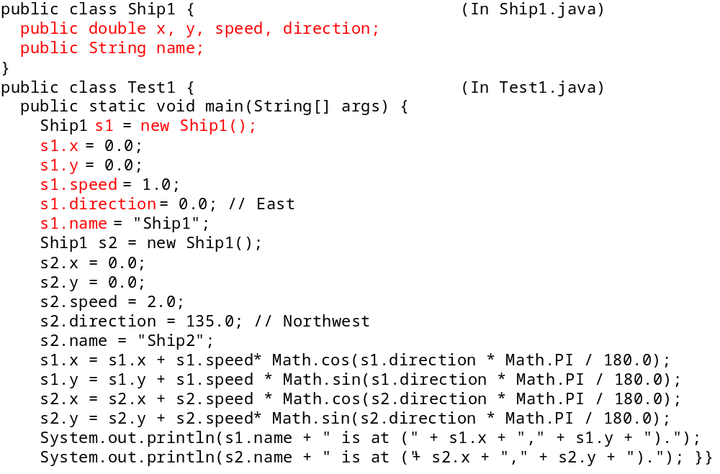
Example 1: Instance variables (“Fields” or “Data Members”)

Slide 6
Instance Variables: Results
Compiling and running manually
DOS> javac Test1.java
DOS> java Test1
Output:
Ship1 is at (1,0).
Ship2 is at (-1.41421,1.41421).

Slide 7
Example1: Major Points
Java naming conventions
Format of class definitions
Creating classes with “new”
Accessing fields with “variableName.fieldName”

Slide 8
Java Naming Conventions
Leading uppercase letter in class name
  public class MyClass {
  ...
  }
Leading lowercase letter in field, local variable, and method (function) names
  myField, myVar, myMethod

Slide 9
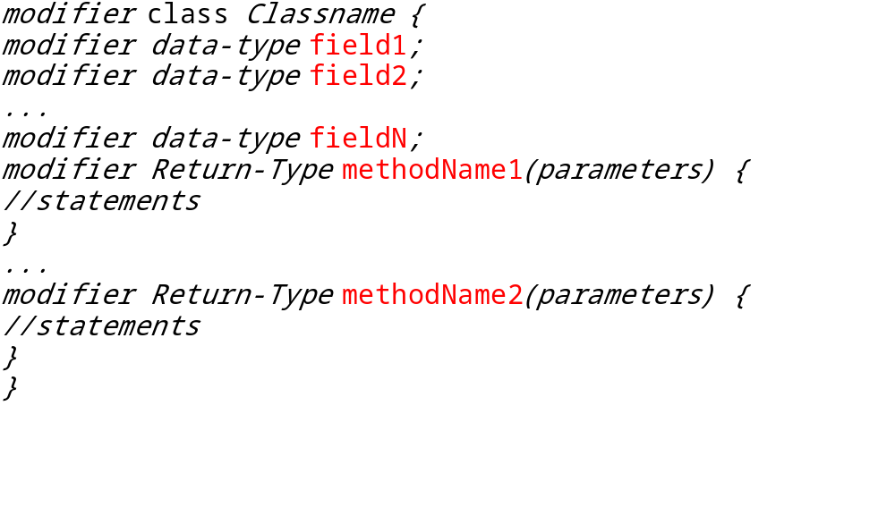
First Look at Java Classes
The general form of simple class is:

Slide 10
Objects and References
Once a class is defined, you can declare variables (object reference) of that type
  Ship s1, s2;
  Point start;
  Color blue;
Object references are initially null
  The null value is a distinct type in Java and is not equal to zero
  A primitive data type (e.g., int) cannot be cast to an object (e.g., String), but there are some conversion wrappers
The new operator is required to explicitly create the object that is referenced
  ClassName variableName = new ClassName();

Slide 11
Accessing instance variables
Use a dot between the variable name and the field name, as follows:
  variableName.fieldName
For example, Java has a built-in class called Point
that has x and y fields
  Point p = new Point(2, 3); // Build a Point object
  int xSquared = p.x * p.x; // xSquared is 4
  int xPlusY = p.x + p.y; // xPlusY is 5
  p.x = 7;
  xSquared = p.x * p.x; // Now xSquared is 49
One major exception applies to the “access fields through varName.fieldName” rule
  Methods can access fields of current object without varName
  This will be explained when methods (functions) are discussed

Slide 12
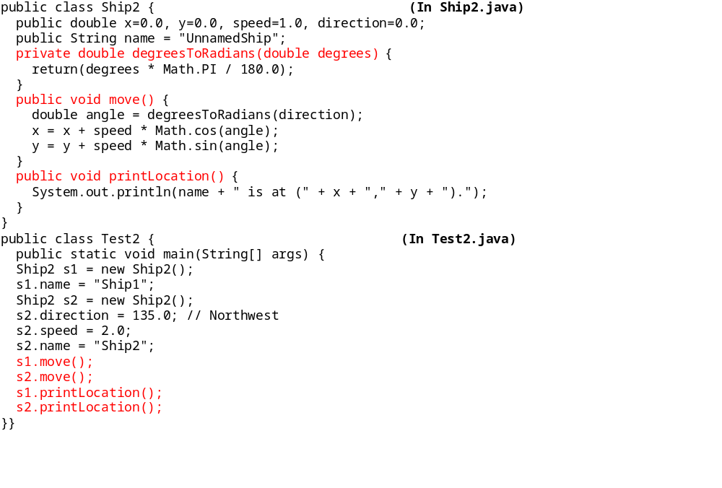
Example 2: Methods

Slide 13
Example 2: Major Points
Format of method definitions
Methods that access local fields
Calling methods
Static methods
Default values for fields
public/private distinction

Slide 14
Defining Methods (Inside Classes)
Basic method declaration:
  public ReturnType methodName(Type1 arg1, Type2 arg2, ...) {
  ...
  return(somethingOfReturnType); //brackets are optional
  }
Exception to this format: if you declare the return type as void
  This special syntax that means “this method isn’t going to return a value – it is just going to do some side effect like printing on the screen”
  In such a case you do not need (in fact, are not permitted), a return statement that includes a value to be returned. i.e. return something;

Slide 15
Methods accessing local fields
You normally access a field through
    variableName.fieldName
but an exception is when a method of a class wants to access fields of that same class
  In that case, omit the variable name and the dot
  For example, a move method within the Ship class might do:
  public void move() {
  x = x + speed * Math.cos(direction);
  ...
  }
    Here, x, speed, and direction are all fields within the class that the move method belongs to, so move can refer to the fields directly
  As we’ll see later, you still can use the variableName.fieldName approach, and Java invents a variable called this that can be used for that purpose

Slide 16
Calling Methods
The term “method” means “function associated with an object” (I.e., “member function”)
  The usual way that you call a method is by doing the following:
    variableName.methodName(argumentsToMethod);
For example, the built-in String class has a method called toUpperCase that returns an uppercase variation of a String
  This method doesn’t take any arguments, so you just put empty parentheses after the function (method) name.
    String s1 = "Hello";
    String s2 = s1.toUpperCase(); // s2 is now "HELLO"

Slide 17
Calling Methods (Cont)
There are two exceptions to requiring a variable name for a method call
  Calling a method defined inside the current class definition
  Functions (methods) that are declared “static”
Calling a method that is defined inside the current class
  You don’t need the variable name and the dot
  For example, a Ship class might define a method called degreeesToRadians, then, within another function in the same class definition, do this:
      double angle = degreesToRadians(direction);
    No variable name and dot is required in front of degreesToRadians since it is defined in the same class as the method that is calling it.

Slide 18
Static Methods
Static functions typically do not need to access any fields within their class and are almost like global functions in other languages
You can call a static method through the class name
      ClassName.functionName(arguments);
  For example, the Math class has a static method called cos that expects a double precision number as an argument
    So you can call Math.cos(3.5) without ever having any object (instance) of the Math class
Note on the main method
  Since the system calls main without first creating an object, static methods are the only type of methods that main can call directly (i.e. without building an object and calling the method of that object)

Slide 19
Method Visibility
public/private distinction
  A declaration of private means that “outside” methods can’t call it -- only methods within the same class can
    Thus, for example, the main method of the Test2 class could not have done
    double x = s1.degreesToRadians(2.2);
  Attempting to do so would have resulted in an error at compile time
  Only say public for methods that you want to guarantee your class will make available to users
  You are free to change or eliminate private methods without telling users of your class about

Slide 20
Declaring Variables in Methods
When you declare a local variable inside of a method, the normal declaration syntax looks like:
    Type varName = value;
The value part can be:
  A constant,
  Another variable,
  A function (method) call,
  A “constructor” invocation (a special type of function prefaced by new that builds an object),
  Some special syntax that builds an object without explicitly calling a constructor (e.g., strings)

Slide 21
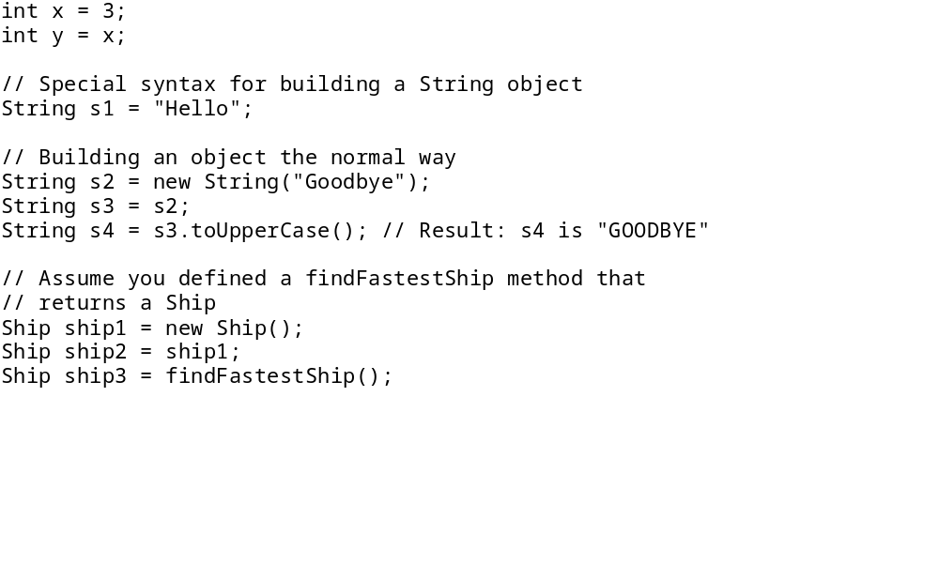
Declaring Variables in Methods: Examples

Slide 22
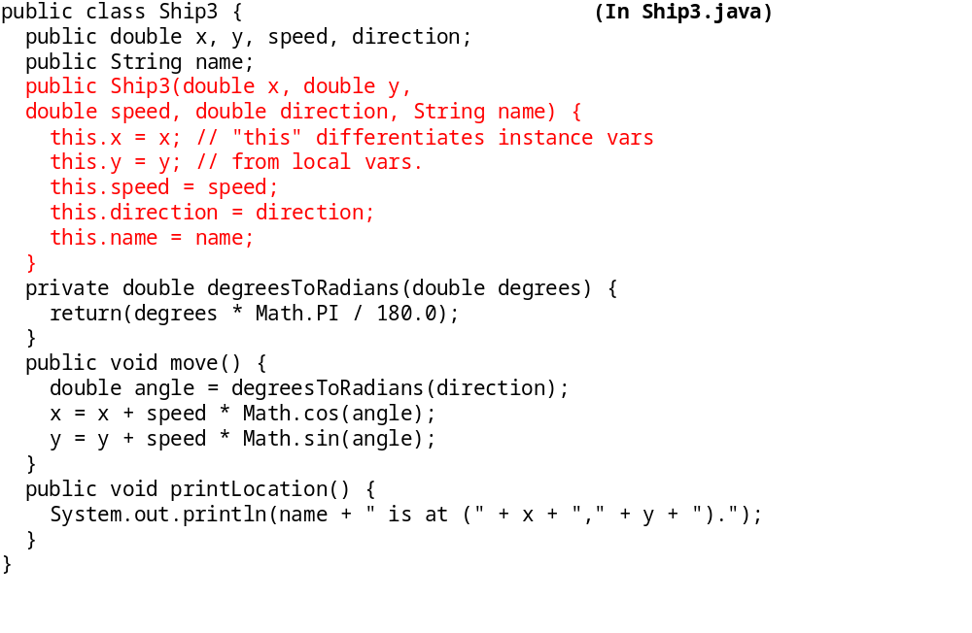
Example 3: Constructors

Slide 23
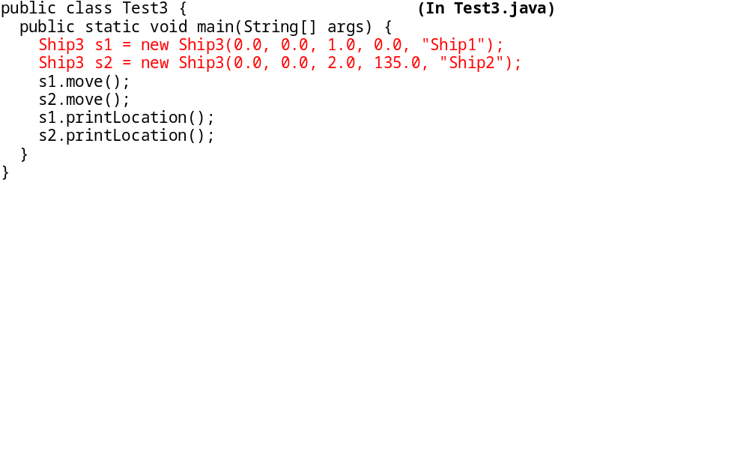
Cont.

Slide 24
Example 3: Major Points
Format of constructor definitions
The “this” reference
Destructors (not!)

Slide 25
Constructors
Constructors are special functions called when a class is created with new
  Constructors are especially useful for supplying values of fields
  Constructors are declared through:
      public ClassName(args) {
      ...
      }
  Notice that the constructor name must exactly match the class name
  Constructors have no return type (not even void), unlike a regular method
  Java automatically provides a zero-argument constructor if and only if the class doesn’t define it’s own constructor

Slide 26
The this variable
The this object reference can be used inside any non-static method to refer to the current object
The common uses of the this reference are:
  To pass a reference to the current object as a parameter to other methods
    someMethod(this);
  To resolve name conflicts
    Using this permits the use of instance variables in methods that have local variables with the same name
  Note that it is only necessary to say this.fieldName when you have a local variable and a class field with the same name; otherwise just use fieldName with no this

Slide 27
Destructors
This page intentionally left blank

Slide 28
Summary
Naming:
  Class names should start with upper case; methods with lower case
Instance variables (aka fields, data members)
  Access fields via objectName.fieldName
Methods (aka member functions)
  Methods are defined inside of a class
  Access methods from within class via methodName(args) and from outside via objectName.methodName(args)
  Methods must define a return type or void if no result is returned
  Methods can refer to instance variables, formal arguments, and local variables with the same syntax

Slide 29
Summary: Continued
  If a method accepts no arguments, the arg-list in the method declaration is empty instead of void as in C
  Static methods do not require an instance of the class; they can be accessed through the class name
Miscellaneous
  The this reference refers to the current object
  Class constructors do not declare a return type
  Java performs its own memory management and requires no destructors

Slide 30
Questions?

