Slide 1
Design Patterns
© 2010. Usman Saleem
http://usmans.info

Slide 2
Acknowledgements
The work in these slides is heavily based on http://sourcemaking.com/design_patterns
Most design patterns covered in these slides were introduced by Erich Gamma (and others) in their book: Design Patterns: Elements of Reusable Object Oriented Software. Addison-Wesley
The authors are often refered as GoF or Gang of Four: Gamma, Erich, Richard Helm, Ralph Johnson, and John Vlissides

Slide 3
Design Patterns
In software engineering, a design pattern is a general repeatable solution to a commonly occurring problem in software design.
A design pattern isn't a finished design that can be transformed directly into code.
It is a description or template for how to solve a problem that can be used in many different situations.

Slide 4
Uses of Design Pattern
Design patterns can speed up the development process by providing tested, proven development paradigms.
  Reusing design patterns improves code readability for coders and architects familiar with the patterns
Design patterns provide general solutions, documented in a format that doesn't require specifics tied to a particular problem.
Design patterns allow developers to communicate using well-known, well understood names for software interactions.
  Common design patterns can be improved over time, making them more robust than ad-hoc designs.

Slide 5
Design Patterns Classifications
Creational Design Patterns
Structural Design Patterns
Behavioral Design Patterns

Slide 6
Creational Design Patterns
These design patterns is all about class instantiation.
This pattern can be further divided into
  class-creation patterns and
  object-creational patterns.
Class-creation patterns use inheritance effectively in the instantiation process,
Object-creation patterns use delegation effectively to get the job done.

Slide 7
Creational Design Patterns (Cont.)
Abstract Factory
  Creates an instance of several families of classes
Builder
  Separates object construction from its representation
Factory Method
  Creates an instance of several derived classes
Object Pool
  Avoid expensive acquisition and release of resources by recycling objects that are no longer in use
Prototype
  A fully initialized instance to be copied or cloned
Singleton
  A class of which only a single instance can exist

Slide 8
Structural Design Patterns
These design patterns is all about Class and Object composition.
Structural class-creation patterns use inheritance to compose interfaces.
Structural object-patterns define ways to compose objects to obtain new functionality

Slide 9
Structural Design Patterns
Adapter
  Match interfaces of different classes
Bridge
  Separates an object’s interface from its implementation
Composite
  A tree structure of simple and composite objects
Decorator
  Add responsibilities to objects dynamically
Facade
  A single class that represents an entire subsystem

Slide 10
Structural Design Patterns
Flyweight
  A fine-grained instance used for efficient sharing
Private Class Data
  Restricts accessor/mutator access
Proxy
  An object representing another object

Slide 11
Behavioral Design Patterns
This design patterns is all about Class's objects communication.
Behavioral patterns are those patterns that are most specifically concerned with communication between objects.

Slide 12
Behavioral Design Patterns (Cont)
Chain of responsibility
  A way of passing a request between a chain of objects
Command
  Encapsulate a command request as an object
Interpreter
  A way to include language elements in a program
Iterator
  Sequentially access the elements of a collection
Mediator
  Defines simplified communication between classes
Memento
  Capture and restore an object's internal state

Slide 13
Behavioral Design Patterns
Null Object
  Designed to act as a default value of an object
Observer
  A way of notifying change to a number of classes
State
  Alter an object's behavior when its state changes
Strategy
  Encapsulates an algorithm inside a class
Template method
  Defer the exact steps of an algorithm to a subclass
Visitor
  Defines a new operation to a class without change

Slide 14
Abstract Factory

Slide 15
Intent
Provide an interface for creating families of related or dependent objects without specifying their concrete classes.
A hierarchy that encapsulates: many possible “platforms”, and the construction of a suite of “products”.
The new operator considered harmful.

Slide 16
Problem
If an application is to be portable, it needs to encapsulate platform dependencies.
These “platforms” might include: windowing system, operating system, database, etc.
Too often, this encapsulation is not engineered in advance, and lots of #ifdef case statements with options for all currently supported platforms begin to procreate like rabbits throughout the code.

Slide 17
Discussion
Provide a level of indirection that abstracts the creation of families of related or dependent objects without directly specifying their concrete classes.
The “factory” object has the responsibility for providing creation services for the entire platform family. Clients never create platform objects directly, they ask the factory to do that for them.
This mechanism makes exchanging product families easy because the specific class of the factory object appears only once in the application - where it is instantiated. The application can wholesale replace the entire family of products simply by instantiating a different concrete instance of the abstract factory.

Slide 18
Because the service provided by the factory object is so pervasive, it is routinely implemented as a Singleton.

Slide 19
Structure
The Abstract Factory defines a Factory Method per product. Each Factory Method encapsulates the new operator and the concrete, platform-specific, product classes. Each “platform” is then modeled with a Factory derived class.

Slide 20
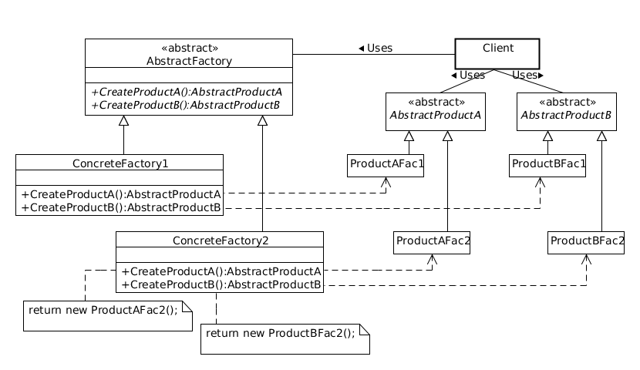
Class Diagram

Slide 21
Checklist
Decide if “platform independence” and creation services are the current source of pain.
Map out a matrix of “platforms” versus “products”.
Define a factory interface that consists of a factory method per product.
Define a factory derived class for each platform that encapsulates all references to the new operator.
The client should retire all references to new, and use the factory methods to create the product objects.

Slide 22
Builder

Slide 23
Intent
Separate the construction of a complex object from its representation so that the same construction process can create different representations.
Parse a complex representation, create one of several targets.

Slide 24
Problem
An application needs to create the elements of a complex aggregate. The specification for the aggregate exists on secondary storage and one of many representations needs to be built in primary storage.

Slide 25
Discussion
Separate the algorithm for interpreting (i.e. reading and parsing) a stored persistence mechanism (e.g. RTF files) from the algorithm for building and representing one of many target products (e.g. ASCII, text widget). The focus/distinction is on creating complex aggregates.
The “director” invokes “builder” services as it interprets the external format. The “builder” creates part of the complex object each time it is called and maintains all intermediate state. When the product is finished, the client retrieves the result from the “builder”.

Slide 26
Discussion (Cont.)
Affords finer control over the construction process. Unlike creational patterns that construct products in one shot, the Builder pattern constructs the product step by step under the control of the “director”.

Slide 27
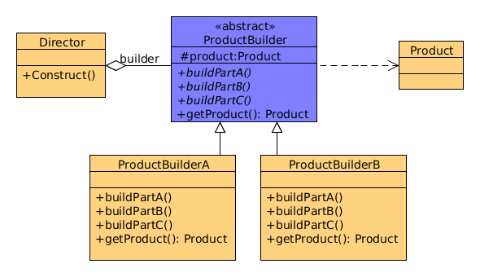
Class Diagram

Slide 28
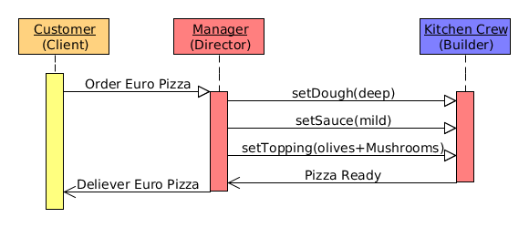
Example

Slide 29
Checklist
Decide if a common input and many possible representations (or outputs) is the problem at hand.
Encapsulate the parsing of the common input in a Director class.
Design a standard protocol for creating all possible output representations. Capture the steps of this protocol in a Builder interface.
Define a Builder derived class for each target representation.
The client creates a Director object and one of the Builder object, and registers the latter with the former.
The client asks the Director to “construct”.
The client asks the Builder to return the result

Slide 30
Additional Considerations
Sometimes creational patterns are complementary:
  Builder can use one of the other patterns to implement which components get built. Abstract Factory, Builder, and Prototype can use Singleton in their implementations.
Builder focuses on constructing a complex object step by step.
  Abstract Factory emphasizes a family of product objects (either simple or complex).
  Builder returns the product as a final step, but as far as the Abstract Factory is concerned, the product gets returned immediately.
Builder often builds a Composite.

Slide 31
Cont...
Often, designers start out using Factory Method (less complicated, more customizable, subclasses proliferate) and evolve toward Abstract Factory, Prototype, or Builder (more flexible, more complex) as the designer discovers where more flexibility is needed.

Slide 32
Factory Method

Slide 33
Intent
Define an interface for creating an object, but let subclasses decide which class to instantiate. Factory Method lets a class defer instantiation to subclasses.
Defining a “Virtual” constructor
The “new” operator considered harmful

Slide 34
Problem
A framework need to standardize the architectural model for a range of applications, but allow for individual applications to define their own domain objects and provide their instantiation

Slide 35
Discussion
In Factory Method pattern, a super class specifies all standard and generic behavior (using abstract “placeholder” for creation steps), and then delegates the creation details to concrete sub classes which are provided by client.
It make design more customizable and only a little more complicated. Other design patterns require new classes, where as Factory Method requires a new operation.
Factory Method is often used as a standardized way of creating objects. However, it is not required if
  Class that instantiated never changes
  Instantiation takes place in an operation which can be override easily by the sub classes

Slide 36
Cont....
Factory Method is similar to Abstract Factory but without the emphasis on Families.
Factory Methods are routinely specified by an architectural framework and is implemented by users of that framework.

Slide 37
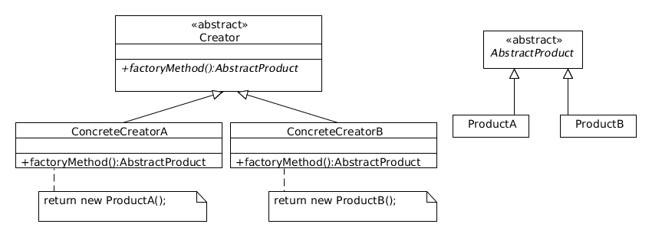
Class Diagram

Slide 38
Implementation
Factory Method is generally implemented as a static method
Unlike constructor, a factory method often has descriptive names
Client is totally decoupled from implementation details of derived class. Hence using polymorphism appropriate sub class is returned.

Slide 39
Checklist
If you have an inheritance hierarchy that exercises polymorphism, consider adding a polymorphic creation capability by defining a static factory method in the base class.
Design the arguments to the factory method. What qualities or characteristics are necessary and sufficient to identify the correct derived class to instantiate?
Consider designing an internal “object pool” that will allow objects to be reused instead of created from scratch.
Consider making all constructors private or protected.

Slide 40
Prototype

Slide 41
Intent
Specify the kinds of objects to create using a prototypical instance, and create new objects by copying this prototype.
Co-opt one instance of a class for use as a breeder of all future instances.
The new operator considered harmful.

Slide 42
Problem
Application hard-code the class of object in each creation with “new” operator

Slide 43
Discussion
Declare an abstract base class that specifies a pure virtual “clone” method, and, maintains a dictionary of all “cloneable” concrete derived classes.
Any class that needs a “polymorphic constructor” capability: derives itself from the abstract base class, registers its prototypical instance, and implements the clone() operation.

Slide 44
Cont...
The client then, instead of writing code that invokes the “new” operator on a hard-coded class name, calls a “clone” operation on the abstract base class, supplying a string or enumerated data type that designates the particular concrete derived class desired.

Slide 45
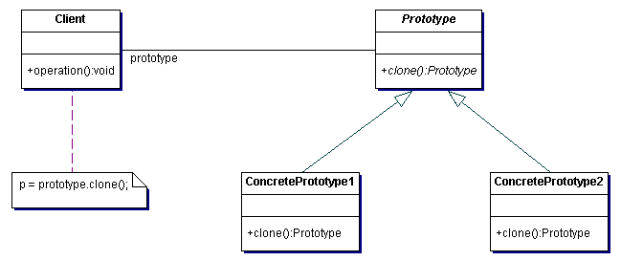
Class Diagram

Slide 46
Checklist
Add a clone() method to the existing “product” hierarchy.
Design a “registry” that maintains a cache of prototypical objects. The registry could be encapsulated in a new Factory class, or in the base class of the “product” hierarchy.
Design a factory method that: may (or may not) accept arguments, finds the correct prototype object, calls clone() on that object, and returns the result.
The client replaces all references to the new operator with calls to the factory method.

Slide 47
Additional Discussion
The rule of thumb could be that you would need to clone() an Object when you want to create another Object at runtime which is a true copy of the Object you are cloning.
True copy means all the attributes of the newly created Object should be the same as the Object you are cloning.
If you could have instantiated the class by using new instead, you would get an Object with all attributes as their initial values.

Slide 48
Singelton

Slide 49
Intent
Ensure a class has only one instance, and provide a global point of access to it.
Encapsulated “just-in-time initialization” or “initialization on first use”.

Slide 50
Problem
Application needs one, and only one, instance of an object. Additionally, lazy initialization and global access are necessary.

Slide 51
Discussion
Make the class of the single instance object responsible for creation, initialization, access, and enforcement. Declare the instance as a private static data member. Provide a public static member function that encapsulates all initialization code, and provides access to the instance.
The client calls the accessor function (using the class name and scope resolution operator) whenever a reference to the single instance is required.

Slide 52
Singleton should be considered only if all three of the following criteria are satisfied:
  Ownership of the single instance cannot be reasonably assigned
  Lazy initialization is desirable
  Global access is not otherwise provided for
If ownership of the single instance, when and how initialization occurs, and global access are not issues, Singleton is not sufficiently interesting.

Slide 53
The Singleton pattern can be extended to support access to an application-specific number of instances.
The “static member function accessor” approach will not support subclassing of the Singleton class.

Slide 54
Structural Design Patterns
In Software Engineering, Structural Design Patterns are Design Patterns that ease the design by identifying a simple way to realize relationships between entities.

Slide 55
Adapter
  Match interfaces of different classes
Bridge
  Separates an object’s interface from its implementation
Composite
  A tree structure of simple and composite objects
Decorator
  Add responsibilities to objects dynamically

Slide 56
Facade
  A single class that represents an entire subsystem
Flyweight
  A fine-grained instance used for efficient sharing
Private Class Data
  Restricts accessor/mutator access
Proxy
  An object representing another object

Slide 57
Adapter Design Pattern

Slide 58
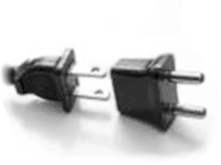
Intent
Convert the interface of a class into another interface clients expect. Adapter lets classes work together that couldn’t otherwise because of incompatible interfaces.
Wrap an existing class with a new interface.
Impedance match an old component to a new system

Slide 59
Problem
An “off the shelf” component offers compelling functionality that you would like to reuse, but its “view of the world” is not compatible with the philosophy and architecture of the system currently being developed.

Slide 60
Discussion
Adapter is about creating an intermediary abstraction that translates, or maps, the old component to the new system.
Clients call methods on the Adapter object which redirects them into calls to the legacy component.
This strategy can be implemented either with inheritance or with aggregation.
Adapter functions as a wrapper or modifier of an existing class. It provides a different or translated view of that class.

Slide 61

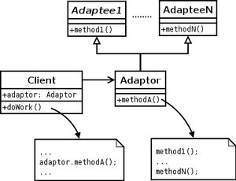
Class Diagram
Object Adapter Pattern
Class Adapter Pattern

Slide 62
Bridge Pattern

Slide 63
Intent
Decouple an abstraction from its implementation so that the two can vary independently.
Publish interface in an inheritance hierarchy, and bury implementation in its own inheritance hierarchy.
Beyond encapsulation, to insulation

Slide 64
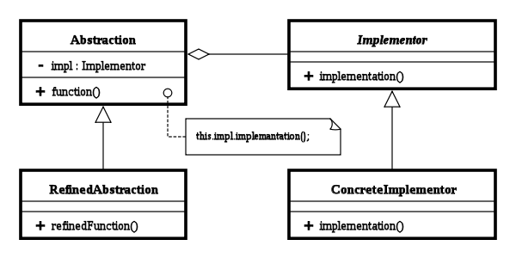
Structure

Slide 65
Abstraction
  defines the abstract interface
  maintains the Implementor reference
RefinedAbstraction
  extends the interface defined by Abstraction
Implementor
  defines the interface for implementation classes
ConcreteImplementor
  implements the Implementor interface

Slide 66
Example
/** "Implementor" */
interface DrawingAPI {
public void drawCircle(double x, double y, double radius);
}
/** "ConcreteImplementor" 1/2 */
class DrawingAPI1 implements DrawingAPI {
public void drawCircle(double x, double y, double radius) {
System.out.printf("API1.circle at %f:%f radius %f\n", x, y, radius);
}
}
/** "ConcreteImplementor" 2/2 */
class DrawingAPI2 implements DrawingAPI {
public void drawCircle(double x, double y, double radius) {
System.out.printf("API2.circle at %f:%f radius %f\n", x, y, radius);
}
}

Slide 67
Example
/** "Abstraction" */
interface Shape {
public void draw(); // low-level
public void resizeByPercentage(double pct); // high-level
}
/** "Refined Abstraction" */
class CircleShape implements Shape {
private double x, y, radius;
private DrawingAPI drawingAPI;
public CircleShape(double x, double y, double radius, DrawingAPI drawingAPI) {
this.x = x; this.y = y; this.radius = radius;
this.drawingAPI = drawingAPI;
}
// low-level i.e. Implementation specific
public void draw() {
drawingAPI.drawCircle(x, y, radius);
}
// high-level i.e. Abstraction specific
public void resizeByPercentage(double pct) {
radius *= pct;
}
}

Slide 68
Example
/** "Client" */
class BridgePattern {
public static void main(String[] args) {
Shape[] shapes = new Shape[2];
shapes[0] = new CircleShape(1, 2, 3, new DrawingAPI1());
shapes[1] = new CircleShape(5, 7, 11, new DrawingAPI2());
for (Shape shape : shapes) {
shape.resizeByPercentage(2.5);
shape.draw();
}
}
}

Slide 69
Checklist
Decide if two orthogonal dimensions exist in the domain. These independent concepts could be: abstraction/platform, or domain/infrastructure, or front-end/back-end, or interface/implementation.
Design the separation of concerns: what does the client want, and what do the platforms provide.
Design a platform-oriented interface that is minimal, necessary, and sufficient. Its goal is to decouple the abstraction from the platform.
Define a derived class of that interface for each platform.
Create the abstraction base class that “has a” platform object and delegates the platform-oriented functionality to it.
Define specializations of the abstraction class if desired.

Slide 70
Composite Design Pattern

Slide 71
Intent
In software engineering, the composite pattern is a partitioning design pattern.
Composite allows a group of objects to be treated in the same way as a single instance of an object.
The intent of composite is to "compose" objects into tree structures to represent part-whole hierarchies.
Composite lets clients treat individual objects and compositions uniformly.

Slide 72
Motivation
When dealing with tree-structured data, programmers often have to discriminate between a leaf-node and a branch.
This makes code more complex, and therefore, error prone.
The solution is an interface that allows treating complex and primitive objects uniformly.
In object-oriented programming, a composite is an object designed as a composition of one-or-more similar objects, all exhibiting similar functionality.
The key concept is that you can manipulate a single instance of the object just as you would manipulate a group of them.

Slide 73
When to Use
Composite can be used when clients should ignore the difference between compositions of objects and individual objects.
If programmers find that they are using multiple objects in the same way, and often have nearly identical code to handle each of them, then composite is a good choice; it is less complex in this situation to treat primitives and composites as homogeneous.

Slide 74
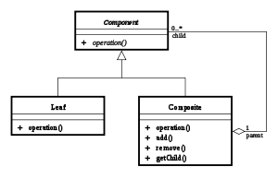
Structure

Slide 75
Component
  is the abstraction for all components, including composite ones
  declares the interface for objects in the composition
  (optional) defines an interface for accessing a component's parent in the recursive structure, and implements it if that's appropriate
Leaf
  represents leaf objects in the composition
  implements all Component methods

Slide 76
Composite
  represents a composite Component (component having children)
  implements methods to manipulate children
  implements all Component methods, generally by delegating them to its children

Slide 77
Decorator Design Pattern

Slide 78
Intent
In object-oriented programming, the decorator pattern is a design pattern that allows new/additional behaviour to be added to an existing object dynamically.

Slide 79
Problem
You want to add behavior or state to individual objects at run-time. Inheritance is not feasible because it is static and applies to an entire class.

Slide 80
Discussion
A Decorator, also known as a Wrapper, is an object that has an interface identical to an object that it contains.
Any calls that the decorator gets, it relays to the object that it contains, and adds its own functionality along the way, either before or after the call.
This gives you a lot of flexibility, since you can change what the decorator does at runtime, as opposed to having the change be static and determined at compile time by subclassing.

Slide 81
Since a Decorator complies with the interface that the object that it contains, the Decorator is indistinguishable from the object that it contains.
That is, a Decorator is a concrete instance of the abstract class, and thus is indistinguishable from any other concrete instance, including other decorators.
This can be used to great advantage, as you can recursively nest decorators without any other objects being able to tell the difference, allowing a near infinite amount of customization.

Slide 82
Decorators add the ability to dynamically alter the behavior of an object because a decorator can be added or removed from an object without the client realizing that anything changed.
It is a good idea to use a Decorator in a situation where you want to change the behaviour of an object repeatedly (by adding and subtracting functionality) during runtime.
The dynamic behavior modification capability also means that decorators are useful for adapting objects to new situations without re-writing the original object's code.

Slide 83
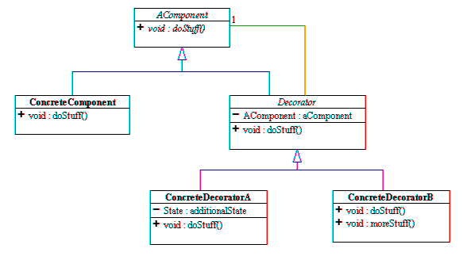
Structure

Slide 84
Facade Design Pattern

Slide 85
Intent
Provide a unified interface to a set of interfaces in a subsystem. Facade defines a higher-level interface that makes the subsystem easier to use.
Wrap a complicated subsystem with a simpler interface.

Slide 86
Problem
A segment of the client community needs a simplified interface to the overall functionality of a complex subsystem.

Slide 87
Discussion
Facade discusses encapsulating a complex subsystem within a single interface object.
This reduces the learning curve necessary to successfully leverage the subsystem.
It also promotes decoupling the subsystem from its potentially many clients.
On the other hand, if the Facade is the only access point for the subsystem, it will limit the features and flexibility that “power users” may need.
The Facade object should be a fairly simple advocate or facilitator. It should not become an all-knowing oracle or “god” object.

Slide 88
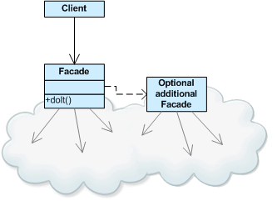
Structure

Slide 89
Checklist
Identify a simpler, unified interface for the subsystem or component.
Design a ‘wrapper’ class that encapsulates the subsystem.
The facade/wrapper captures the complexity and collaborations of the component, and delegates to the appropriate methods.
The client uses (is coupled to) the Facade only.
Consider whether additional Facades would add value.

Slide 90
Flyweight Design Pattern

Slide 91
Intent
Flyweight is a software design pattern.
A flyweight is an object that minimizes memory use by sharing as much data as possible with other similar objects; it is a way to use objects in large numbers when a simple repeated representation would use an unacceptable amount of memory.

Slide 92
Problem
Designing objects down to the lowest levels of system “granularity” provides optimal flexibility, but can be unacceptably expensive in terms of performance and memory usage.

Slide 93
Discussion
The Flyweight pattern describes how to share objects to allow their use at fine granularities without prohibitive cost.
Each “flyweight” object is divided into two pieces:
  the state-dependent (extrinsic) part,
  the state-independent (intrinsic) part.
Intrinsic state is stored (shared) in the Flyweight object.
Extrinsic state is stored or computed by client objects, and passed to the Flyweight when its operations are invoked.

Slide 94
Example
A classic example usage of the flyweight pattern is the data structures for graphical representation of characters in a word processor.
It might be desirable to have, for each character in a document, a glyph object containing its font outline, font metrics, and other formatting data, but this would amount to hundreds or thousands of bytes for each character.
Instead, for every character there might be a reference to a flyweight glyph object shared by every instance of the same character in the document; only the position of each character (in the document and/or the page) would need to be stored internally.

Slide 95
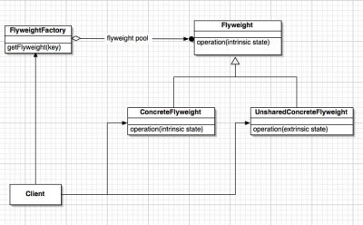
Structure

Slide 96
Checklist
Ensure that object overhead is an issue needing attention, and, the client of the class is able and willing to absorb responsibility realignment.
Divide the target class’s state into: shareable (intrinsic) state, and non-shareable (extrinsic) state.
Remove the non-shareable state from the class attributes, and add it the calling argument list of affected methods.
Create a Factory that can cache and reuse existing class instances.

Slide 97
The client must use the Factory instead of the new operator to request objects.
The client (or a third party) must look-up or compute the non-shareable state, and supply that state to class methods.

Slide 98
Proxy Design Pattern

Slide 99
Intent
Provide a surrogate or placeholder for another object to control access to it.
Use an extra level of indirection to support distributed, controlled, or intelligent access.
Add a wrapper and delegation to protect the real component from undue complexity.

Slide 100
Problem
You need to support resource-hungry objects, and you do not want to instantiate such objects unless and until they are actually requested by the client.

Slide 101
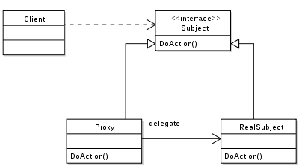
Structure

Slide 102
Checklist
Identify the leverage or “aspect” that is best implemented as a wrapper or surrogate.
Define an interface that will make the proxy and the original component interchangeable.
Consider defining a Factory that can encapsulate the decision of whether a proxy or original object is desirable.
The wrapper class holds a pointer to the real class and implements the interface.
The pointer may be initialized at construction, or on first use.
Each wrapper method contributes its leverage, and delegates to the wrappee object.

Slide 103
Comparison with other patterns
Adapter provides a different interface to its subject. Proxy provides the same interface. Decorator provides an enhanced interface.
Decorator and Proxy have different purposes but similar structures. Both describe how to provide a level of indirection to another object, and the implementations keep a reference to the object to which they forward requests.

Slide 104
Behavioral Design Patterns
In software engineering, behavioral design patterns are design patterns that identify common communication patterns between objects and realize these patterns. By doing so, these patterns increase flexibility in carrying out this communication.

Slide 105
Chain of Responsibility

Slide 106
Intent
Avoid coupling the sender of a request to its receiver by giving more than one object a chance to handle the request. Chain the receiving objects and pass the request along the chain until an object handles it.
Launch-and-leave requests with a single processing pipeline that contains many possible handlers.
An object-oriented linked list with recursive traversal.

Slide 107
Problem
There is a potentially variable number of “handler” or “processing element” or “node” objects, and a stream of requests that must be handled. Need to efficiently process the requests without hard-wiring handler relationships and precedence, or request-to-handler mappings.

Slide 108
Discussion
Encapsulate the processing elements inside a “pipeline” abstraction; and have clients “launch and leave” their requests at the entrance to the pipeline.
The pattern chains the receiving objects together, and then passes any request messages from object to object until it reaches an object capable of handling the message. The number and type of handler objects isn’t known a priori, they can be configured dynamically. The chaining mechanism uses recursive composition to allow an unlimited number of handlers to be linked.

Slide 109
Chain of Responsibility simplifies object interconnections. Instead of senders and receivers maintaining references to all candidate receivers, each sender keeps a single reference to the head of the chain, and each receiver keeps a single reference to its immediate successor in the chain.
Make sure there exists a “safety net” to “catch” any requests which go unhandled.
Do not use Chain of Responsibility when each request is only handled by one handler, or, when the client object knows which service object should handle the request.

Slide 110
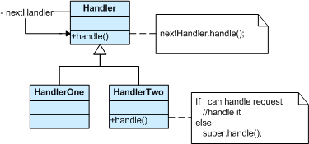
Structure

Slide 111
The derived classes know how to satisfy Client requests. If the “current” object is not available or sufficient, then it delegates to the base class, which delegates to the “next” object, and the circle of life continues.
Multiple handlers could contribute to the handling of each request. The request can be passed down the entire length of the chain, with the last link being careful not to delegate to a “null next”.

Slide 112
Check List
The base class maintains a “next” pointer.
Each derived class implements its contribution for handling the request.
If the request needs to be “passed on”, then the derived class “calls back” to the base class, which delegates to the “next” pointer.
The client (or some third party) creates and links the chain (which may include a link from the last node to the root node).
The client “launches and leaves” each request with the root of the chain.

Slide 113
Additional Considerations
Chain of Responsibility, Command, Mediator, and Observer, address how you can decouple senders and receivers, but with different trade-offs. Chain of Responsibility passes a sender request along a chain of potential receivers.
Chain of Responsibility can use Command to represent requests as objects.
Chain of Responsibility is often applied in conjunction with Composite. There, a component’s parent can act as its successor.

Slide 114
Command Design Pattern

Slide 115
Intent
Encapsulate a request as an object, thereby letting you parameterize clients with different requests, queue or log requests, and support undoable operations.
Promote “invocation of a method on an object” to full object status
An object-oriented callback

Slide 116
Problem
Need to issue requests to objects without knowing anything about the operation being requested or the receiver of the request.

Slide 117
Discussion
Three terms always associated with the command pattern are client, invoker and receiver.
The client instantiates the command object and provides the information required to call the method at a later time.
The invoker decides when the method should be called.
The receiver is an instance of the class that contains the method's code.

Slide 118
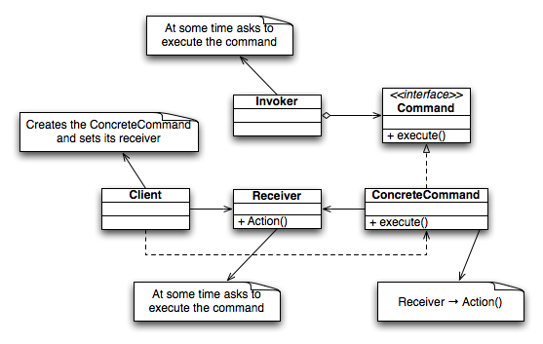
Structure

Slide 119
Example
Consider a "simple" switch. In this example we configure the Switch with 2 commands: to turn the light on and to turn the light off.
A benefit of this particular implementation of the command Pattern is that the switch can be used with any device, not just a light - the Switch in the following example turns a light on and off, but the Switch's constructor is able to accept any subclasses of Command for its 2 parameters. For example, you could configure the Switch to start an engine.

Slide 120
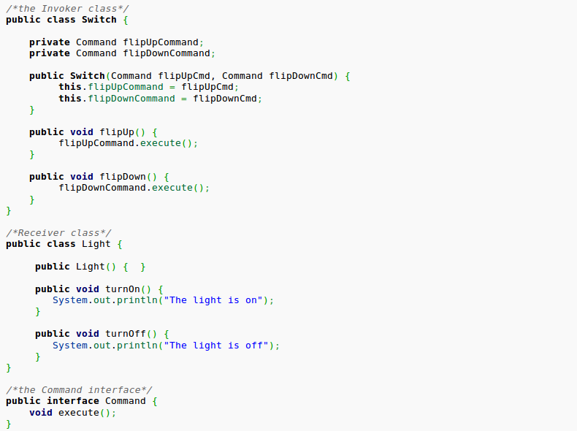

Slide 121
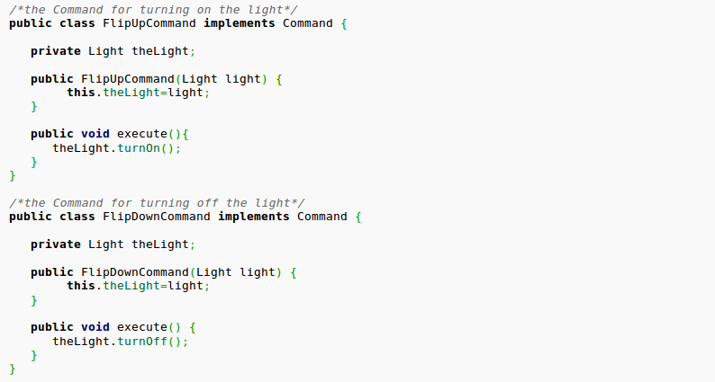

Slide 122
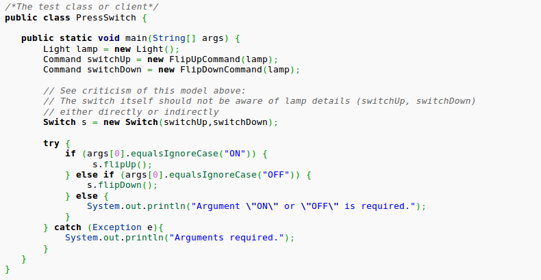

Slide 123
Check List
Define a Command interface with a method signature like execute().
Create one or more derived classes that encapsulate some subset of the following: a “receiver” object, the method to invoke, the arguments to pass.
Instantiate a Command object for each deferred execution request.
Pass the Command object from the creator (aka sender) to the invoker.
The invoker decides when to execute().

Slide 124
Interpreter
Given a language and its representation for its grammar, an interpreter uses the representation to interpret sentences in the language.
Use the Interpreter Pattern when there is a language to interpret, and you can represent statements in the language as abstract syntax trees.
The Interpreter Pattern works best when:
  The grammar is simple. For complex grammars, the class hierarchy for the grammar becomes large and unmanageable.
  Tools such as parser generators are a better alternative in such cases. They can interpret expressions without building abstract syntax trees, which can save space and possibly time.

Slide 125
Cont...
  Efficiency is not a critical concern. The most efficient interpreters are usually not implemented by interpreting parse trees directly but by first translating them into another form.
  For example, regular expressions are often transformed into state machines. But even then, the translator can be implemented by the Interpreter pattern, so the pattern is still applicable.

Slide 126
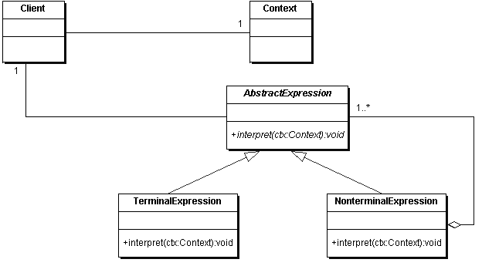
Class Structure

Slide 127
Iterator
It provides a way to access the elements of an aggregate object sequentially without exposing its underlying representation.
An aggregate object such as a list should give you a way to access its elements without exposing its internal structure. Moreover, you might want to traverse the list in different ways, depending on what you want to accomplish.
But you probably don't want to bloat the List interface with operations for different traversals, even if you could anticipate the ones you will need.
You might also need to have more than one traversal pending on the same list.

Slide 128
The Iterator pattern lets you do all this. The key idea in this pattern is to take the responsibility for access and traversal out of the list object and put it into an iterator object.
The Iterator class defines an interface for accessing the list's elements.
An Iterator object is responsible for keeping track of the current element; that is, it knows which elements have been traversed already.

Slide 129
Uses of Iterator
To access an aggregate object's contents without exposing its internal representation.
To support multiple traversals of aggregate objects.
To provide a uniform interface for traversing different aggregate structures (that is, to support polymorphic iteration).

Slide 130
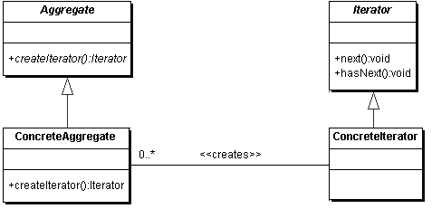
Class Structure

Slide 131
Mediator
Define an object that encapsulates how a set of objects interact.
Mediator promotes loose coupling by keeping objects from referring to each other explicitly, and it lets you vary their interaction independently.
Object-oriented design encourages the distribution of behavior among objects.
Such distribution can result in an object structure with many connections between objects; in the worst case, every object ends up knowing about every other.

Slide 132
Though partitioning a system into many objects generally enhances reusability, proliferating interconnections tend to reduce it again.
Lots of interconnections make it less likely that an object can work without the support of others - the system acts as though it were monolithic.
Moreover, it can be difficult to change the system's behavior in any significant way, since behavior is distributed among many objects.
As a result, you may be forced to define many subclasses to customize the system's behavior.

Slide 133
You can avoid these problems by encapsulating collective behavior in a separate Mediator object.
A mediator is responsible for controlling and coordinating the interactions of a group of objects.
The Mediator serves as an intermediary that keeps objects in the group from referring to each other explicitly.
The objects only know the Mediator, thereby reducing the number of interconnections.

Slide 134
Use Mediator Design Pattern
A set of objects communicate in well-defined but complex ways. The resulting interdependencies are unstructured and difficult to understand.
Reusing an object is difficult because it refers to and communicates with many other objects.
A behavior that's distributed between several classes should be customizable without a lot of subclassing.

Slide 135
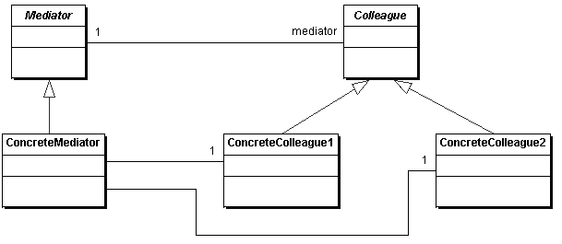
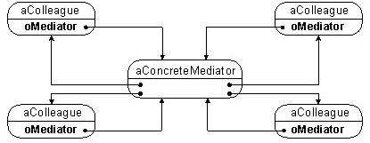

Slide 136
Memento
Without violating encapsulation, capture and externalize an object's internal state so that the object can be restored to this state later.
Sometimes it's necessary to record the internal state of an object.
This is required when implementing checkpoints and undo mechanisms that let users back out of tentative operations or recover from errors.
You must save state information somewhere so that you can restore objects to their previous states.

Slide 137
But objects normally encapsulate some or all of their state, making it inaccessible to other objects and impossible to save externally.
Exposing this state would violate encapsulation, which can compromise the application's reliability and extensibility.

Slide 138
We can solve this problem with the Memento pattern.
A memento is an object that stores a snapshot of the internal state of another object - the memento's originator.
The undo mechanism will request a memento from the originator when it needs to checkpoint the originator's state.
The originator initializes the memento with information that characterizes its current state. Only the originator can store and retrieve information from the memento - the memento is "opaque" to other objects.

Slide 139
Use Memento
A snapshot of (some portion of) an object's state must be saved so that it can be restored to that state later, AND
A direct interface to obtaining the state would expose implementation details and break the object's encapsulation.

Slide 140
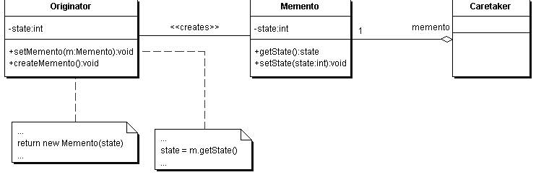
Class Structure

Slide 141
Observer
Define a one-to-many dependency among objects so that when one object changes state, all its dependents are notified and updated automatically.
An event can occurs and a number of entities need to receive a message about it.
When will the event occur? Perhaps if it will occur at all it will be unpredictable.
Also, the number of entities, and which entities they are, is unpredictable. Ideally, the subscribers to this notification should be configurable at runtime.

Slide 142
A common side-effect of partitioning a system into a collection of cooperating classes is the need to maintain consistency between related objects.
You don't want to achieve consistency by making the classes tightly coupled, because that reduces their reusability.
The Observer Design Pattern describes how to establish these relationships.
The key objects in this pattern are subject and observer.

Slide 143
A subject may have any number of dependent observers. All observers are notified whenever the subject undergoes a change in state.
In response, each observer will query the subject to synchronize its state with the subject's state.
This kind of interaction is also known as publish-subscribe.
The subject is the publisher of notifications. It sends out these notifications without having to know who its observers are.
Any number of observers can subscribe to receive notifications.

Slide 144
Use Observer Pattern
When an abstraction has two aspects, one dependent on the other. Encapsulating these aspects in separate objects lets you vary and reuse them independently.
When a change to one object requires changing others, and you don't know how many objects need to be changed.
When an object should be able to notify other objects without making assumptions about who these objects are. In other words, you don't want
these objects tightly coupled.

Slide 145
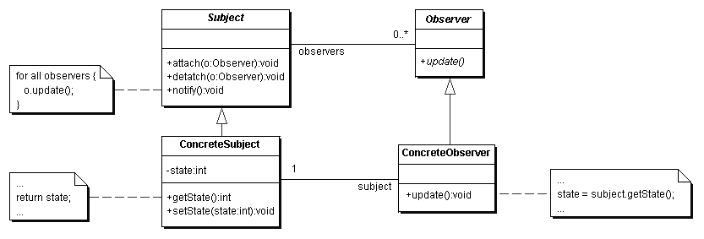
Class Structure

Slide 146
State Pattern
It allows an object to alter its behavior when its internal state changes. The object will appear to change its class.
The key idea in this pattern is to introduce an abstract class to represent the possible
states of the object.
This class declares an interface common to all the classes that represent different operational states.
The concrete subclasses implement state specific behavior.
Based on the current state, the appropriate concrete class is selected and used.

Slide 147
Use State Pattern
An object's behavior depends on its state, and it must change its behavior at run-time depending on that state.
Operations have large, multipart conditional statements that depend on the object's state. This state is usually represented by one or more enumerated constants. Often, several operations will contain this same conditional structure. The State pattern puts each branch of the conditional in a separate class. This lets you treat the object's state as an object in its own right that can vary independently from other objects.

Slide 148
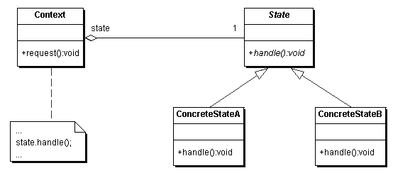
Class Structure

Slide 149
Strategy
Define a family of algorithms, encapsulate each one, and make them interchangeable.
Strategy lets the algorithm vary independently from clients that use it.
A single behavior with varying implementation exists, and we want to decouple consumers of this behavior from any particular implementation.
We may also want to decouple them from the fact that the implementation is varying at all.

Slide 150
Use Strategy Pattern when:
Many related classes differ only in their behavior. Strategies provide a way to configure a class with one of many behaviors.
You need different variants of an algorithm. For example, you might define algorithms reflecting different space/time trade-offs. Strategies can be used when these variants are implemented as a class hierarchy of algorithms.
An algorithm uses data that clients shouldn't know about. Use the Strategy pattern to avoid exposing complex, algorithm-specific data structures.

Slide 151
A class defines many behaviors, and these appear as multiple conditional statements in its operations. Instead of many conditionals, move related conditional branches into their own Strategy class.

Slide 152
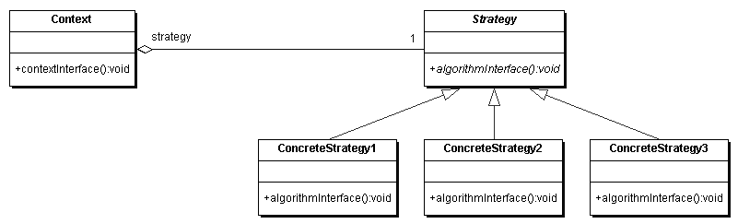
Class Structure

