Slide 1
Java Workshop
File I/O
By Usman Saleem
usman@usmans.info

Slide 2
Agenda
Handling Files and Directories through the File class
Understand which streams to use for character based or byte based streams
Character File input and output
Reading data from the console
Binary File input/output

Slide 3
File Class
A File object can refer to either a file or a directory
        File file1 = new File(“data.txt”);
        File file2 = new File(“C:\\Java”);
  To obtain the path of the current working directory
        System.getProperty(“user.dir”);
  To obtain the file or path separator use
        System.getProperty(“file.separator”);
        System.getProperty(“path.separator”);
                or
        File.separator();
        File.pathSeparator();

Slide 4
Useful File Methods
isFile/isDirectory
canRead/canWrite
length
list
  If the File object is a directory, returns a String array of all the files and directory in that directory
mkdir
delete
toURL

Slide 5
Task 1 – Directory Listing
Write a java program which prints all files and directories in User's home directory.
  Hint – System.getProperty(“user.home”);

Slide 6
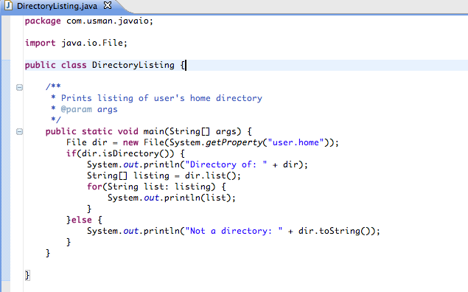
DirectoryListing - Example

Slide 7
Input/Output
The java.io provides a large number (over 60) input/output classes (Streams)
Streams are combined (piped together) to create desired data source or sink
Streams are either byte oriented or character oriented.
    Use InputStream/OutputStream for byte oriented
    Use Reader/Writer for character based I/O
NOTE: IOException may be thrown in all I/O operations

Slide 8
Character File Output
Desired... | Methods | Constructon
Character File Output | FileWriter write(int char) write(byte[] buffer) write(String str) | File f = new File(“abc.txt”); FileWriter fout = new FileWriter(f); or FileWriter fout = new FileWriter(“abc.txt”);
Buffered Character File Output | BufferedWriter write(int char) write(char[] buffer) write(String str) newLine() | File f = new File(“abc.txt”); FileWriter fout = new FileWriter(f); BufferedWriter bout = new BufferedWriter(fout);
Character Output | PrintWriter write(int char) write(char[] buffer) write(String str) print println | File f = new File(“abc.txt”); FileWriter fout = new FileWriter(f); PrintWriter pw = new PrintWriter(fout);

Slide 9
FileWriter
Constructors
  FileWriter(String filename)/FileWriter(File file)
  FileWriter(File file, boolean append)
Useful Methods
  write(String str)/write(char[] buffer)
  write(int ch)
  flush
  close
  getEncoding

Slide 10
Task 2 – Writing text to file
Modify your previous program to write the directory contents to a file of your choice in current working directory.
  Don't forget to close your Writer(s) objects
  Handle IOException correctly

Slide 11
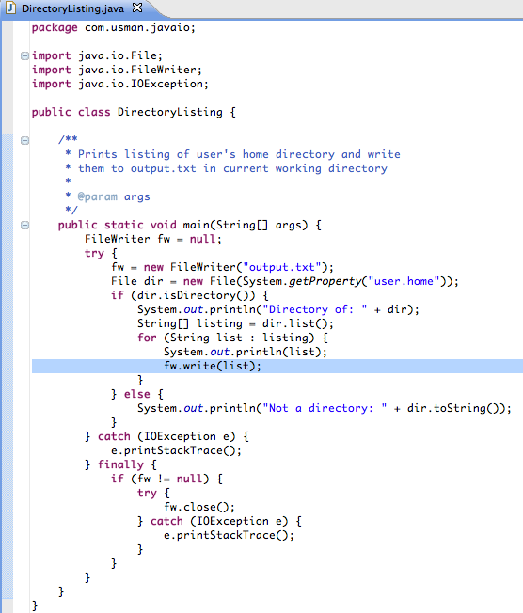

Slide 12
Character File Input
Desired... | Methods | Constructon
Character File Input | FileReader read() read(char[] buffer) | File f = new File(“abc.txt”); FileReader fin = new FileReader(f); or FileReader fin = new FileReader(“abc.txt”);
Buffered Character File Input | BufferedReader read() read(char[] buffer) readLine() | File f = new File(“abc.txt”); FileReader fin = new FileReader(f); BufferedReader br = new BufferedReader(fin);

Slide 13
FileReader
Constructors
  FileReader(String filename)/FileReader(File file)
Useful Methods
  read/read(char[] buffer)
    Reads a single character or an array of characters
    Returns -1 if eof is reached
  reset
    Move to beginning of stream
  skip
    Advances a number of characters
Note: Wrap a BufferedReader around a FileReader to read full lines from the file using readLine method

Slide 14
Task 3 – File Reading
Modify or write a new program which reads the file which was created in previous task and print the contents on standard output (console)

Slide 15
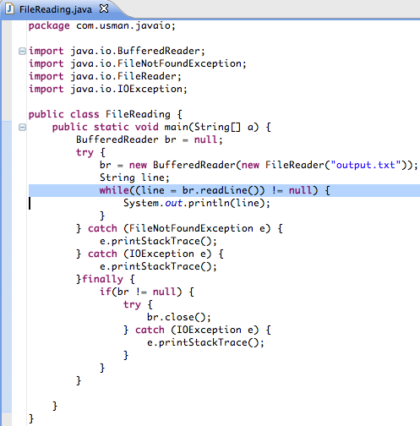

Slide 16
Console Input
To read from console, a stream must be associated with standard input stream (System.in)
    BufferedReader br = new BufferedReader(new InputStreamReader(System.in));
    String keyboardInput = br.readLine();

Slide 17
Task 4
Modify previous file reading program to take the file name from user input.

Slide 18
Binary File Output
Handle byte based I/O using DataInputStream/DataOutputStream
To write bytes to a file, wrap DataOutputStream to FileOutputStream
To read bytes from a file, wrap DataInputStream to FileInputStream
Use BufferedOutputStream/BufferedInputStream over DataOutput/InputStream for efficient reading/writing.

Slide 19
Java Serialization API
Java provides Serialization API which can be used to serialize/deserialize Java objects using Java I/O streams
Implement “Serializable” marker interface on classes which should be persisted by Serialization API
    public class Student implements Serializable
To persist the object, use ObjectOutputStream class.
  ObjectOutputStream is wrapped over other streams such as FileOutputStream or Socket's InputStream
    FileOutputStream fos = new FileOutputStream(“student.ser”);
    ObjectOutputStream out = new ObjectOutputStream(fos);
    out.writeObject(student);
    out.close();

Slide 20
Java Serialization API (Cont.)
Similarly, to deserialize a Java object, use ObjectInputStream's readObject method
    FileInputStream fis = new FileInputStream(“student.ser”);
    ObjectInputStream in = new ObjectInputStream(fis);
    Student student = (Student) out.readObject();
    in.close();
  Handle ClassNotFoundException
All fields of a class must be either primitive or implement Serializable interface for persistence using Serialization API
“transient” can be used to mark fields which should not be persisted

Slide 21
Rules for Serialization
Rule #1: The object to be persisted must implement the Serializable interface or inherit that implementation from its object hierarchy
Rule #2: The object to be persisted must mark all nonserializable fields transient

Slide 22
Customizing serialization mechanism
private void writeObject(ObjectOutputStream out) throws IOException;
private void readObject(ObjectInputStream in) throws IOException, ClassNotFoundException;

Slide 23
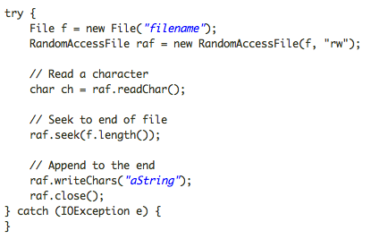
Random Access File
Random Access File allows to write bytes at any specified location in a file.
It is usually not used in Java programs

Slide 24
Task 5 – Main Task
We want to create a simple application which maintains a list of user's contacts. Think of a contact as a contact in your mobile phone (Name, phone, email etc.). Your program should be able to do following:
  Give user options to 1. create a new contact .2. print all available contacts
  The persistence mechanism will be both Java Serialization API and Java File I/O
  Design your program such that if we want to use Java File I/O (or in future JDBC or Sockets), there will be minimum change to your existing program logic. (We should be able to change a configuration parameter in the program to choose required persistence logic – This configuration parameter will be read from configuration file by your program on its initialization).

