Slide 1
Servlet Basics

Slide 2
Agenda
The basic structure of servlets
A servlet that generates plain text
Compiling and deploying a servlet using Jboss
A servlet that generates HTML
The servlet life cycle
Servlet debugging strategies

Slide 3
A Servlet's Job
Read explicit data sent by client (form data)
Read implicit data sent by client (request headers)
Generate the results
Send the explicit data back to client (HTML)
Send the implicit data to client
(status codes and response headers)

Slide 4
A servlet that generates plain text
import java.io.*;
import javax.servlet.*;
import javax.servlet.http.*;
public class HelloWorld extends HttpServlet {
public void doGet(HttpServletRequest request,
HttpServletResponse response)
throws ServletException, IOException {
PrintWriter out = response.getWriter();
out.println("Hello World");
}
}

Slide 5
Compiling servlet using JBoss
Create a working folder for your servlets. I will be using $HOME/study/servlets/first.
Copy (or use directly) servlet-api.jar from JBoss' common/lib directory to your working folder.
Create WEB-INF/web.xml file (next slide)
Create WEB-INF/classes folder(the servlet class files will reside here, use -d switch with javac)
Create HelloWorld.java (from previous slide)
Compile (Use ; in classpath if on Windows)
javac -classpath .:./servlet-api.jar
-d META-INF/classes HelloWorld.java

Slide 6
WEB-INF/web.xml
<?xml version="1.0" encoding="UTF-8"?>
<web-app
xmlns="http://java.sun.com/xml/ns/javaee"
xmlns:xsi="http://www.w3.org/2001/XMLSchema-instance"
xsi:schemaLocation="http://java.sun.com/xml/ns/javaee
http://java.sun.com/xml/ns/javaee/web-app_2_5.xsd"
version="2.5">
<display-name>HelloWorldServlet</display-name>
<servlet>
<display-name>HelloWorld</display-name>
<servlet-name>HelloServlet</servlet-name>
<servlet-class>HelloWorld</servlet-class>
</servlet>
<servlet-mapping>
<servlet-name>HelloServlet</servlet-name>
<url-pattern>/MyFirstServlet</url-pattern>
</servlet-mapping>
</web-app>

Slide 7
Create Web Archive (.war)
Create WEB-INF/classes folder
Create war file containing WEB-INF folder:
jar <options> <war_file> <contents>
jar cf myservlet.war ./WEB-INF

Slide 8
Testing our first servlet
Start JBoss
Copy myservlet.war TO jboss_home/server/default/deploy
cp myservlet.war /home/usman/jboss-5.0.1.GA/server/default/deploy/.
Open browser and access http://localhost:8080/myservlet/MyFirstServlet
/myservlet has been taken from the .war file
/MyFirstServlet was taken from web.xml

Slide 9
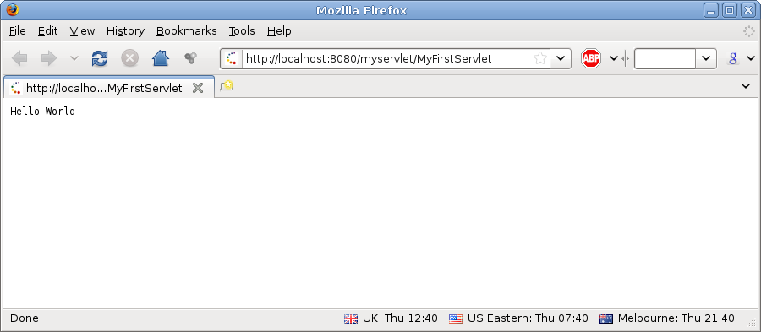

Slide 10
A servlet that generates HTML
Tell browser that we are sending html
  response.setContentType("text/html");
Modify the println statements to build a legal Web page
  Print statements should output HTML tags
Check your HTML with a formal syntax validator
  http://validator.w3.org/
  http://www.htmlhelp.com/tools/validator/

Slide 11
Code
import java.io.*;
import javax.servlet.*;
public class HelloHtmlServlet extends HttpServlet {
public void doGet(HttpServletRequest request,
HttpServletResponse response)
throws ServletException, IOException {
response.setContentType( ”text/html” );
PrintWriter out = response.getWriter();
String docType =
"<!DOCTYPE HTML PUBLIC \"-//W3C//DTD HTML 4.0 "+
"Transitional//EN\">\n";
out.println(docType +
"<HTML>\n" +
"<HEAD><TITLE>Hello</TITLE></HEAD>\n"+
"<BODY BGCOLOR=\"#FDF5E6\">\n" +
"<H1>Hello</H1>\n" +
"</BODY></HTML>");
}
}

Slide 12
Compile and deploy
Create and save the servlet java code in same folder as the previous file. In my case it is $HOME/study/servlets/first/HelloHtmlServlet.java
Modify web.xml to contain a new servlet tag and its mapping for our new servlet class
Compile java code and create war file
Deploy
  Note: You can create a new directory structure for this servlet as well – do try it at your own.

Slide 13
web.xml (partial)
...
...
<servlet>
<display-name>HelloHTML</display-name>
<servlet-name>HelloHtmlServlet</servlet-name>
<servlet-class>HelloHtmlServlet</servlet-class>
</servlet>
<servlet-mapping>
<servlet-name>HelloHtmlServlet</servlet-name>
<url-pattern>/MyHtmlServlet</url-pattern>
</servlet-mapping>
</web-app>

Slide 14
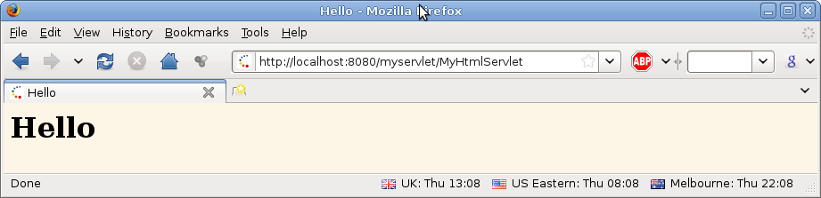
Compile, war and deploy
javac -classpath .:./servlet-api.jar -d WEB-INF/classes *.java
jar cf myservlet.war WEB-INF/
cp myservlet.war /home/usman/jboss-5.0.1.GA/server/default/deploy/

Slide 15
Servlet Life Cycle
init
  Executed once when the servlet is first loaded.Not called for each request.
service
  Called in a new thread by server for each request.
  Dispatches to doGet, doPost, etc.
  Do not override this method!
doGet, doPost, doXxx
  Handle GET, POST, etc. Requests.
  Override these to provide desired behavior.
Destroy
  Called when server deletes servlet instance.
  Not called after each request.

Slide 16
Servlet Debugging Strategies
Use print statements; run server on desktop
Use Apache Log4J or Java's own logging
Integrated debugger in IDE such as Eclipse or NetBeans
Look at the HTML source
Return error pages to the client
  Plan ahead for missing or malformed data
Use the log file
  log("message") or log("message", Throwable)
Make sure browser is not caching
  Internet Explorer: use Shift-RELOAD
  Firefox: use Control-RELOAD
Stop and restart the server

Slide 17
Summary
Main servlet code goes in doGet or doPost:
  The HttpServletRequest contains the incoming information
  The HttpServletResponse let you set outgoing information
    Call setContentType to specify MIME type
    Call getWriter to obtain a Writer pointing to client (browser)
One-time setup code goes in init
  Servlet gets initialized and loaded once
  Servlet gets invoked multiple times
  Initialization parameters set in web.xml (to be discuss)

Slide 18
Questions?

