Slide 1
Servlets
Handling client data from Servlets

Slide 2
Agenda
HTML Forms
Creating and submitting HTML forms
Reading reqeuest parameters from Servlet

Slide 3
HTML Post Form (form.html)
  <!DOCTYPE HTML PUBLIC "-//W3C//DTD HTML 4.01 Transitional//EN">
  <html>
  <head></head><body>
  <h1>Basic HTML Form</h1>
  <form action="formservlet" method="POST">
  First Parameter: <input name="param1" type="text"><br>
  Second Parameter: <input name="param2" type="text"><br>
  Third Parameter: <input name="param3" type="text"><br>
  <center>
  <input type="submit"></center>
  </form>
  </body></html>

Slide 4
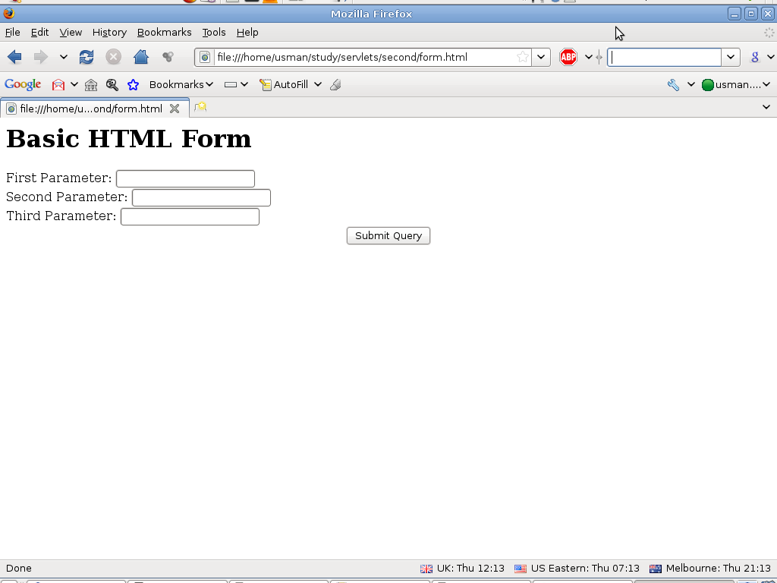
Initial Form

Slide 5
Additional: HTML files
HTML files do not go into src
  These are static content of your web application
  They are outside of WEB-INF folder, the compiled code goes into WEB-INF/classes folder
  they are accessed from top level context
Example:
  working_folder/form.html
  working_folder/WEB-INF/classes/FormServlet.class

Slide 6
Cont.
URL:
  http://localhost:8080/formapp/form.html
  http://localhost:8080/formapp/formservlet
Project:
  Project name formapp.war
  Servlet class name: FormServlet.java
  Mapping URL Pattern: formservlet
  HTML Form: form.html

Slide 7
Read form data from Servlets
request.getParameter("name")
  Returns URL-decoded value of first occurrence of name in query string
  Works identically for GET and POST requests
  Returns null if no such parameter is in query data
request.getParameterValues("name")
  Returns an array of the URL-decoded values of all occurrences of name in query string
  Returns a one-element array if param not repeated
  Returns null if no such parameter is in query

Slide 8
Cont.
request.getParameterNames() or request.getParameterMap()
  Returns Enumeration or Map of request params
  Usually reserved for debugging

Slide 9
Servlet code to read parameters
//A simple servlet to read three parameters from an HTML FORM.
import java.io.*;
import javax.servlet.*;
import javax.servlet.http.*;
public class FormServlet extends HttpServlet {
public void doGet(HttpServletRequest req, HttpServletResponse res)
throws IOException, ServletException {
//read submitted parameters
String p1 = req.getParameter("param1");
String p2 = req.getParameter("param2");
String p3 = req.getParameter("param3");
//Lets simply send same information back to client
res.setContentType("text/html");
PrintWriter out = res.getWriter();
out.println("<html><head></head><body>\n");
out.println("<ul>\n<li>First Param:"+ p1 +"</li>\n");
out.println("<li>Second Param:"+ p2 +"</li>\n");
out.println("<li>Third Param:"+ p3 +"</li>\n</ul></body></html>");
}

Slide 10
Code Cont...
public void doPost(HttpServletRequest req, HttpServletResponse res)
throws IOException, ServletException {
//the logic of GET is same for POST in this example
doGet(req,res);
}
}

Slide 11
Compiling, bundling and deployment
Compile your Servlet class
Modify your web.xml
Create .war file (formapp.war) containing WEB-INF and form.html
Deploy it
Test it

Slide 12
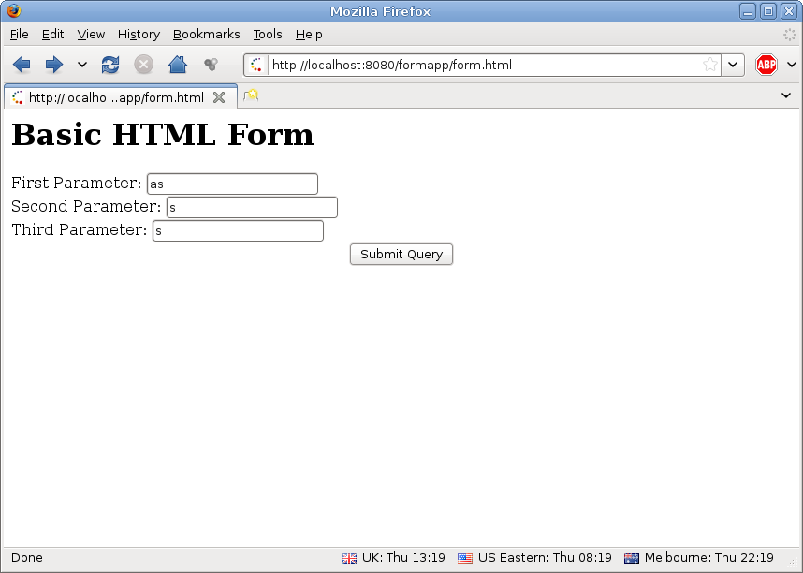
Form deployed

Slide 13
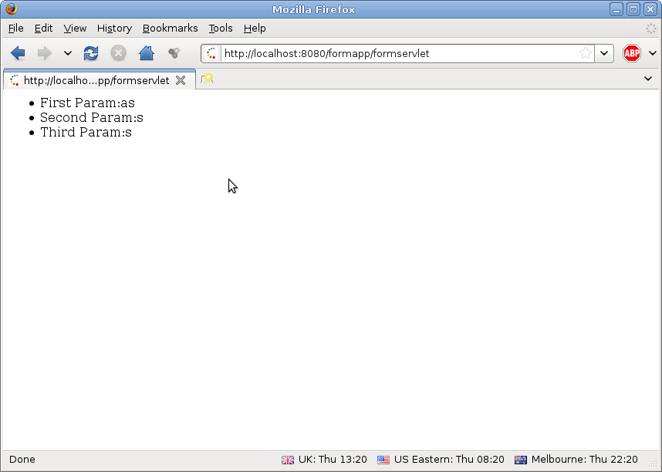
Servlet generated HTML page

