Slide 1

LEAD PARTNERSHIP PROPOSAL · 2026
Garage Doors Milton Keynes
A ready-built website that sends garage door enquiries in Milton Keynes straight to your phone.
Prepared by Muhammad Usman Siddiqui · garage-doors-milton-keynes.co.uk
Notes:
A website built to rank for garage door searches in Milton Keynes, set up so every call and form goes to one local installer.

Slide 2
THE OPPORTUNITY
People search for garage doors every day
478k
10,950
£2.88
UK searches a month
Local searches a month
Average cost per click
Across 38,964 garage door keywords, from repairs to new electric doors.
Searches that name Milton Keynes or one of the 14 nearby towns the site covers.
What advertisers pay Google for one click on a Milton Keynes garage door search.
Source: Ahrefs keyword export, Google UK, October 2026. Monthly search volumes.

Slide 3
LOCAL DEMAND
One site covers Milton Keynes and five big neighbours
Town | Keywords | Searches / mo
Northampton | 83 | 3,620
Milton Keynes | 47 | 2,580
Bedford | 67 | 2,290
Aylesbury | 25 | 1,730
Buckingham & Bucks | 26 | 580
Leighton Buzzard | 15 | 60
Other towns (9) | 5 | 80
All covered areas | 270 | 10,950
Every town has its own page on the site, so one website can win searches across the whole patch, not just central Milton Keynes.
On top of these, Google shows local results for unnamed searches like "garage doors near me", which gets 3,800 searches a month UK-wide on its own.
Source: Ahrefs, Google UK. Counts only keywords that name the town. Other towns: Bletchley, Newport Pagnell, Olney, Wolverton, Stony Stratford, Towcester, Woburn Sands, Cranfield, Winslow.

Slide 4
TOP MILTON KEYNES SEARCHES
The site has a page built for each of these
Keyword | Searches / mo | CPC | Page on the site
garage doors milton keynes | 400 | £2.50 | Home page
roller garage doors milton keynes | 150 | £3.50 | Roller doors
hormann garage doors milton keynes | 150 | £4.50 | Hörmann
up and over garage doors milton keynes | 150 | £3.00 | Up and over
side hinged garage doors milton keynes | 150 | n/a | Side hinged
sectional garage doors milton keynes | 150 | n/a | Sectional
wooden garage doors milton keynes | 100 | n/a | Wooden & timber
automatic garage doors milton keynes | 90 | £0.80 | Electric doors
garage doors repairs milton keynes | 90 | n/a | Repairs
Source: Ahrefs, Google UK. CPC = average Google Ads cost per click; n/a = not reported for that keyword.

Slide 5
WHAT PEOPLE SEARCH FOR
Roller and electric doors drive the most demand
Roller doors
75,490
Electric / automatic
66,600
Wooden / timber
32,950
Sectional
20,620
Up and over
20,380
Prices & cost
20,010
Insulated
19,540
Side hinged
17,090
Repairs
8,880
Monthly UK searches by topic. Source: Ahrefs, Google UK. A keyword can count in more than one topic (e.g. "electric roller garage doors").

Slide 6
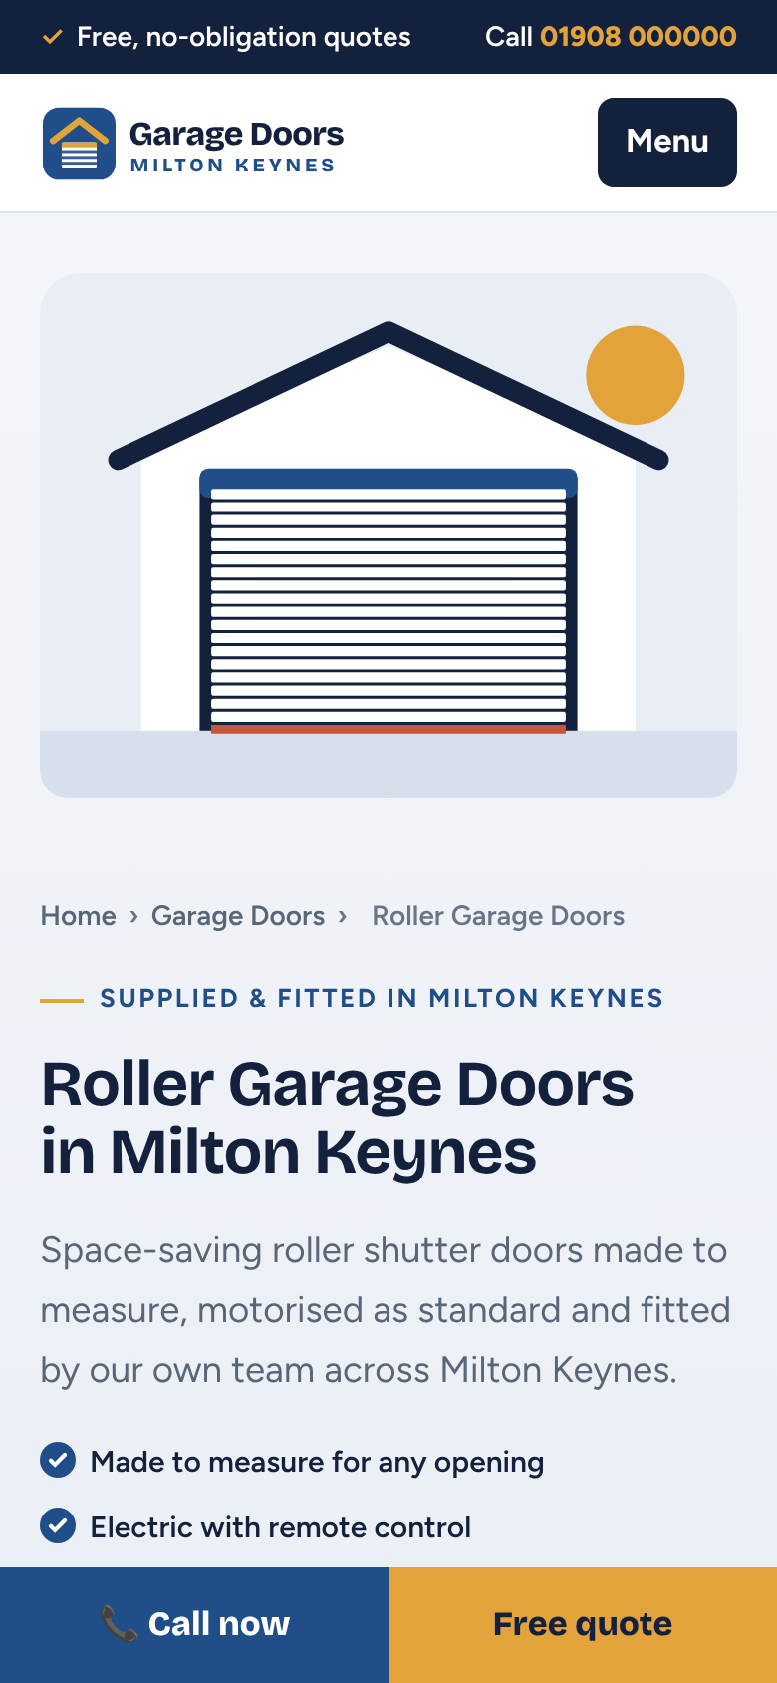
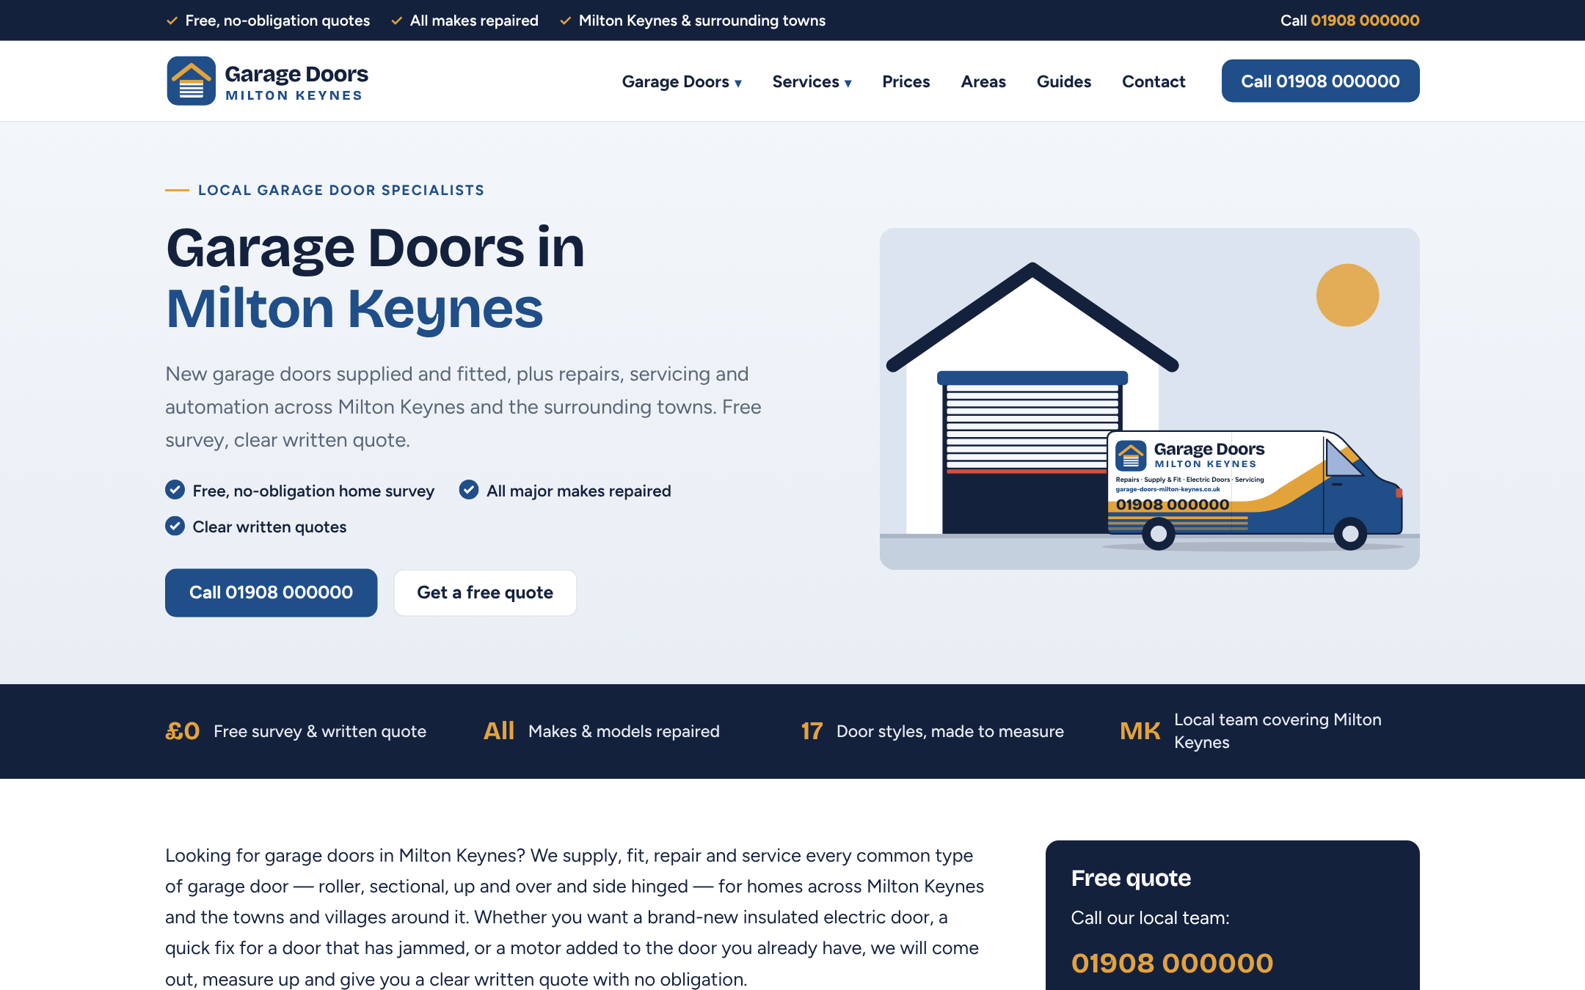
THE ASSET
A 72-page website, already built
17 door type pages
8 service pages
14 local area pages
6 brand pages
17 expert guides
1 full price guide
Every page links to the others, carries Google's structured data and has a call button and quote form. It works on phones, where most of these searches happen.

Slide 7
HOW RANK AND RENT WORKS
We bring the enquiries. You do the jobs.
1
2
3
4
A homeowner searches
They find our site
They call or send a form
Your phone rings
"Electric garage doors Milton Keynes" on Google or Maps.
A page built for exactly that door, with prices and answers.
A local 01908 number we own, or the quote form.
The call forwards to you instantly. You quote and win the job.
You pay a monthly fee for exclusive use of the site and its leads. We keep the site, the number and the rankings working.

Slide 8
WHAT A LEAD IS WORTH
One won install pays for months of rent
£25–£90
£700–£2,800
Fixed
Buying leads from Google Ads
A typical job
Rank and rent
Per enquiry, at £2.50–£4.50 a click if 5–10% of clicks get in touch. The cost stops the day the ads stop.
From a fitted steel up and over door to a single electric roller door, using the site's own price guide.
One monthly fee for every call and form, with no cost per click and no bidding against competitors.
CPC range from the Ahrefs data (Milton Keynes and Aylesbury terms). Enquiry rates and job values are typical estimates, not guarantees.

Slide 9
LEAD PROJECTION
What the site could send once it ranks
10,950
×
5–10%
×
4–6%
=
22–66
local searches a month
click on our site
call or send a form
enquiries a month
This is an illustrative range for a mature site, typically 6 to 12 months after launch. Real results depend on rankings, competition and how quickly calls are answered. We track every call so both sides see the real numbers.

Slide 10
SETUP ROADMAP
Seven steps from launch to steady leads
# | Step | Who | When
1 | Domain live and website published | Us | Week 1 (site built)
2 | Local 01908 tracking number, forwarded to you | Us | Week 1
3 | Quote form delivering to your inbox | Us | Week 1
4 | Search Console, Analytics and sitemap submitted | Us | Week 1
5 | Google Business Profile for your business | Together | Weeks 1–3
6 | Directory listings and local links | Us | Months 1–3
7 | Monthly report: calls, forms, rankings | Us | Every month
Directory listings include Bing Places, Apple Business Connect, Yell, Facebook and Nextdoor, with matching business details everywhere.

Slide 11
GOOGLE BUSINESS PROFILE
Your profile puts us on Google Maps, done by the rules
How we set it up
What we never do
• Created in your business's real name and verified by you
• Set up as a service-area business covering Milton Keynes and the towns, with your home address hidden
• Main category "Garage door supplier", plus matching repair and installation categories
• Website set to our site; phone set to the 01908 tracking number
• Real photos of your van and jobs, weekly posts, and a review request after every job
• Virtual office or made-up addresses
• Keyword-stuffed business names
• Fake or paid-for reviews
Google suspends profiles that break its guidelines, and a suspension can take the whole listing off Maps.
Notes:
Google requires a real business that serves customers in the area to own and verify the profile, so it belongs to the partner. The website, domain and tracking number stay with us; that is what is being rented.

Slide 12
CALLS AND FORWARDING
Every call reaches you, and every call is counted
Local 01908 number
Instant forwarding
Call whisper
A Milton Keynes number from a UK VoIP provider. Callers see a local business.
Rings your mobile or office straight away, or several phones at once.
You hear "Call from Garage Doors Milton Keynes" before it connects.
Recording and logs
Missed-call alerts
Monthly report
Time, duration and caller logged. Recording plays a short notice, as UK GDPR requires.
Text or email for missed calls, and voicemail sent to your inbox.
Calls, forms and rankings, so the fee is always tied to real leads.
Providers such as Twilio, Telnyx, CallRail or Ringover offer UK geographic numbers with these features. We own the number, so it stays with the site.

Slide 13
PARTNERSHIP OPTIONS
Three ways to work together
£30–£50
RECOMMENDED
Base + lead
£600–£1,000
Pay per lead
Hybrid
Per genuine call or form. The low-risk start: you only pay for enquiries that come in.
Exclusive monthly rent
A lower monthly fee plus a smaller per-lead fee. A balance of steady cost and pay-for-results.
Per month, all leads. Every call and form for the whole area, for one fixed fee.
Suggested starting prices for discussion. Final figures are agreed once lead volumes are tracked.

Slide 14
WHO DOES WHAT
A clear split keeps the leads flowing
We handle
You handle
• Website, hosting, content and rankings
• The 01908 number, forwarding and call recording
• Directory listings and local links
• A monthly report of every call and form
• Exclusivity: no other installer gets these leads
• Answer calls quickly, or call back within the hour
• Survey, quote and fit to a good standard
• Verify and own your Google Business Profile
• Send real job photos and ask customers for reviews
• Keep the price guide on the site accurate

Slide 15
TIMELINE
Leads build over the first year
Month 1
Months 2–3
Months 4–6
Months 6–12
Live and indexed
First calls
Steady flow
Main terms
Site, number, form and profile set up. Google starts finding the pages.
Specific searches like door types in a town start ranking.
Area pages and Maps listing gain ground; leads become regular.
Competing for "garage doors Milton Keynes" and the biggest searches.
A typical path for a new local site. Timings vary with competition and Google updates; rankings are never guaranteed.

Slide 16

NEXT STEPS
Start with a trial month
1. Agree the area and the starting model
2. We point the 01908 number at your phone
3. Take the calls, quote and win the jobs
4. Review the numbers together after 30 days
Muhammad Usman Siddiqui
siddiquiusman93@gmail.com
[Phone number]
garage-doors-milton-keynes.co.uk

