Slide 1
Operating Systems
Disk Scheduling

Slide 2
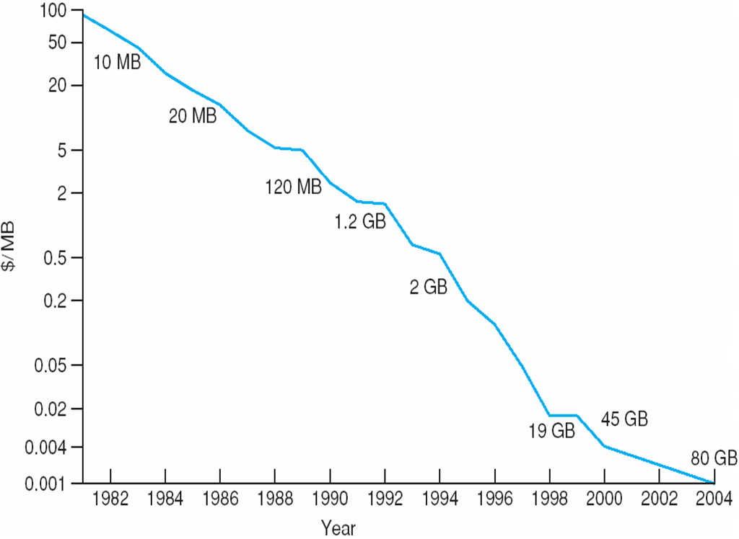
Price per Megabyte of
Magnetic Hard Disk, From 1981 to 2004
A. Frank - P. Weisberg

Slide 3

Moving-head Disk Mechanism
A. Frank - P. Weisberg

Slide 4
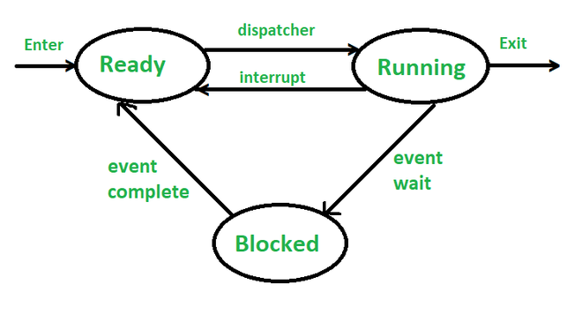
Part of CPU - Scheduling
Rewind: 3-State Process Model
A. Frank - P. Weisberg

Slide 5
Disk Scheduling
The operating system is responsible for using hardware efficiently — for the disk drives, this means having a fast access time and disk bandwidth.
seek time ≈ seek distance.
Disk bandwidth is the total number of bytes transferred, divided by the total time (completion of last transfer).
A. Frank - P. Weisberg

Slide 6
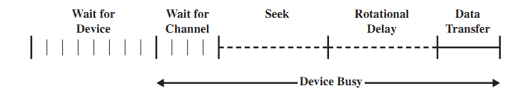
Components of Disk I/O Transfer
OS by Tannenbaum

Slide 7
Disk Scheduling Algorithms
Several algorithms exist to schedule the servicing of disk I/O requests.
We illustrate them with a I/O request queue (cylinders are between 0-199):
- queue = 98, 183, 37, 122, 14, 124, 65, 67
- head starts at 53

Slide 8

First Come First Serve (FCFS) Example
Example From OS by Siberchatz

Slide 9
First Come First Serve (FCFS)
Handle I/O requests sequentially.
Fair to all processes.
Issue:
Suffers from global zigzag effect.

Slide 10

Shortest Seek Time First (SSTF) Example
Illustration shows total head movement of 236 cylinders.

Slide 11
Shortest Seek Time First (SSTF)
Selects the request with the minimum seek time from the current head position (Tannenbaum).
Also called Shortest Seek Distance First (SSDF) – It’s easier to compute distances.
SSTF scheduling is a form of SJF scheduling; may cause starvation of some requests.

Slide 12
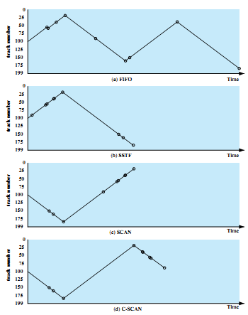
Graphs for previous example
LOOK
A. Frank - P. Weisberg
C-LOOK

Slide 13
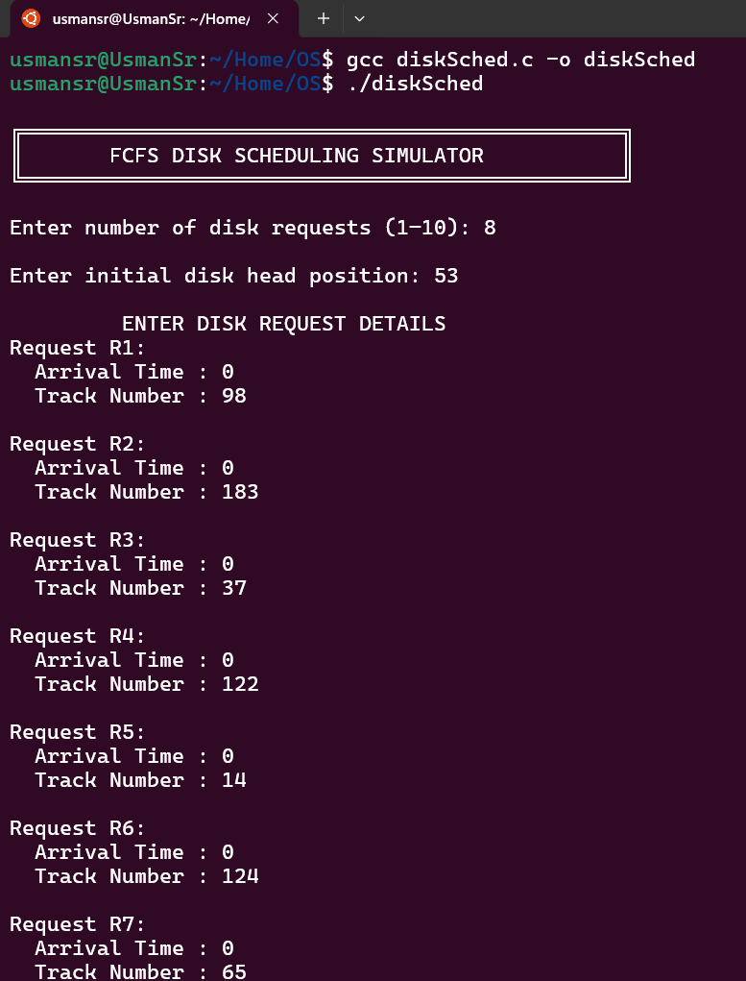
Code Output

Slide 14
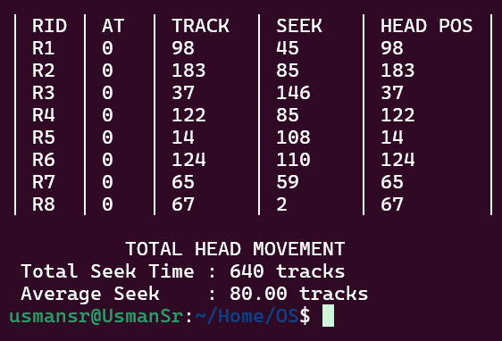
Code Output

Slide 15
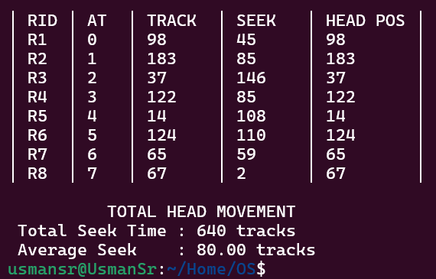
Code Output

Slide 16
Code Output

Slide 17
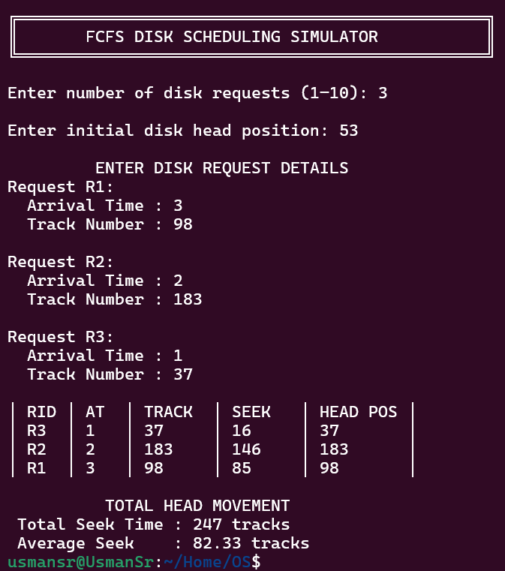

Slide 19
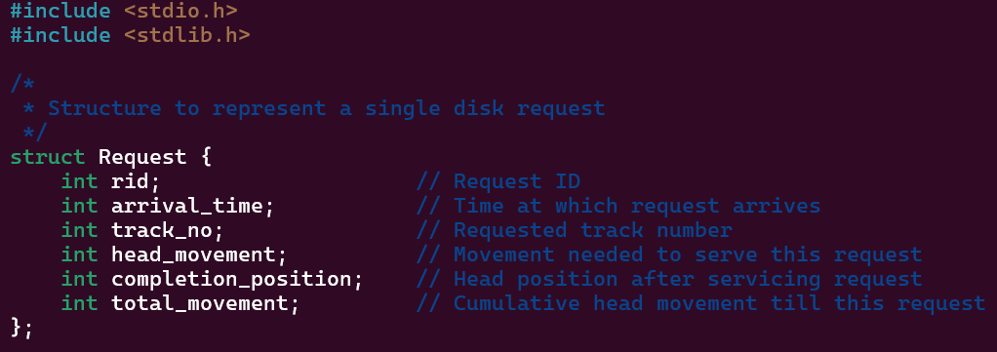
Code Insides

Slide 20
Code Insides

Slide 21
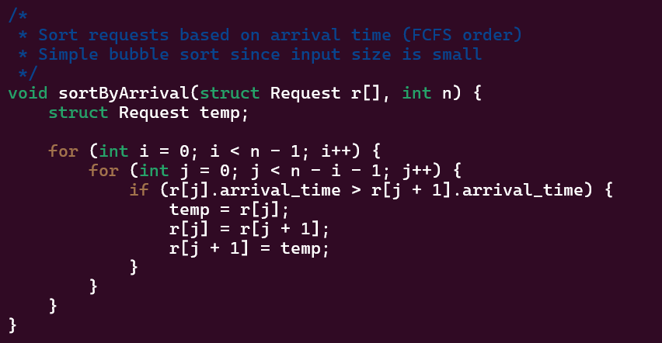
Code Insides

Slide 22
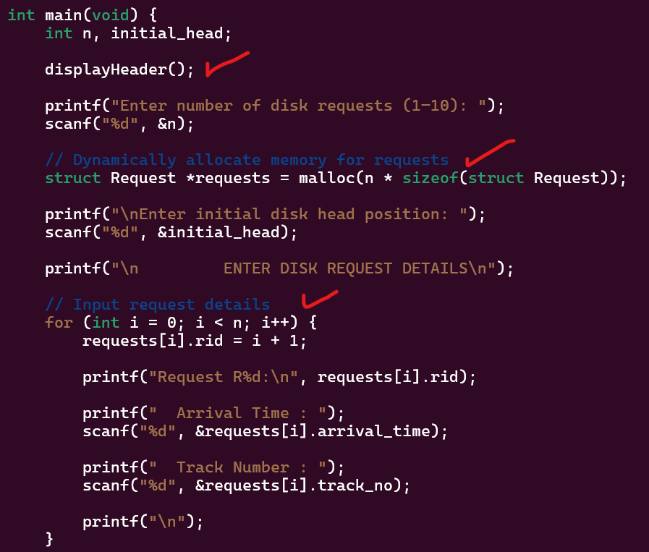
Code Insides

Slide 23
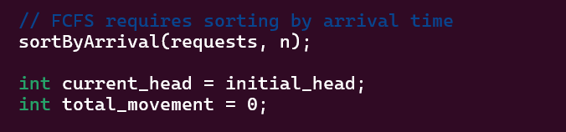
Code Insides

Slide 24
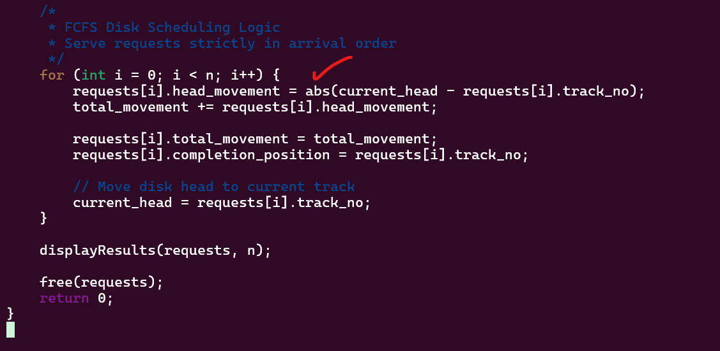
Code Insides

Slide 25
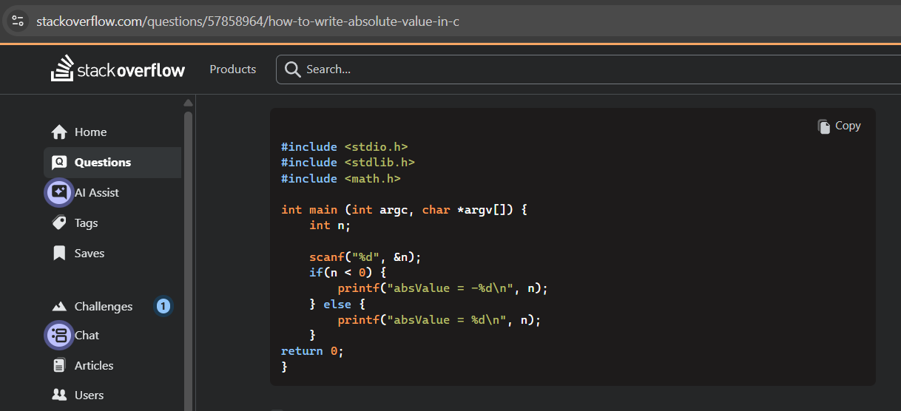
Code Insides

Slide 26
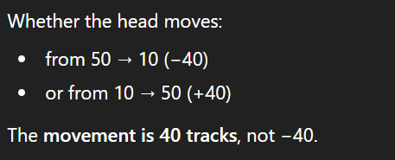
Code Insides

Slide 27
FAQs
Read/write multiple blocks in parallel
What about SSDs, NVMEs?
SSDs and NVMEs have
  Channels, Dies, Planes
Read/write multiple blocks in parallel
Writes can block reads
Reads over writes (latency-sensitive)
So… does disk scheduling still exists? Yes — but not “disk scheduling” as taught in FCFS/SSTF terms.

Slide 28
FAQs
Read/write multiple blocks in parallel
What about SSDs?
In modern OS (Linux example):
NOOP or Deadline is preferred.

Slide 29
FAQs
Read/write multiple blocks in parallel
Feature | HDD (Hard Disk Drive) | SSD / NVMe
Storage type | Mechanical (rotating platters) | Solid-state (no moving parts)
Read/Write head | Yes (moves physically) | No
Seek time | Very high | Almost zero
Rotational latency | Yes | No
Access time | Depends on head movement | Nearly uniform
Main performance issue | Head movement & seek time | Internal controller limits
Disk scheduling goal | Minimize seek time | Manage throughput & latency
Common OS scheduler | FCFS, SSTF, SCAN / C-SCAN | NOOP / Deadline
Who handles optimization | OS + disk mechanics | SSD controller firmware

Slide 30
FAQs
Read/write multiple blocks in parallel
We don’t use fork(), request_queue(), generic_make_request(), struct biostruct(), struct request() or Kernel-level disk calls in a disk scheduling simulator ?

Slide 31

Read/write multiple blocks in parallel

