Slide 1
SWITCHED RELUCTANCE MOTORS
Usman Mahmood Khan
Muahammad Abdullah Ahsan
Fahad Fareed
- Osama Imran

Slide 2
Reluctance motor is a kind of stepper motor that runs by reluctance torque.
In this presentation, we will try to justify their increasing usage in applications such as electric & hybrid cars.
Notes:
Unlike common DC motor types, power is delivered to windings in the stator (case) rather than the rotor. This greatly simplifies mechanical design as power does not have to be delivered to a moving part, but it complicates the electrical design as some sort of switching system needs to be used to deliver power to the different windings.
However, as we will see very shortly that with modern electronic devices, precisely timed switching is not a problem, and therefore SRM is a popular design for modern stepper motors.

Slide 3
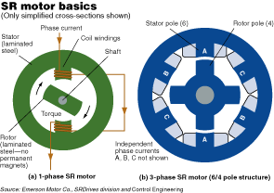

Slide 4
Power is delivered to windings in stator rather than rotor.
This simplifies mechanical design but complicates electrical design as precisely timed switching is required.
Fortunately, with modern electronic device(s), this is not a problem!
Notes:
Unlike common DC motor types, power is delivered to windings in the stator (case) rather than the rotor. This greatly simplifies mechanical design as power does not have to be delivered to a moving part, but it complicates the electrical design as some sort of switching system needs to be used to deliver power to the different windings.
However, as we will see very shortly that with modern electronic devices, precisely timed switching is not a problem, and therefore SRM is a popular design for modern stepper motors.

Slide 5
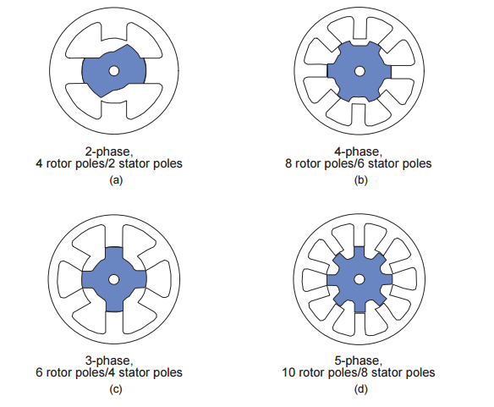
Notes:
The basic operating principle of the SRM is quite simple; as current is passed through one of the stator windings, torque is generated by the tendency of the rotor to align with the excited stator pole. The direction of torque generated is a function of the rotor position with respect to the energized phase, and is independent of the direction of current flow through the phase winding. Continuous torque can be produced by intelligently synchronizing each phase’s excitation with the rotor position. By varying the number of phases, the number of stator poles, and the number of rotor poles, many different SRM geometries can be realized.
This is shown in this figure.

Slide 6
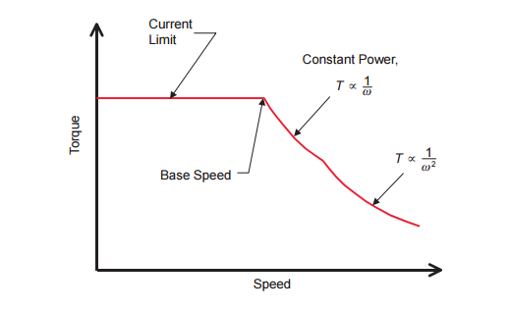
TORQUE-SPEED CHARACTERISTICS
Notes:
Like other motors that we have studied in class, torque is limited by maximum allowed current, and speed by the available bus voltage. With increasing shaft speed, a current limit region persists until the rotor reaches a speed where the back-EMF of the motor is such that, given the DC bus voltage limitation we can get no more current in the winding—thus no more torque from the motor. At this point, called the base speed, and beyond, the shaft output power remains constant, and at it’s maximum. At still higher speeds, the back-EMF increases and the shaft output power begins to drop. This region is characterized by the product of torque and the square of speed remaining constant

Slide 7
CONTROL / SWITCHING
While traditional motors use mechanical commutator* to switch winding currents, SRM uses dedicated electronic position sensor** to determine the position of rotor.
This offers great possibilities of dynamic control of pulse timing & shape.
*troublesome & high-maintenance
**trouble-free & low-maintenance
Notes:
This differs from the apparently similar induction motor which also has windings that are energised in a rotating phased sequence, in that the magnetization of the rotor is static (a salient pole that is made 'North' remains so as the motor rotates) while an induction motor has slip, and rotates at slightly less than synchronous speed. This absence of slip makes it possible to know the rotor position exactly, and the motor can be stepped arbitrarily slowly.

Slide 8
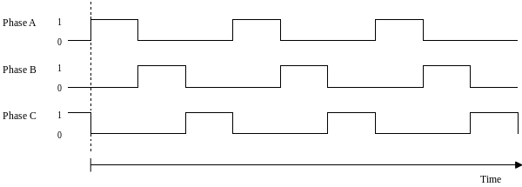
A SIMPLE SWITCHING CASE
Notes:
If the poles A0 and A1 are energised then the rotor will align itself with these poles. Once this has occurred it is possible for the stator poles to be de-energised before the stator poles of B0 and B1 are energized. The rotor is now positioned at the stator poles b. This sequence continues through c before arriving back at the start. This sequence can also be reversed to achieve motion in the opposite direction. This sequence can be found to be unstable, however.

Slide 9
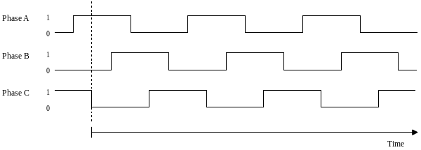
A BETTER ONE
Notes:
A much more stable system can be found by using the following "quadrature" sequence. First, stator poles A0 and A1 are energized. Then stator poles of B0 and B1 are energized which pulls the rotor so that it is aligned in between the stator poles of A and B. Following this the stator poles of A are de-energized and the rotor continues on to be aligned with the stator poles of B, this sequence continues through BC, C and CA before a full rotation has occurred. This sequence can also be reversed to achieve motion in the opposite direction. As at any time two coils are energised, and there are more steps between positions with identical magnetisation, so the onset of missed steps occurs at higher speeds or loads.

Slide 10
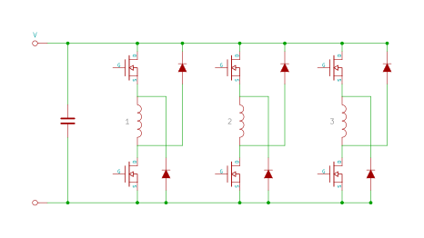
POWER CIRCUITRY [ASSYMETRIC BRIDGE CONVERTER]
Notes:
There are 3 phases in an asymmetric bridge converter corresponding to the phases of the switched reluctance motor. If both of the power switches on either side of the phase are turned on, then that corresponding phase shall be actuated. Once the current has risen above the set value, the switch shall turn off. The energy now stored within the motor winding shall now maintain the current in the same direction until that energy is depleted.

Slide 11
SIMULATION

Slide 12
REVISITING ANALYSIS [1]
The turn-on and turn-off angles and the magnitude of the phase current, determine the ultimate performance of the SRM.
Tradeoff:
Maximizing the torque output of the motor OR maximizing the efficiency of the motor.
Efficiency is optimized by minimizing the dwell angle
- Torque is optimized by maximizing the dwell angle
Notes:
The exact choice of the turn-on and turn-off angles and the magnitude of the phase current, determine the ultimate performance of the SRM. The design of commutation angles, sometimes called firing angles, usually involves the resolution of two conflicting concerns − maximizing the torque output of the motor or maximizing the efficiency of the motor. In general, efficiency is optimized by minimizing the dwell angle (the dwell angle is the angle traversed while the phase conducts), and maximum torque is achieved by maximizing the dwell angle to take advantage of all potential torque output from a given phase.

Slide 13
REVISITING ANALYSIS [2]
Ripple width decreases with increase in speed.
Notes:
At start, speed is slow, so dwell angle stays longer. This means ripple width is high. As motor speeds up, dwell angle stays for a shorter duration. So, ripple width decreases.

Slide 14
REVISITING ANALYSIS [3]
The control mechanism of SRM causes torque ripples which is one of its main drawbacks.
Can be lessened by increasing poles & phases.

Slide 15
CURRENT RESEARCH
Hybrid Electric Vehicles
- High Power Output
High Starting Torque
Wide Speed Range
Robust performance
- Cheap construction

Slide 16
REFERENCES
DiRenzo, M. T. Switched Reluctance Motor Control – Basic Operation and Example Using the TMS320F240. Texas Instruments
Arefeen, M. S. Implementation of a Current Controlled Switched Reluctance Motor Drive Using TMS320F240. Texas Instruments
Cristian, S. et al. Hybrid Electric Vehicles Based on Switched Reluctance Motor Drives.

