Slide 1
Equality

Slide 2
Equality…
So far, we have ignored formulas containing equality. If we were to simply treat equality as a normal predicate, we would miss many unsatisfiable sets of clauses, for example, {a = b, b = c, a = c}. To handle these, it is necessary to augment the set of clauses to ensure that all of the special properties of equality are taken into account.

Slide 3
Equality…
What we require are the clausal versions of the axioms of equality:
reflexitivity: ∀x. x = x;
symmetry: ∀x∀y. x = y ⊃ y = x;
transitivity: ∀x∀y∀z. x = y ∧ y = z ⊃ x = z;

Slide 4
Equality…
substitution for functions: for every function symbol f of arity n, an axiom
∀x1∀y1 ···∀xn∀yn. x1 = y1 ∧···∧ xn = yn ⊃ f(x1, ... , xn) = f( y1, ... , yn);
substitution for predicates: for every predicate symbol P of arity n, an axiom
∀x1∀y1 ···∀xn∀yn. x1 = y1 ∧···∧ xn = yn ⊃ P(x1, ... , xn) ≡ P( y1, ... , yn).

Slide 5
Equality…
It can be shown that with the addition of these axioms, equality can be treated as a binary predicate, and soundness and completeness of Resolution for the empty clause will be preserved.

Slide 6
Example
In this example, the KB is ∀x.
Married(father(x),mother(x))
father(john)=bill
and the query to derive is
Married(bill,mother(john))

Slide 7
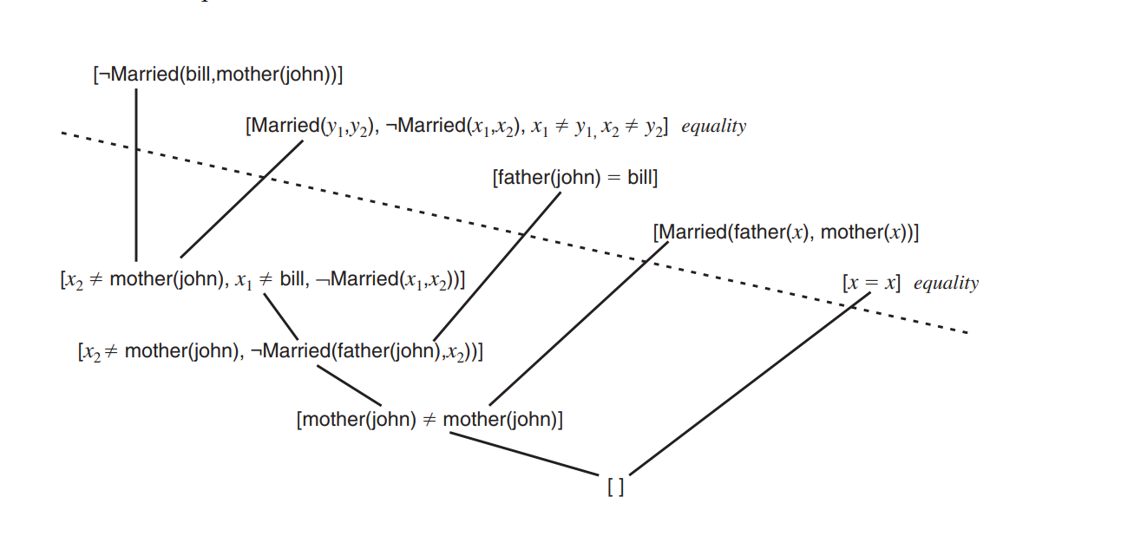
Example…

Slide 8
Example…
Note that the derivation uses two of the axioms: reflexitivity and substitution for predicates.

