Slide 1
Bev’s Bakery Final
Adrian Grimm
WDD229
4/28/2020

Slide 2
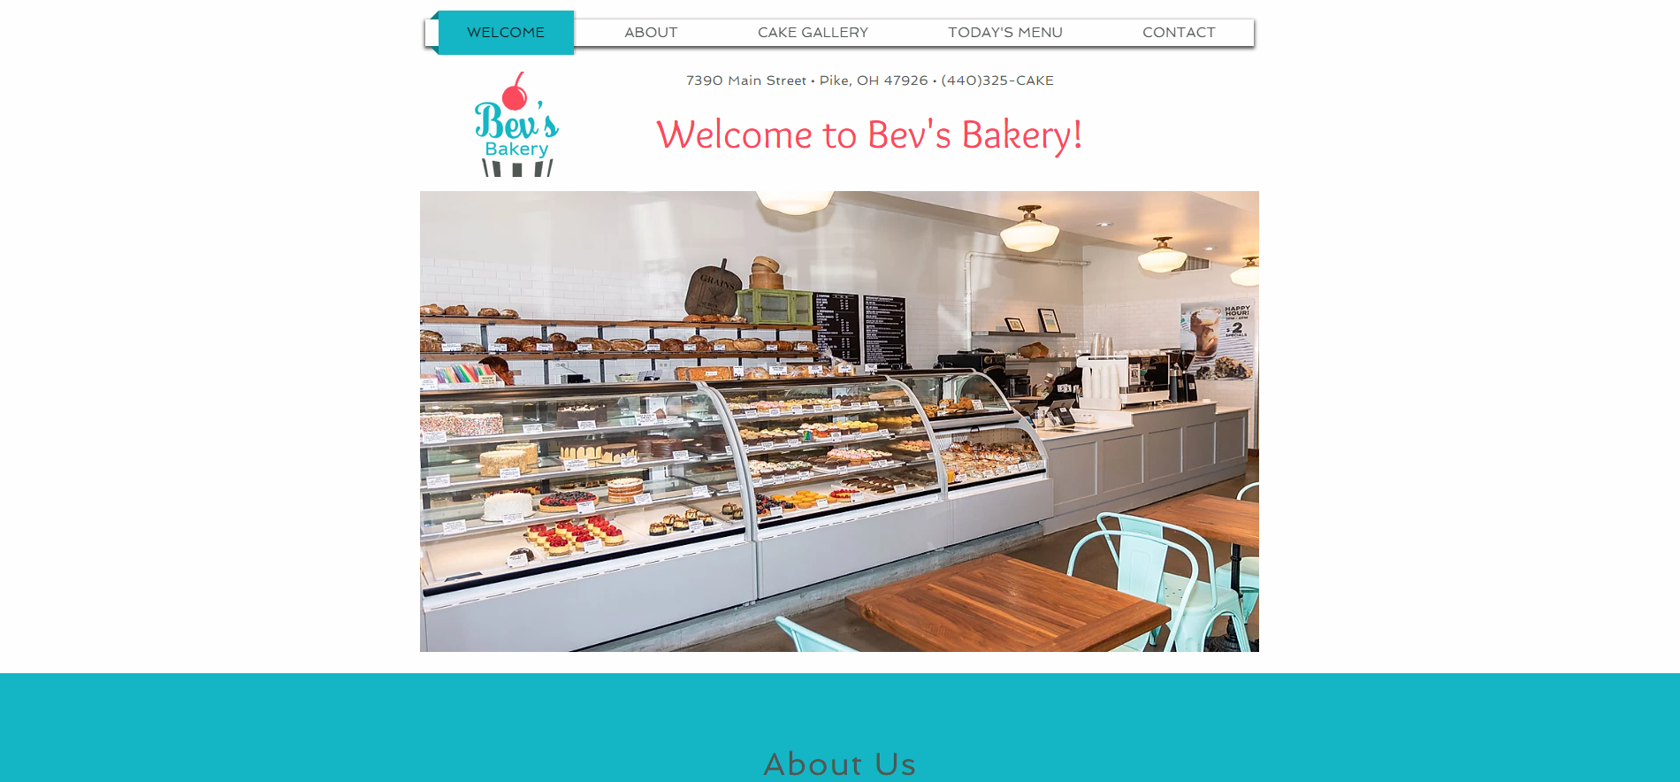
https://usmcamgrimm.wixsite.com/bevsbakery

Slide 3
Google Analytics
Google analytics would provide the following benefits to the website:
Track success of ad campaigns
Track visitors and map their movement through the site
Capturing target audiences
Understanding of visitors’ needs as potential customers

Slide 4
Digital Marketing

Slide 5
Facebook Marketing
Run single image ad for a month
Set a daily budget of $4
Maximum monthly budget of $121

Slide 6
Instagram Marketing
Instagram ads the highest engagement rate of all digital ad platforms
Run a photo add until maximum budget is met
Maximum budget of $109 will allow 145 interactions at $.75 per click

Slide 7


Advertisement Examples

Slide 8
Hootsuite
Effective way to improve presence across multiple social media platforms.
Scheduled content releases
Engage with users
Reports to measure campaign success
Plans start at $29/month
30 day free trial to check effectiveness

