Slide 1
Bev’s Bakery Final
Adrian Grimm
WDD229
4/28/2020

Slide 2
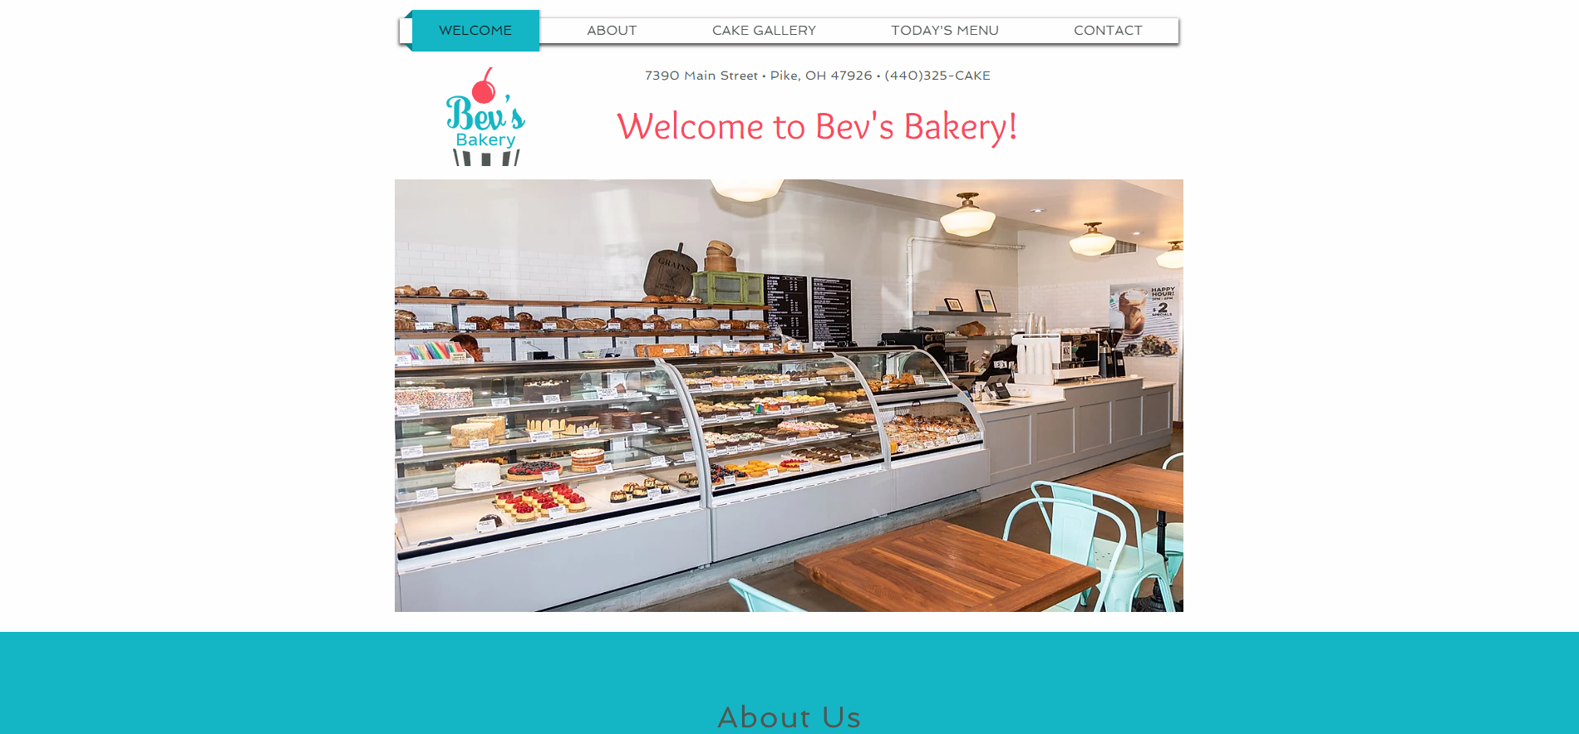
https://usmcamgrimm.wixsite.com/bevsbakery

Slide 3
Google Analytics
Google analytics would provide the following benefits to the website:
Track success of ad campaigns
Track visitors and map their movement through the site
Capturing target audiences
Understanding of visitors’ needs as potential customers

