Slide 1

Intel® Edison Workshop
Day 2, 6th December 2016
Lab 4 Level 3 School of Computer Science USM Penang 11800
Notes:
NOTE: Finalize workflow for content as the final slide will be updated later.

Slide 2
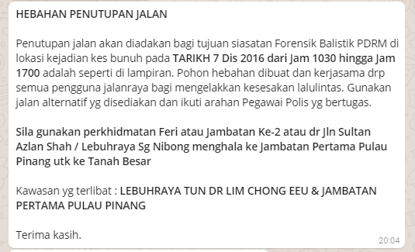

Slide 3
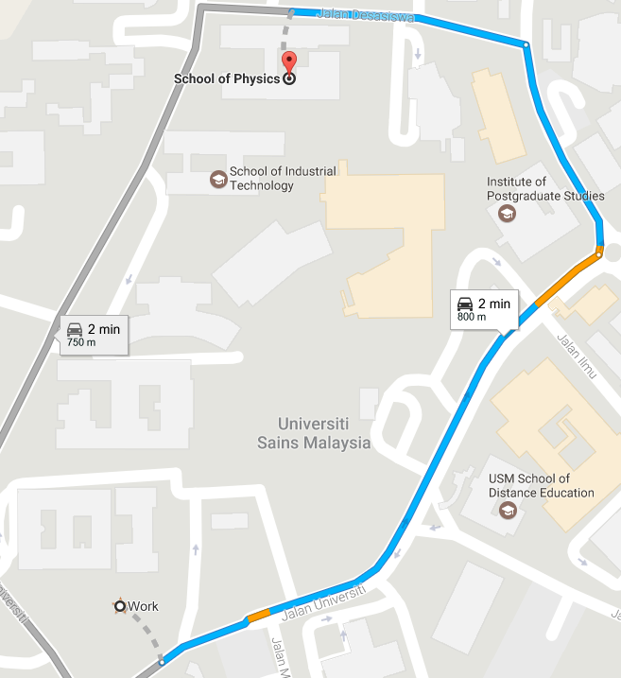
FIZIK
DAY 3
Park your car here
PSKOMP

Slide 4
Hands-on
01 - build http-express

Slide 5
Pre-requisites
Sublime Text Editor
Git bash
Make sure you have all those application in your PC. Kindly call facilitators if you can’t find those programs.

Slide 6
Run code sample: 01-HTTP-Express
Right click from ‘http-Express’ folder, Choose Git Bash Here
Resolve dependencies
$ npm install –save
Run
$ node main.js

Slide 7


HTTP-Express
main.js
index.html
(server)
e.g: 10.207.134.83:11111
(client)

Slide 8
Run code samples: 02-SocketIO
Launch Sublime text Editor.
File > Open Folder, (open your “http-express” folder)

Slide 9
HTTP-Express
socket.io
main.js
index.html
(server)
random.int(0,100)
(client)
80

Slide 10
Run code sample: 03-rand-mobile
Run server
Go to ‘server’ folder. Right click > Git Bash here
Resolve dependencies
$ npm install –save
Run main.js
$ node main.js

Slide 11
Run code sample: 03-rand-mobile
Run rand-mobile with Intel XDK
Launch Intel XDK.
Click ‘OPEN AN INTEL XDK PROJECT’ and open ‘rand-mobile.xdk’
Simulate mobile app
Click ‘Simulate’
Choose IOS > Apple Iphone 6
Click play icon tu start simulator
Enter IP Address and port number.

Slide 12
HTML5 Mobile app with Intel XDK

Slide 13
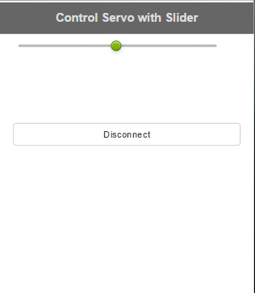
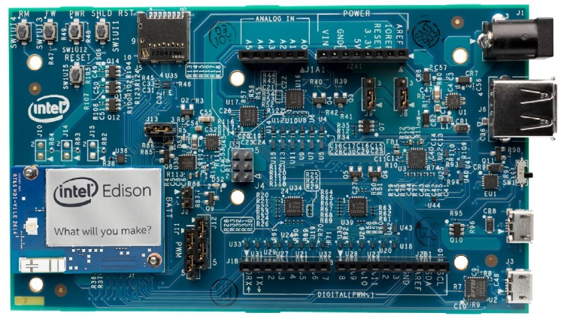
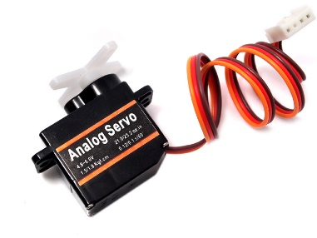
Objective
Build simple mobile app that use slider to control servo rotation angle on Intel Edison.

Slide 14
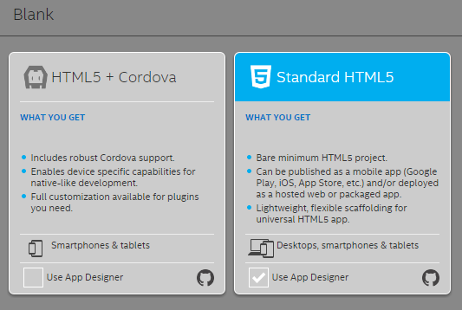
Create empty HTML5 mobile app with Intel XDK
Click ‘START A NEW PROJECT’ > HTML5 COMPANION HYBRID MOBILE OR WEB APP > BLANK > Standard HTML5 (Use App Designer)

Slide 15
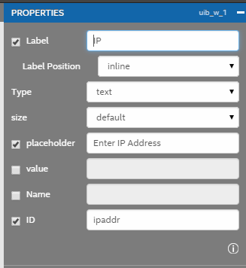
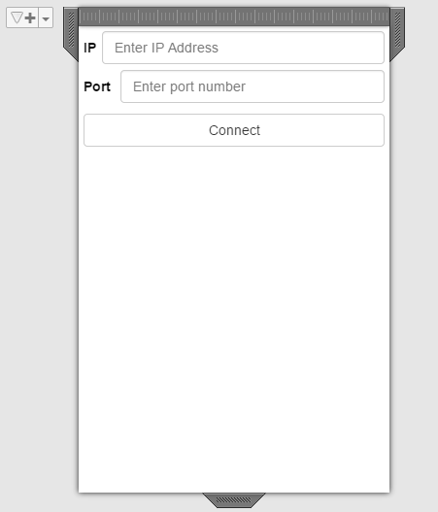
Create Front page
Common - Input
Buttons - Button
Rename the label, placeholder and ID for each input textboxes for IP and Port.

Slide 16
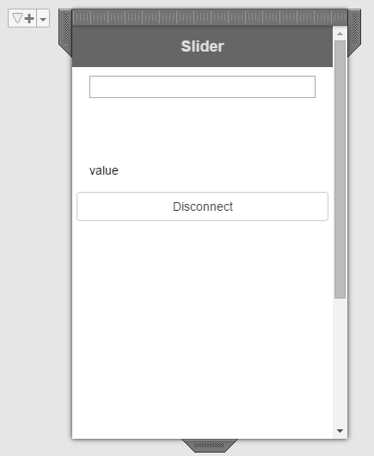
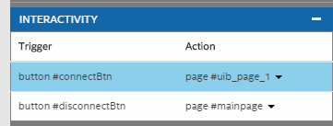
Create slider page
Header,
Layout - Row
Buttons - Button
Assign action trigger for ‘Connect’ & ‘Disconnect’ buttons.

Slide 17
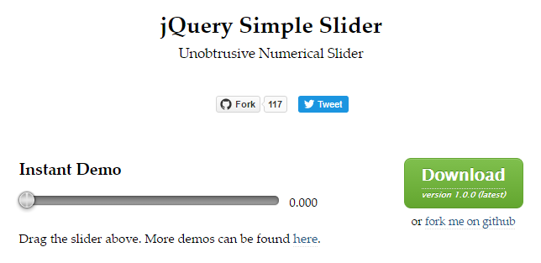
jQuery Simple Slider
We are going to use this simple slider for our servo control
http://loopj.com/jquery-simple-slider/

Slide 18
Install Slider
Extract loopj-jquery-simple-slider.zip
Copy simple-slider.js into your project directory at ‘<your-mobile-slider-project>\www\js’
Copy simple-slider.css into your project directory at ‘<your-mobile-slider-project>\www\css’

Slide 19
Install Slider: Cont.
Put these lines exactly before </head> in ‘index.html’
<script src="js/simple-slider.js"></script>
<link href="css/simple-slider.css" rel="stylesheet" type="text/css" />

Slide 20
Install Slider: Cont.
Add these line:
inside this ‘widget-container’ block from your ‘index.html’ so that you will have:
<input type="text" data-slider="true" d="my-input" data-slider-range="0, 180">
<span id="myspan">value</span>
<div class="widget-container content-area vertical-col">
<input type="text" data-slider="true" id="my-input" data-slider-range="0, 180">
<span id="myspan">value</span>
</div>

Slide 21
Install Slider: Result
Go to ‘Simulate’ tab, and start the simulator.

Slide 22
Build logic for Slider HTML5 mobile app
Go to ’04_iot-slider_demo’ and open ‘mobile-slider’ with Intel XDK.

Slide 23
Add Socket.IO to connect to Edison
Add Socket.IO CDN script before </head> in your ‘index.html’ (line: 75)
<script src="https://cdn.socket.io/socket.io-1.4.5.js"></script>

Slide 24
Add Socket.IO to connect to Edison
Establish connection from mobile-slider to Edison servo (refer index.html line: 141)
var ip = $("#ipaddr").val();
var portnum = $("#port").val();
var socket = io("http://" + ip + ":" + portnum);

Slide 25
Get values from Slider and pass it to Edison
index.html, Line: 147
socket.on('connect', function() {
console.log("connected!");
$("#my-input").bind("slider:changed", function (event, data) {
// The currently selected value of the slider
document.getElementById("myspan").textContent = data.value;
// stream-out to edison
socket.emit('msg', data.value);
});

Slide 26
Run DEMO
04_iot-slider_demo

Slide 27

Overview:
edison-J5servo
mobile-slider
socket.io
(server)
Receive slider values to rotate servo
(client)
Send slider value to Edison

Slide 28
Run: edison-j5servo
Copy ‘edison-j5servo.tar.gz’ into your Edison
Right click > Git Bash Here in ‘edison-j5servo’ folder
Copy
$ scp edison-j5servo.tar.gz root@<your-ip>:/home/root

Slide 29
Run: edison-j5servo (cont.)
Open Serial connection to Edison using PuTTY
Extract the project
$ tar xzvf edison-j5servo.tar.gz

Slide 30
Run: edison-j5servo (cont.)
Go into project folder
$ cd edison-j5servo
Resolve dependencies
$ npm install --save
Run edison-j5servo
$ node main.js

Slide 31

Run: edison-j5servo (explained)
Make edison as http server, equipped with websocket comm.

Slide 32
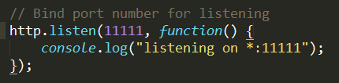
Run: edison-j5servo (explained)
Edison waits (at port 11111) for any incoming client to connect

Slide 33
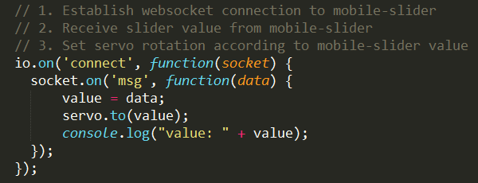
Run: edison-j5servo (explained)
If receive connection, run servo with given slider values from client

Slide 34
Run: mobile-slider
Run mobile-slider with Intel XDK
Launch Intel XDK.
Click ‘OPEN AN INTEL XDK PROJECT’ and open ‘mobile-slider.xdk’
Simulate mobile app
Click ‘Simulate’
Choose IOS > Apple Iphone 6
Click play icon to start simulator
Enter IP Address and port number.

Slide 35
Run: mobile-slider (explained)

Slide 36

End

