Slide 1
Need for Coffee Shop in Fredericton
by Usmon Kuchimov

Slide 2
About project
Fredericton is the Capital City of the Canadian bilingual Province of New Brunswick and is beautifully located on the banks of the Saint John River. While one of the least populated provincial capital cities with a population base of less than 60 thousand residents, it offers a wide spectrum of commercial venues and government institutions, universities and cultural attractions.
As the city grows and develops, it becomes increasingly important to examine and understand it quantitatively using latest available technologies. The City of Fredericton provides open data for everyone and encourages entrepreneurial use to develop services for the benefit of its citizens.

Slide 3
Questions to be answered
Developers, policy makers and/or city planners and wide range of interested parties have an interest in answering the following questions:
Which neighborhoods have the highest crime rate?
Is population density indicator linear correlation with crime rates?
As per Foursquare data, what are the venues that are most common in various neighborhoods of the city?
Does the Knowledge Park really need another coffee shop?

Slide 4
Data acquisition and preparing

Slide 5
Data points
To understand and explore we will need the following City of Fredericton Open Data:
Open Data Site: http://data-fredericton.opendata.arcgis.com/
Fredericton Neighbourhoods: http://data-fredericton.opendata.arcgis.com/datasets/neighbourhoods-quartiers
Fredericton Crime by Neighbourhood: http://data-fredericton.opendata.arcgis.com/datasets/crime-by-neighbourhood-2017--crime-par-quartier-2017

Slide 6
Data points (continued…)
Fredericton Census Tract Demographics: http://data-fredericton.opendata.arcgis.com/datasets/census-tract-demographics--donn%C3%A9es-d%C3%A9mographiques-du-secteur-de-recensement
Fredericton locations of interest: https://github.com/usmonkuchimov/Coursera_Capstone/blob/master/Fredericton%20Locations.xlsx
Foursquare Developers Access to venue data: https://foursquare.com

Slide 7
Data Analysis

Slide 8
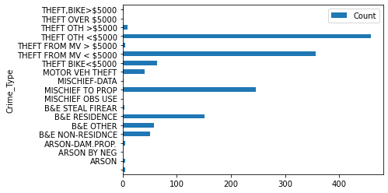
Crime count by neighborhood
Once the data was prepared, a choropleth map was created to view the crime count by neighbourhood. As expected the region of greatest crime count was found in the downtown and Platt neighbourhoods.
Examining the crime types enables us to learn the most frequent occuring crimes which we then plot as a bar chart to see most frequenty type.

Slide 9
Correlation of crime frequency
Visualising the population density enables us to determine that the Platt neighbourhood has lower correlation to crime frequency than I would have expected.
Refer to density map in the Notebook.

Slide 10
Location analysis
Grouping rows by location and the mean of the frequency of occurance of each category we venue categories we study the top five most common venues.
Putting this data into a pandas dataframe we can then determine the most common venues by location and plot onto a map.
Refer to Notebook for the map

Slide 11
Conclusion

Slide 12
Fredericton
Given the findings of the top 10 most frequent venues by locations of interest, the Knowledge Park does not have Coffee Shops in the top 10 most common venues as determined from the Foursquare dataset. Given this area has the greatest concentration of stores and shops as venues, it would be safe to assume a coffee shop would be beneficial to the business community and the citizens of Fredericton.
While overall, the City of Fredericton Open Data is interesting, it misses the details required for true valued quantitiatve analysis and predictive analytics which would be most valued by investors and developers to make appropriate investments and to minimize risk.
The Open Data project is a great start and empowers the need for a "Citizens Like Me" model to be developed where citizens of digital Fredericton are able to share their data as they wish for detailed analysis that enables the creation of valued services.

