Slide 1
Developing a Calculator for the Phase Fraction and Uncertainty of Austenite in Steel
Caleb Schenck & Max Garman
Date: February 20, 2022
Advisors: Dr. Adam Creuziger, David Newton (MS)
& Dr. Kip Findley
Sheet and Coated Steels

Slide 2
Undergraduate Research
Date Initiated: September, 2021
Anticipated Completion Date: May, 2022
Research Timetable:
Task 1: Completion date
Task 2: Completion date
etc……………………..
etc…………………….
Notes:
Project Status
Use greater then 20 point Arial font

Slide 3
Industrial Relevance
Vehicle Lightweighting
Retained Austenite (TRIP, TWIP, etc)
Reduced Sheet Thickness
Maintain Safety and Toughness
Commercial Production
Practicality
Research
Industry
Standards
Notes:
Industrial Relevance
Include a clear statement of industrial relevance
Use greater then 20 point Arial font

Slide 4
Project Plan
Project Objective:
- To develop a web-based application (calculator) that takes XRD data inputs from the user and outputs a table detailing the phase fractions in the material. Importantly, the calculator includes an uncertainty of the measurement which has been largely ignored in the past.
Expected Results:
- Pre-recorded demo here?
(a succinct statement of your expected results – presented in a manner to assist sponsors in assessing how they should plan to use your results.)
Notes:
Project Plan
Working Hypothesis or Project Objective: (Insert a clear statement that identifies the hypothesis, that clarifies why you are doing what you are doing.)
Expected Results: (a succinct statement of your expected results – presented in a manner to assist sponsors in assessing how they should plan to use your results.)
Project Scope: (a clear statement of the scope of your program that clarifies what you are doing and how you are doing it – if necessary the scope could be on a separate page)
Use greater then 20 point Arial font

Slide 5
Project Plan Cont.
Project Scope: (Read over for correctness of content not actual presentation format)
- The calculator is a python-based application which leverages the GSAS II code base to calculate the fractions of the phases contained in the sample. It does this by taking a standard XRD data file along with specific instrument parameters, and automatically fitting the Intensity vs 2θ plot.
- In order to find the phase fractions, a theoretical intensity of each phase is generated and then compared to the experimental data. This method is further described in the following slides.
(a clear statement of the scope of your program that clarifies what you are doing and how you are doing it – if necessary, the scope could be on a separate page)

Slide 6
Project Plan Cont.
Project Scope:
- An input of XRD data is placed into the python-based application. Using calculated theoretical intensity values of each phase present and comparing that to the empirical data, the phase fraction in the material can be found.
XRD Data
Uncertainty
Instrument Parameters
Calculator
Phase Fractions

Slide 7
Theoretical Intensity
*need source*
A reference for the integrated area of the pure phases in a microstructure must be developed. See below:
Notes:
Industrial Relevance
Include a clear statement of industrial relevance
Use greater then 20 point Arial font

Slide 8

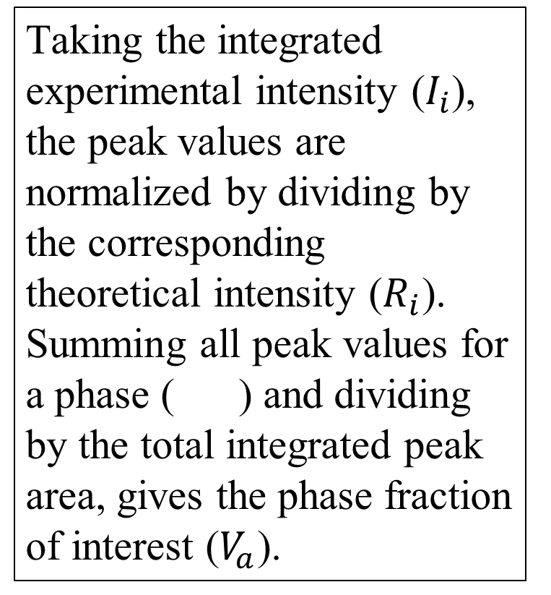
Experimental Phase Fraction
1)
Taking the integrated experimental intensity ($I_{i}$), the peak values are normalized by dividing by the corresponding theoretical intensity ($R_{i}$). Summing all peak values for a phase ( ) and dividing by the total integrated peak area, gives the phase fraction of interest ($V_{a}$).
2)
3)
4)

Slide 9
Sources of Uncertainty

