Slide 1
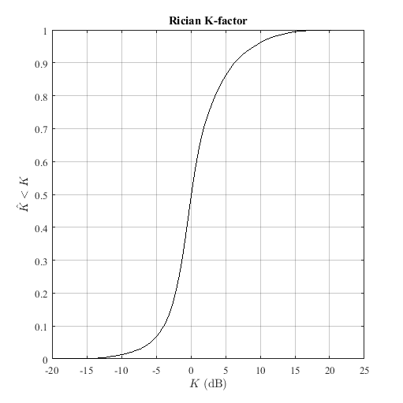
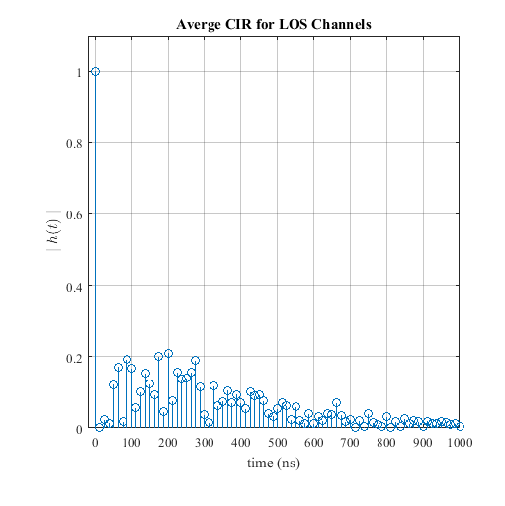
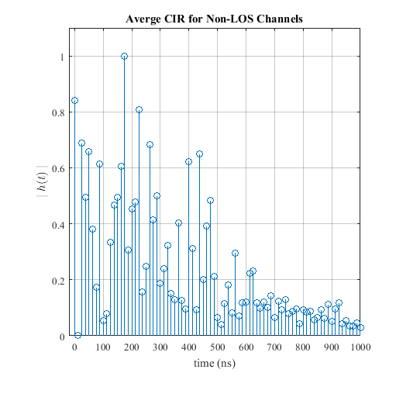
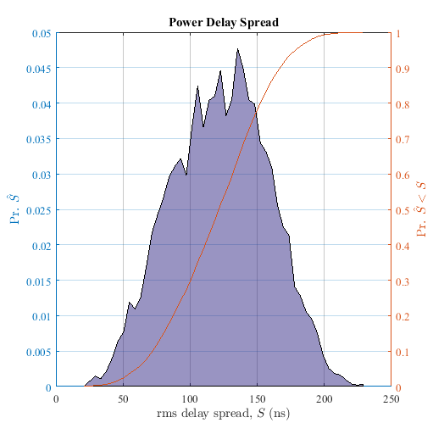
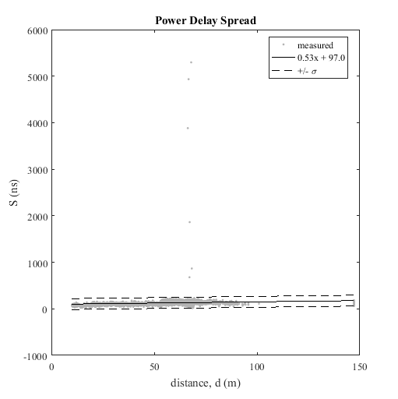
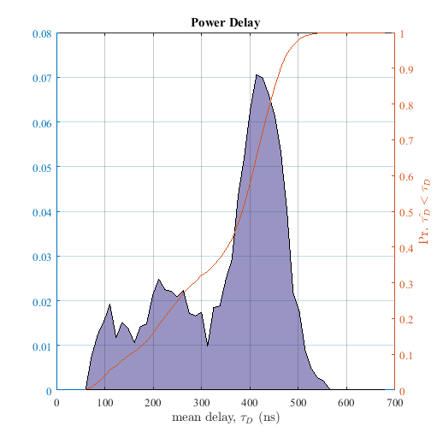
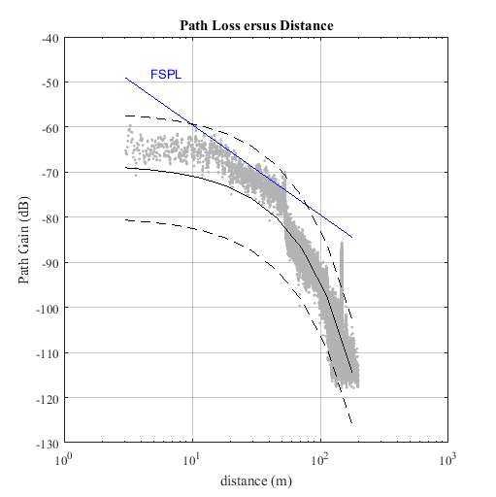
Mat File: AAPlantD1_2GHz_TX1_hpol_run4
Frequency: 2.245000e+00
Location: AA Plant Day 1 at Automotive Assembly Plant
RX Antenna: Omni-directional, Cross Pol
RX Antenna Gain: -4.200000e+00
TX Antenna: Omni-directional, V Pol
TX Antenna Gain: 2.900000e+00
TX Power, Watts: 1.500000e+00
PN Oversample Factor: _x0004_
Sample rate, MHz: P
Frequency: 2.245000e+00

