Slide 1
WORKSHOP: “ALL ABOUT DATA” Experimental data collection and initial analysis
PPEPPD 2019
Vancouver, Canada
May 15, 2019
Ala Bazyleva
Thermodynamics Research Center (TRC)
Applied Chemicals and Materials Division
National Institute of Standards and Technology (NIST)
Boulder, Colorado, USA

Slide 2
Steps to be taken: 1) Search for relevant literature sources 2) Extraction of experimental data 3) Initial analysis of experimental data

Slide 3
Literature sources for the propane + hydrogen sulfide system
Abbreviation | Full bibliographic information
1940 gil sch | Gilliland, E. R.; Scheeline, H. W. High-Pressure Vapor-Liquid Equilibrium. For the Systems Propylene-Isobutane and Propane + Hydrogen Sulfide. Ind. Eng. Chem., 1940, 32, 48-54
1945 ste | Steckel, F. Vapor-liquid equilibria of some binary systems containing hydrogen sulfide under pressure. Sven. Kem. Tidskr., 1945, 57, 209-216
1950 ram | Rambosek, G.M. Liquid-vapor equilibrium composition relationships in the propane-hydrogen sulfide systems. Ph.D. Thesis, Ohio State University, Columbus, OH (1950)
1953 kay ram | Kay, W. B.; Rambosek, G. M. Liquid-Vapor Equilibrium Relations in Binary Systems. Propane-Hydrogen Sulfide Systems. Ind. Eng. Chem., 1953, 45, 221-226
1960 bre | Brewer, J. Phase equilibria of the propane - hydrogen sulfide system from the cricondondentherm to the solid-liquid-vapor locus. Ph.D. Thesis, Univ. Kansas, Lawrence, KA (1960)
1961 bre rod | Brewer, J.; Rodewald, N.; Kurata, F. Phase equilibria of the propane-hydrogen sulphide system from the cricondontherm to the solid-liquid-vapor region. AIChE J., 1961, 7, 13-16
1965 rob jac | Robinson Jr., R. L.; Jacoby, R. H. Better Compressibility Factors. Hydrocarbon Proc. Petr. Refiner, 1965, 44, 141-145
1995 jou car | Jou, F.-Y.; Carroll, J. J.; Mather, A. E. Azeotropy and critical behavior in the system propane-hydrogen sulfide. Fluid Phase Equilib., 1995, 109, 235-244
2006 lob fer | Lobo, L. Q.; Ferreira, A. G. M.; Fonseca, I. M. A.; Senra, A. M. P. Vapour pressure and excess Gibbs free energy of binary mixtures of hydrogen sulphide with ethane, propane, and n-butane at temperature of 182.33 K. J. Chem. Thermodyn., 2006, 38, 1651-1654
2011 jar riv | Jarne, C.; Rivollet, F.; Richon, D. PρT Data for Hydrogen Sulfide + Propane from (263 to 363) K at Pressures up to 40 MPa. J. Chem. Eng. Data, 2011, 56, 84-88
2012 dic coq | Dicko, M.; Coquelet, C.; Theveneau, P.; Mougin, P. Phase Equilibria of H2S-Hydrocarbons (Propane, n-Butane, and n-Pentane) Binary Systems at Low Temperatures. J. Chem. Eng. Data, 2012, 57, 1534-1543

Slide 4
Extraction of experimental data

Slide 5
Experimental data for the propane + hydrogen sulfide system
Abbreviation | Reported properties (directly measured)
1940 gil sch | VLE (pTxy - isobars)
1945 ste | VLE (pTxy - isotherms)
1950 ram | Critical locus (pρTx), VLE (pTxy - bubble and dew points), saturated densities of liquid and gas
1953 kay ram | The same as 1950 ram, corrected smoothing (processing)
1960 bre | VLE (pTxy - bubble and dew points, volume fraction of liquid), SLVE, critical locus (pTx), azeotropic temperature
1961 bre rod | The same as 1960 bre, corrected smoothing (processing)
1965 rob jac | Compressibility factor (supercritical fluid)
1995 jou car | Azeotrope locus (pTx), critical locus (pTx)
2006 lob fer | VLE (pTx - isotherm)
2011 jar riv | Density (gas, liquid, supercritical fluid)
2012 dic coq | VLE (pTx - isotherms)

Slide 6
1945 ste Steckel, F. Vapor-liquid equilibria of some binary systems containing hydrogen sulfide under pressure. Sven. Kem. Tidskr., 1945, 57, 209-216
Challenge 1: availability
1945 ste Steckel, F. Vapor-liquid equilibria of some binary systems containing hydrogen sulfide under pressure. Sven. Kem. Tidskr., 1945, 57, 209-216
Journal: Svensk Kemisk Tidskrift

Slide 7
Challenge 2: language

Slide 8
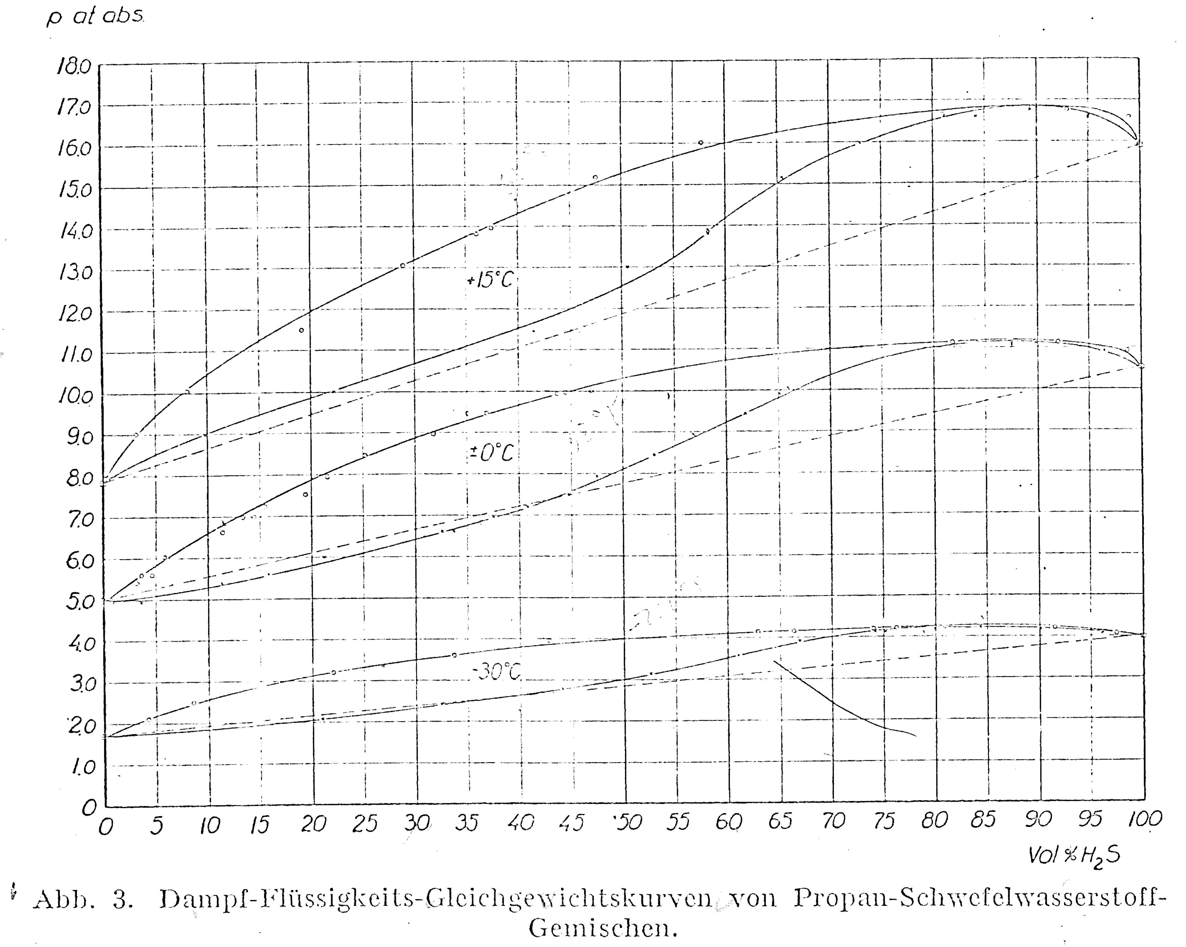
Challenge 3: only graphical representation of data

Slide 9
Challenge 4: ill-defined data

Slide 10
Digitized data

Slide 11
Challenge 5: unclear separation between experimental and calculated data
2006 lob fer
calculated

Slide 12
Challenge 6: typographical errors
Data from the table
Corrigendum published in 2007

Slide 13
Challenge 6: typographical errors
1953 kay ram
161
159
Guess
Digitize
789
789

Slide 14
Challenge 7: inconsistency between repeated publications by the same authors
First publication: 1960 bre (dissertation, contains both raw experimental and smoothed values).
Second publication: 1961 bre rod (article, contains only smoothed values).
Differences: smoothed VLE isobars at 20, 50, and 100 psi; smoothed azeotropic compositions below -40ºF.

Slide 15
Initial analysis of experimental data

Slide 16
Initial analysis of experimental data: what to look at?
Sample description
Method description
Experimental peculiarities and difficulties
Are there any anomalies and non-physical behavior?
Comparison with other sources
Comparison for endpoints
Observations vs interpretation
Primary vs derived data

Slide 17
Sample quality
1945 ste
H₂S – synthesized by the author from FeS (Merck, pro analysi) + H₂SO₄ (diluted, pure), then condensed and redistilled; vapor pressure check and analysis “by Schuftan” showed “high purity”.
C₃H₈ – synthesized by the author from propylene (99.6% purity) + H₂ (unspecified), then washed with concentrated H₂SO₄, condensed and redistilled; no olefin detected; vapor pressure check showed “no air or H₂”.
H₂S
(including the data from two other binary mixtures)
C₃H₈
Is that sufficient to conclude
about the sample quality?

Slide 18
Sample quality
1945 ste
H₂S – synthesized by the author from FeS (Merck, pro analysi) + H₂SO₄ (diluted, pure), then condensed and redistilled; vapor pressure check and analysis “by Schuftan” showed “high purity”.
C₃H₈ – synthesized by the author from propylene (99.6% purity) + H₂ (unspecified), then washed with concentrated H₂SO₄, condensed and redistilled; no olefin detected; vapor pressure check showed “no air or H₂”.
243 K
273 K

Slide 19
Experimental method
1940 gil sch
Samples: H₂S (Matheson Company, C.P. grade – 99%, used as is)
C₃H₈ (Phillips Petroleum Company, 99.9%, used as is)
Observation: Critical parameters for C₃H₈ deviate from the literature by 2.1 K for T_{c} and 3% for p_{c}.
Method: Glass recirculation still with copper tubing
Titration for absorbed H₂S, volume measurements for unabsorbed C₃H₈
Recorded difficulties: Corrosion of copper parts of the apparatus by H₂S
Large deviations from the authors’ smoothed curves
400 psi
600 psi
Any concerns about the method?

Slide 20
Anomalies or non-physical behavior
1960 bre and 1961 bre rod
SLVE with pure H₂S solid phase
(total)
Anything strange with the data?

Slide 21
Conclusions
Do not trust a randomly found value – use multiple sources.
Collection, structuring, and preliminary analysis of experimental data before using them in any modeling is an essential, but non-trivial task.
Challenges are unavoidable (hard to predict their scale and diversity).
Analysis of every aspect of a considered experiment is needed for data quality assessment.

Slide 22
Thank you for your attention!
Any comments, concerns, suggestions?

