Slide 1
FIpY
Trevor Keller, Daniel Wheeler, Jon Guyer
NIST
CHiMaD Phase Field Methods Workshop III & Hackathon
MAY 3-5, 2016

Slide 2
Question 1

Slide 3
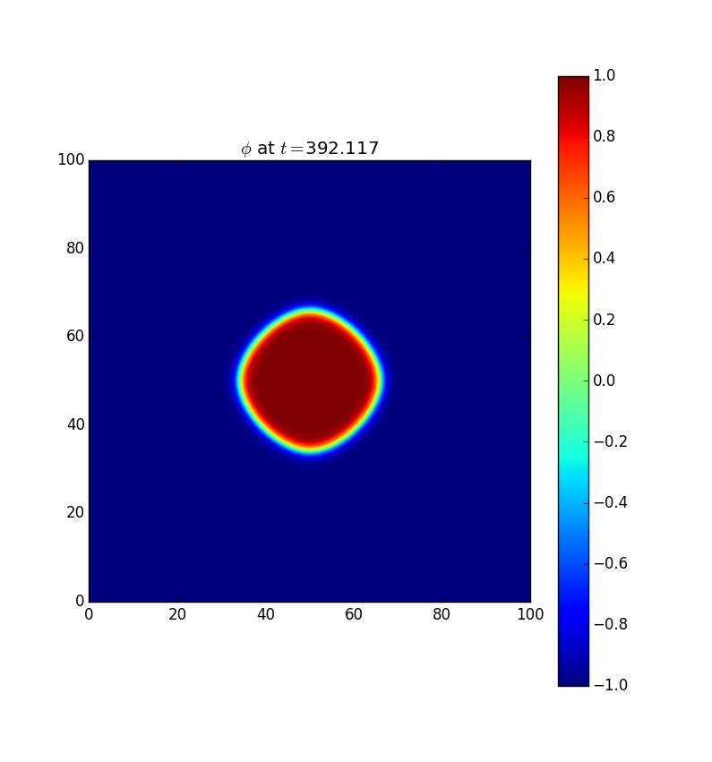
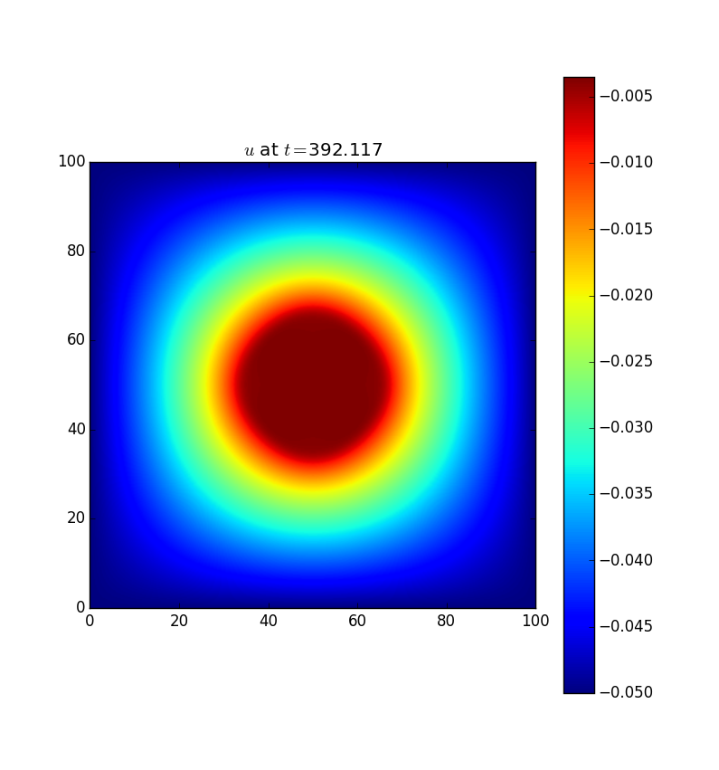
Q1 – Movie of Evolution

Slide 4
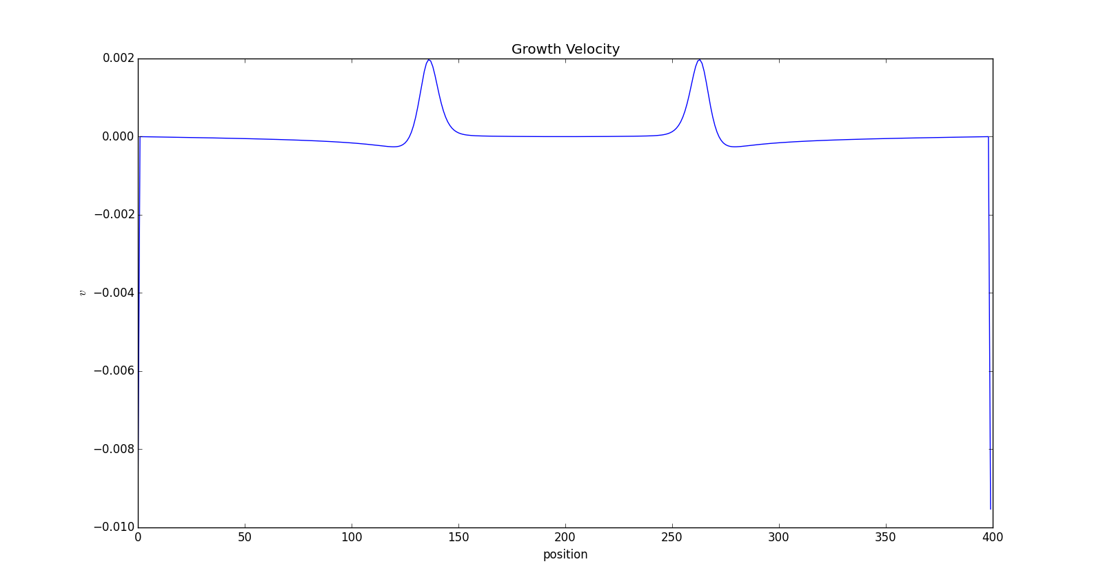
Q1 – Tip Velocity vs Time
Show 2 plots as indicated in the question
Specify how you measured these velocities

Slide 5
Q1 – Workflow (flowchart)
https://www.github.com/usnistgov/PhaseFieldHackathon-FiPy

Slide 6
Q1 – Details
# cores: 6
Core hours: 54
Wall clock time: 9
Computation time: 392
https://www.github.com/usnistgov/PhaseFieldHackathon-FiPy

Slide 7
Question 2

Slide 8
Q2 – Energy vs “Time” (Plot)

Slide 9
Q2 – 3D representation of result

Slide 10
Q2 – Measurement of Aspect Ratio along principal directions
Specify how you measured these dimensions

Slide 11
Q2 – Workflow (flowchart)
https://www.github.com/usnistgov/PhaseFieldHackathon-FiPy

Slide 12
Q2 – Details
# cores: 0
Core hours: 0
Wall clock time: 0
Computation time: 0
https://www.github.com/usnistgov/PhaseFieldHackathon-FiPy

