Slide 1
NIST Big Data Program
Alignment: Roadmap & Reference Architecture
Version 1.3
Roadmap Subgroup
NIST Big Data Working Group (NBD-WG)
September 13, 2013

Slide 2
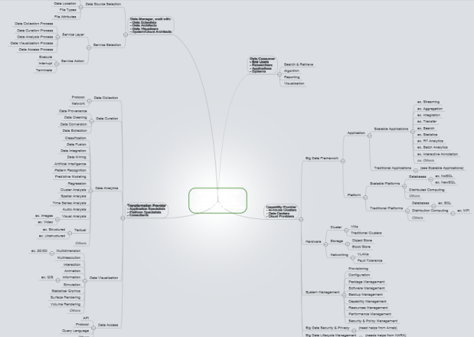
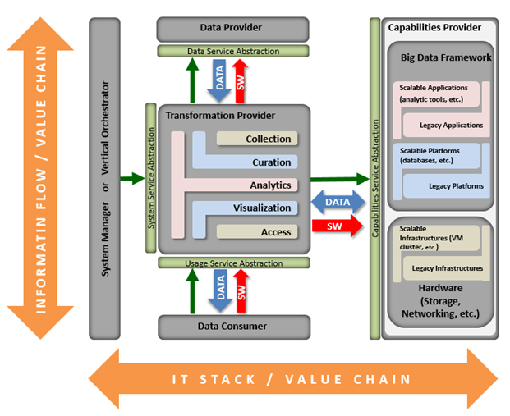
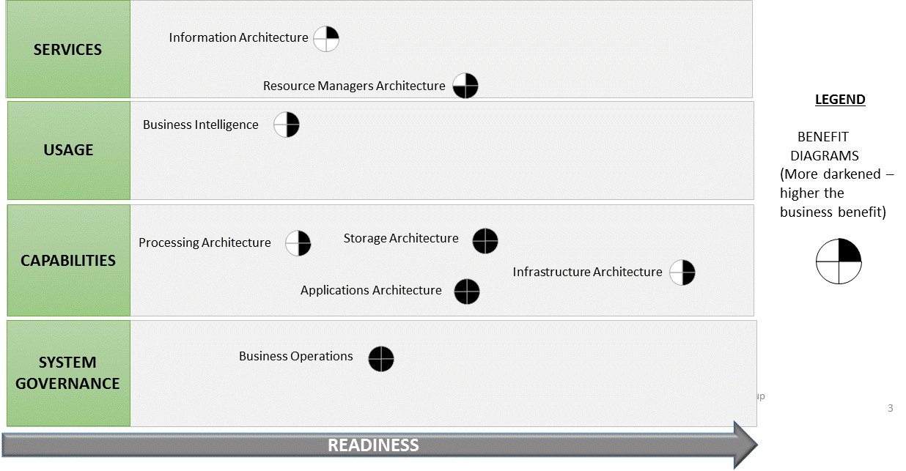
Taxonomy Mind-map
Latest RA
Roadmap Inputs

Slide 3
SERVICES
Information Architecture
Resource Managers Architecture
LEGEND
BENEFIT
DIAGRAMS
(More darkened –
higher the
business benefit)
USAGE
Business Intelligence
CAPABILITIES
Processing Architecture
Storage Architecture
Infrastructure Architecture
Applications Architecture
SYSTEM
GOVERNANCE
Business Operations
Standards Integration Architecture
READINESS

Slide 4
Disclaimer regarding IP: Credit to VoltDB for the bottom section of this material
Color | Feature
 | Capabilities
 | Usage
 | Sys. Gov.
 | Servcies
READINESS
Capabilities: Feature
Services: Feature
Usage: Feature
Usage: Feature
Sys. Gov.: Feature
Usage: Feature
Capabilities: Feature
Capabilities: Feature
Capabilities: Feature
Services: Feature
Capabilities: Feature
Sys. Gov.: Feature
Usage: Feature
Services: Feature
Sys. Gov.: Feature
Services: Feature
Capabilities: Feature
LIFE OF THE DATA

Slide 5
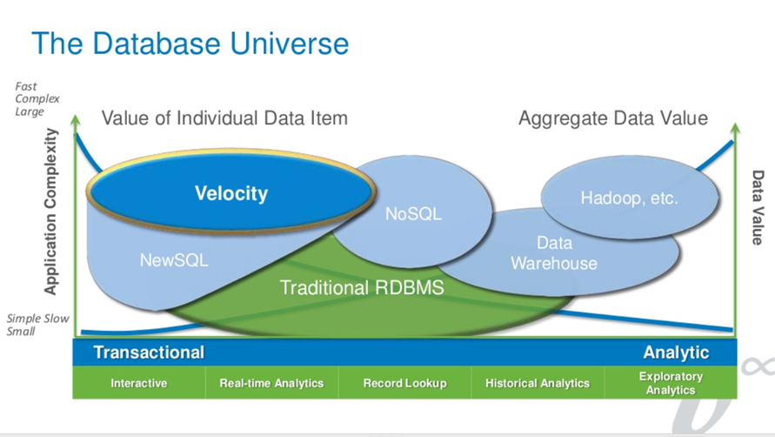
Disclaimer regarding IP: Credit to VoltDB for the bottom section of this material

Slide 6
APPENDIX

Slide 7
GOAL: | Align Roadmap to: Reference Architecture Capabilities Requirements Actors Readiness
STATUS: | Yellow.
RISK: | If Top 10 Roadmap Capabilities are not defined, alignment with RA cannot take place.
NEXT STEPS: | Confirm with RA Subgroup: The RA diagram that is to be used. Matching of RA and Roadmap Capabilities. Update the Roadmap Matrix Capabilities Actors Readiness RA Subgroups Proposal: Incorporate topology, deployment, business relation(M0100, Slide #7) Socialize with Roadmap Subgroup

Slide 8
Use Case Packages being incorporated into Roadmap
Ref. Arch.
Requirements
Capabilities
M100
M123
M198 (TBD)
M100
M123
M198 (TBD)
M123
Roadmap
Actors
Readiness
M142)
M187

Slide 9
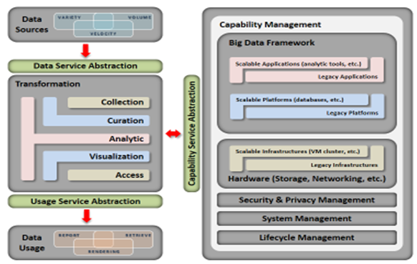
Objective of this deck: Align the RA with the Roadmap Categories
Architecture
Storage Architecture
Processing Architecture
Resource Managers Architecture
Infrastructure Architecture
Information Architecture
Standards Integration Architecture
Applications Architecture
Business Operations
Business Intelligence
Business Relationship Intelligence
Business Adoption
Business Gap Analysis
Processing Performance Improvements
Application Development Improvements
Complex Analytics Improvements
Interoperability Improvements
Possible Alternative Deployment Improvements
Interface Improvements

Slide 10
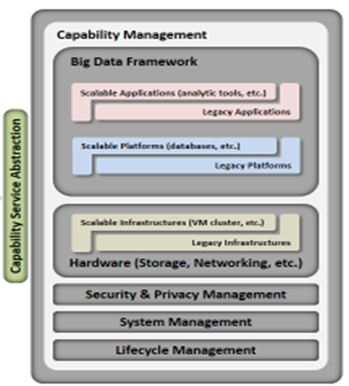
Use Case Requirement:
Be able to support mixed of legacy/traditional and cloud computing framework with the additional management of hardware, security and Privacy, systems, and lifecycle management.
RA Component:
Mapping Roadmap Capabilities to RA Component:
MATCH | FUZZY MATCH | NO MATCH
Architecture Storage Architecture Processing Architecture Resource Managers Architecture Infrastructure Architecture Information Architecture Standards Integration Architecture Applications Architecture | Processing Performance Improvements Application Development Improvements |  | Business Intelligence Business Relationship Intelligence Business Gap Analysis Business Operations Business Intelligence Business Relationship Intelligence Business Adoption Business Gap Analysis Complex Analytics Improvements Interoperability Improvements Possible Alternative Deployment Improvements Interface Improvements

Slide 11

Use Case Requirement: Be able to support diversified data
sources with variety, volume, and velocity of data
RA Component:
Roadmap Capabilities to RA Component:
MATCH | FUZZY MATCH | NO MATCH
 | Architecture Storage Architecture Processing Architecture Resource Managers Architecture Infrastructure Architecture Information Architecture Standards Integration Architecture Applications Architecture | Business Operations Business Intelligence Business Relationship Intelligence Business Adoption Business Gap Analysis Processing Performance Improvements Application Development Improvements Complex Analytics Improvements Interoperability Improvements Possible Alternative Deployment Improvements Interface Improvements

Slide 12
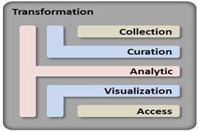
Use Case Requirement:
Be able to support various transformation functions such as collect, curate, analysis, visual, and access for a given
RA Component:
Roadmap Capabilities to RA Component:
MATCH | FUZZY MATCH | NO MATCH
Business Intelligence Business Relationship Intelligence Business Gap Analysis Complex Analytics Improvements |  | Architecture Storage Architecture Processing Architecture Resource Managers Architecture Infrastructure Architecture Information Architecture Standards Integration Architecture Applications Architecture | Business Operations Business Intelligence Business Relationship Intelligence Business Adoption Business Gap Analysis Processing Performance Improvements Application Development Improvements Interoperability Improvements Possible Alternative Deployment Improvements Interface Improvements

Slide 13
Use Case Packages being incorporated into Roadmap
Ref. Arch.
Requirements
Capabilities/
Features
Roadmap
Actors
Readiness

