Slide 1
NIST Big Data Public Working Group
Definition and Taxonomy Subgroup Presentation
September 30, 2013
Nancy Grady, SAIC
Natasha Balac, SDSC
Eugene Lister, R2AD

Slide 2
Overview
Objectives
Approach
Big Data Component Definitions
Data Science Component Definitions
Taxonomy
  Roles
  Activities
  Components
  Subcomponents
Templates
Next Steps

Slide 3
Objectives
Identify concepts
Focus on what is new and different
Clarify terminology
Attempt to avoid terms that have domain-specific meanings
Remain independent of specific implementations

Slide 4
Approach
Hold scope to what is different because of Big Data
  Use additional concepts needed for completeness
Restrict terms to represent single concepts
Don’t stray too far from common usage
In the report go straight to Big Data and Data Science
  This presentation will start from more elemental concepts
Relationship to cloud, but not required

Slide 5
Definitions
Big Data
Data Science

Slide 6
Concepts Relating to Data
Data Type (structured, semi-structured, unstructured)
  Beyond our scope (and not new)
Data Lifecycle
  Raw Data
  Usable Information
  Synthesized Knowledge
  Implemented Benefit
Metadata: data about data or system or processing
  Provenance: Data Lifecycle history
Complexity: dependent relationships across data elements

Slide 7
Concepts Relating to Dataset at Rest
Volume: amount of data
Variety: many data types
  and also across data domains
Persistence: storing in {flat files, RDBMS, NoSQL, markup,…}
NoSQL
  Big Table
  Name-value
  Graph
  Document
Tiered storage {in-memory, cache, SSD, hard disk, …}
Distributed {local, multiple local, network-based}

Slide 8
Concepts Related to Dataset in Motion
Velocity: rate of data flow
Variability: change in rate of data flow, also
  Structure
  Refresh rate
Accessibility: new concept of Data-as-a-Service
Transport formats (not new)
Transport protocols (not new)

Slide 9
Big Data Analogy to Parallel computing
Processor improvements slowed
Coordinate a loose collection of processors
Adds resource communication complexities
  System clocks
  Message passing
Distribution of processing code
Distribution of data for processing nodes

Slide 10
Big Data - Jan 15-17 NIST Cloud/Big Data Workshop
Big Data refers to digital data volume, velocity, and/or variety that:
Enable novel approaches to frontier questions previously inaccessible or impractical using current or conventional methods; and/or
Exceed the storage capacity or analysis capability of current or conventional methods and systems.
Differentiates by storing and analyzing population data and not sample sizes

Slide 11
Refinements are Welcome
The heart of the change is the scaling
  Data seek times increasing slower than Moore’s Law
  Data volumes increasing faster than Moore’s Law
Implies the addition of horizontal scaling to vertical scaling
  Data analogous to MPP processing changes
Difficult to define as
  An implication of engineering changes
  Data Lifecycle process order changes
  Implication of a new type of analytics
  As moving the processing to the data not the data to the processing

Slide 12
Big Data Analytics Characteristics
Analytics Characteristics are not new
Value: produced when the analytics output is put into action
Veracity: measure of accuracy and timliness
Quality:
  well-formed data
  Missing values
  cleanliness
Latency: time between measurement and availability
Data types have differing pre-analytics needs

Slide 13
Data Science as a Science Progression
Coined the “Fourth Paradigm” by the late Jim Gray
Experiment: Empirical measurement science
Theory: Causal interpretation
  Explains experiments
  Calculates measurements that would confirm the theoretical models
Simulation: Performing theory (model)-driven experiments that are not empirically possible
Data Science: Empirical analysis of data produced by processes

Slide 14
Data Science Analogy (simplistically)
Statistics
  precise deterministic causal analysis
  over precisely collected data
Data Mining:
  deterministic causal analysis
  over re-purposed data that has been carefully sampled
Data Science
  Trending or correlation analysis
  Over existing data that typically uses the bulk of the population

Slide 15
Data Science
Data Science is the extraction of actionable knowledge directly from data through a process of discovery, hypothesis, and analytical hypothesis analysis.
A Data Scientist is a practitioner who has sufficient knowledge of the overlapping regimes of expertise in business needs, domain knowledge, analytical skills and programming expertise to manage the end-to-end scientific method process through each stage in the big data lifecycle (through action) to deliver value.

Slide 16
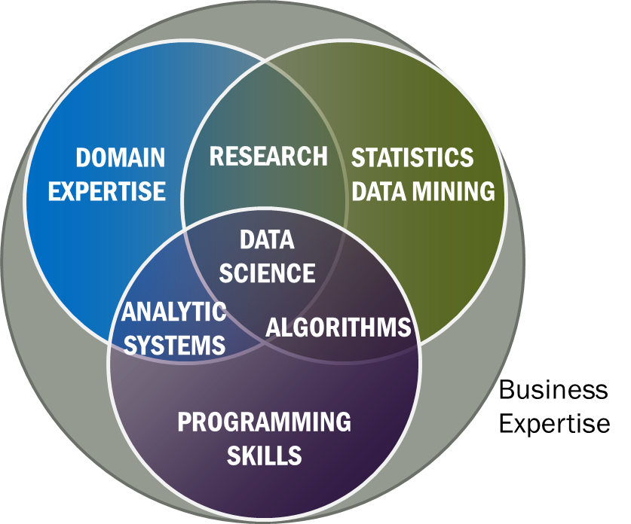
Data Science Skillsets

Slide 17
Data Science Addendums
Is not just Analytics
The end-to-end data system is the equipment
The analytics over Big Data can be
  Exploratory or discovery-driven for hypothesis generation
  Focused hypothesis verification
  Focused on operationalization

Slide 18
Taxonomy
Actors
Roles
Activities
Components
Subcomponents

Slide 19
Big Data Taxonomy
Actors
Roles
Activities
Components
Sub-components

Slide 20
Actors
Sensors
Applications
Software agents
Individuals
Organizations
Hardware resources
Service abstractions

Slide 21
System Roles
Data Provider – makes available data internal and/or external to the system
Data Consumer – uses the output of the system
System Orchestrator – governance, requirements, monitoring
Big Data Application Provider – instantiates application
Big Data Framework Provider – provides resources

Slide 22
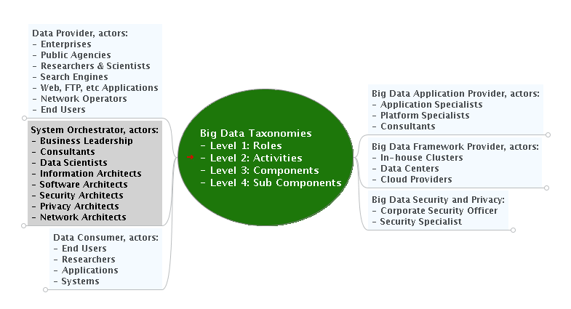
Roles and Actors

Slide 23
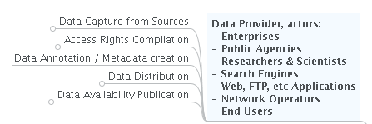
Data Provider

Slide 24
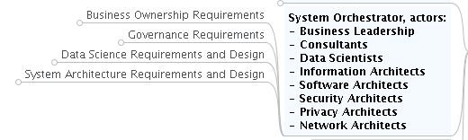
System Orchestrator

Slide 25
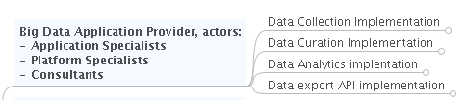
Big Data Application Provider

Slide 26

Big Data Framework Provider

Slide 27
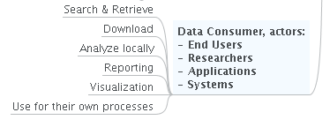
Data Consumer

Slide 28

Big Data Security

Slide 29
Big Data Application Provider

Slide 30

Data Lifecycle Processes
Goal
Need
Collect
Benefit
Data
Evaluate
Act &
Monitor
Curate
Knowledge
Information
Analyze

Slide 31
Data Warehouse Template– store after curate
COLLECT
CURATE
ANALYZE
ACT
ETL
Cleanse Transform
Algorithm
Action
Staging
Warehouse
Analytic
Mart
Summarized
Data
Domain
ETL = extract, transform, load

Slide 32
Volume template – store raw data after collect
COLLECT
CURATE
ANALYZE
ACT
Volume
Model Building
Model Analytics
Mart
Data Product
Map/Reduce
Raw Data Cluster
Model Data
Cleanse
Transform
Analyze
Domain
Complexity

Slide 33
Velocity Template – store after analytics
COLLECT
CURATE
ANALYZE
ACT
Alerting
Cleanse
Transform
Volume
Velocity
Domain
Enriched
Data Cluster

Slide 34
Variety Template – Schema-on-Read
COLLECT
CURATE
ANALYZE
ACT
Map/Reduce
Analyze
Common Query
Fused
Data
Query
Variety
Complexity

Slide 35
Analysis to Action Template
Seconds – Streaming Real-time Analytics
Minutes– Batch jobs of operational model
Hours – Ad-hoc analysis
Months – Exploratory analysis

Slide 36
Possible Next Steps
Refinement Big Data Definition
Word-smithing of all definitions
Refinement Taxonomy Mindmap for completeness
Exploration of Templates for categorization
Data distribution templates according to CAP compliance
Measures and Metrics (how big is Big Data)

