Slide 1
NIST Big Data Public Working Group
Reference Architecture Subgroup
September 30, 2013
Co-chairs:
Orit Levin Microsoft
James Ketner AT&T
Don Krapohl Augmented Intel

Slide 2
Agenda
Deliverable #1: White Paper: Survey of Existing Big Data RAs
Deliverable #2: NIST Big Data Reference Architecture
Next Steps

Slide 3
NIST White Paper Survey of Big Data Architecture Models
Input Document M0151

Slide 4
List Of Surveyed Architectures
Vendor-neutral and technology-agnostic proposals
Bob Marcus ET-Strategies
Orit Levin Microsoft
Gary Mazzaferro AlloyCloud
Yuri Demchenko University of Amsterdam
Vendors’ Architectures
IBM
Oracle
Booz Allen Hamilton
EMC
SAP
9sight
LexusNexis

Slide 5
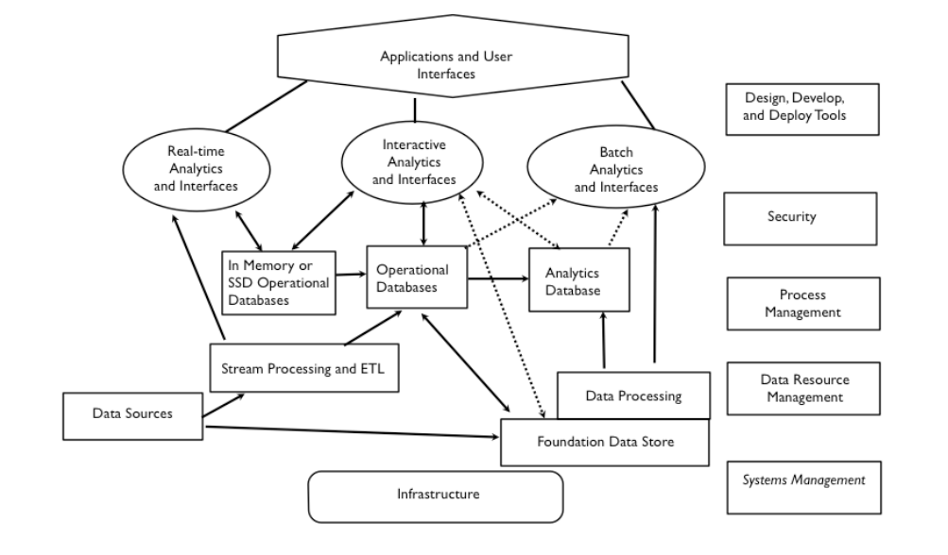
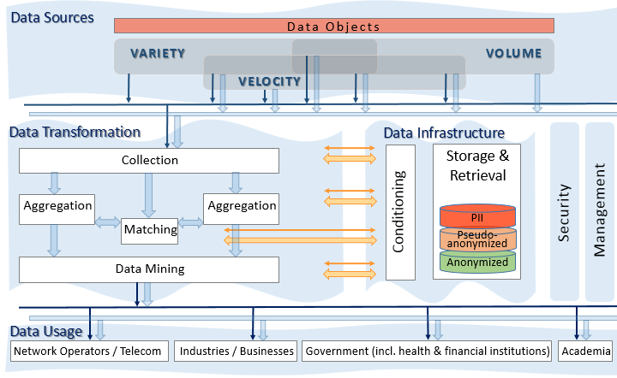
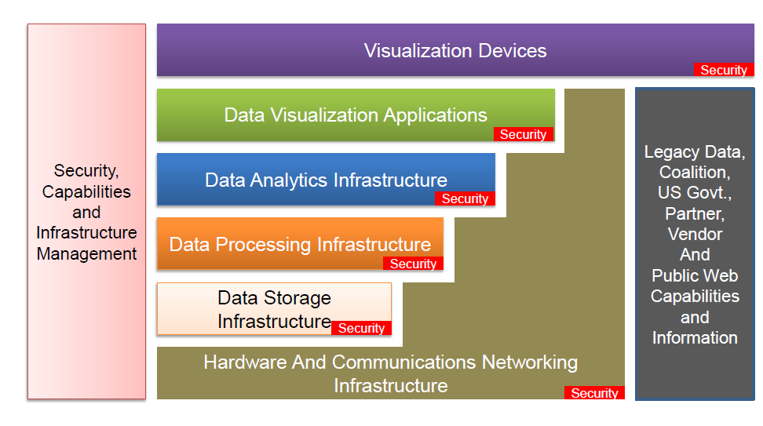
Vendor-neutral and Technology-agnostic Proposals
Data Processing Flow
M0039
Data Transformation Flow
M0017
IT Stack
M0047

Slide 6
Vendor-neutral and Technology-agnostic Proposals
Data Processing Flow
M0039
Data Transformation Flow
M0017
IT Stack
M0047

Slide 7
Vendor-neutral and Technology-agnostic Proposals
Data Processing Flow
M0039
Data Transformation Flow
M0017
IT Stack
M0047

Slide 8
Vendor-neutral and Technology-agnostic Proposals
Data Processing Flow
M0039
Data Transformation Flow
M0017
IT Stack
M0047

Slide 9
Draft Agreement / Rough Consensus
Transformation includes
Processing functions
Analytic functions
Visualization functions
Data Infrastructure includes
Data stores
In-memory DBs
Analytic DBs
Sources
Transformation
Data Infrastructure
Security
Cloud Computing
Management
Network
Usage

Slide 10
NIST BIG DATA Reference Architecture
Input Document M0226

Slide 11
What the Baseline Big Data RA Is Is Not
A superset of a “traditional data” system
A representation of a vendor-neutral and technology-agnostic system
A functional architecture comprised of logical roles
Applicable to a variety of business models
Tightly-integrated enterprise systems
Loosely-coupled vertical industries
A business architecture representing internal vs. external functional boundaries
A deployment architecture
A detailed IT RA of a specific system implementation
All of the above will be developed in the next stage in the context of specific use cases.

Slide 12
Big Data Frameworks
Main Functional Blocks
System Orchestrator
Analytic processing of data
Transfer of data
Code execution on data et situ
Storage, retrieval, search, etc. of data
Providing computing infrastructure
Providing networking infrastructure
Etc.
Big Data Application Provider
Data Provider
Data Consumer
Big Data Framework Provider
Processing Frameworks (analytic tools, etc.)
Horizontally Scalable
Vertically Scalable
Platforms (databases, etc.)
Horizontally Scalable
Vertically Scalable
Infrastructures
Horizontally Scalable (VM clusters)
Vertically Scalable
Physical and Virtual Resources (networking, computing, etc.)

Slide 13
Big Data Application Provider
Main Functional Blocks
System Orchestrator
Big Data Application Provider
Analytics
Data Provider
Curation
Visualization
Data Consumer
Collection
Access
Big Data Framework Provider
Processing Frameworks (analytic tools, etc.)
Horizontally Scalable
Vertically Scalable
Platforms (databases, etc.)
Horizontally Scalable
Vertically Scalable
Infrastructures
Horizontally Scalable (VM clusters)
Vertically Scalable
Physical and Virtual Resources (networking, computing, etc.)

Slide 14
Big Data Frameworks
Main Functional Blocks
Big Data Flow
Application Specific
Identity Management & Authorization
Etc.
System Orchestrator
Big Data Application Provider
Analytics
Data Provider
Curation
Visualization
Data Consumer
Data Provider
DATA
DATA
SW
Collection
Access
SW
DATA
SW
Discovery of data
Description of data
Access to data
Code execution on data
Etc.
Big Data Framework Provider
Discovery of services
Description of data
Visualization of data
Rendering of data
Reporting of data
Code execution on data
Etc.
Processing Frameworks (analytic tools, etc.)
Horizontally Scalable
Vertically Scalable
Platforms (databases, etc.)
Horizontally Scalable
Vertically Scalable
Infrastructures
Horizontally Scalable (VM clusters)
Vertically Scalable
Physical and Virtual Resources (networking, computing, etc.)

Slide 15
Security & Privacy (& Management)
System Orchestrator
Big Data Application Provider
Analytics
Data Provider
Curation
Visualization
Data Consumer
DATA
DATA
SW
Collection
Access
SW
DATA
SW
Big Data Framework Provider
Processing Frameworks (analytic tools, etc.)
Horizontally Scalable
Vertically Scalable
Security & Privacy
Platforms (databases, etc.)
Management
Horizontally Scalable
Vertically Scalable
Infrastructures
Horizontally Scalable (VM clusters)
Vertically Scalable
Physical and Virtual Resources (networking, computing, etc.)

Slide 16
INFORMATION VALUE CHAIN
System Orchestrator
Big Data Application Provider
Analytics
Data Provider
Curation
Visualization
Data Consumer
DATA
DATA
SW
Collection
Access
SW
DATA
SW
Big Data Framework Provider
Processing Frameworks (analytic tools, etc.)
IT VALUE CHAIN
Horizontally Scalable
Vertically Scalable
Security & Privacy
K E Y :
Platforms (databases, etc.)
Management
Horizontally Scalable
Service
Use
Vertically Scalable
DATA
Infrastructures
Data Flow
Horizontally Scalable (VM clusters)
SW
Analytic Tools Transfer
Vertically Scalable
Physical and Virtual Resources (networking, computing, etc.)

Slide 17
Big Data Reference Architecture V1.0 Outline
Executive Summary
1 Introduction
2 Big Data System Requirements
3 Conceptual Model
4 Main Components
4.1 Data Provider
4.2 Big Data Application Provider
4.3 Big Data Framework Provider
4.4 Data Consumer
4.5 System Orchestrator
5 Management
5.1 System Management
5.2 Lifecycle Management
6 Security and Privacy
7 Big Data Taxonomy
Appendix A: Terms and Definitions
Appendix B: Acronyms
Appendix C: References
Appendix D: Deployment Considerations
1 Big Data Framework Provider
1.1 Traditional On-Premise Frameworks
1.2 Cloud Service Providers

Slide 18
Summary
Summary
The draft of the NIST White Paper: Survey of Existing Big Data RAs (v.1.2) is available as M0151v3
The draft of the NIST Big Data functional reference architecture (RA v.1.0) is available as M0226v8
Next Steps
Continue the editorial and alignment effort
Map generic Big Data use cases to RA
Map specific collected Big Data cases to RA
Let’s exchange additional ideas this afternoon at the breakout session!

Slide 19
THANK YOU
Co-chairs:
Orit Levin Microsoft
James Ketner AT&T
Don Krapohl Augmented Intel

