Slide 1
NIST Big Data Public Working Group
Technology Roadmap Subgroup Presentation
September 30, 2013
Carl Buffington (Vistronix)
David Boyd (Data Tactic)
Dan McClary (Oracle)

Slide 2
Overview
Goals and Objectives
Charter
Culmination of Subgroups
Approach
Guiding Principles
Outcomes
Action Items
09.30.2013
Technology Roadmap

Slide 3
Goals and Objectives
Gather input from NBD subgroups and study the taxonomies for the actors’ roles and responsibility, use cases and requirements, and secure reference architecture.
Gain understanding of what standards are available or under development for Big Data
Perform a thorough gap analysis and document the findings
Identify what possible barriers may delay or prevent adoption of Big Data
Document vision and recommendations
09.30.2013
Technology Roadmap

Slide 4
Approach: Guiding Principles
Technologically Agnostic
Audience of Industry, Government, and Academia
Align with all four of the other subgroups and deliverable artifacts
Culmination of concepts from the four subgroups
Recommend actionable items for Big Data programs
09.30.2013
Technology Roadmap

Slide 5
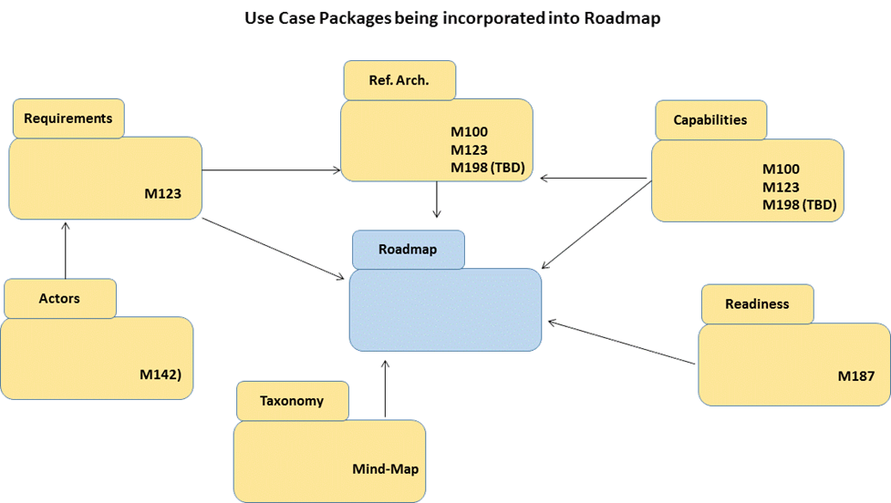
Approach: Culmination of Subgroups
09.30.2013
Technology Roadmap

Slide 6
Approach: Summary
Develop a Big Data Technology Roadmap that:
Analyzes current state, by feature not by technology
Identifies maturity, and how to improve
Gives recommendations for any Big Data program
09.30.2013
Technology Roadmap

Slide 7
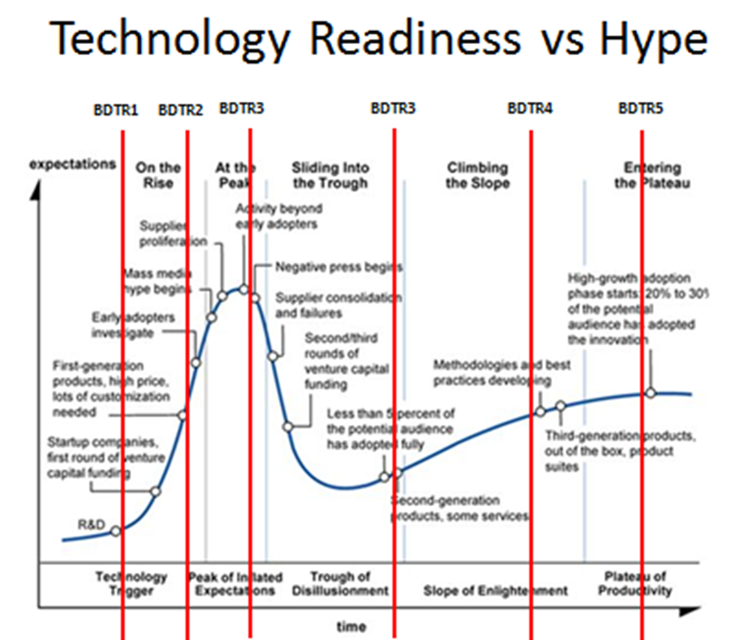
Outcomes: Technology Readiness
09.30.2013
Technology Roadmap

Slide 8
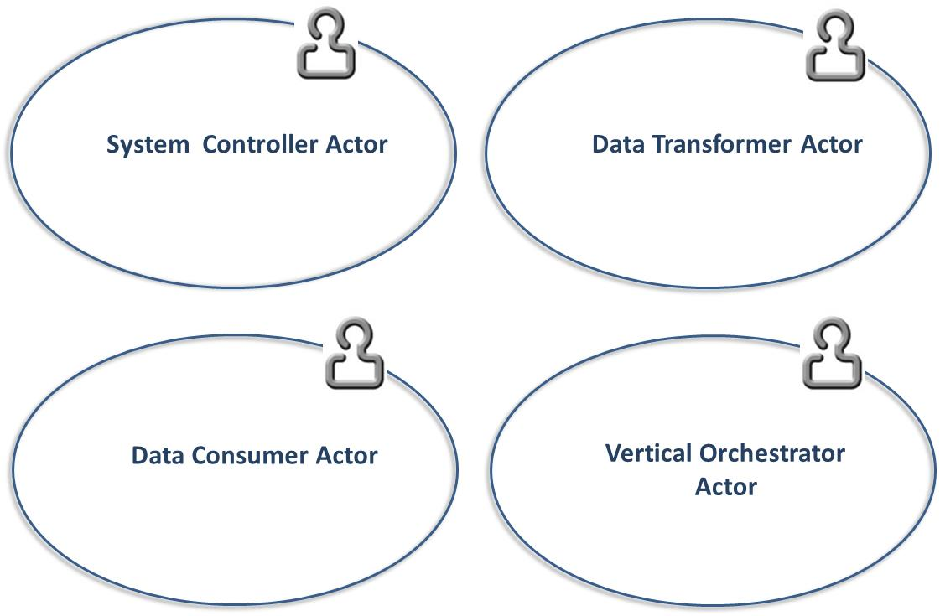
Outcomes: Primary Actors
09.30.2013
Technology Roadmap

Slide 9
Outcomes: Features
Feature | Roles | Readiness | RA Mapping
Storage Framework | TBD | TBD | Capabilities
Processing Framework | TBD | TBD | Capabilities
Resource Managers Framework | TBD | TBD | Capabilities
Infrastructure Framework | TBD | TBD | Capabilities
Information Framework | TBD | TBD | Data Services
Standards Integration Framework | TBD | TBD | Data Services
Applications Framework | TBD | TBD | Capabilities
Business Operations | TBD | TBD | Vertical Orchestrator
09.30.2013
Technology Roadmap

Slide 10
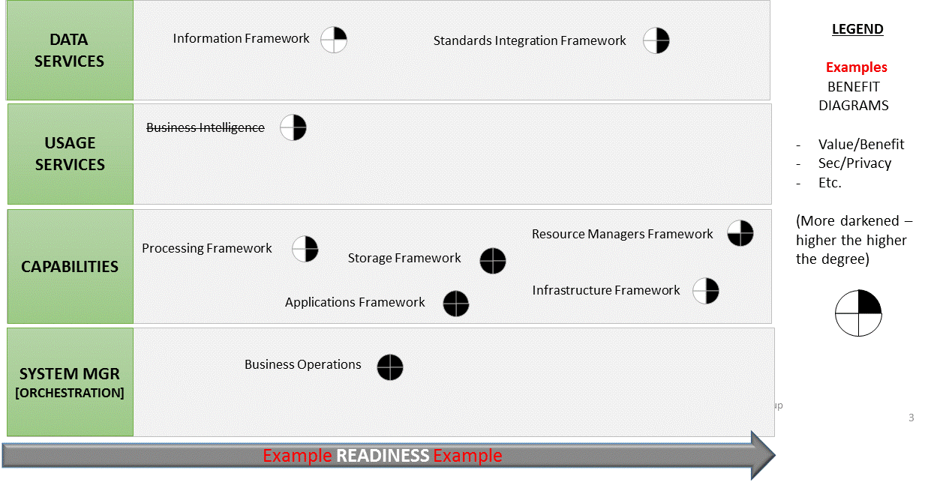
Outcomes: Features Graphically
09.30.2013
Technology Roadmap

Slide 11
Outcomes: Standards
Section 7 - Big Data Related Multi-stakeholder Collaborative Initiatives
09.30.2013
Technology Roadmap

Slide 12
Outcomes: Strategies
Section 8 - Big Data Strategies
Adoption
Implementation
Resourcing (staff)
09.30.2013
Technology Roadmap

Slide 13
Action Items: Today
60 minutes on working drafts
Overview of Roadmap
Features
Consensus on roles and readiness
What are the gaps
Standards
What other collaborative initiatives are there?
Strategies
Consensus on Adoption, Implementation, and Resourcing
60 minutes on next steps
Recommendations back to WG Chair
09.30.2013
Technology Roadmap

