Slide 1
NIST Big Data Public Working Group
Security and Privacy Subgroup Presentation
September 30, 2013
Arnab Roy, Fujitsu
Akhil Manchanda, GE
Nancy Landreville, University of MD

Slide 2
Overview
Process
Taxonomy
Use Cases
Security Reference Architecture
Mapping
Next Steps

Slide 3
Process
The CSA Big Data Working Group Top 10 S&P Challenges
Googledoc with initial set of topics and solicitation of use cases
Taxonomy of topics
Input from Reference Architecture Group
Security Reference Architecture overlaid on RA
Mapping use cases to the SRA
Editorial phase
Current Working Draft (M0110)

Slide 4
CSA BDWG: Top Ten Big Data Security and Privacy Challenges10 Challenges Identified by CSA BDWG
Secure computations in distributed programming frameworks
Security best practices for non-relational datastores
Secure data storage and transactions logs
End-point input validation/filtering
Real time security monitoring
Scalable and composable privacy-preserving data mining and analytics
Cryptographically enforced access control and secure communication
Granular access control
Granular audits
Data provenance

Slide 5
Top 10 S&P Challenges: Classification
Infrastructure security
Secure Computations in Distributed Programming Frameworks
Security Best Practices for Non-Relational Data Stores
Data Privacy
Privacy Preserving Data Mining and Analytics
Cryptographically Enforced Data Centric Security
Granular Access Control
Data Management
Secure Data Storage and Transaction Logs
Granular Audits
Data Provenance
Integrity and Reactive Security
End-point validation and filtering
Real time Security Monitoring

Slide 6
Taxonomy
Privacy
Data Confidentiality
Access Policies
Computing on Encrypted Data
Secure Data Aggregation
Provenance
Systems
Crypto Enforced
Searching and Reporting
Fully Homomorphic Encryption
Key Management
End-point Input Validation
Authenticated Computations on Data
Granular Audits
System Health
Security against DoS
Big Data for Security
Analytics for Security Intelligence
Data-driven Abuse Detection
Event Detection
Forensics
Control of Valuable Assets
Lifecycle Management
Retention, Disposition, Hold
Communication Privacy
Communication Integrity
Digital Rights Management
Construction of cryptographic protocols proactively resistant to DoS
Trusted Platforms
Crypto Enforced
Semantic Validation
Syntactic Validation

Slide 7
Use Cases
Retail/Marketing
Modern Day Consumerism
Nielsen Homescan
Web Traffic Analysis
Healthcare
Health Information Exchange
Genetic Privacy
Pharma Clinical Trial Data Sharing
Cyber-security
Government
Military
Education

Slide 8
INFORMATION VALUE CHAIN
System Orchestrator
Big Data Application Provider
Analytics
Data Provider
Curation
Visualization
Data Consumer
DATA
DATA
SW
Collection
Access
SW
DATA
SW
Big Data Framework Provider
Processing Frameworks (analytic tools, etc.)
IT VALUE CHAIN
Horizontally Scalable
Vertically Scalable
Security & Privacy
Platforms (databases, etc.)
Management
Horizontally Scalable
Vertically Scalable
Infrastructures
Horizontally Scalable (VM clusters)
Vertically Scalable
Physical and Virtual Resources (networking, computing, etc.)

Slide 9
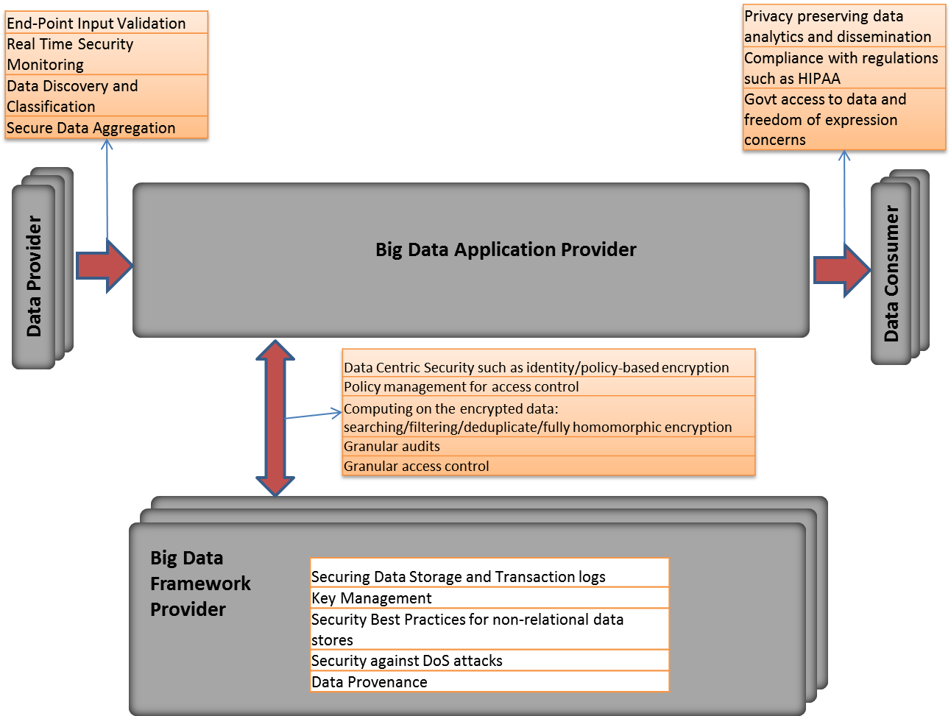
Big Data Security Reference Architecture

Slide 10

Interface of Data Providers -> BD App Provider
Big Data Application Provider
Analytics
Data Provider
Curation
Visualization
Collection
Access
S&P Consideration | Health Info Exchange | Military UAV
End-Point Input Validation | Strong authentication, perhaps through X.509v3 certificates, potential leverage of SAFE bridge in lieu of general PKI | Need to secure sensor to prevent spoofing/stolen sensor streams
Real Time Security Monitoring | Validation of incoming records. May need to check for evidence of Informed Consent. | On-board & control station secondary sensor security monitoring
Data Discovery and Classification | Leverage HL7 and other standard formats opportunistically, but avoid attempts at schema normalization. | Varies from media-specific encoding to sophisticated situation-awareness enhancing fusion schemes.
Secure Data Aggregation | Clear text columns can be deduplicated, perhaps columns with deduplication. | Fusion challenges range from simple to complex.

Slide 11
Interface of BD App Provider -> Data Consumer
Big Data Application Provider
Analytics
Curation
Visualization
Data Consumer
Collection
Access
S&P Consideration | Health Info Exchange | Military UAV
Privacy preserving data analytics and dissemination | Searching on encrypted data. Determine if drug administered will generate an adverse reaction, without breaking the double blind. | Geospatial constraints: cannot surveil beyond a UTM. Military secrecy: target, point of origin privacy.
Compliance with regulations | HIPAA security and privacy will require detailed accounting of access to HER data. | Numerous. Also standards issues.
Govt access to data and freedom of expression concerns | CDC, Law Enforcement, Subpoenas and Warrants. Access may be toggled based on occurrence of a pandemic or receipt of a warrant. | Google lawsuit over streetview.

Slide 12
Interface of BD App Provider -> BD Framework Provider
Big Data Application Provider
Analytics
Curation
Visualization
Collection
Access
Big Data Framework Provider:
Processing, Platform, Infrastructure, Resources
S&P Consideration | Health Info Exchange | Military UAV
Policy based encryption | Row-level and Column-level Encryption | Policy-based encryption, often dictated by legacy channel capacity/type.
Policy management for access control | Role-based and claim-based | Transformations tend to be made within DoD-contractor devised system schemes.
Computing on encrypted data | Privacy preserving access to relevant events, anomalies and trends. | Sometimes performed within vendor-supplied architectures, or by image-processing parallel architectures.
Audits | Facilitate HIPAA readiness, and HHS audits | CSO, IG audit.

Slide 13
Internal to BD Framework Provider
Big Data Framework Provider:
Processing, Platform, Infrastructure, Resources
S&P Consideration | Health Info Exchange | Military UAV
Securing Data Stores and Transaction Logs | Need to be protected for integrity and for privacy, but also for establishing completeness, with an emphasis on availability. | The usual, plus data center security levels are tightly managed (e.g., field vs. battalion vs. HQ).
Security Best Practices for non-relational data | End-to-end encryption. | Not handled differently at present; this is changing in DoD.
Security against DoS attacks | Mandatory – availability is a compliance requirement. | DoD anti-jamming e-measures.
Data Provenance | Completeness and integrity of data with records of all accesses and modifications | Must track to sensor point in time configuration, metadata.

Slide 14
Next Steps
Streamline content internally
Consistent vocabulary
Fill up missing content
Discuss new content
Streamline flow across sections
Synchronize terminology with D&T and RA subgroups

Slide 15
Big Data Security: Key Points
Big Data may be gathered from diverse end-points. There may be more types of actors than just Provider and Consumers – viz. Data Owners: e.g., mobile users, social network users.
Data aggregation and dissemination have to be made securely and inside the context of a formal, understandable framework. This could be made part of a contract with Data Owners.
Availability of data to Data Consumers is often an important aspect in Big Data, possibly leading to public portals and ombudsman-like roles for data at rest.
Data Search and Selection can lead to privacy or security policy concerns. What capabilities are provided by the Provider in this respect?
Privacy-preserving mechanisms are needed, although they add to system complexity or hinder certain types of analytics. What is the privacy attribute of derived data?
Since there may be disparate processing steps between Data Owner, Provider and Data Consumer, the integrity of data coming from end-points must be ensured. End-to-end information assurance practices for Big Data, e.g., for verifiability, are not dissimilar from other systems, but must be designed on a larger scale.

Slide 16
Thank you!
Please join us for the Security and Privacy Subgroup Break Out Session (Lecture Room D)

Slide 17
Backup

Slide 18
End-Point Input Validation
Real Time Security Monitoring
Data Discovery and Classification
Secure Data Aggregation
Privacy preserving data analytics and dissemination
Compliance with regulations such as HIPAA
Govt access to data and freedom of expression concerns
Big Data Application Provider
Data Provider
Data Consumer
Data Centric Security such as identity/policy-based encryption
Policy management for access control
Computing on the encrypted data: searching/filtering/deduplicate/fully homomorphic encryption
Granular audits
Granular access control
Big Data
Framework
Provider
Securing Data Storage and Transaction logs
Key Management
Security Best Practices for non-relational data stores
Security against DoS attacks
Data Provenance

