Slide 1
NIST Big Data Public Working Group
Big Data PWG Overview Presentation
September 30, 2013
Wo Chang, NIST
Robert Marcus, ET-Strategies
Chaitanya Baru, UC San Diego

Slide 2
Agenda
Why Big Data? Why NIST?
NBD-PWG Charter
Overall Workplan
Subgroups Charter and Deliverables
Use Case and Requirements SG
Definitions and Taxonomies SG
Reference Architecture SG
Security and Privacy SG
Technology Roadmap SG
Next Steps

Slide 3
Why Big Data? Why NIST?
Why Big Data? There is a broad agreement among commercial, academic, and government leaders about the remarkable potential of “Big Data” to spark innovation, fuel commerce, and drive progress.
Why NIST? (a) Recommendation from January 15 -- 17, 2013 Cloud/Big Data Forum and (b) A lack of consensus on some important, fundamental questions is confusing potential users and holding back progress. Questions such as:
What are the attributes that define Big Data solutions?
How is Big Data different from the traditional data environments and related applications that we have encountered thus far?
What are the essential characteristics of Big Data environments?
How do these environments integrate with currently deployed architectures?
What are the central scientific, technological, and standardization challenges that need to be addressed to accelerate the deployment of robust Big Data solutions?
NBD-PWG is being launched to address these questions and is charged to develop consensus definitions, taxonomies, secure reference architecture, and technology roadmap for Big Data that can be embraced by all sectors.

Slide 4
NBD-PWG Charter (M0001)
Launched Date: June 26, 2013; Target Date: September, 27, 2013
The focus of the (NBD-PWG) is to form a community of interest from industry, academia, and government, with the goal of developing a consensus definitions, taxonomies, secure reference architectures, and technology roadmap. The aim is to create vendor-neutral, technology and infrastructure agnostic deliverables to enable big data stakeholders to pick-and-choose best analytics tools for their processing and visualization requirements on the most suitable computing platforms and clusters while allowing value-added from big data service providers and flow of data between the stakeholders in a cohesive and secure manner.

Slide 5
NBD-PWG Deliverables
Working Drafts version 1.0 for
Big Data Definitions
Big Data Taxonomies
Big Data Requirements
Big Data Security and Privacy Requirements
Big Data Architectures White Paper Survey
Big Data Reference Architectures
Big Data Security and Privacy Reference Architectures
Big Data Technology Roadmap

Slide 6
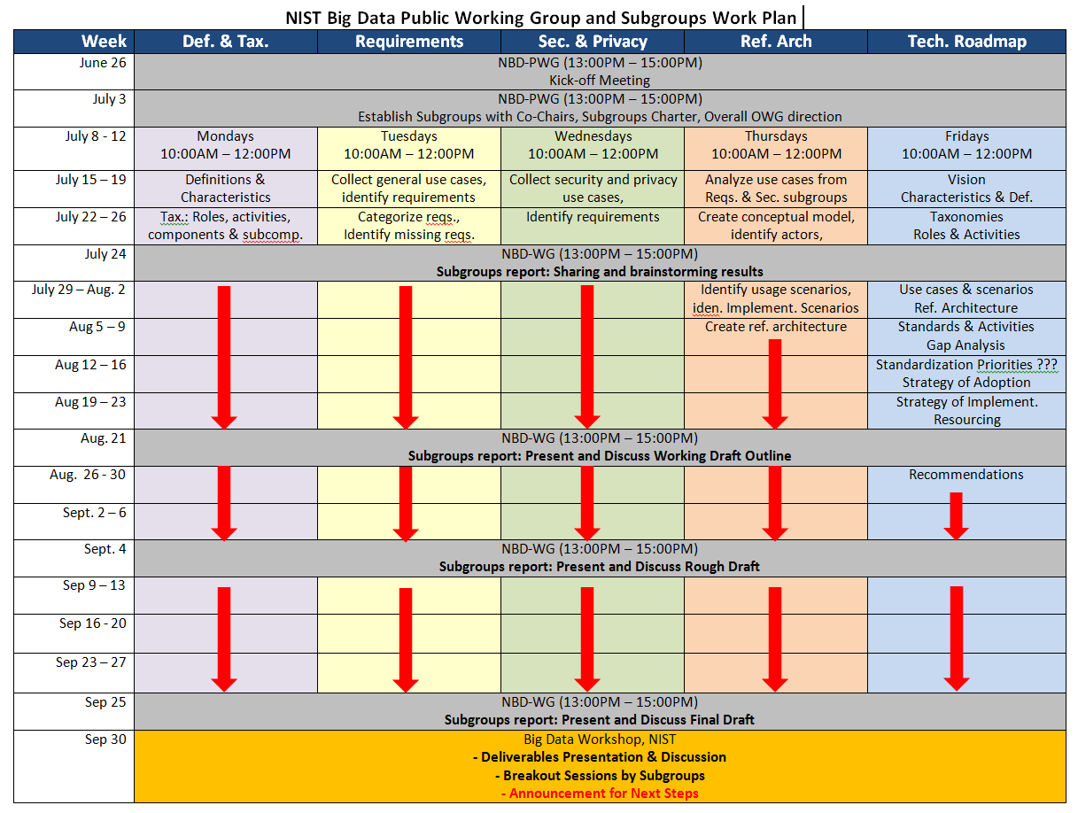
NBD-PWG Workplan

Slide 7
NBD-PWG Subgroups & Co-Chairs
Requirements and Use Cases SG
Geoffrey Fox, U. Indiana; Joe Paiva, VA; Tsegereda Beyene, Cisco
Definitions and Taxonomies SG
Nance Grady, SAIC; Natasha Balac, SDSC; Eugene Luster, R2AD
Reference Architecture SG
Orit Levin, Microsoft; James Ketner, AT&T; Don Krapohl, Augmented Intelligence
Security and Privacy SG
Arnab Roy, CSA/Fujitsu Nancy Landreville, U. MD Akhil Manchanda, GE
Technology Roadmap SG
Carl Buffington, Vistronix; Dan McClary, Oracle; David Boyd, Data Tactic

Slide 8
Requirements and Use Case Subgroup
The focus is to form a community of interest from industry, academia, and government, with the goal of developing a consensus list of Big Data requirements across all stakeholders. This includes gathering and understanding various use cases from diversified application domains.
Tasks
Gather input from all stakeholders regarding Big Data requirements.
Analyze/prioritize a list of challenging general requirements that may delay or prevent adoption of Big Data deployment
Develop a comprehensive list of Big Data requirements

Slide 9
Definitions and Taxonomies Subgroup
The focus is to gain a better understanding of the principles of Big Data. It is important to develop a consensus-based common language and vocabulary terms used in Big Data across stakeholders from industry, academia, and government. In addition, it is also critical to identify essential actors with roles and responsibility, and subdivide them into components and sub-components on how they interact/ relate with each other according to their similarities and differences.
Tasks
For Definitions: Compile terms used from all stakeholders regarding the meaning of Big Data from various standard bodies, domain applications, and diversified operational environments.
For Taxonomies: Identify key actors with their roles and responsibilities from all stakeholders, categorize them into components and subcomponents based on their similarities and differences

Slide 10
Reference Architecture Subgroup
The focus is to form a community of interest from industry, academia, and government, with the goal of developing a consensus-based approach to orchestrate vendor-neutral, technology and infrastructure agnostic for analytics tools and computing environments. The goal is to enable Big Data stakeholders to pick-and-choose technology-agnostic analytics tools for processing and visualization in any computing platform and cluster while allowing value-added from Big Data service providers and the flow of the data between the stakeholders in a cohesive and secure manner.
Tasks
Gather and study available Big Data architectures representing various stakeholders, different data types,’ use cases, and document the architectures using the Big Data taxonomies model based upon the identified actors with their roles and responsibilities.
Ensure that the developed Big Data reference architecture and the Security and Privacy Reference Architecture correspond and complement each other.

Slide 11
Security and Privacy Subgroup
The focus is to form a community of interest from industry, academia, and government, with the goal of developing a consensus secure reference architecture to handle security and privacy issues across all stakeholders. This includes gaining an understanding of what standards are available or under development, as well as identifies which key organizations are working on these standards.
Tasks
Gather input from all stakeholders regarding security and privacy concerns in Big Data processing, storage, and services.
Analyze/prioritize a list of challenging security and privacy requirements that may delay or prevent adoption of Big Data deployment
Develop a Security and Privacy Reference Architecture that supplements the general Big Data Reference Architecture

Slide 12
Technology Roadmap Subgroup
The focus is to form a community of interest from industry, academia, and government, with the goal of developing a consensus vision with recommendations on how Big Data should move forward by performing a good gap analysis through the materials gathered from all other NBD subgroups. This includes setting standardization and adoption priorities through an understanding of what standards are available or under development as part of the recommendations.
Tasks
Gather input from NBD subgroups and study the taxonomies for the actors’ roles and responsibility, use cases and requirements, and secure reference architecture.
Gain understanding of what standards are available or under development for Big Data
Perform a thorough gap analysis and document the findings
Identify what possible barriers may delay or prevent adoption of Big Data
Document vision and recommendations

Slide 13
Interaction Between Subgroups
Requirements & Use Cases
❶
Reference Architecture
Technology Roadmap
❸
❷
Security & Privacy
❶
❷
❷
Definitions & Taxonomies
Due to time constraints, activities were carried out in parallel.

Slide 14
Subgroup Presentation & Discussion; Report Back
Subgroups Presentation & Discussion (AM)
Presentation: 30 minutes
Q/A discussion: 15 minutes
Note: Each presentation will be videotaped and made available when ready.
Breakout Sessions (PM)
60 minutes on working drafts
60 minutes on next steps
Report Back (PM)
Each subgroup: 10 minutes (report + simple Q/A)
Next steps announcement…

Slide 15
NBR-PWG Next Steps…
1st 3 months: Oct. – Dec. 2012
2nd 3 months: Jan. – Mar. 2013
Ongoing Activities (working drafts) | Oct.: Editing Nov. – Dec.: RFI Guide to using deliverables FAQs on deliverables | Jan. – Feb.: incorporate feedback from RFI Mar.: NIST internal review Apr.: NBD V1.0 Publication
Proposed Tasks | Map use cases to RA Define RA interfaces (RAI) Use case implementation with RAI and technologies Refine RA components | Validate & refine RA Identify standards gaps Produce implementation guide Produce NBD Version 2.0
Breakout Suggested Tasks | < YOUR INPUT > | < YOUR INPUT >

Slide 16
NBD-PWG Resources
Contact: bigdatainfo@nist.gov
Website: http://bigdatawg.nist.gov
Join NBD-PWG: http://bigdatawg.nist.gov/newuser.php
Documents: http://bigdatawg.nist.gov/show_InputDoc.php
Working Drafts
Big Data Definitions and Taxonomies (M0142)
Big Data Requirements (M0245)
Big Data Security and Privacy Requirements (M0110)
Big Data Architectures White Paper Survey M0151)
Big Data Reference Architectures (M0226)
Big Data Security and Privacy Reference Architectures (M0110)
Big Data Technology Roadmap (M0087)
NIST Big Data Workshop Slides: http://bigdatawg.nist.gov/workshop.php

