Slide 1
NIST Big Data Public Working Group
Use Case and Requirements Subgroup
September 30, 2013
Co-chairs:
Geoffrey Fox, Indiana University
Joe Paiva, VA
Tsegereda Beyene, Cisco

Slide 2
Overview
Initial Process with use case collection
Use Cases
Continuing Process with requirement specifications
Requirements
Web Resources
Next Steps

Slide 3
Working Group Process I
Iteratively discuss goals of working group quickly focusing on use cases
Based on prototyping of 8 use cases, agree August 11 2013 on use case template with minor later clarifications on fields
26 template fields cover topics of Reference Architecture
51 Use cases collected from end of July through September 7
Contact to organizations/people including NIST Big Data and Research Data Alliance soliciting use cases
Especially strong NASA and DoE response
In planning write-up, realized value of “English” summaries and pictures and added these as separate request to review our summary and add pictures

Slide 4
51 Use Cases in 9 areas Part I
Government Operation (4): National Archives and Records Administration, Census Bureau
Commercial (8): Finance in Cloud, Cloud Backup, Mendeley (Citations), Netflix, Web Search, Digital Materials, Cargo shipping (as in UPS)
Defense (3): Sensors, Image surveillance, Situation Assessment
Healthcare and Life Sciences (10): Medical records, Graph and Probabilistic analysis, Pathology, Bioimaging, Genomics, Epidemiology, People Activity models, Biodiversity
Deep Learning and Social Media (6): Driving Car, Geolocate images, Twitter, Crowd Sourcing, Network Science, NIST benchmark datasets

Slide 5
51 Use Cases in 9 areas Part II
The Ecosystem for Research (4): Metadata, Collaboration, Language Translation, Light source experiments
Astronomy and Physics (5): Sky Surveys including comparing to simulation, Large Hadron Collider at CERN, Belle Accelerator II Japan
Earth, Environmental and Polar Science (10): Radar Scattering in Atmosphere, Earthquake, Ocean, Earth, Environment Observation, Ice sheet Radar scattering, Earth radar mapping, Climate simulation datasets, Atmospheric turbulence identification, Subsurface Biogeochemistry (microbes to watersheds), AmeriFlux and FLUXNET gas sensors
Energy (1): Smart grid
Data volumes vary from TB’s to 10’s PB’s
Platforms from clouds to HPC

Slide 6
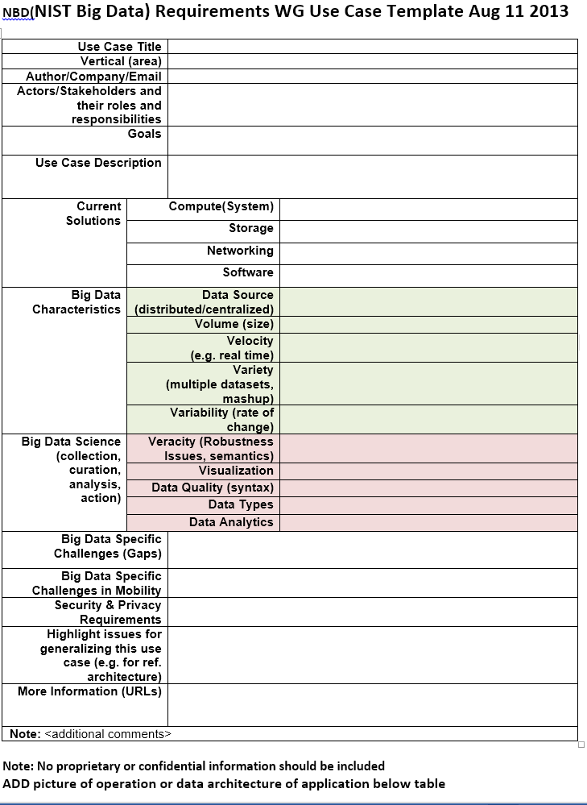
Use Case Template
Note agreed in this form August 11
Some clarification on Veracity v. Data Quality added
Request for picture added
Early use cases did a detailed breakup of workflow into multiple stages identifying
Use case/goals component, Infrastructure, Data Sources, Data Analytics, Security & Privacy

Slide 7
Example Use Case: Summary of Genomics
Application: NIST/Genome in a Bottle Consortium integrates data from multiple sequencing technologies and methods to develop highly confident characterization of whole human genomes as reference materials, and develop methods to use these Reference Materials to assess performance of any genome sequencing run.
Current Approach: The storage of ~40TB NFS at NIST is full; there are also PBs of genomics data at NIH/NCBI. Use Open-source sequencing bioinformatics software from academic groups (UNIX-based) on a 72 core cluster at NIST supplemented by larger systems at collaborators.
Futures: DNA sequencers can generate ~300GB compressed data/day which volume has increased much faster than Moore’s Law. Future data could include other ‘omics’ measurements, which will be even larger than DNA sequencing. Clouds have been explored.

Slide 8
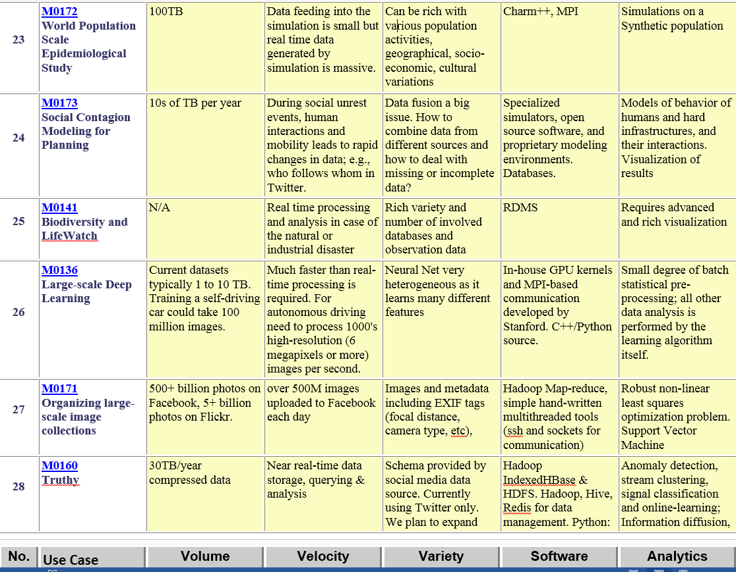
Part of Property Summary Table

Slide 9
Requirements Extraction Process
Two-step process is used for requirement extraction:
Extract specific requirements and map to reference architecture based on each application’s characteristics such as:
data sources (data size, file formats, rate of grow, at rest or in motion, etc.)
data lifecycle management (curation, conversion, quality check, pre-analytic processing, etc.)
data transformation (data fusion/mashup, analytics),
capability infrastructure (software tools, platform tools, hardware resources such as storage and networking), and
data usage (processed results in text, table, visual, and other formats).
all architecture components informed by Goals and use case description
Security & Privacy has direct map
Aggregate all specific requirements into high-level generalized requirements which are vendor-neutral and technology agnostic.

Slide 10
Requirements
437 Requirements were extracted from Use Cases by working group members
This is tentative as role and especially categorization of requirements evolved as reference architecture evolved
Each use case has its own set of specific requirements such as:
Requires high volume data transfer to remote batch processing resource
Software needs R, Matlab, Weka, Hadoop
Support data update every 15 minutes
Significant privacy issues requiring anonymization by aggregation
Require rich robust provenance defining complex machine/human processing
Real time and batch mode both needed

Slide 11
Working Group Process II
Note sum Σ_{i=0}⁵⁰ ε_{i} can be pretty large however small ε_{i} is
i.e. processing 51 use cases takes a long time even for modest tasks
Future solution would be to automate process so that submitter does most of post-processing tasks
Following material available for use cases
Template with 26 fields
“Readable” summary with fields Application, Current Approach, Futures and sometimes pictures
Digest with fields Data Volume, Velocity, Variety (The big 3 V’s), Software, Data Analytics
Set of Specific requirements extracted from each use case with (sometimes) explicit tie to use case
Link between Specific requirements and General requirements

Slide 12
35 General Requirements
These were organized in 7 categories suggested by components of reference architecture
As specific requirements and reference architecture only completed in last days, these could change
Example: Transformation Provider General Requirements (# Specific Requirements generalized)
TPR-1: Needs to support diversified compute intensive, analytic processing and machine learning techniques (38)
TPR-2: Needs to support batch and real time analytic processing (7)
TPR-3: Needs to support processing large diversified data content and modeling (15)
TPR-4: Needs to support processing data in motion (streaming, fetching new content, tracking, etc.) (6)

Slide 13
Size of Process
The draft use case and requirements report is 264 pages
How much web and how much publication?
35 General Requirements
437 Specific Requirements
8.6 per use case, 12.5 per general requirement
Data Sources: 3 General 78 Specific
Transformation: 4 General 60 Specific
Capability: 6 General 133 Specific
Data Consumer: 6 General 55 Specific
Security & Privacy: 2 General 45 Specific
Lifecycle: 9 General 43 Specific
Other: 5 General 23 Specific

Slide 14
Significant Web Resources
Index to all use cases http://bigdatawg.nist.gov/usecases.php
This links to individual submissions and other processed/collected information
List of specific requirements versus use case http://bigdatawg.nist.gov/uc_reqs_summary.php
List of general requirements versus architecture component http://bigdatawg.nist.gov/uc_reqs_gen.php
List of general requirements versus architecture component with record of use cases giving requirement http://bigdatawg.nist.gov/uc_reqs_gen_ref.php
List of architecture component and specific requirements plus use case constraining this component http://bigdatawg.nist.gov/uc_reqs_gen_detail.php

Slide 15
Next Steps
Review and clean up current draft material
Request clarifications from some submitters
Evaluate – especially with architecture group – requirements
Specific and General
See how particular use cases map into reference architecture
If expect to collect more use cases, decide on more automated (less work by requirements group) process
Set up web use case upload resource

