Slide 1
NIST Big Data Security and Privacy Requirements Updates 12/23/2013
SnP subgroup
Internal Security Practices – Marcia Mangold and Pw Carey

Slide 2
Background
The subgroups will develop a set of preliminary consensus working drafts by September 27, 2013:
Big Data Definitions
Big Data Taxonomies
Big Data Requirements
Big Data Security and Privacy Requirements
Big Data Reference Architectures White Paper Survey
Big Data Reference Architectures
Big Data Security and Privacy Reference Architectures
Big Data Technology Roadmap
The drafts were further refined in November

Slide 3
Goal
To standardize on a security reference architecture there is a need to leverage specialists in diverse domains, by attempting to identify security and privacy issues particular to Big Data, while being mindful of key elements to Big Data, Variety, Volume and Velocity (where possible).

Slide 4
Deliverables
Produce a working draft for Big Data Security and Privacy Requirements Document
Produce a working draft Big Data Security and Privacy Reference Architecture

Slide 5
Scope
Fault tolerance is resistance to unintended accidents, while security is resistance to malicious actions.
We need to understand how Big Data security concerns arise out of the defining characteristics of Big Data and how it is differentiated from traditional security concerns.

Slide 6
Classification of Security and Privacy Topics
Security and Privacy concerns are classified in four categories:
Infrastructure Security
Data Privacy
Data Management
Integrity and Reactive Security

Slide 7
Subcategories of Security and Privacy Topics
Infrastructure Security
 | Review of technologies and frameworks
 | High availability issues
Data Privacy
 | Impact of the social data revolution
 | Potential for violence and abuse
 | Data protection
Governance
 | Data discovery and classification
 | Policy management
 | Data masking technologies
 | Cross-border regulation
 | Government access to data
 | Data deletion
 | Computing on encrypted data
Data Management
 | Securing data stores
 | Attack surface reduction
 | Key management and data ownership
Integrity and Security Intelligence
 | Security intelligence
 | Large-scale analytics
 | Streaming data analytics
 | Event detection
 | Forensics
 | Security of analytics results

Slide 8
Internal Security Practices (Section 5)
Internal Access control rules for general industry
must address the complexities associated with cloud-specific security requirements triggered by the cloud characteristics:
Broad network access,
Decreased visibility and control by consumer,
Dynamic system boundaries, and comingled roles/responsibilities between consumer and provider,
Multi-tenancy,
Data residency,
Measured service,
Order of magnitude increase in scale (on demand), dynamics (elasticity, cost optimization) and complexity (automation, virtualization).
Agencies need to
identify all cloud-specific risk-adjusted security controls or components in advance
request from the cloud service providers through contractual means and service level agreements.

Slide 9
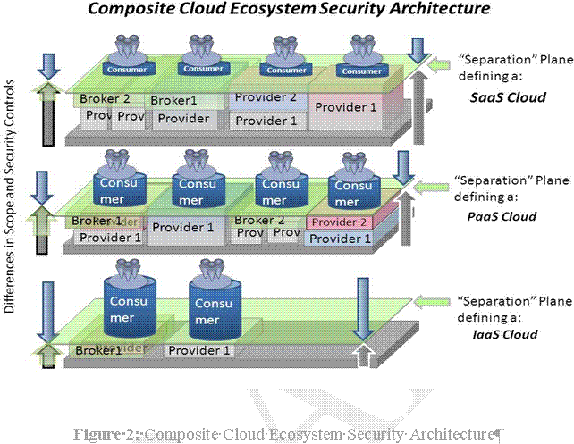
Complexity of multiple inter-dependencies

Slide 10
The Five Constructs
Categorize the data value and criticality of information systems and the data custodians duties and responsibilities to the organization, using either a discretionary access control policy or a mandatory access control policy based
Laws, regulatory obligations
Directives, Policy Guidelines, Strategic Goals and Objectives, Information Security Requirements, Priorities and Resources Available (filling in any Gaps)
Select the appropriate level of security controls required to protect same
Implement Access Security Controls and modify upon analysis assessments
Authorize appropriate information systems
Monitor Access Security Controls, at a minimum once a year.....

Slide 11
GRC and CIA regulatory obligations
To meet the GRC (Governance, Risk & Compliance) and CIA (Confidentiality, Integrity & Availability) regulatory obligations by implementing a layered approach, comprised of multiple access control gates, including but not limited to the following :
1). Physical Security/Facility Security, Equipment Location, Power Redundancy, Barriers, Security Patrols, Electronic Surveillance, Physical Authentication,
2). InfoSec Management (Residual Risk Management)
3). HR Security, including but not limited to employee Codes of Conduct, Roles & Responsibilities, Job Descriptions and Employee Terminations
4). Database, End Point and Cloud Monitoring
5). Authentication Services Management/Monitoring
6). Privilege Usage Management/Monitoring
7). Identify Management/Monitoring
8). Security Management/Monitoring
9). Asset Management/Monitoring
with the knowledge and understanding that each organization will have various and uniquely specific business requirements

Slide 12
Internal Access Control Rules
Internal Access control rules for general industry
The overarching rule is that the highest classification of any data element or string governs the protection of the data.
Access should only be granted on a need to know / use basis that is reviewed periodically to control the access.
Protection should be based on classification of the data, least privilege and separation of duties that can reduce the risks

Slide 13
Access Controls
Access control for big data covers more than accessing data.
Most accounts share between different systems and environments and can be accessed via different methods by various means, which increases the risks of compromise.
Therefore, knowing who is accessing the data is critical in protecting same.
The trade-offs between strict data access control versus conducting business requires answering the following questions:
How important/critical is the data to the life blood and sustainability of the organization?
What are you responsible for (aka: all nodes, components, boxes, and machines within the Big Data/Cloud Eco-system)?
Where are they located?
Who should have access to them?
Very restrictive measures to control accounts is difficult to implement much less maintain, Use of best practices, such as protection based on classification of the data, least privilege, 3-tier authentication, and separation of duties can help reduce the risks.
Notes:
Access control for big data covers more than accessing data. The security of the account that is used for access needs to be considered. Since most accounts shared between different systems and environments the possibility and opportunity that access control can be compromised is ever present. Data can be accessed via multiple channels, networks and platforms, including laptops, cell phones, smart phones, tablets, even fax machines connected to internal networks, remote mobile networks, the Internet and/or all of the above. With this reality in mind, the same data may be accessed by a user, administrator, another system, etc. This very same data may be accessed via a remote connection/access point, as well as internally via unsecured ports. Therefore, knowing who is accessing the data is critical in protecting same. The trade-offs between strict data access control versus conducting business requires answering the following questions:

Slide 14
General (Security Controls)
Least privileges – access to big data should be based on the minimum amount of privilege need to perform the function.
If one of the data elements is protected because of its classification (for example – PII, HIPAA, PCI, etc.), then all of the data that it is sent with it, will inherit that classification. That way if the data is joined to / associated with other data that may cause a privacy issue, then all of that data is already protected.
If data is accessed from, transfer to, or transmitted to the cloud, internet or another external entity, then the data should be protected based on its classification.
There should be an indicator / disclaimer on the display of the user, if privacy or sensitive data is being accessed or viewed.
All accounts (except for system related accounts) should be reviewed at a minimum of one year to insure that they are still required.

Slide 15
General (cont.)
All accounts (except for system related accounts) that have not been used within 180 days should be deleted. If the system will not allow deletion of the account then the account should be disabled.
Access to privacy of sensitive data should be logged. The minimum logging requirements should be timestamp, account number.
Role-based-access to big data should be based on roles. Each role should be assigned the least privileges needed to perform the function.
Roles should be reviewed a minimum of every 2 years to insure that they are still valid and to insure that the accounts assigned to them are still valid.

Slide 16
User and System (Security Controls)
User
Each user should have his or her personal account. Shared accounts should not be used unless there is a systems limitation.
A user account should not be a multipurpose account. For example, the user account should not be used as an administrative account or to run production jobs.
System
In case of system to system access, there should not be shared accounts.
Access for a system that contains big data needs to be approved by the data owner or their representative. The representative should not the system administrator, since that may cause a separation of duties issue.
The same type of data stored on different systems should the same classification and rules for access controls to ensure that it has the same level of protection.

Slide 17
Administrative (Security Controls)
System administrators should maintain a separate user account that is not used for administrative purposes. In addition, an administrative account should not be used as a user account.
The same administrative account should not be used for access to the production and non-production (test, development, QA, etc.) systems.

