Slide 1
Embed Privacy, By Design
into IT and Engineering …
Welcome to the Future
Ann Cavoukian, Ph.D.
Executive Director
Privacy and Big Data Institute
Ryerson University
Useable Privacy Series
National Institute of Standards and Technology
December 1, 2014

Slide 2
Privacy ≠ Secrecy
Privacy is not about having something to hide

Slide 3
Privacy = Control

Slide 4
Privacy = Personal Control
User control is critical
Freedom of choice
Informational self-determination
Context is key!

Slide 5
Pew Research Internet Project
Public Perceptions of Privacy and Security in the Post-Snowden Era: November 2014
  Widespread concern about surveillance:
    91% of adults agree that consumers have lost control over their personal information;
    80% of social network users are concerned about third parties accessing their data;
    80% of adults agree that Americans should be concerned about government surveillance;
  81% feel “not very” or “not at all secure” using social media to share private information.
Notes:
Most Americans are aware of the government’s monitoring of communications;
Only 5% have heard “nothing at all” about government surveillance;
There is little confidence in the security of common communications channels;
81% feel “not very” or “not at all secure” using social media to share private information;
There exists a Mismatch between Behavior and Attitude:
Six out of Ten adults say they would like to do more to protect their privacy;
55% are willing to share some information in order to be able to use a service for free;
Context is very Important: users will change their levels of disclosure based on the context.

Slide 6

The Decade of Privacy by Design

Slide 7

Adoption of “Privacy by Design” as an International Standard
Landmark Resolution Passed to Preserve the Future of Privacy
By Anna Ohlden – October 29th 2010 - http://www.science20.com/newswire/landmark_resolution_passed_preserve_future_privacy
JERUSALEM, October 29, 2010 – A landmark Resolution by Ontario's Information and Privacy Commissioner, Dr. Ann Cavoukian, was approved by international Data Protection and Privacy Commissioners in Jerusalem today at their annual conference. The resolution recognizes Commissioner Cavoukian's concept of Privacy by Design - which ensures that privacy is embedded into new technologies and business practices, right from the outset - as an essential component of fundamental privacy protection.
Full Article:
http://www.science20.com/newswire/landmark_resolution_passed_preserve_future_privacy

Slide 8
Privacy by Design:
Proactive in 37 Languages!
English
French
German
Spanish
Italian
Czech
Dutch
Estonian
Hebrew
Hindi
Chinese
Japanese
13.Arabic
14.Armenian
15.Ukrainian
16.Korean
17.Russian
18.Romanian
19.Portuguese
20.Maltese
21.Greek
22.Macedonian
23.Bulgarian
24. Croatian
25.Polish
26.Turkish
27.Malaysian
28.Indonesian
29.Danish
30.Hungarian
31.Norwegian
32.Serbian
33.Lithuanian
34.Farsi
35.Finnish
36.Albanian
37.Catalan

Slide 9

Why We Need Privacy by Design
Most privacy breaches remain undetected – as regulators, we only see the tip of the iceberg
The majority of privacy breaches remain unchallenged, unregulated ... unknown
Regulatory compliance alone, is unsustainable as the sole model for ensuring the future of privacy

Slide 10
Positive-Sum Model: The Power of “And”
Change the paradigm
from a zero-sum to
a “positive-sum” model:
Create a win-win scenario,
not an either/or (vs.)
involving unnecessary trade-offs
and false dichotomies …
replace “vs.” with “and”

Slide 11
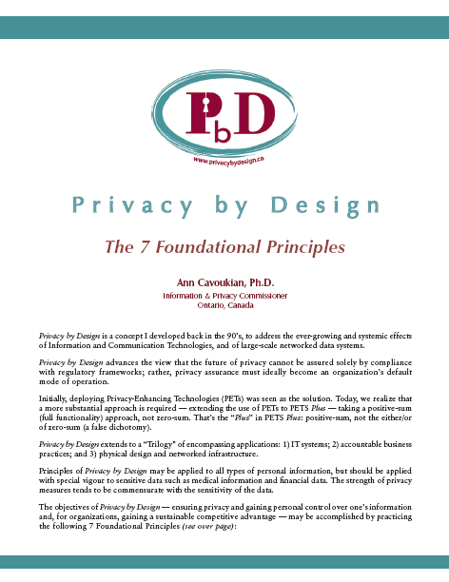
Privacy by Design:
The 7 Foundational Principles
Proactive not Reactive: Preventative, not Remedial;
Privacy as the Default setting;
Privacy Embedded into Design;
Full Functionality: Positive-Sum, not Zero-Sum;
End-to-End Security: Full Lifecycle Protection;
Visibility and Transparency: Keep it Open;
Respect for User Privacy: Keep it User-Centric.
www.ipc.on.ca/images/Resources/7foundationalprinciples.pdf

Slide 12
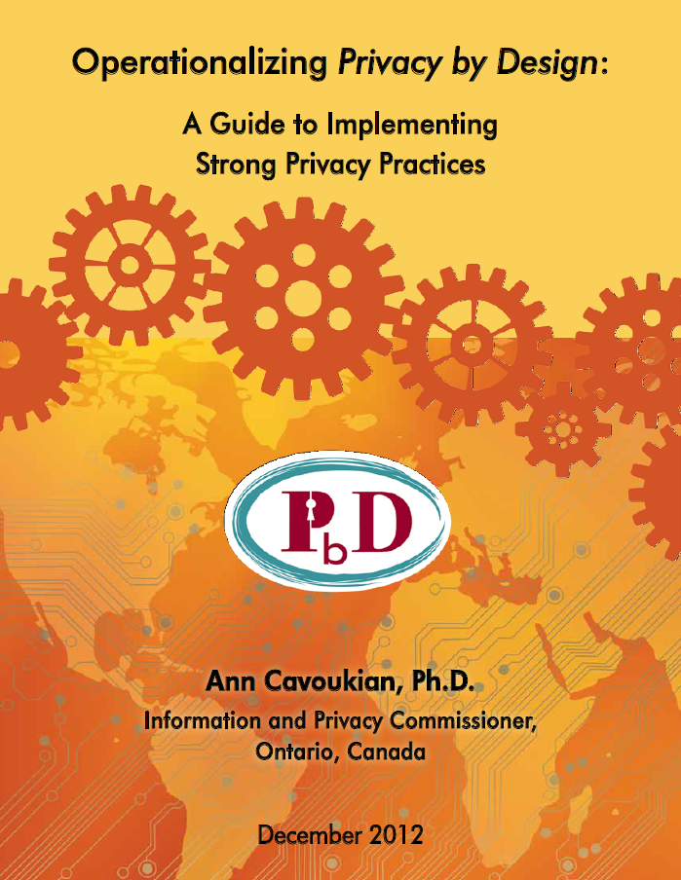
Operationalizing Privacy by Design
9 PbD Application Areas
CCTV/Surveillance cameras in mass transit systems;
Biometrics used in casinos and gaming facilities;
Smart Meters and the Smart Grid;
Mobile Communications;
Near Field Communications;
RFIDs and sensor technologies;
Redesigning IP Geolocation;
Remote Home Health Care;
Big Data and Data Analytics.

Slide 13
Letter from JIPDEC – May 28, 2014
“Privacy by Design is considered one of the most important concepts by members of the Japanese Information Processing Development Center …
We have heard from Japan’s private sector companies that we need to insist on the principle of Positive-Sum, not Zero-Sum and become enlightened with Privacy by Design.”
— Tamotsu Nomura,
Japan Information Processing Development Center,
May 28, 2014

Slide 14
Current Activities
Involving PbD

Slide 15
Carnegie Mellon University –
Privacy By Design
Master's degree program for privacy engineers offered by Carnegie Mellon University, School of Computer Science;
The Master of Science in Information Technology-Privacy (MSIT-Privacy) is a 12-month program that began in the fall of 2013;
The program will emphasize the concept of Privacy by Design, in which safeguards are incorporated into the design of systems and products from the very beginning of the development process.
Notes:
OASIS

Slide 16
OASIS Technical Committee – Privacy by Design for Software Engineers
Commissioner Cavoukian and Professor Jutla are the Co-Chairs of a new technical committee (TC) of OASIS “PbD-SE (software engineers) TC;”
The purpose of PbD-SE is to provide PbD governance and documentation for software engineers; and
The PbD standards developed will pave the way for software engineers to code for Privacy, by Design.
Notes:
More from OASIS
Professor Jutla is the winner of the prestigious U.S. World Technology Award (IT Software – Individual 2009) and is recognized for her innovative work with long-term significance on the evolving technological landscape as well as the transcendent imperative of privacy protection.
Data-Centric architecture – functioning architecture must revolve around the permissible uses of data.

Slide 17
OASIS and Privacy by Design
June 2014 – the OASIS PbD-SE Technical Committee (TC) approved the Privacy by Design Documentation for Software Engineers Version 1.0 as a Committee Specification Draft (CSD), and the Annex Guide to Privacy by Design Documentation for Software Engineers Version 1.0 as a Committee Note Draft (CND);
This vote represents a milestone for the PbD-SE TC, acknowledging the substantial progress that has been made over the last year;
The PbD-SE TC will undertake another review cycle before submitting the CSD and CND to public review.
Notes:
IPC Big Data Papers

Slide 18
NIST Privacy Engineering Objectives and Risk Model
NIST introduced the concept of outcome-based design objectives at an April Workshop

Slide 19
The Automata Processor by Micron Technology
A revolutionary computing architecture capable of performing the high-speed, comprehensive analysis of unstructured data required for Big Data computing;
Accelerates time-to-solution in Big Data domains;
Utilizes the parallel computing possibilities offered by memory based design;
A custom development language that allows full exploitation of data processing capabilities;
Usable in single chip, module and multi-module applications means it is a fully scalable solution.
http://www.micron.com

Slide 20
What’s on the Horizon at the Privacy and Big Data Institute
Ryerson University

Slide 21
  SmartData:
  Privacy by Design 2.0
Context is Key

Slide 22
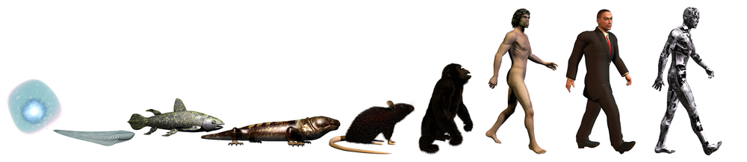
The Next Evolution in Data Protection:
“SmartData”
Developed by Dr. George Tomko, at the Identity, Privacy and Security Institute, University of Toronto, SmartData represents privacy in the future with greater control of personal information.
Intelligent “smart agents” to be introduced into IT systems virtually – thereby creating “SmartData,” – a new approach to Artificial Intelligence, bottom-up, that will contextualize the field of AI .
Notes:
SmartData – User Control
The concept of SmartData was developed at IPSI – it proposes that intelligent or “smart agents” be introduced into IT systems virtually – thereby creating “SmartData,” a new approach to AI (Artificial intelligence) that will revolutionize the field

Slide 23
SmartData:
It’s All About User Control
It’s All About Context:
Evolving virtual cognitive agents that can act as your proxy to protect your personally identifiable data;
Intelligent agents will be evolved to:
Protect and secure your personal information;
Disclose your information only when your personal criteria for release have been met;
Put the user firmly in control – Big Privacy, Radical Control!

Slide 24
Concluding Thoughts
Privacy risks are best managed by proactively embedding the principles of Privacy by Design – prevent the harm from arising – avoid the data breach;
Focus on prevention: It is much easier and far more cost-effective to build in privacy, up-front, rather than after-the-fact;
Abandon zero-sum thinking – embrace doubly-enabling systems: Big Data and Big Privacy;
Get smart – lead with Privacy – by Design, not privacy by chance or, worse, Privacy by Disaster!
Notes:
How to Contact Us

Slide 25


Contact Information
Ann Cavoukian, Ph.D.
Executive Director
Privacy and Big Data Institute
Ryerson University
285 Victoria Street
Toronto, Ontario
M5B 2K3
Phone: (416) 979-5000 ext. 3138
ann.cavoukian@ryerson.ca
ann.cavoukian@ryerson.ca
twitter.com/PrivacyBigData

