Slide 1
Summary of 11179 Work
In ISO/IEC JTC1 SC32 WG2
(INCITS/DM32.8 is US TAG)
Frank Farance, Farance Inc.
frank@farance.com, +1 212 486 4700
Notes:
2007-03-22
Improvements to 11179 Edition 3, F. Farance, D. Gillman

Slide 2
Metadata Standards Work
ISO/IEC JTC1: Information Technology
ISO/IEC JTC1 SC32: Data Management
ISO/IEC JTC1 SC32 WG2: Metadata
INCITS/DM32.8:
  Committee that represents US interests in WG2
  Must be a member of DM32.8 to participate
  Next meeting: December 8, 1-4 PM ET (telecom)
  Agenda includes: data provenance, v-attributes, work on 11179-7, 11179-8, and related topics
Contact DM32.8 chair:
  Frank Farance, frank@farance.com, +1 212 486 4700
2014-12-02
Summary of 11179 Work
Notes:
2007-03-22
Improvements to 11179 Edition 3, F. Farance, D. Gillman

Slide 3
11179 Series
Describes “data elements”
  Individual datum
  A row
  A column
  A table
  A database
  A dataset
2014-12-02
Summary of 11179 Work
Notes:
2007-03-22
Improvements to 11179 Edition 3, F. Farance, D. Gillman

Slide 4
11179 Series In Multiple Parts
Part 1: Framework
Part 2: Classification
Part 3: Registry metamodel and basic attributes
  Standardizes attributes of general data description
Part 4: Formulation of data definitions
  How to write a good data definition
Part 5: Naming and identification
  Describing naming conventions
Part 6: Registration
  The maturity process of data description
2014-12-02
Summary of 11179 Work
Notes:
2007-03-22
Improvements to 11179 Edition 3, F. Farance, D. Gillman

Slide 5
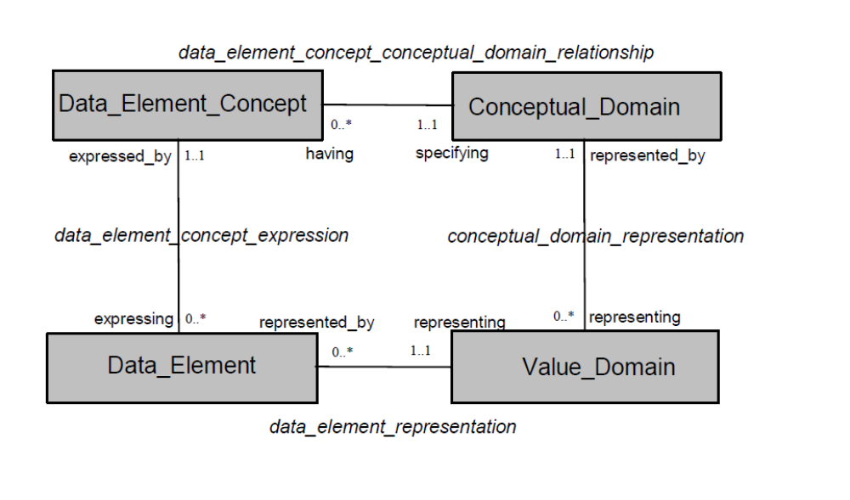
11179-3 Methodology
Applies to many “observations”
2014-12-02
Summary of 11179 Work

Slide 6
11179 Series, 2 new parts
Part 7: Datasets (tentative title)
“... the discovery and use of public or private datasets requires metadata in the categories of volume, variety, velocity (frequency of updates), veracity (completeness and accuracy), value (purpose), and semantics of the data.”
Part 8: Data provenance
“... discovery and use of public or private data add/or datasets requires metadata about the creation, curation, ownership, and custody of the data. This subdivision will support the standardization of the metadata required to meet these needs as an extension of ISO/IEC 11179”
2014-12-02
Summary of 11179 Work
Notes:
2007-03-22
Improvements to 11179 Edition 3, F. Farance, D. Gillman

Slide 7
19763 Series
Metamodel Framework on Interoperability
About metamodels (data models for metadata)
Part 1: Reference Model
Part 3: Metamodel for ontology registration
Part 5: Metamodel for process model registration
Part 6: Registry summary
Part 7: Metamodel for service registration
Part 8: Metamodel for role/goal registration
Part 9: On-Demand Model Selection
Part 10: Core model and basic mapping
Part 12: Metamodel for info model registration
Part 13: Metamodel for forms registration
Part 14: Metamodel for dataset registration
Part 15: Metamodel for data provenance registration
2014-12-02
Summary of 11179 Work
Notes:
2007-03-22
Improvements to 11179 Edition 3, F. Farance, D. Gillman

Slide 8
19773 Metadata Module
Module 10: Data structure for reference-or-literal (reflit)
Module 11: Data structure for multiple internationalized/localized values and data
Module 12: Data structure for multiple internationalized/localized strings and texts
Module 13: Data structure for slot tuple
Module 14: Data structure for unstructured table of slot tuples
Module 15: Data structure for reified relationships and relationships systems
Module 16: Data structure for UPU postal data
Module 17: Data structure for ITU-T E.164 phone number data
Module 18: Data structure for who-what-where-when-why-how (W5H) event data
Module 19: Data structure for entity-person-group (EPG) contact data
Module 20: Data structure for entity-person-group (EPG) security credentials data
Module 21: Data structure for entity-person-group (EPG) relationships and grouping data
2014-12-02
Summary of 11179 Work
Notes:
2007-03-22
Improvements to 11179 Edition 3, F. Farance, D. Gillman

Slide 9
Others
20944 metamodel interoperability
  5 parts, codings, apis, protocols
11404 data types
19583 metadata
ANSI standards (national standards) on vocabularies, from Data.Gov and Open Government Vocabularies (OGV) work
2014-12-02
Summary of 11179 Work

