Slide 1
Big Data Technology Readiness
BDTR 1: Emerging
Technology is basically at the research level
Access is limited to those developing the technology
Research may be being conducted at a University or Commercial company (e.g. Google)
May or may not scale at all
BDTR 2: Incubating
Technology is functional outside of the lab
Builds can be unstable and frequent
Could be open source or commercial
May not yet scale in all cases
Documentation may be sparse
BDTR 3: Reference Implementation
A reference implementation is available and generally usable at scale
Still has limited adoption outside core community
Reasonable documentation available
BDTR 4: Emerging Adoption
Wider adoption outside of core community
Proven robust in a range of applications/environments
Significant training and documentation available
BDTR 5: Evolving
New implementations with specific enhancements available
Robust tool suites ease access
Competition for market share
BDTR 6: Standardized
Draft standards in place and accepted
Mature processes for implementation
Best Practices Defined

Slide 2
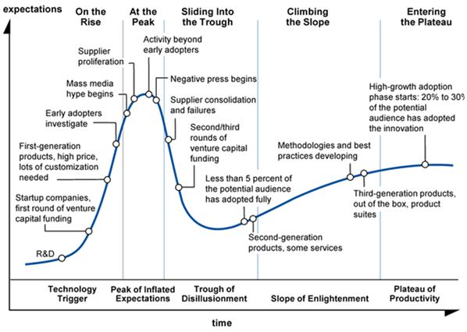
Technology Readiness vs Hype
BDTR1
BDTR2
BDTR3
BDTR3
BDTR4
BDTR5

Slide 3
Organization Readiness for Bigdata
Business Readiness
A clear and compelling business case for the investment
Management believes in the business case
Data Readiness
Data Quality Measures
Data Understanding (you know what your data is)
Data Integration
IT Infrastructure Readiness
IT Service Delivery
IT Security
Infrastructure Architecture
Analytics Readiness
Analytics understanding – what they do and don’t mean
Analytic Rigor

